Slide 1

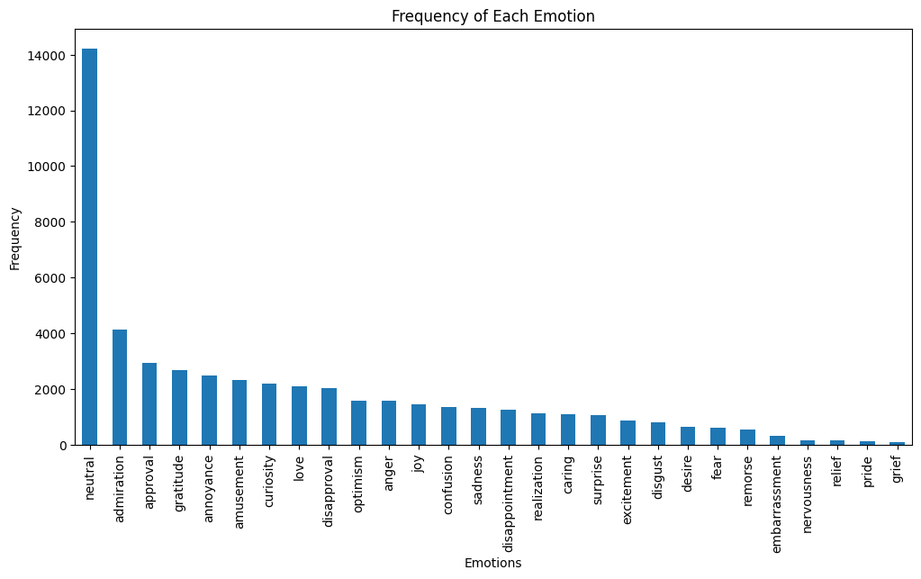
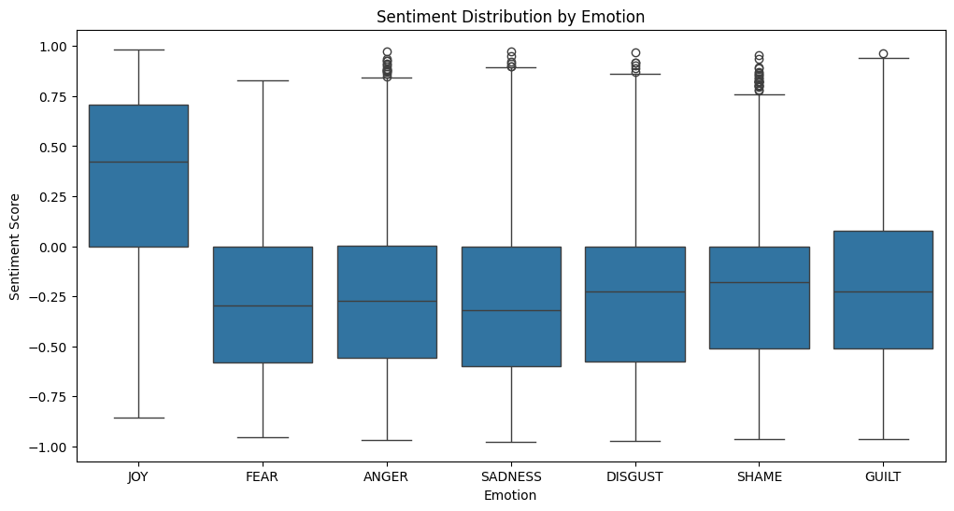
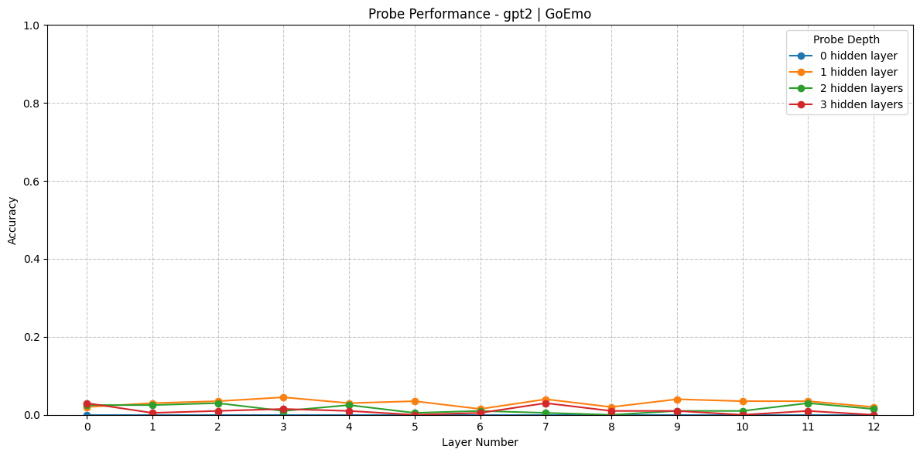
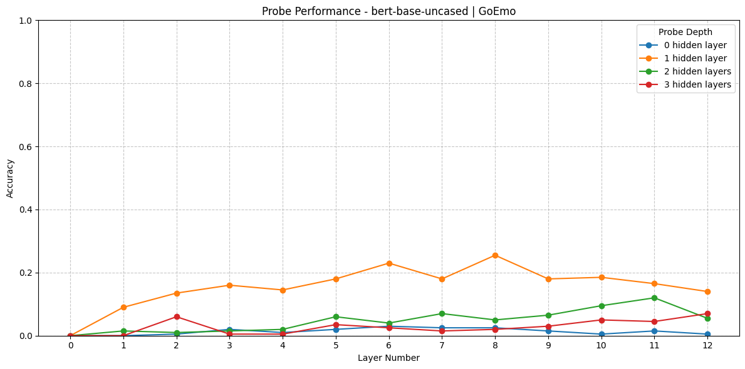
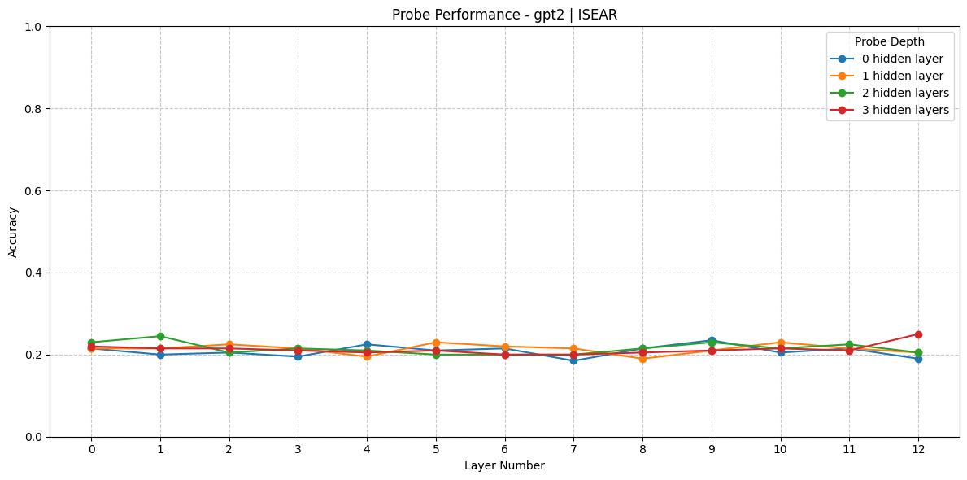
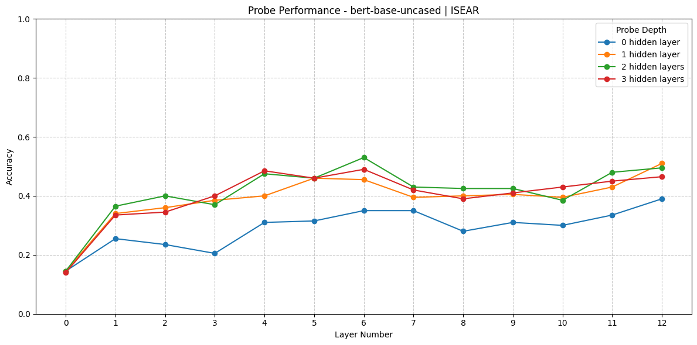
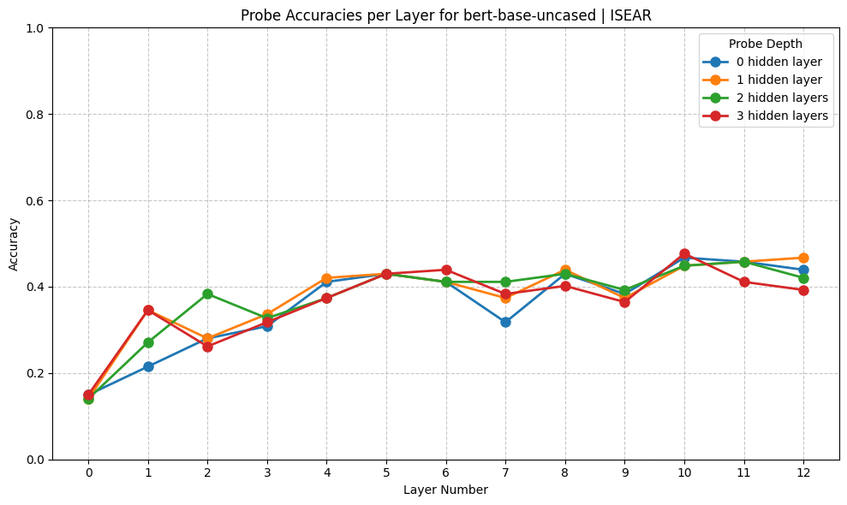
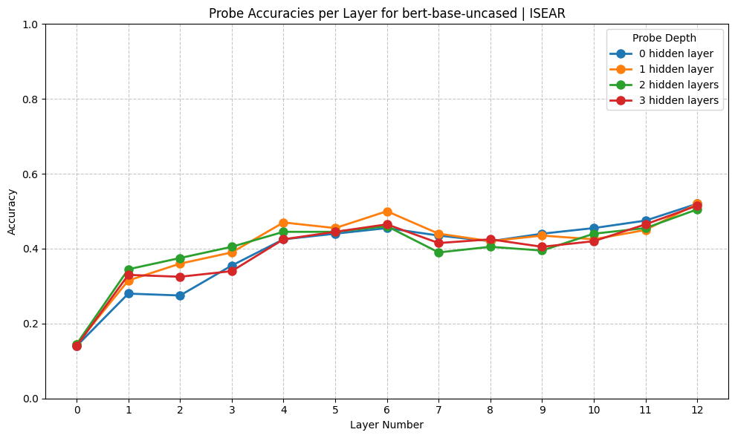
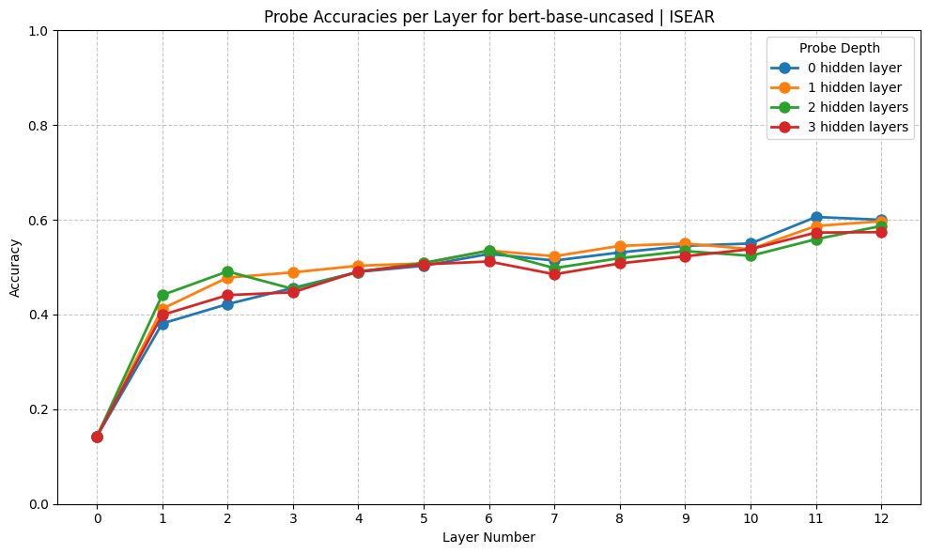
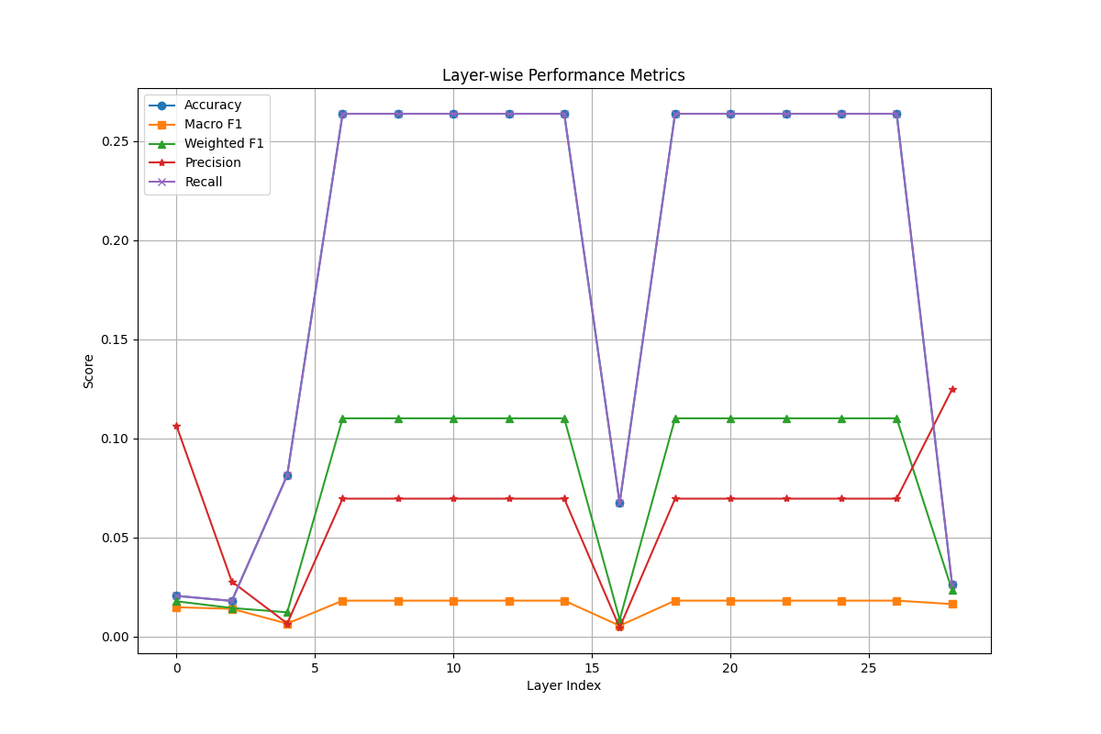
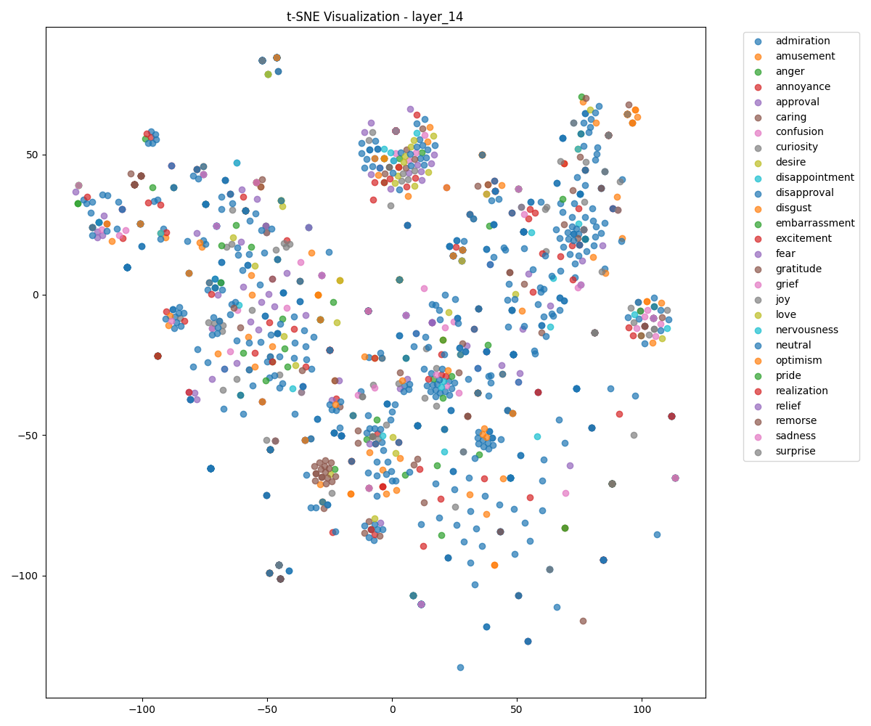
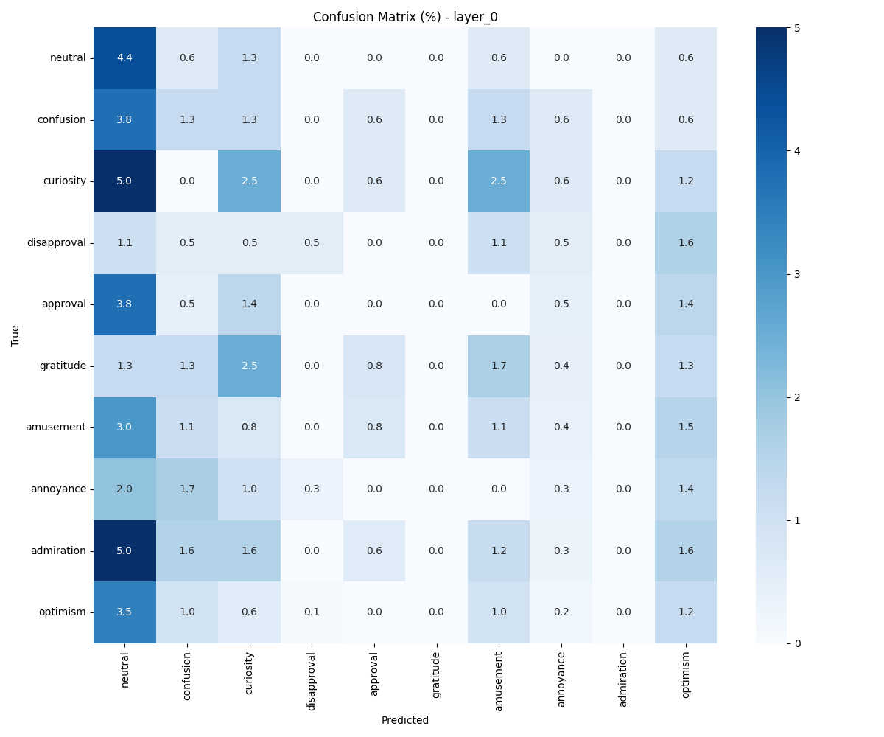
Emotion Learning in Large Language Models
Amirali Famili
University of Exeter – Computer Science Department
Introduction
Emotion representation in each Dataset
Large Language Models (LLMs) are becoming a mainstream tool, project to enter every aspect of our lives. It is vital that we improve interpretability and transparency on how they learn about various context.
Emotions, key to human communication, are potentially learned by LLMs through vast text corpora, yet their black-box nature obscures how and where this learning occurs.
In this work I investigate emotion knowledge in transformer models (i.e.. Encoder component) QWEN/BERT/GPT-2 using classifier probing (CP) -> The objective is mapping emotional representations across model layers.
This project goal is to improve interpretability by determining the responsible layers for emotion learning in different LLMs. This means understanding:
Whether emotions are encoded during pre-training.
Which layers contribute to emotion detection.
Go-Emotion
ISEAR
Results
The accuracy in each hidden layer of the model for each dataset
GPT-2
BERT
Higher accuracy in Emotion learning
Go-Emotion
Go-Emotion
Workflow
GPT-2
BERT
Higher accuracy in Emotion learning
Preprocessing datasets
ISEAR
ISEAR
Get pre-trained model
Extract hidden states of the model for given data
BERT – ISEAR:
As number of samples in training probe increases, the accuracy saturates which
Train the probe model (MLP) using the hidden states
Of each model
N_samples = 500
N_samples = 1000
N_samples = 2000
Evaluate the trained probes with the dataset
by performing classification
QWEN Model – Preliminary results – still running to extract hidden states
Accuracy- F1 score and Precision
PCA dimensionality reduction for hidden states plotted with TSNE
Confusion Matrix
Perform analysis of the accuracy of the prediction at
each hidden layer of the model
Draw conclusion on which hidden layers are most
responsible for emotion learning for each model
Computational Limitations
Datasets
Due to the large size of QWEN model, loading the pretrained model on personal laptop is not possible.
Extracting hidden states for this model for the go-Emotion dataset takes 4 days continuous run to complete on M3 MacBook pro.
The large size of the hidden states when written to disc and further loading for training probe (more than 25GB )
Two datasets are chosen to ensure representation of variety of emotions and diversity of annotation.
Feature | ISEAR | Go-Emotion
Total Documents | 7666 | 54263
Classes | 7 (Joy, fear, anger, sadness, disgust, shame, guilt) | 28 (27 emotions + neutral)
Docs per Class | 1095 | Imbalanced (14k neutral, 40 grief)
Avg. Document Length | 1-3 sentences | 1-2 sentences
Label Type | Single-label | Multi-label
Domain | Curated personal experiences | Reddit social media comments
Goal of Dataset | Psychology research, emotion context analysis | NLP models for fine-grained emotion detection
Conclusion
My results help understanding of emotion knowledge in the encoder of QWEN, BERT and GPT-2 :
BERT model is better than GPT2 at emotion detection. The results clearly show that the middle to later layers are better at emotion recognition.
We can also conclude that for GPT-2 Probe with 1 hidden layer performs better and Probe with 3 hidden layer has an upward trend (to be validated with more samples).
For BERT, The probe with 3 hidden layers has the worst performance in BERT (1 hidden layer > 2 hidden layer > 0 hidden layer > 3 hidden layers).
QWEN model show poor classification and accuracy due to low number of samples the probe is trained on.
Notes:
From my results the Encoder only models perform better at understanding emotions than decoder only models
- by comparing the results of the different probes we can conclude that the probe with 1 hidden layer generally preforms better
The varying result from ISEAR and Go-Emotion is due to the number of classes, with ISEAR there is a 1 in 7 chance to guess the emotion but with go-emotion is 1 in 28.

