Slide 1
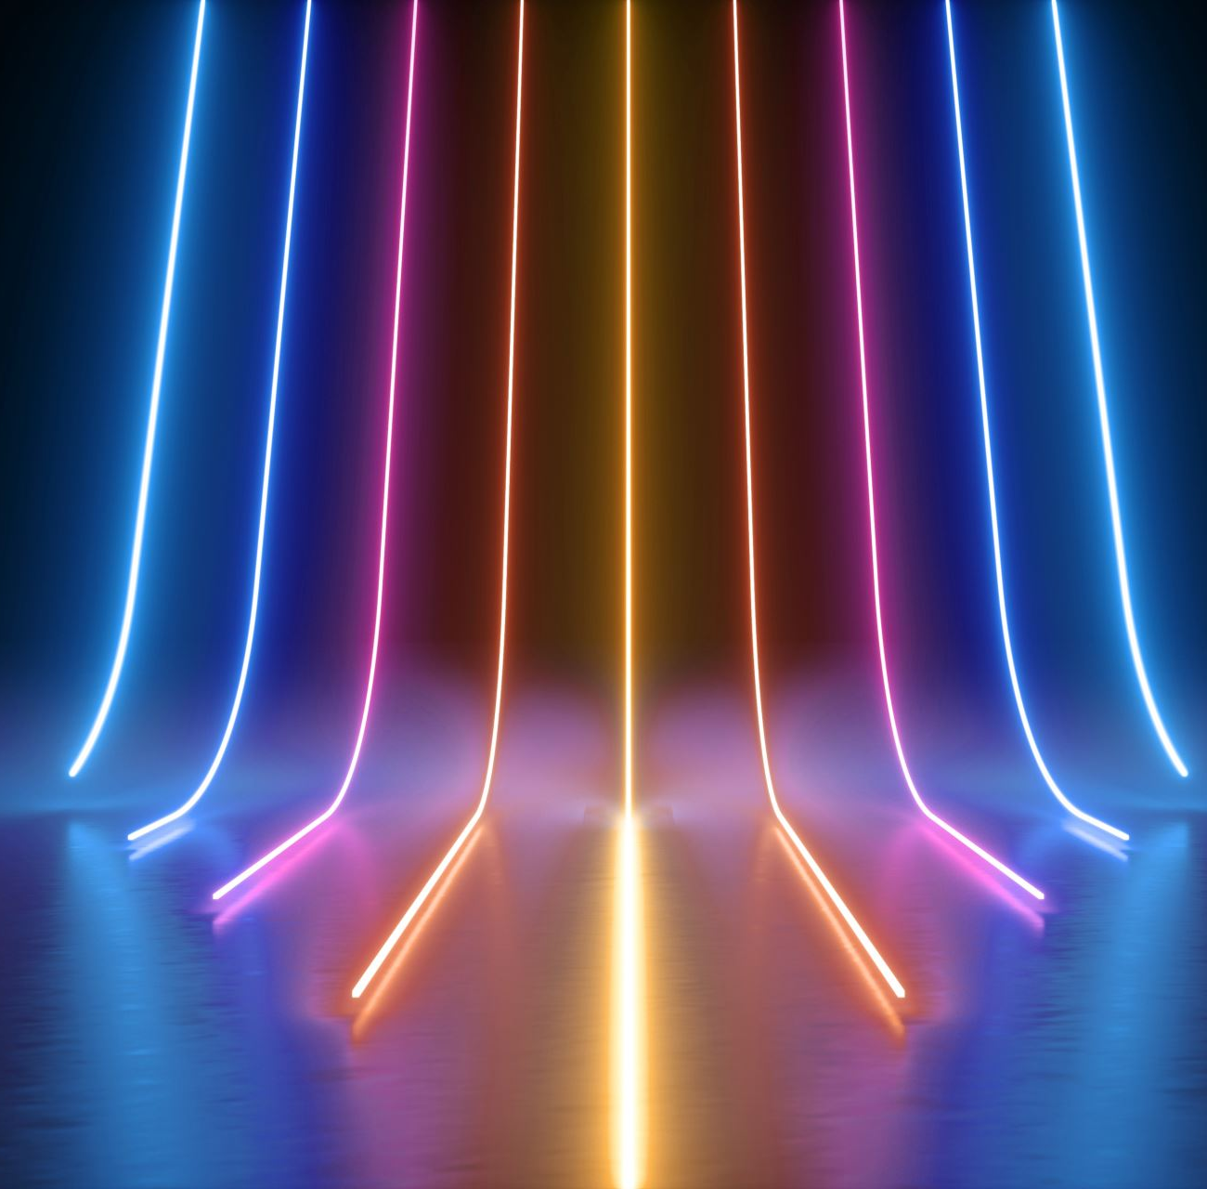
Layers responsible for Emotion Detection in QWEN series
Amirali Famili

Slide 2
Completed tasks
Dataset:
- Analysis and Pre-processed datasets.
Code development:
End-to-End pipeline which extracts and saves hidden states given model names and datasets
Code for training and evaluating the probes given a hidden state and dataset
Analysis class to analyze the hidden states
Software Engineering:
- Utilized Version control
Research:
Probed BERT and GPT2.
Probing QWEN2-7B and QWEN-7B (computational power limitation)
Plots for the validated probes
Comparison of different probes with different depth for their classifier (from logistic regression to deep NN)

Slide 3
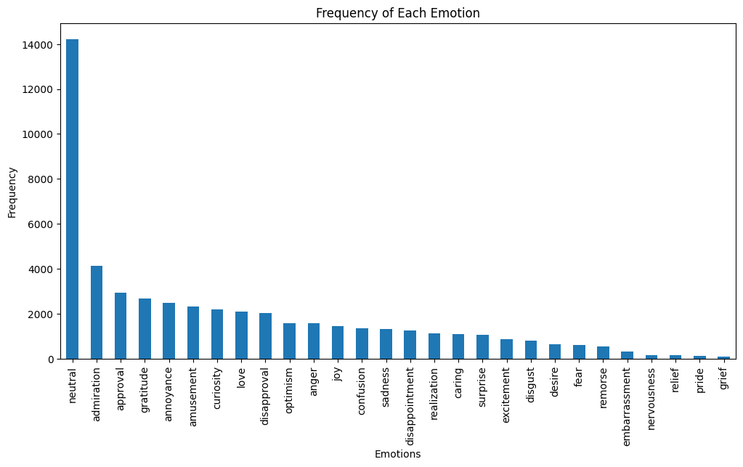
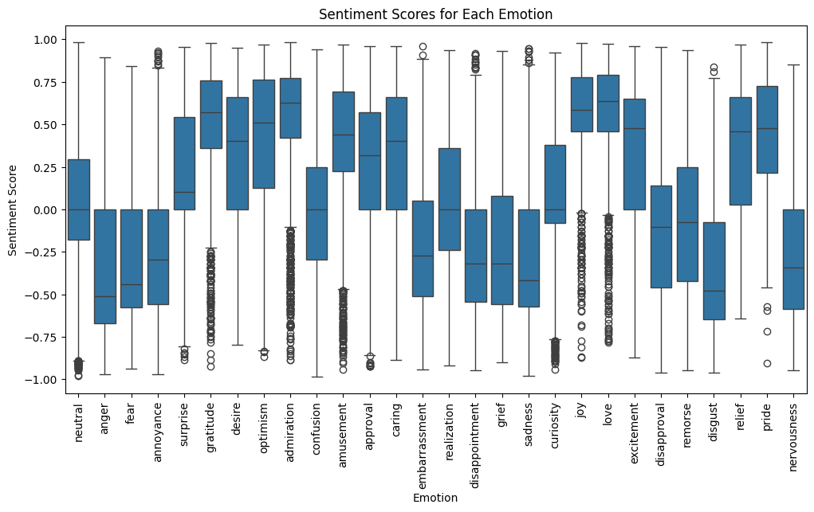
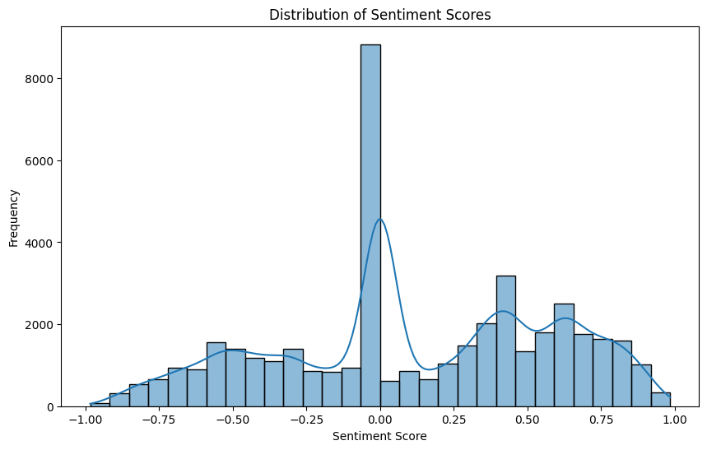
Go-Emotion data analysis and statistics
Distribution of data for various emotion
Sentiment score distribution

Slide 4
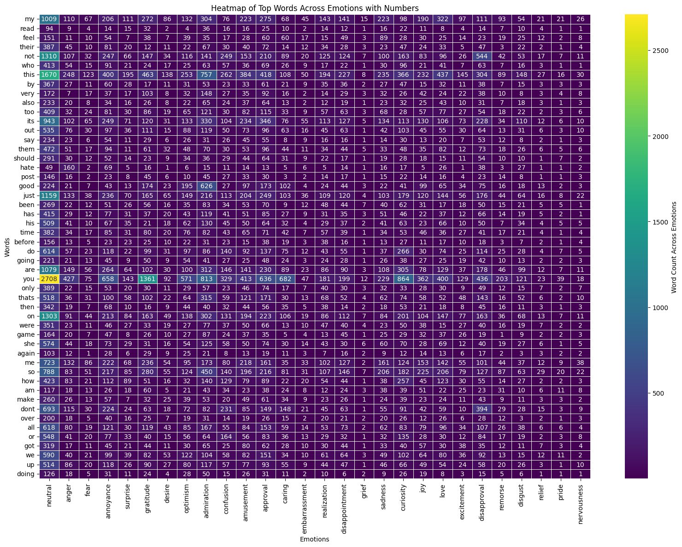
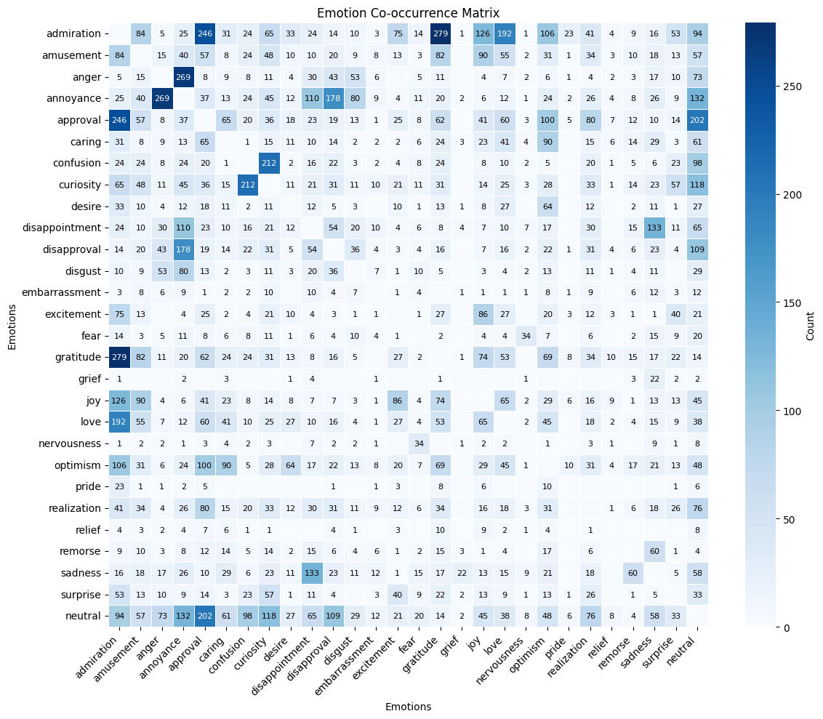
Words association with emotions Emotion correlation
Notes:
On the right we have the heatmap of emotion correlation (which emotions usually come together (as in describing a new emotion)), on the left we have the most associated word with each of the emotions.

Slide 5
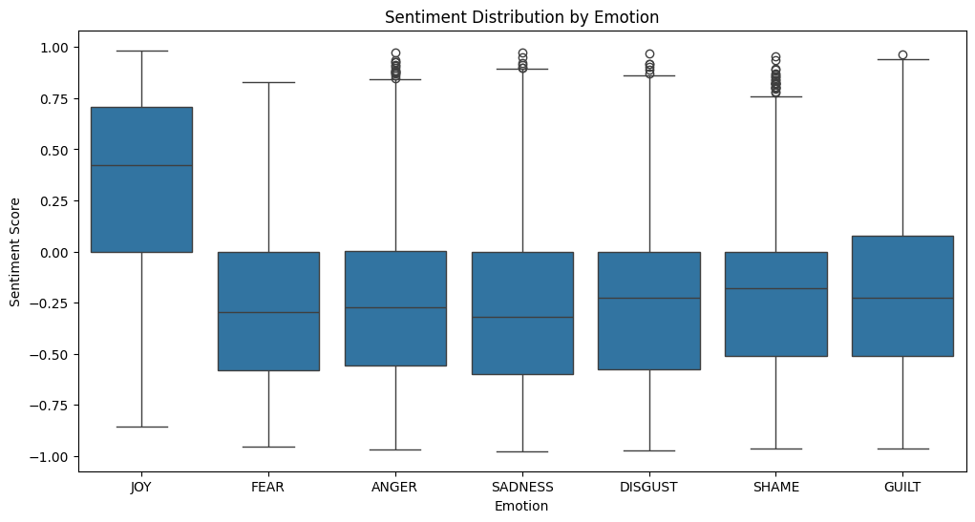
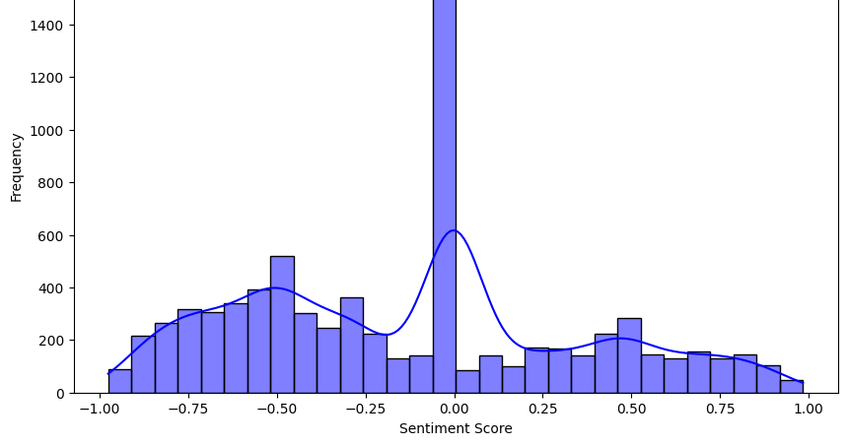
Sentiment analysis
Isear Dataset
We can observe the difference in emotions expressed over social media and a lab environment.

Slide 6
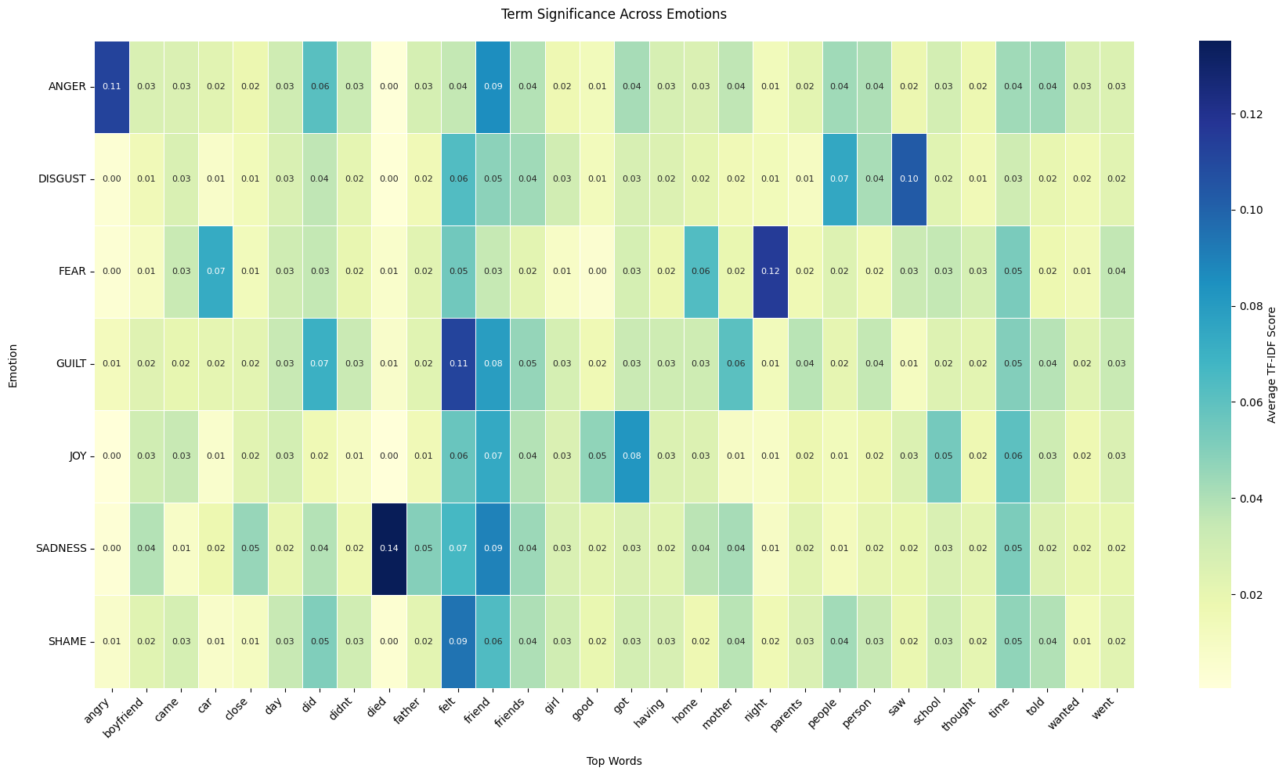
Words used when expressing an emotion

Slide 7
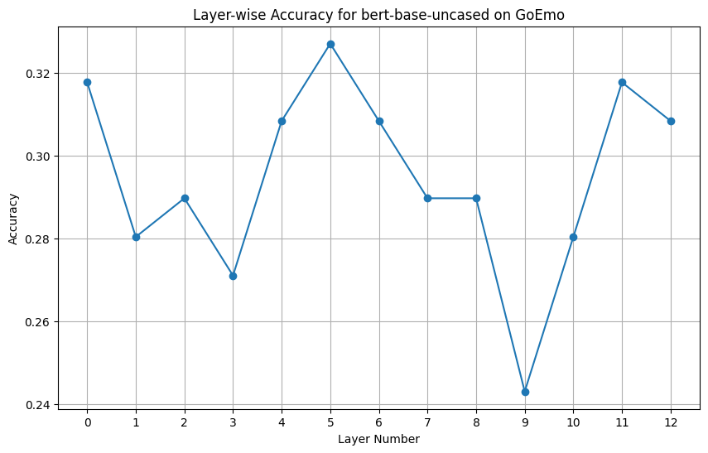
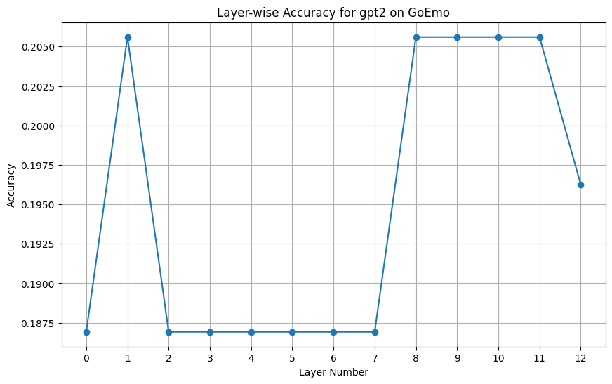
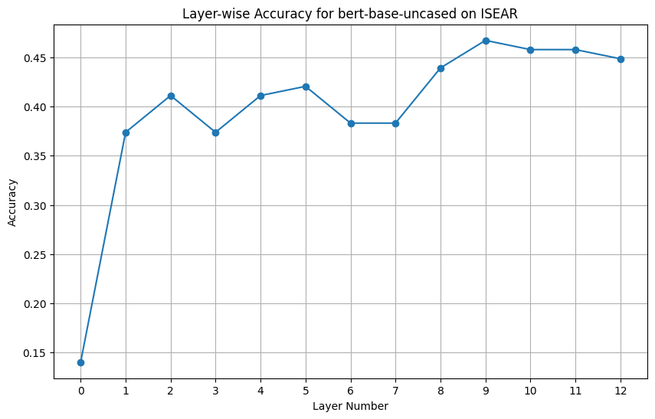
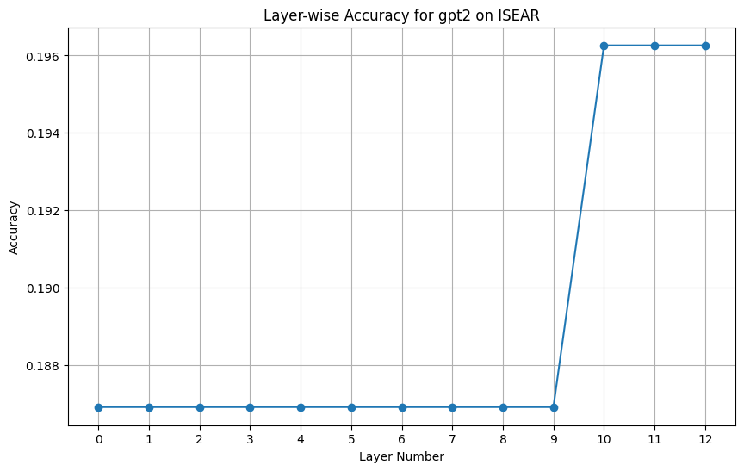
Logistic Regression
Bert
GPT-2
From the results of the first 532 samples, we can demonstrate that BERT model is better at detecting emotions than GPT2
Solver = ‘liblinear’
max_iter = 1000
Random_state = 42
532 samples

Slide 8
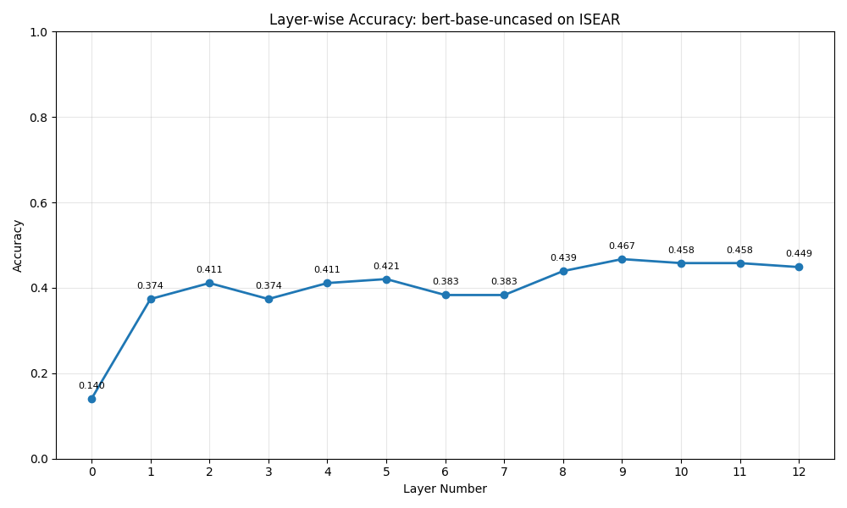
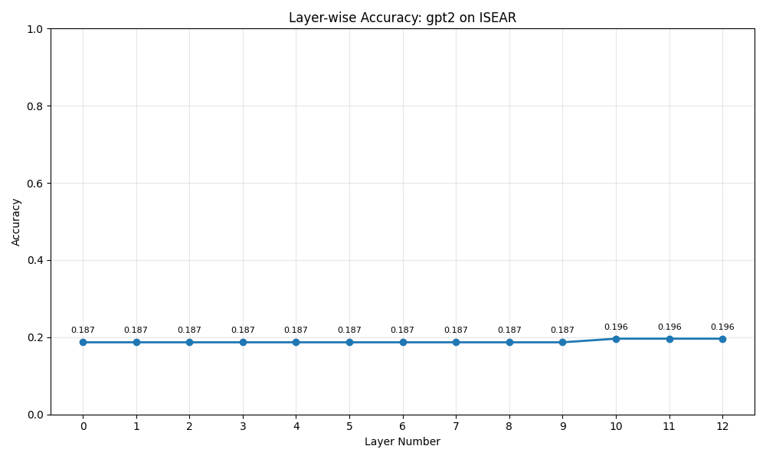
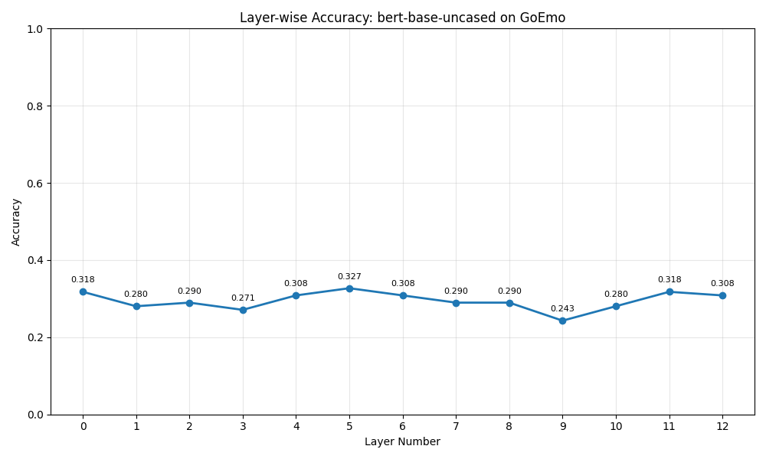
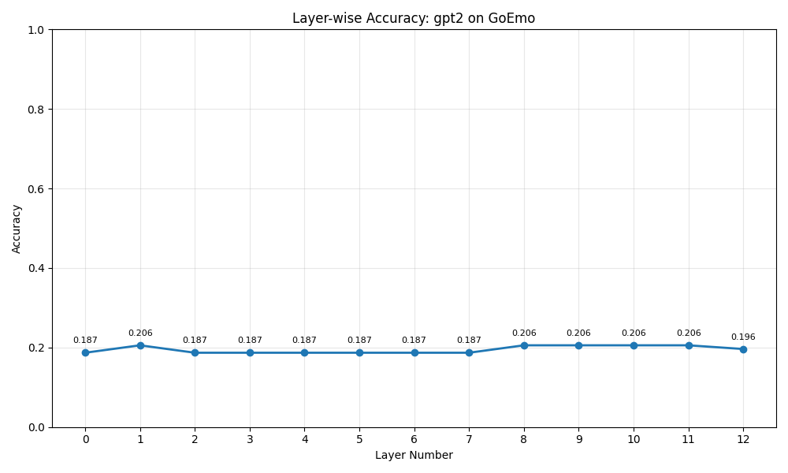
Bert
GPT-2

Slide 9
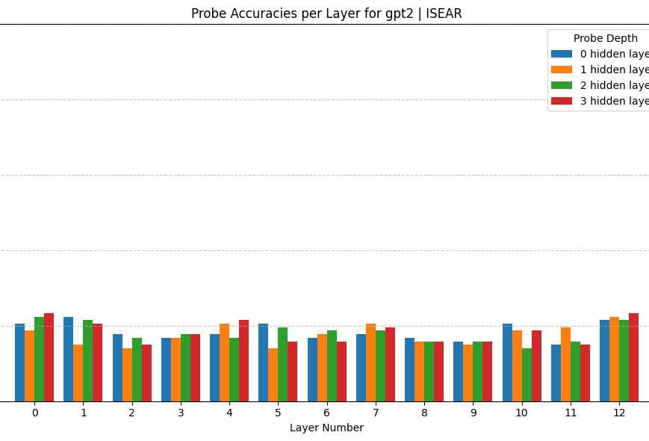
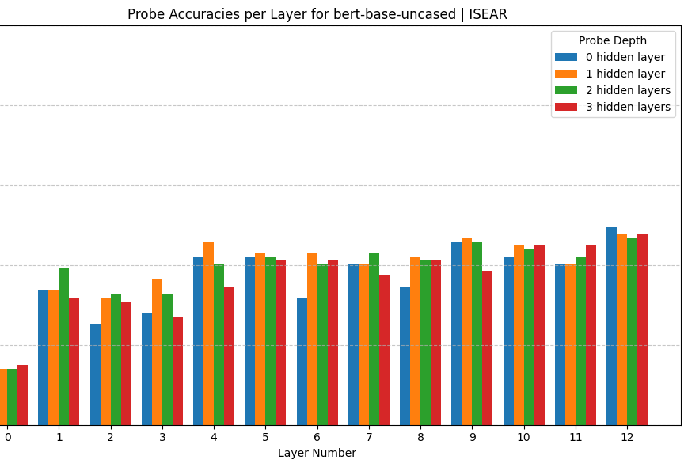
Multi Layer Perceptron with 0 (logistic regression), 1, 2 and 3 hidden layers
BERT model is better than GPT2 at emotion detection
Middle to later layers are better at emotion recognition
From analyzing these plots and each probe individually:
For GPT-2
Probe with 1 hidden layer performs better
Probe with 3 hidden layer has an upward trend (to be validated with more samples)
Question to answer : Why does Logistic Regression have accuracy close to the probe with 1 hidden layer since emotions are not likely linearly separable (need more data)
For BERT:
The probe with 3 hidden layers has the worst performance in BERT (1 hidden layer > 2 hidden layer > 0 hidden layer > 3 hidden layers)

Slide 10
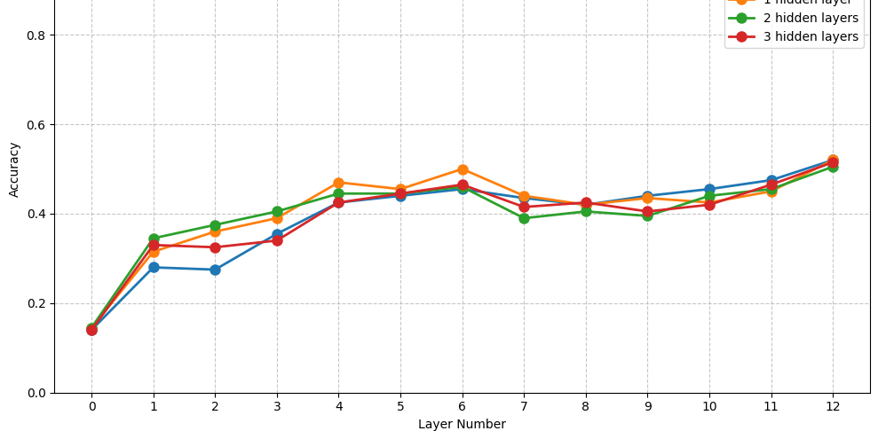
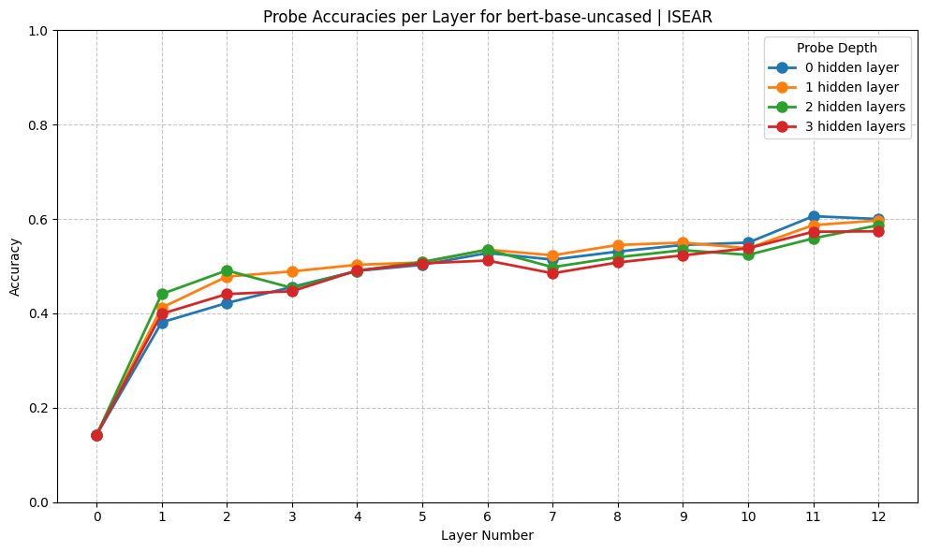
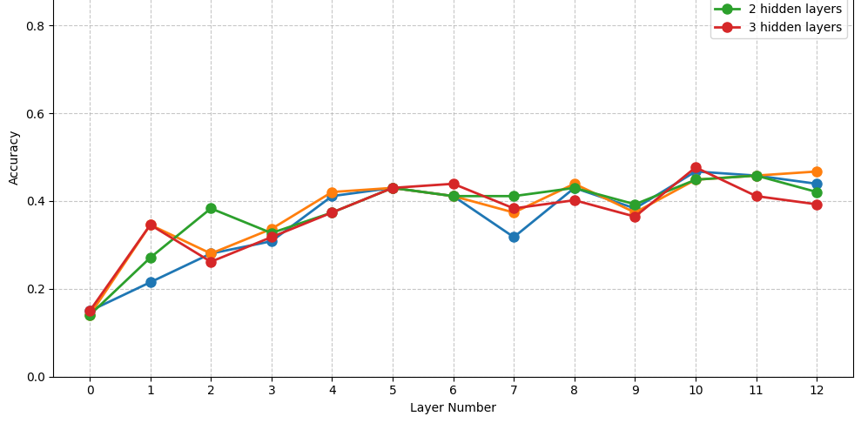
Emotion Learning in BERT – Isear Dataset
Accuracy generally increases as n_samples increases for all Probes
There is a sudden increase in accuracy for BERT layers 4-5-6
This pattern repeats in BERT layers 10-11-12
As the number of samples increases the accuracy of the models saturates.
From these results we can demonstrate how middle to later layers are more likely to be responsible for emotion learning.
Bert, n=500
Bert, n=1000
Bert, n=2000
Notes:
We can observe that increasing the number of samples significantly improves the accuracy of the probes, given that we are getting [almost the same results] everytime we run this code, one can assume that their results are fixed. Furthuremore, given that all probes regardless of the number of their hidden states, they are displaying similar results, it would almost proves that the probes are not overfitted with the hidden states data.

Slide 11
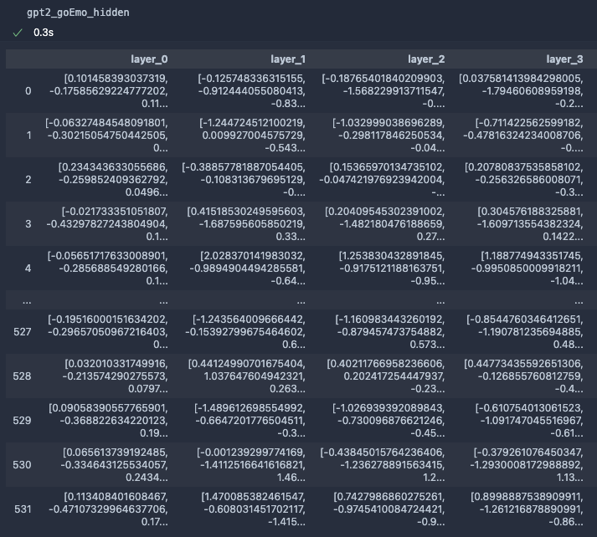
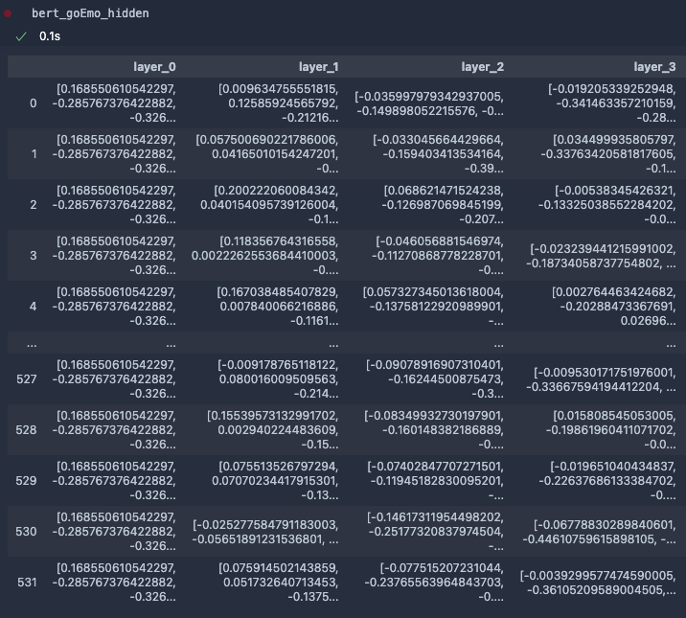
Potential reasons for difference in the performance of GPT-2 and BERT - The weights for GPT-2 layers change for every sample for the first layer where BERT has the same weights for all samples - the values of weights increase with number of layers in a more linear way for BERT model in comparison to GPT-2 which appears to be more varied
Notes:
Note how the first layer in BERT is always the same while the GPT2’s first layer values are close to each other but not the same (as if BERT model is following a certain structure regardless of the input it’s taking) Furthermore, By observing the later layers we can see that the weight values in each layer number is extremely close in the BERT model, while this is not the case for GPT2, if we assume that there exists a domain of real numbers from -2 to 2 which represents their entire knowledge set, one might assume that default BERT model can better stay on the main topic while successfully identifying the relevant subjects which whole around the main, question input. Which suggests why it might be better at emotion detection (a insignificant matter in a text for computer) than GPT2. Please do note these are just assumptions and are not validated using explainability or machine learning techniques or any scientific resource.

Slide 12
Blockers
Bugs
Computational resources :
Currently there is a problem with the hidden states extracted for go emotion, although the source of the error is not clear still, i suspect that it’s happening due to a miss match between the format of the hidden states of the different models (even though they have the same number of layers, the number of value and their consistency may vary).
Large size of the QWEN models (specifically 7b models are ~15GB)
Large size of the extracted hidden states for the selected datasets (the JSON file size for all samples hidden states for Go Emotion alone is ~14GB for each of the model BERT, GPT2 and the QWEN series)
My personal Computer crashes when trying to load QWEN2-7B
Time limits:
Extracting hidden states for each batch = 16 samples on a borrowed M3 processor takes 350s

Slide 13
To do and Questions:
What further analysis can I use for better understanding emotion learning ?
Can I include less samples for QWEN series as they take significantly longer to run?
Do I need to validate the result with another dataset?
How can I identify if the models better at detecting some of the main emotions better than the other ones ? (no evidence in result)
For hyperparameter tuning of the probes, are there any automated techniques you recommend?
Are there any other explainability techniques I need to consider ?
Is there value in probing the attention heads?

Slide 14
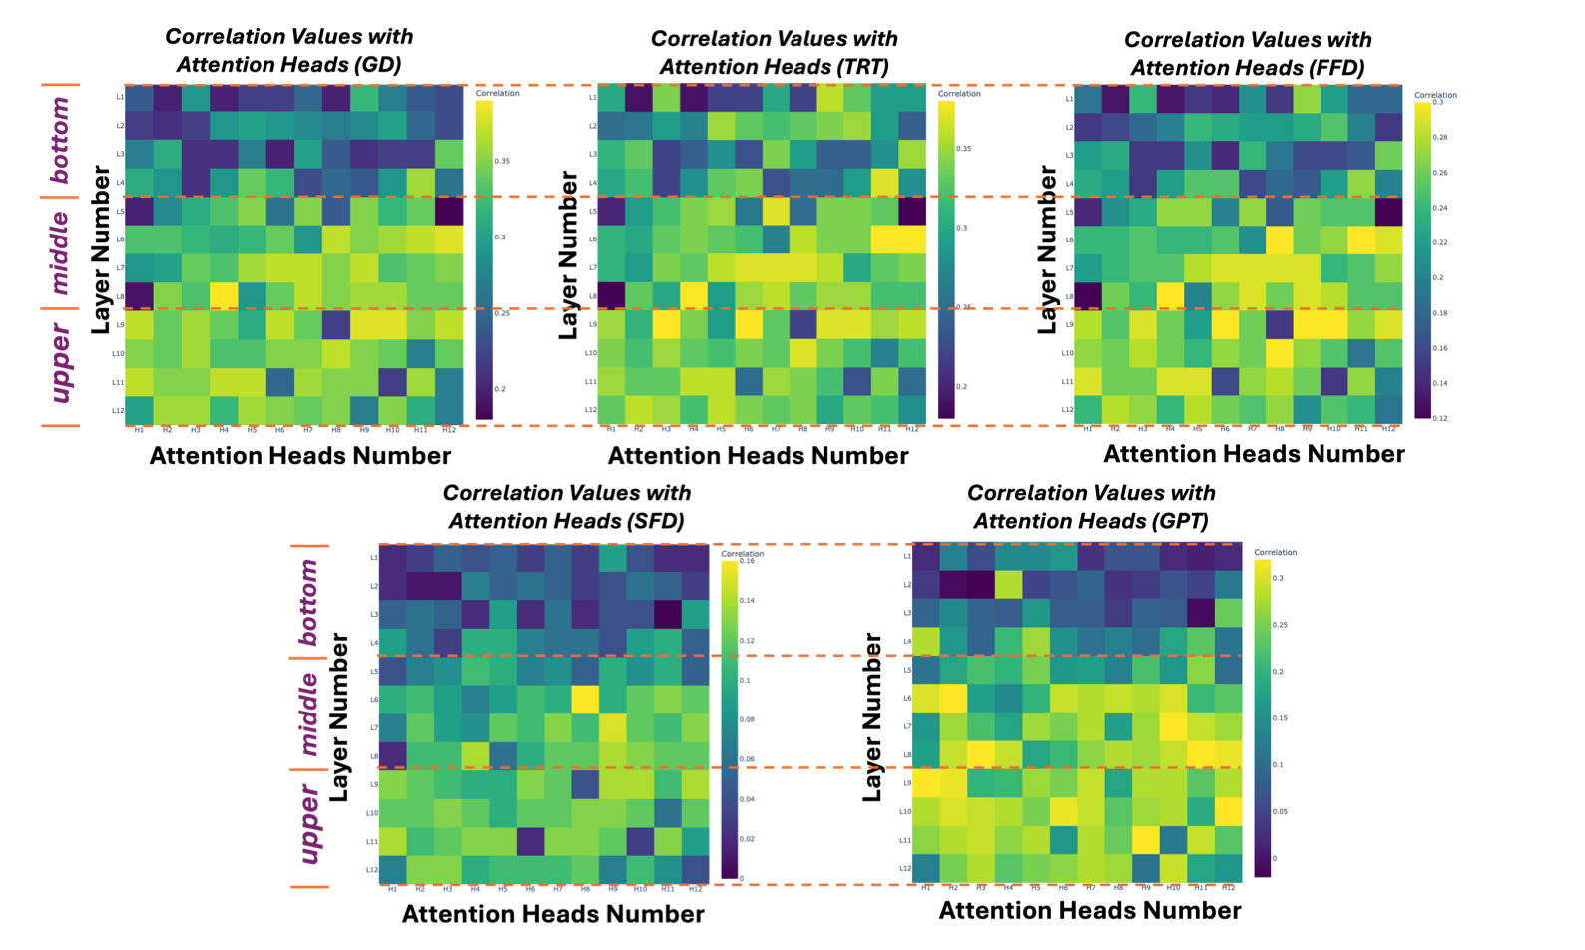
More ideas
From The paper : Probing Large Language Models from A Human Behavioural Perspective
In this paper they probe the attention heads.
Do you think there is any value in doing this?
Is it time consuming or doable in the time I have?

