Slide 1
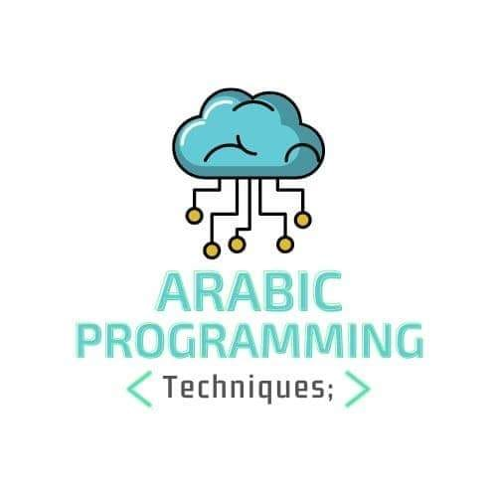
Design Patterns
Arabic Programming Techniques
Amir Hanna

Slide 2
Factory Method

Slide 3
Context
Define an interface for creating an object, but let subclasses decide which class to instantiate.

Slide 4
Solution
Make interface return ClassType
Create a class that implements this interface
Create another interface (the type will be returned )

Slide 5
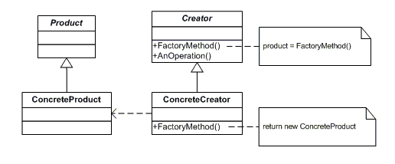
Structure (Class Diagram )

Slide 6
Thank You
Arabic Programming Techniques
Amir Hanna

