Slide 1
How to choose your first language
Arabic Programming Techniques

Slide 2
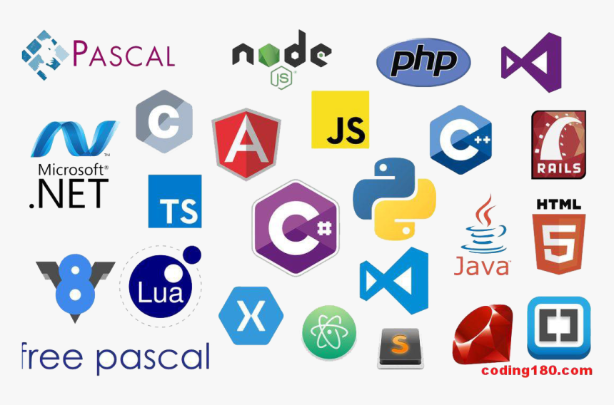

Slide 3
First part Basic syntax:
Statements
Comment
Variables and its data types
All operators
Conditions (if,else,…etc)
Loops (for,…,etc)
Arrays
Pointers , References
Function

Slide 4
Second part:
Object Oriented Programming
Classes
Objects
Methods
Constructors
…… etc

Slide 5
Links:
FaceBook Group
LinkedIn
C++ course
Problem Solving

