Slide 1

Design patterns
Arabic Programming Techniques
Amir Hanna

Slide 2
First Design Pattern
Singleton Design Pattern

Slide 3
Context
It's important for some classes to have exactly one instance.
only one university (ex:helwan)
only one company
….and so on

Slide 4
Problem
How you ensure everyone want an instance from the class take the same object that created ?

Slide 5
Force
The solution is
Make the constructor private
Create static variable in the class of the same type of the class
Create a static method to return this object

Slide 6
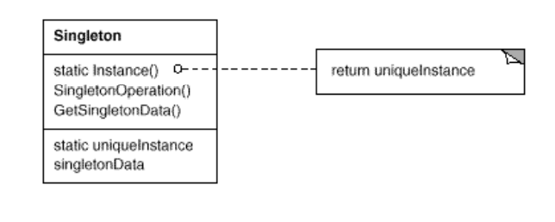
Structure (Class Diagram )

Slide 7
Thanks
Arabic Programming Techniques
Amir Hanna

