Slide 1
NUMERICAL EXTREMA STUDY
How do U and spin–orbit coupling
shape W/Wₙ maxima and minima?
Targeted scan, local refinement, and numerical checks
Professor briefing • 31 October 2026
Relaxed-policy results, with explicit limits on interpretation
01 / 09

Slide 2
1 | Define the observable and keep temperature ensembles separate
R(U,VSO,T) = W/Wₙ = Sₛ꜀ / Sₙ
REDUCED T
ABSOLUTE T
T/Tc = 0.3, 0.5, 0.7, 0.9, 0.999
T = 0.1t and 0.2t
Compare systems at the same fraction of their own Tc.
Broad scan: U = 15–150 (ΔU = 2.5t); VSO = 0–0.9t (ΔVSO = 0.1t), plus 0.4082t.
The superconducting U interval changes with VSO.
Its endpoint is estimated from Tc(U,VSO) = T; this is not the same question as fixed T/Tc.
Focused refinement: T/Tc = 0.3, 0.5; U = 15–40 (ΔU = 0.5t); VSO = 0.60–0.90 (ΔVSO = 0.025t).
U–VSO attenuation analysis • 31 Oct 2026
2

Slide 3
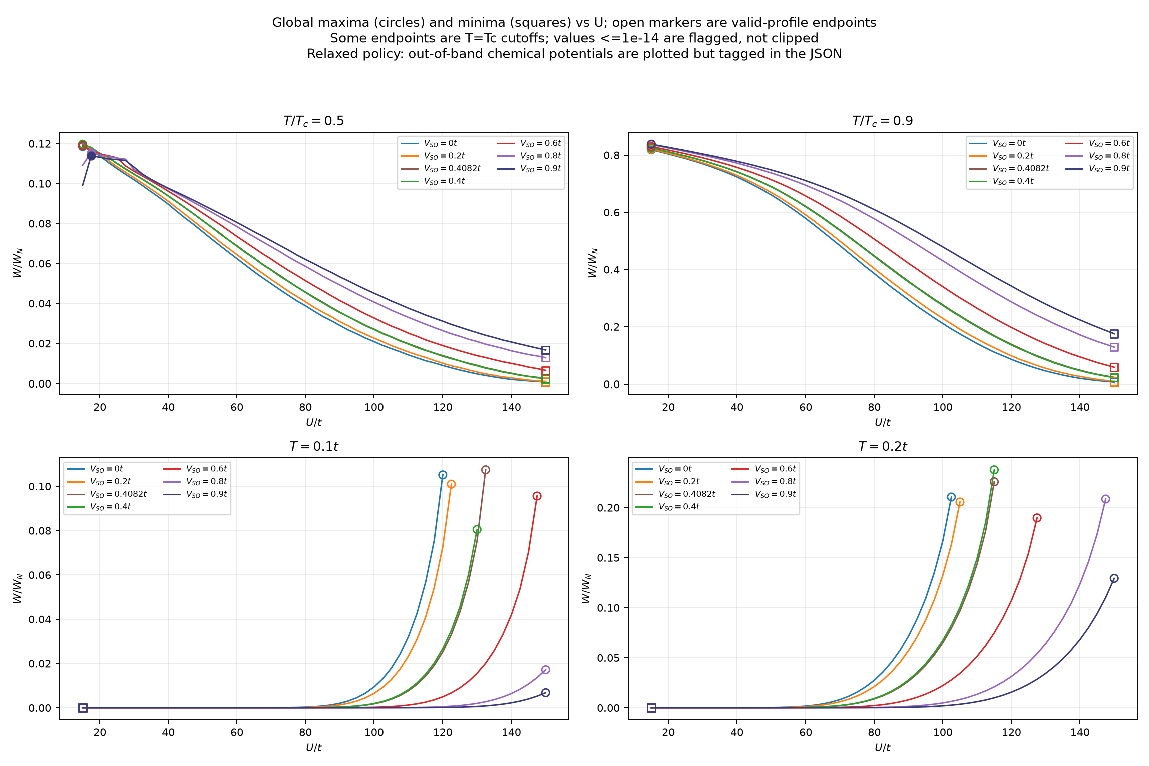
2 | Full-range view: boundaries dominate the broad curves
VERIFIED
Fixed T/Tc: sampled minima are usually at U = 150t; maxima often lie at low-U boundaries.
NOTE
At fixed absolute T, the superconducting curve ends at Tc = T. An endpoint maximum is not an interior peak.
CAUTION
Low-U extrema in the relaxed scan carry an outside-window μ₀ diagnostic; see slide 8.
Global extrema include scan endpoints. The plot is an overview; the next slide zooms into candidate low-U features.
U–VSO attenuation analysis • 31 Oct 2026
3

Slide 4
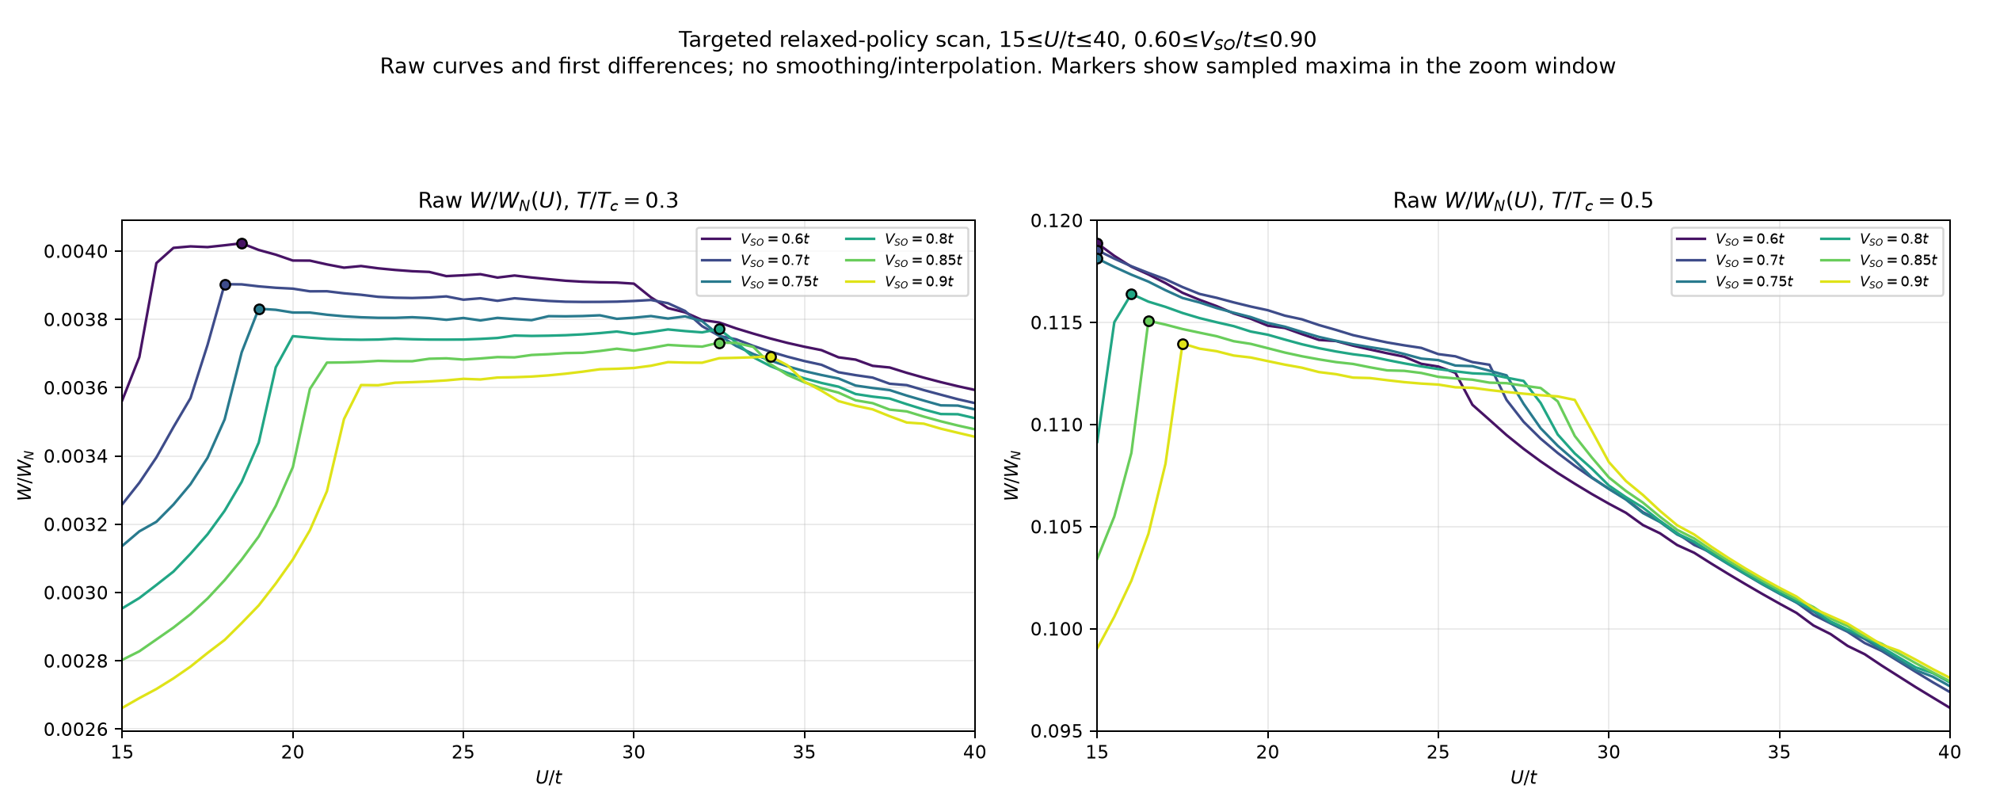
3 | The U zoom reveals candidate maxima without smoothing
T/Tc = 0.3: sampled Umax moves from ~18t (VSO = 0.60–0.75t) to ~31–34t (0.775–0.90t). The jump needs investigation.
T/Tc = 0.5: Umax leaves the U = 15t boundary between VSO = 0.75t and 0.775t; at 0.8t it is U = 16t.
U–VSO attenuation analysis • 31 Oct 2026
4

Slide 5
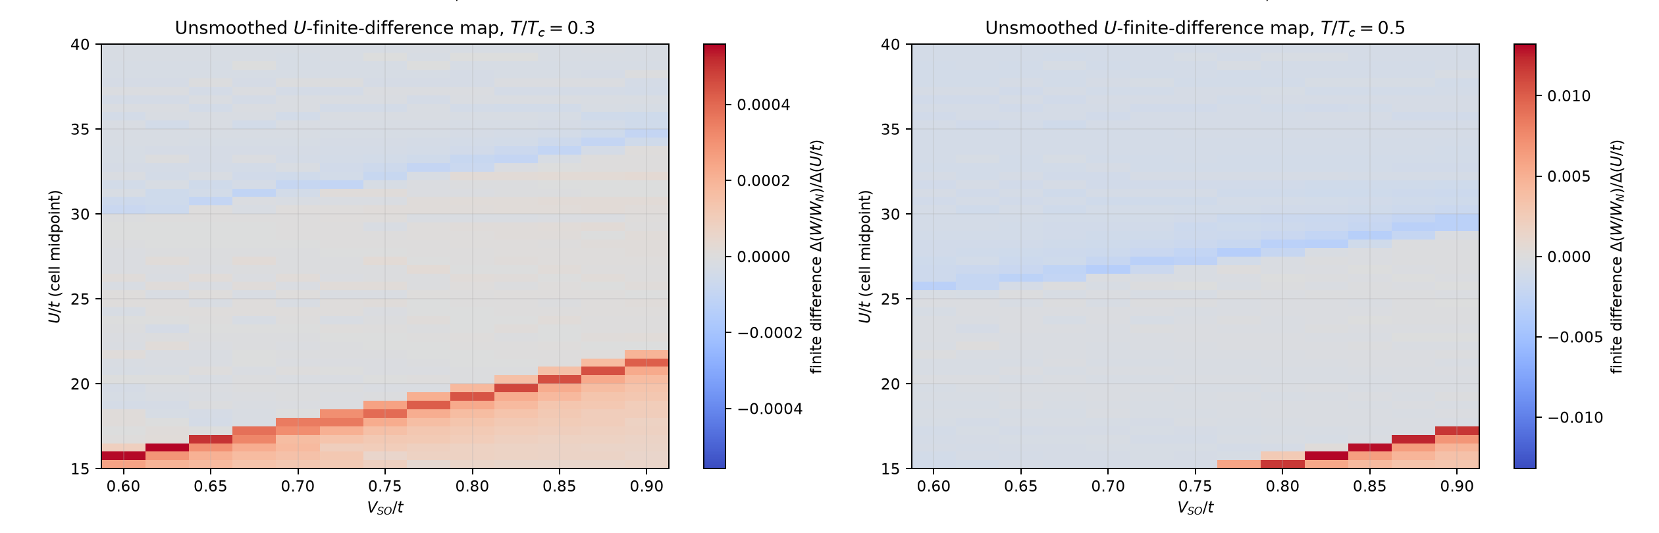
4 | First differences show where the U-profile turns
These are raw adjacent-grid Δ(W/Wₙ)/Δ(U/t) values. Positive-to-negative changes flag sampled turning regions; the map is not smoothed and does not prove that every small wiggle is physical.
U–VSO attenuation analysis • 31 Oct 2026
5

Slide 6
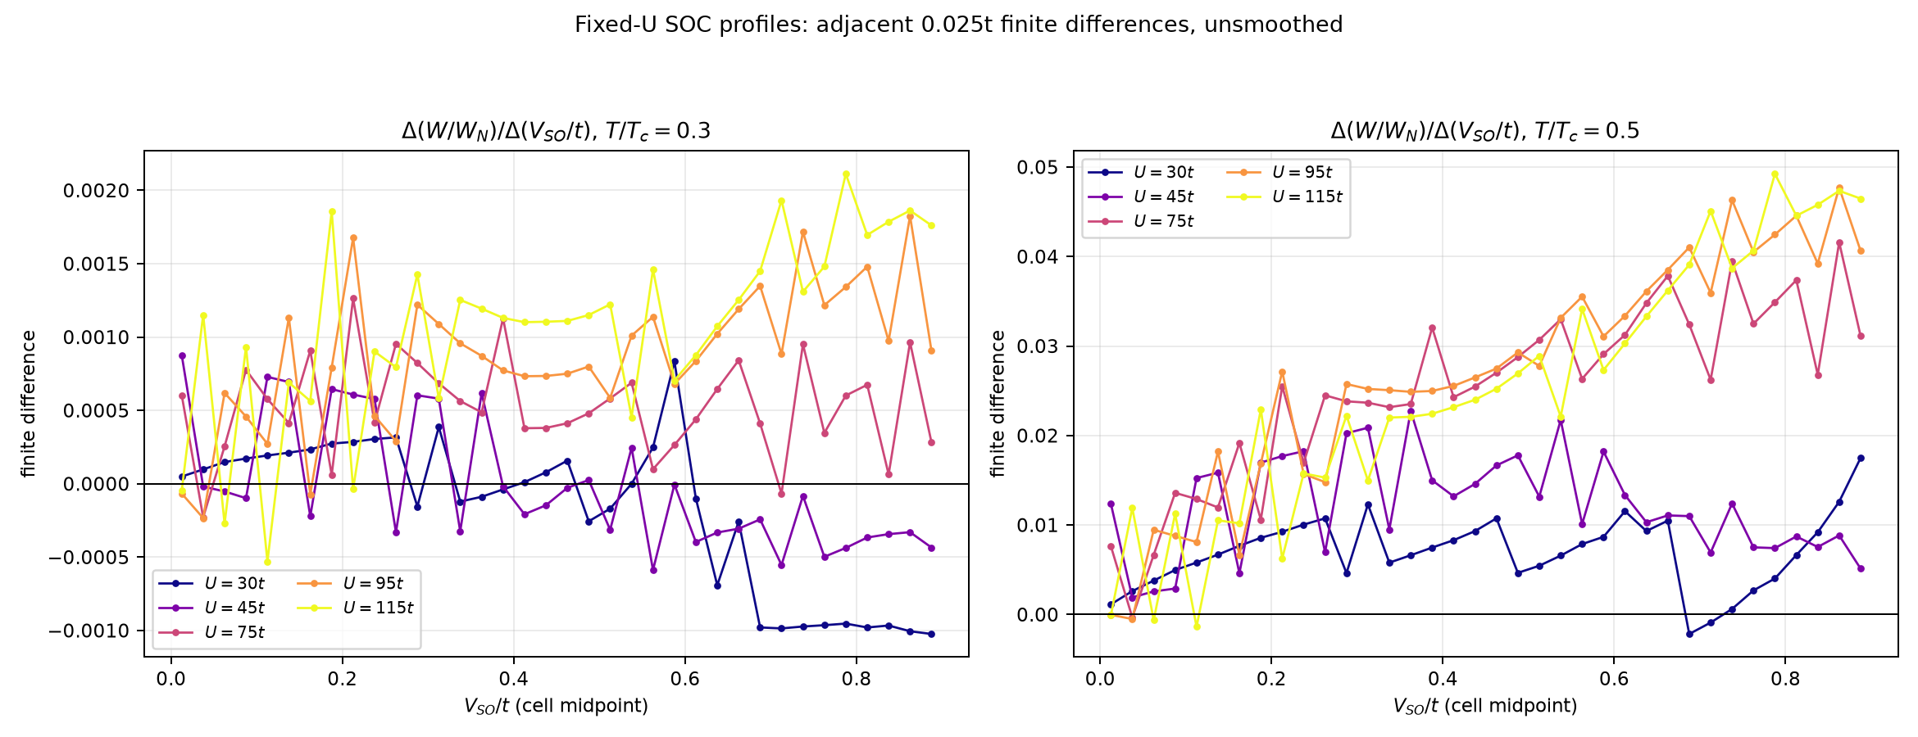
5 | At fixed U, SOC-dependent slopes expose small fluctuations
Finite differences use the existing 0.025t SOC family at U = 30, 45, 75, 95, 115t. Sign changes are visible, especially at T/Tc = 0.3; these profiles were not re-solved at doubled SOC resolution.
U–VSO attenuation analysis • 31 Oct 2026
6

Slide 7
6 | Two different cutoffs answer two different questions
A. Interior-maximum onset in the reduced-temperature scan
T/Tc = 0.5: first prominence-screened interior maximum at VSO = 0.775t; sampled bracket [0.75, 0.775]t.
T/Tc = 0.3: an interior sampled maximum exists in the U zoom, but it fails the stated prominence screen; no robust cutoff is established.
B. Superconducting U endpoint at fixed absolute T: Tc(Uc,VSO) = T
T | VSO | Estimated Uc/t | Adjacent U-grid bracket
0.1t | 0 | 121.06 | [120, 122.5]
0.1t | 0.4082 | 132.89 | [132.5, 135]
0.1t | 0.6 | 147.81 | [147.5, 150]
0.2t | 0 | 104.83 | [102.5, 105]
0.2t | 0.4082 | 115.98 | [115, 117.5]
0.2t | 0.6 | 129.18 | [127.5, 130]
0.2t | 0.8 | 147.57 | [147.5, 150]
Linear estimates between sampled U values; at higher SOC some cutoffs exceed the scanned U = 150t boundary.
U–VSO attenuation analysis • 31 Oct 2026
7

Slide 8
7 | Numerical stability is encouraging; physical stability is not established
VERIFIED
QUALIFIER
663 coarse points; 71 candidate-neighborhood points recalculated with doubled grids.
Maximum |ΔR|: 9.1×10⁻⁷ at T/Tc=0.3; 1.08×10⁻⁵ at T/Tc=0.5.
Maximum |ΔTc| across the checked points: 3.33×10⁻⁵.
226 exact overlaps with existing family data: maximum |ΔR| = 0.
All 663 refined points: `mu_window.inside = False` for the Stage-1 μ₀ diagnostic.
Relaxed policy retains these roots for exploration; the flag is not itself a stability verdict.
In the broad scan, the in-window sampled R(U) profiles were monotonically decreasing.
The doubled-grid comparison changes several resolutions together; it is not an isolated error budget or free-energy test.
Paper context: HHM benchmarks are reproduced in the repository; that benchmark alone does not certify every out-of-window root as stable.
U–VSO attenuation analysis • 31 Oct 2026
8

Slide 9
8 | Defensible takeaway and discussion question
VERIFIED
A sampled interior maximum at T/Tc=0.5 appears between VSO = 0.75t and 0.775t and persists in the checked local neighborhoods.
LIKELY
Relaxed roots reveal structured low-U shoulders and SOC-dependent shifts; their physical significance remains conditional.
UNVERIFIED
Thermodynamic stability of out-of-window roots, a continuum SOC cutoff, and the smaller fixed-U SOC extrema.
Question for discussion: should we retain the relaxed roots as exploratory solutions and next test branch continuation / free-energy stability before making a physical claim?
Presenter script and Q&A notes: presentations/Professor_briefing_notes.md • HHM: arXiv:1801.08988

