Slide 1
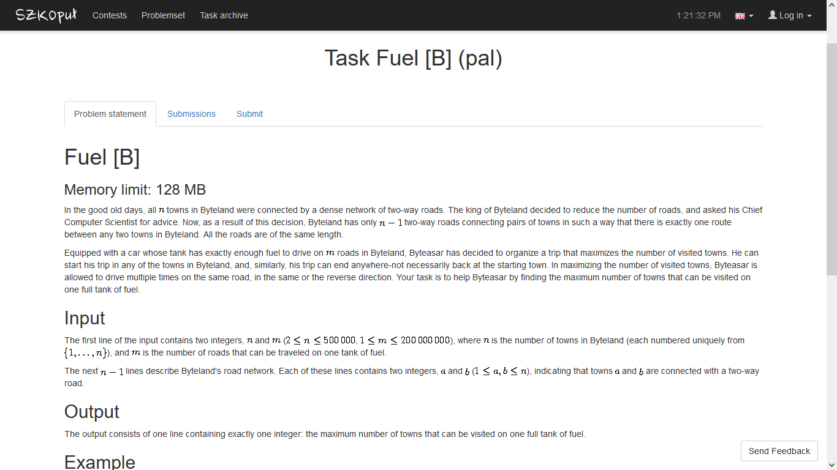
https://szkopul.edu.pl/problemset/problem/5g0vDW-MvMGHfWQqh56jQKx1/site/?key=statement

Slide 2


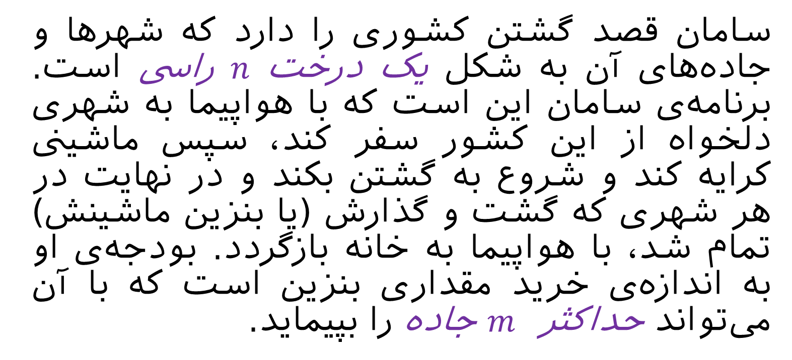
سامان قصد گشتن کشوری را دارد که شهرها و جاده‌های آن به شکل یک درخت $n$راسی است. برنامه‌ی سامان این است که با هواپیما به شهری دلخواه از این کشور سفر کند، سپس ماشینی کرایه کند و شروع به گشتن بکند و در نهایت در هر شهری که گشت و گذارش (یا بنزین ماشینش) تمام شد، با هواپیما به خانه بازگردد. بودجه‌ی او به اندازه‌ی خرید مقداری بنزین است که با آن می‌تواند حداکثر $m$ جاده را بپیماید.
m
سامان می‌خواهد طوری مسیر گشت و گذارش را انتخاب کند که تعداد شهرهایی که از آن‌ها حداقل یک بار بازدید کرده بیشینه شود. الگوریتمی بهینه ارائه دهید که این بیشینه تعداد شهرهای ممکن را بدست آورد.

Slide 3
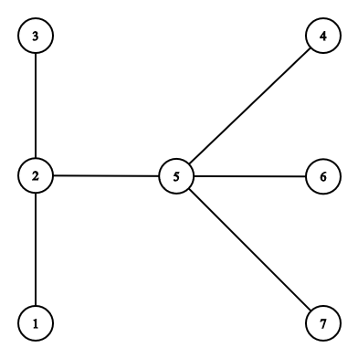
m

Slide 4
m=6

Slide 5

m=6

Slide 6
m=5

Slide 7
m=4

Slide 8
m=3

Slide 9
m=2

Slide 10
m=1

Slide 11
m=0

Slide 12
m=6

Slide 13
m=6

Slide 14
m=5

Slide 15
m=4

Slide 16
m=3

Slide 17
m=2

Slide 18
m=1

Slide 19
m=0

Slide 20
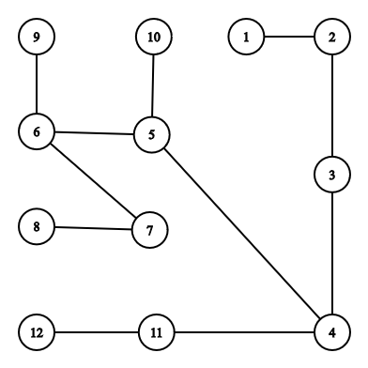
max length=?

Slide 21
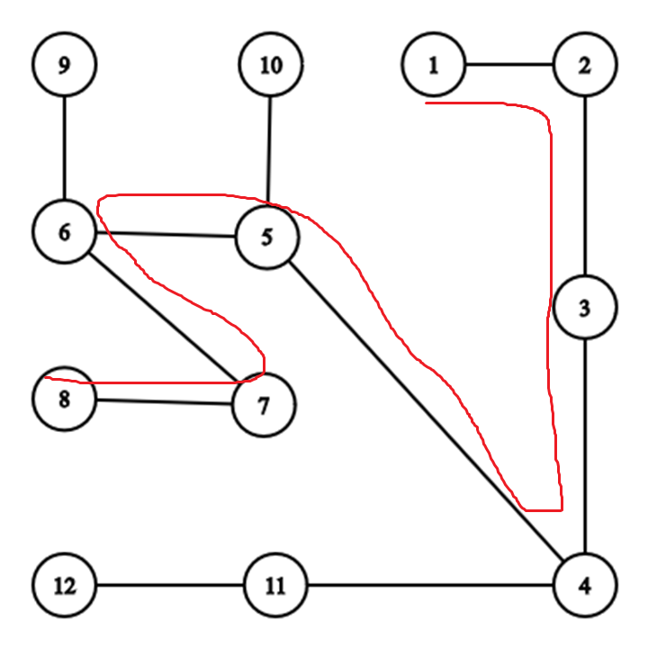
max length=7

Slide 22
diameter=7

Slide 23
diameter=7
O(n)

Slide 24
diameter=7
m ≤ d

Slide 25
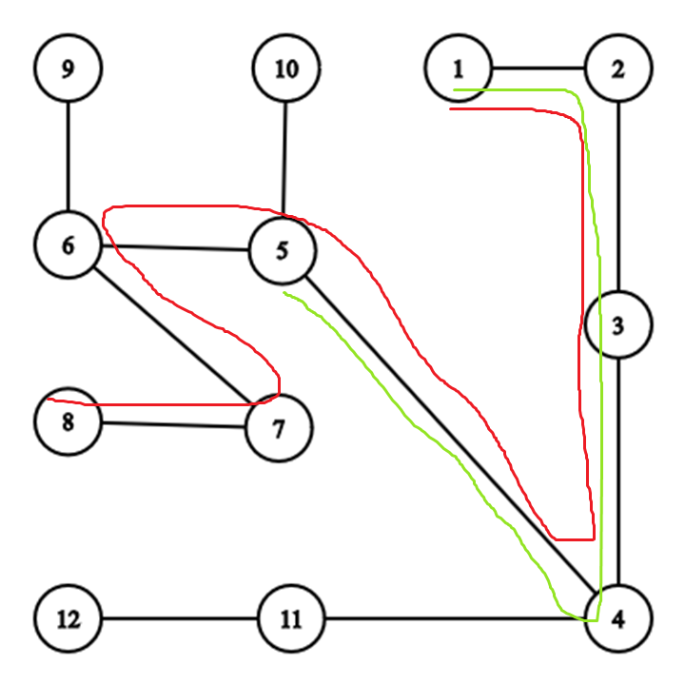
diameter=7
m=4

Slide 26

m ≤ d Answer: m+1

Slide 27
m ≤ d Answer: m+1
m > d Answer: ?

Slide 28



m ≤ d Answer: m+1
m > d Answer: ?

Slide 29
diameter=7
m=11

Slide 30
diameter=7
m=11
Answer ≥ 8

Slide 31
diameter=7
m=11

Slide 32
diameter=7
m=11
m – d = 4

Slide 33
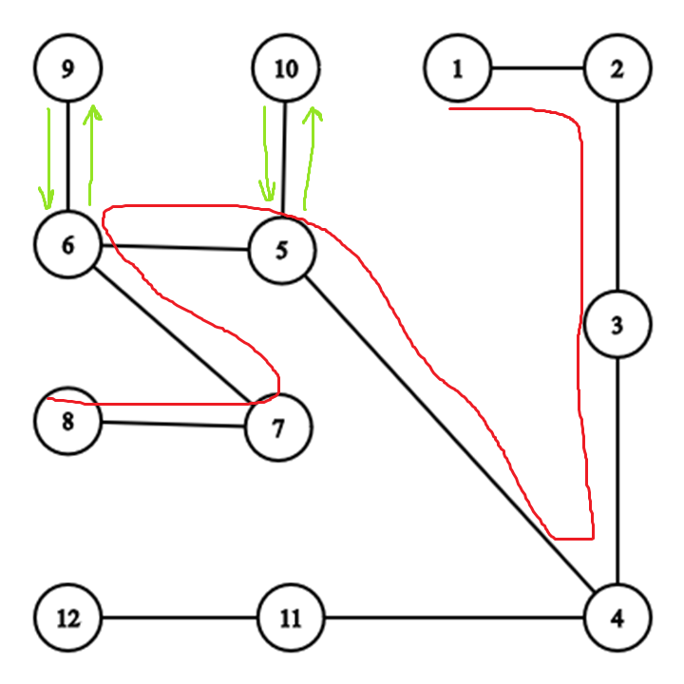
diameter=7
m=11
m – d = 4

Slide 34

diameter=7
m=11
m – d = 4

Slide 35
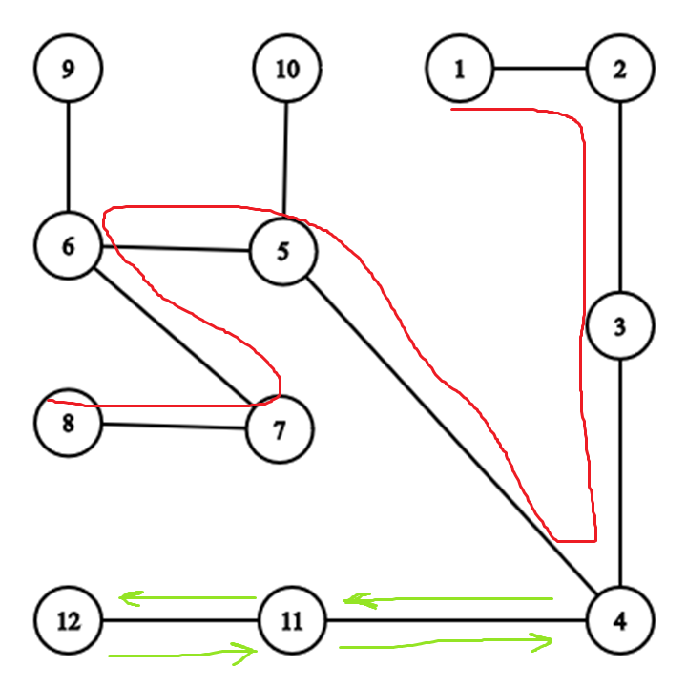
diameter=7
m=11
m – d = 4

Slide 36
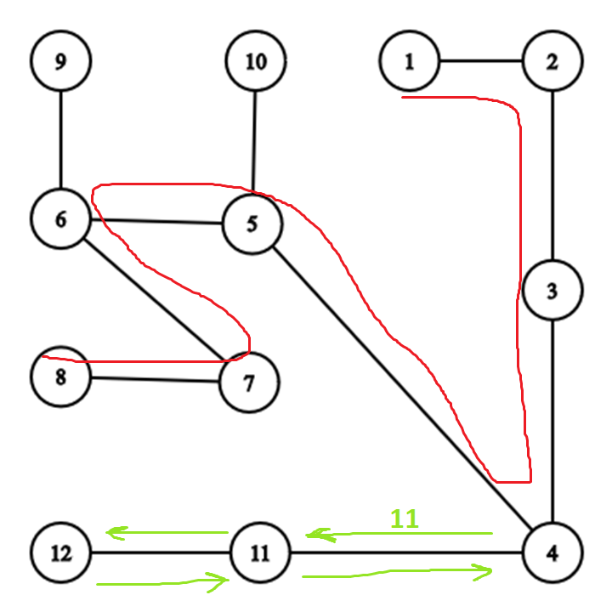
diameter=7
m=11
m – d = 4

Slide 37
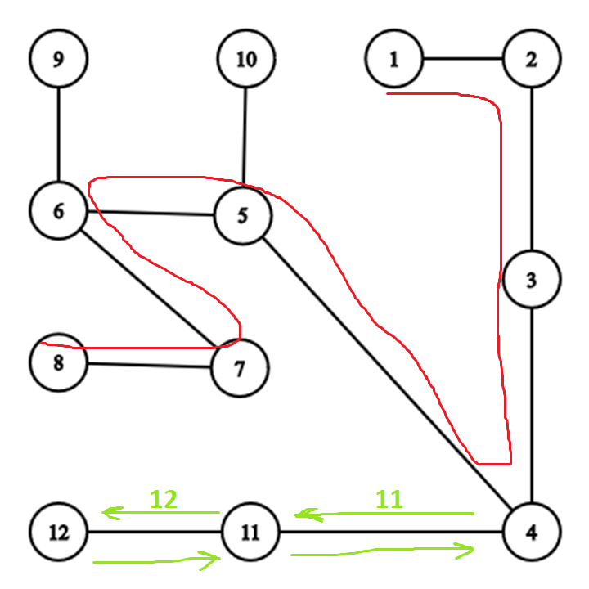
diameter=7
m=11
m – d = 4

Slide 38
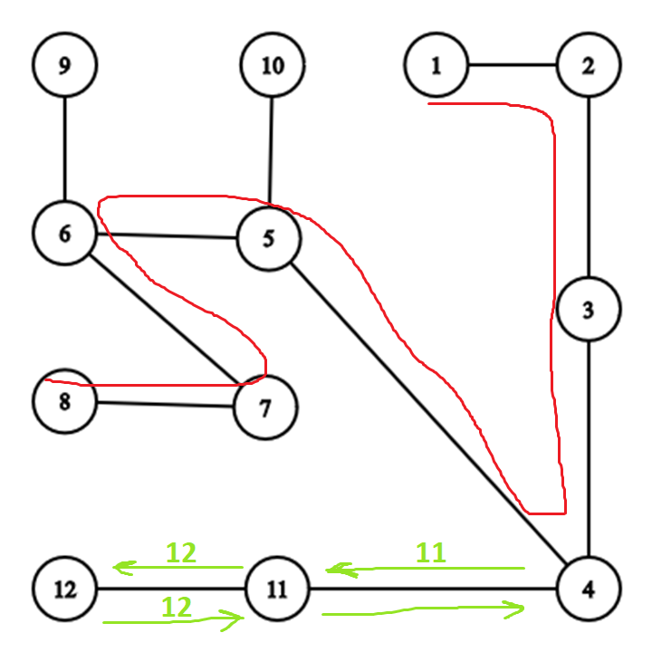
diameter=7
m=11
m – d = 4

Slide 39
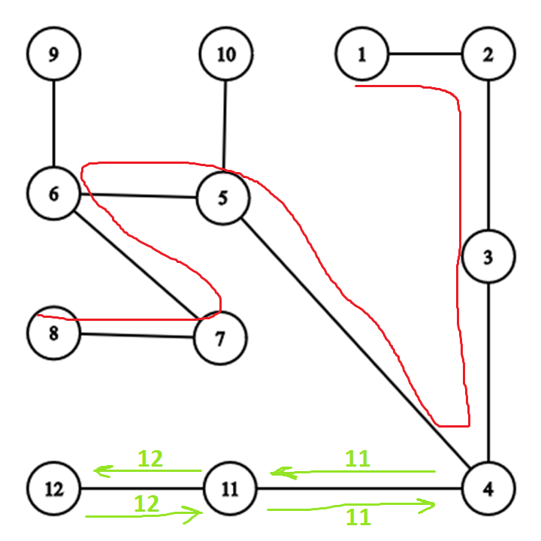
diameter=7
m=11
m – d = 4

Slide 40
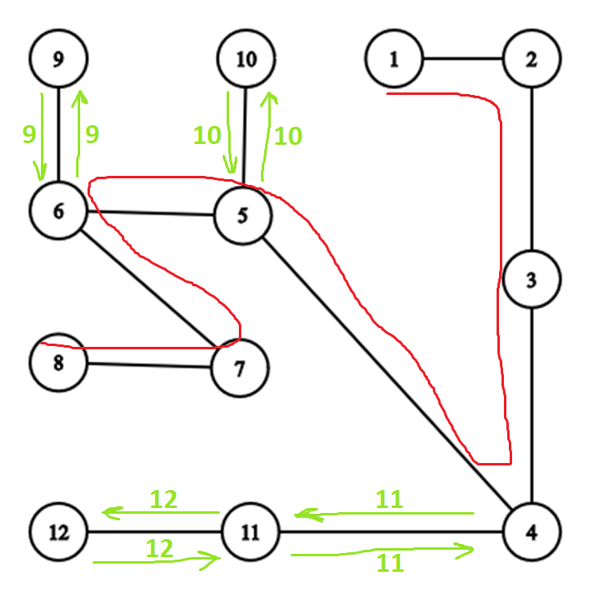
diameter=7
m=11
m – d = 4

Slide 41
d+1
diameter=7
m=11
m – d = 4

Slide 42
d+1 + m-d
2
diameter=7
m=11
m – d = 4

Slide 43
d+1 + m-d
2
diameter=7
m=10
m – d = 3

Slide 44
d+1 + m-d
2
diameter=7
m=10
m – d = 3

Slide 45

Any special case?

Slide 46
diameter=7
m=100
m – d = 93

Slide 47
d+1 + m-d
2
diameter=7
m=100
m – d = 93

Slide 48
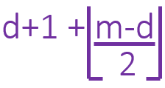
min( , n)
diameter=7
m=100
m – d = 93

Slide 49


m ≤ d Answer: m+1
m > d Answer:

Slide 50
How to get diameter?

Slide 51

naïve approach
Run dfs/bfs from every node

Slide 52
naïve approach
Run dfs/bfs from every node
O(n(V+E))=O(n(n+n-1))=O(n²)

Slide 53
naïve approach
Run dfs/bfs from every node
O(n(V+E))=O(n(n+n-1))=O(n²)
Is it good enough?

Slide 54

naïve approach
Run dfs/bfs from every node
O(n(V+E))=O(n(n+n-1))=O(n²)
Is it good enough?
But we can do better than that…

Slide 55
greedy approach
pick an arbitrary vertex s

Slide 56
greedy approach
pick an arbitrary vertex s
find farthest vertex r to s

Slide 57
greedy approach
pick an arbitrary vertex s
find farthest vertex r to s
find farthest vertex t to r

Slide 58
greedy approach
pick an arbitrary vertex s
find farthest vertex r to s
find farthest vertex t to r
t to r path is a diameter!

Slide 59

greedy approach
pick an arbitrary vertex s
find farthest vertex r to s
find farthest vertex t to r
t to r path is a diameter!

Slide 60
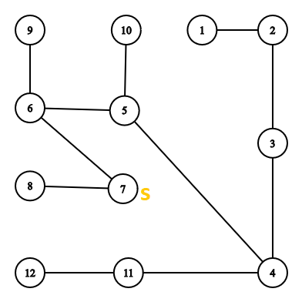
greedy approach
pick an arbitrary vertex s
find farthest vertex r to s
find farthest vertex t to r
t to r path is a diameter!

Slide 61
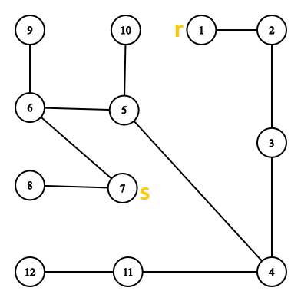
greedy approach
pick an arbitrary vertex s
find farthest vertex r to s
find farthest vertex t to r
t to r path is a diameter!

Slide 62
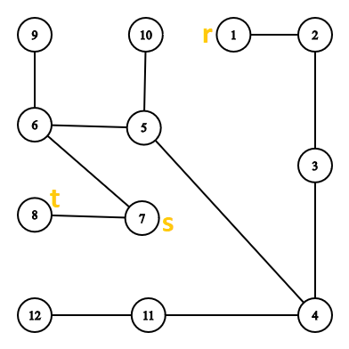
greedy approach
pick an arbitrary vertex s
find farthest vertex r to s
find farthest vertex t to r
t to r path is a diameter!

Slide 63
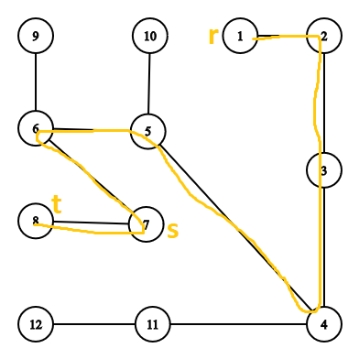
greedy approach
pick an arbitrary vertex s
find farthest vertex r to s
find farthest vertex t to r
t to r path is a diameter!

Slide 64
proof of correctness

Slide 65
proof of correctness
case 1:
s on diameter
picked s
case 2:
s not on diameter

Slide 66
proof of correctness
case 1:
s on diameter

Slide 67
proof of correctness
case 1:
s on diameter

Slide 68

proof of correctness
case 1:
s on diameter

Slide 69
proof of correctness
case 1:
s on diameter

Slide 70
proof of correctness
case 1:
s on diameter

Slide 71
proof of correctness
case 1:
s on diameter

Slide 72

proof of correctness
case 1:
s on diameter

Slide 73
proof of correctness
case 1:
s on diameter

Slide 74
proof of correctness
case 1:
s on diameter

Slide 75
proof of correctness
case 1:
s on diameter

Slide 76

proof of correctness
case 1:
s on diameter

Slide 77
proof of correctness
case 1:
s on diameter

Slide 78
proof of correctness
case 1:
s on diameter

Slide 79
greedy approach
pick an arbitrary vertex s
find farthest vertex r to s
find farthest vertex t to r
t to r path is a diameter!

Slide 80
greedy approach
pick an arbitrary vertex s
find farthest vertex r to s
find farthest vertex t to r
t to r path is a diameter!
Case 1 proved
(s on diameter)

Slide 81
proof of correctness
case 2:
s not on diameter

Slide 82
proof of correctness
case 2:
s not on diameter

Slide 83
proof of correctness
case 2:
s not on diameter

Slide 84

proof of correctness
case 2:
s not on diameter

Slide 85
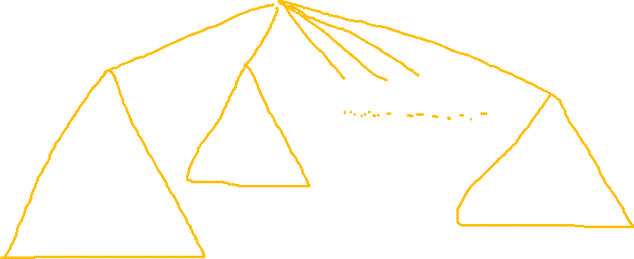
proof of correctness
case 2:
s not on diameter

Slide 86
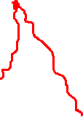
proof of correctness
case 2:
s not on diameter

Slide 87

proof of correctness
case 2:
s not on diameter

Slide 88

proof of correctness
case 2:
s not on diameter

Slide 89

proof of correctness
case 2:
s not on diameter

Slide 90

proof of correctness
case 2:
s not on diameter

Slide 91
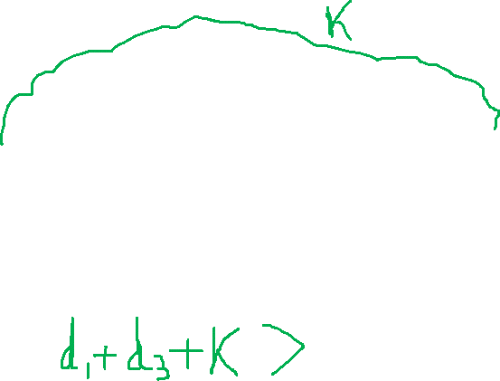
proof of correctness
case 2:
s not on diameter

Slide 92
proof of correctness
case 2:
s not on diameter

Slide 93
proof of correctness
case 2:
s not on diameter

Slide 94
proof of correctness
case 2:
s not on diameter

Slide 95
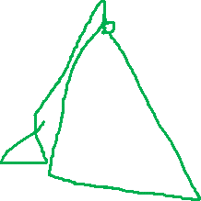
proof of correctness
case 2:
s not on diameter

Slide 96
proof of correctness
case 2:
s not on diameter

Slide 97

proof of correctness
case 2:
s not on diameter

Slide 98
proof of correctness
case 2:
s not on diameter

Slide 99
proof of correctness
case 2:
s not on diameter

Slide 100
proof of correctness
case 2:
s not on diameter

Slide 101
proof of correctness
case 1:
s on diameter
proved
picked s
case 2:
s not on diameter
proved

Slide 102

proof of correctness
case 1:
s on diameter
proved
picked s
case 2:
s not on diameter
proved

Slide 103
https://github.com/AmiriShavaki/Task-Fuel

Slide 104

https://github.com/AmiriShavaki/Task-Fuel
Thank you!

