Slide 1

Structure of the minimalist model
Amir Mohammad Esmaieeli Sikaroudi

Slide 2
Structure of data
Synthetic trajectories with fixed length 4 and has lat/lon (4x2)
Trajectories are built on a grid of pixels in [0,1] range
Pixels are either allowed to moved or not
Setup of pixels is random with fixed seed number
Each trajectory is made by a sequence of moves to adjacent allowed pixels
Adjacency is simply defined by 8 neighboring pixels
1000 sample trajectories is generated for training

Slide 3
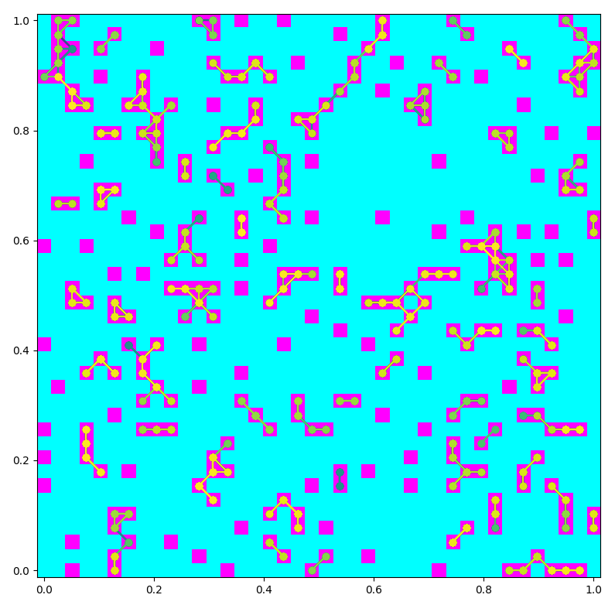
Example dataset
Isolated pixels are excluded so that trajectories with the same lat/lon all along won’t be created.

Slide 4
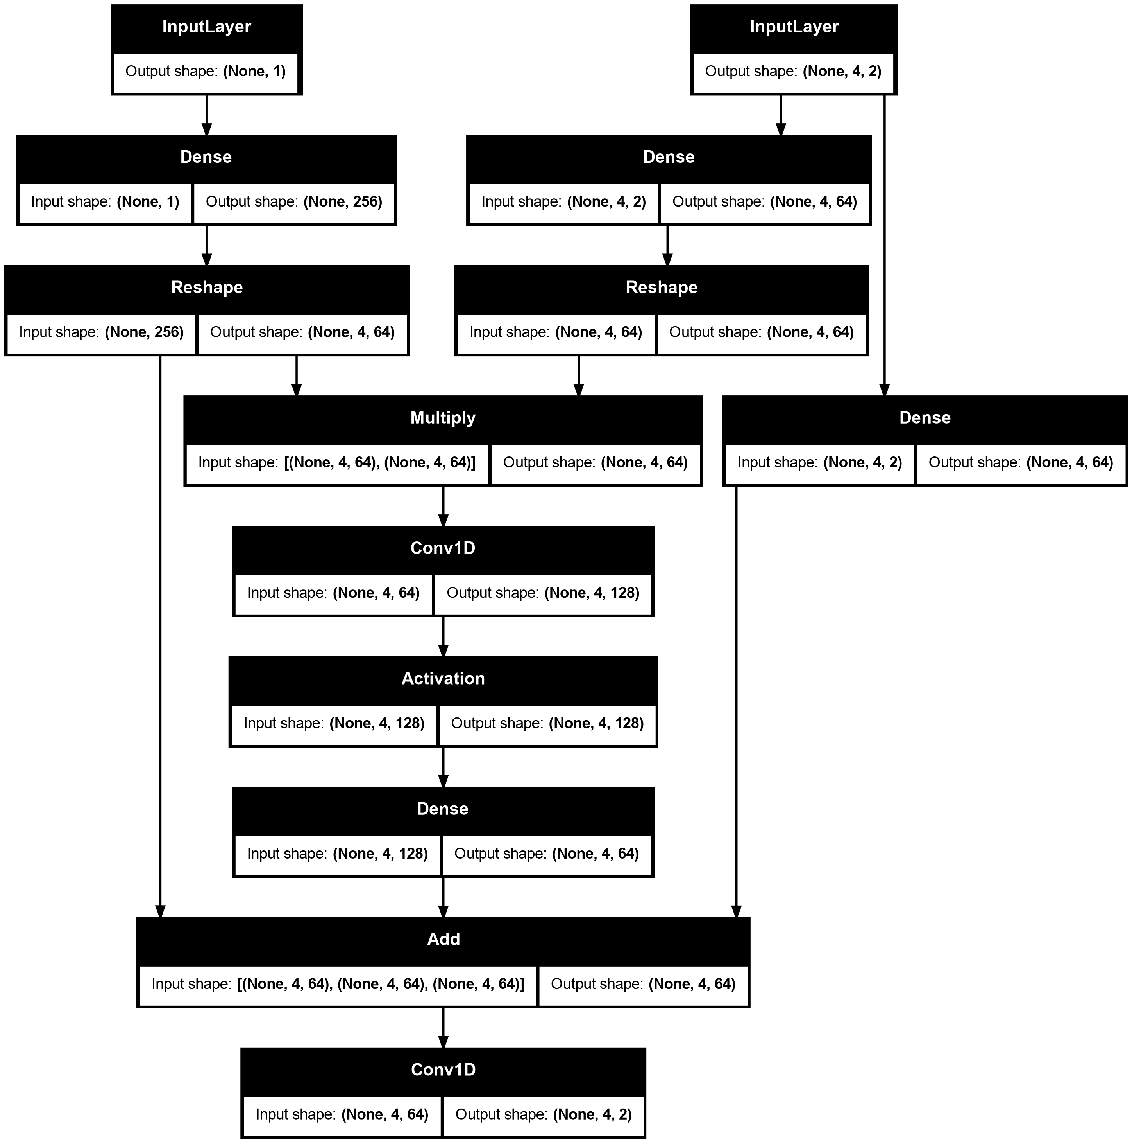
Old design
Runtime: 20 seconds on RTX 3060 Ti
Loss plateaus instead of going to 0

Slide 5
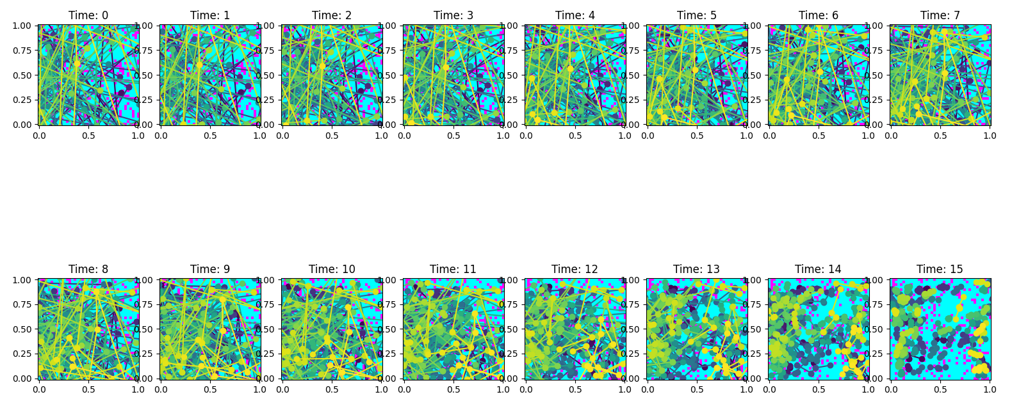
Old results, trajectory length 4

Slide 6
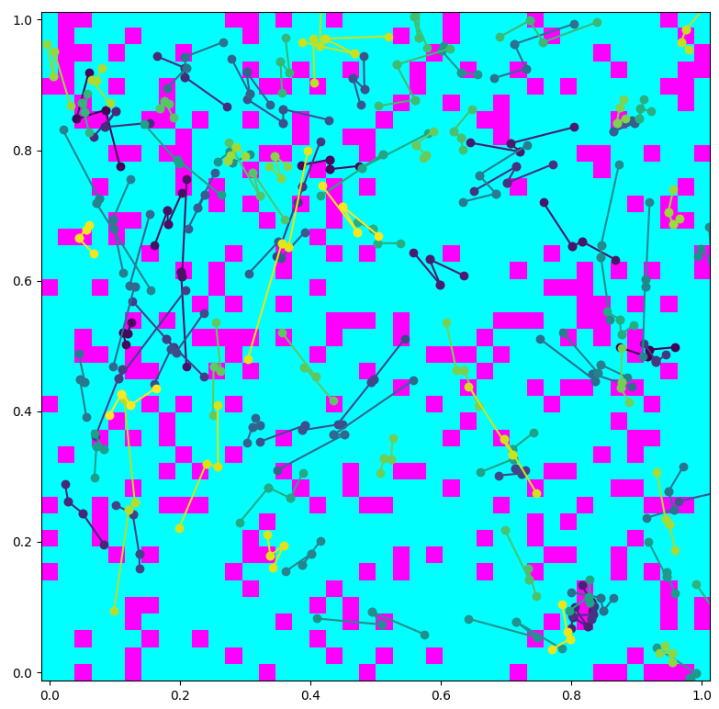
Old results, trajectory length 4

Slide 7
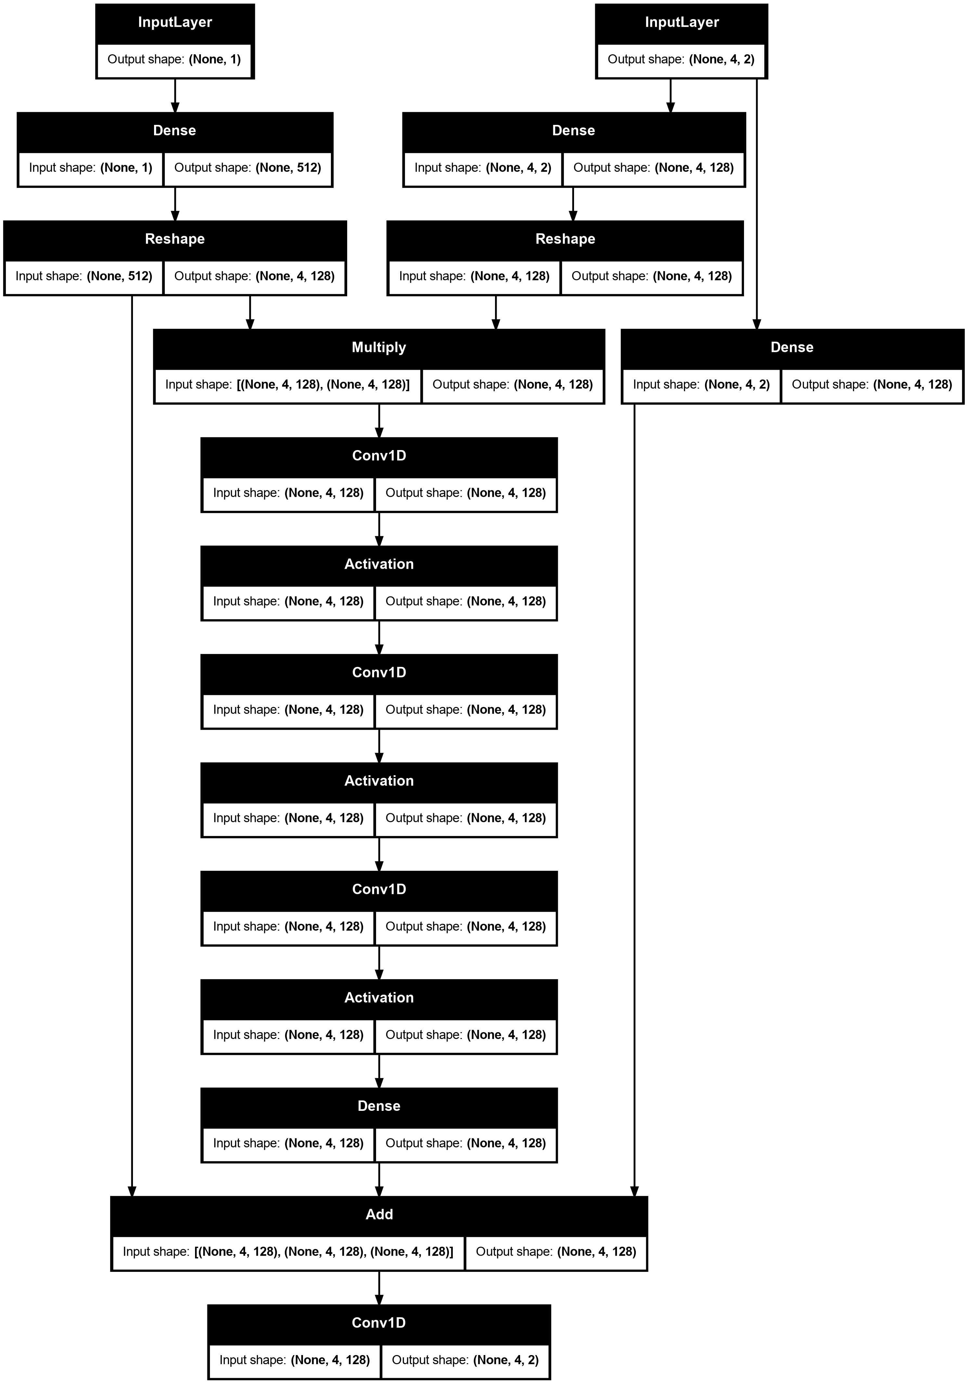
Architecture
Runtime: 30 seconds on RTX 3060 Ti
Loss plateaus instead of going to 0

Slide 8
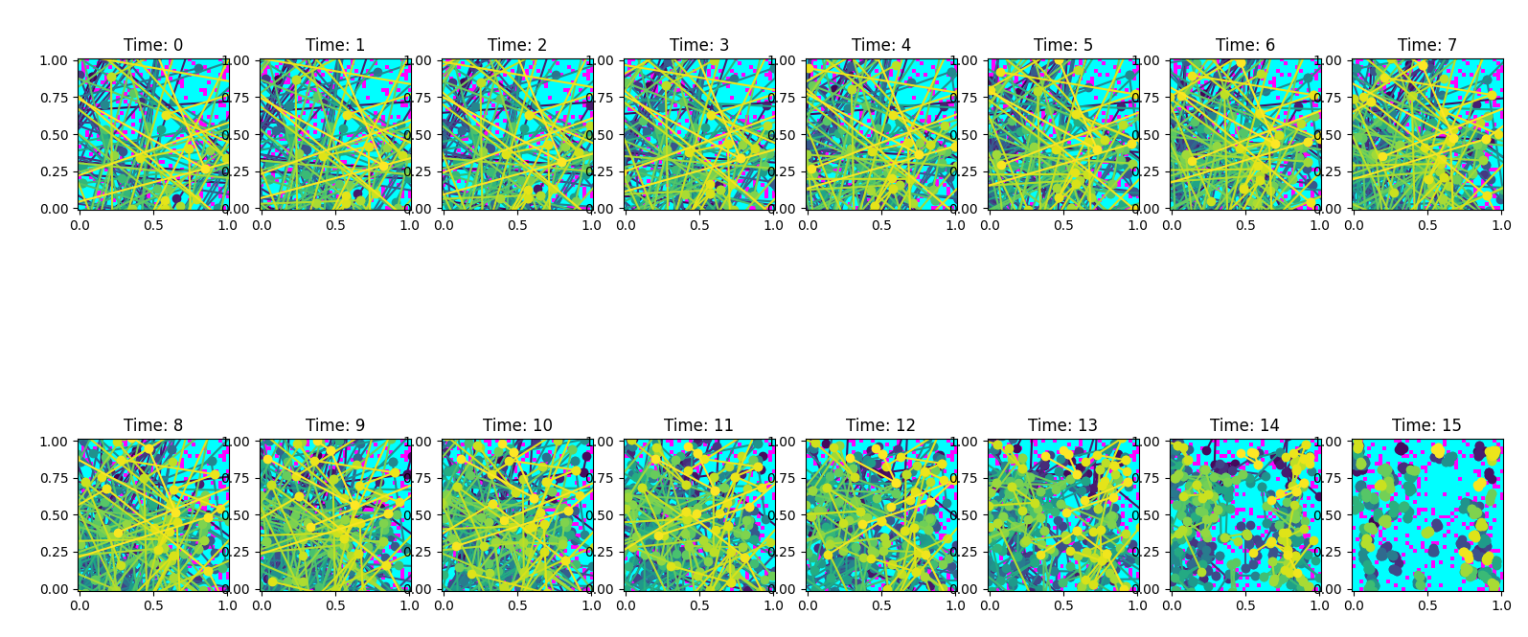
Results, trajectory length 4

Slide 9
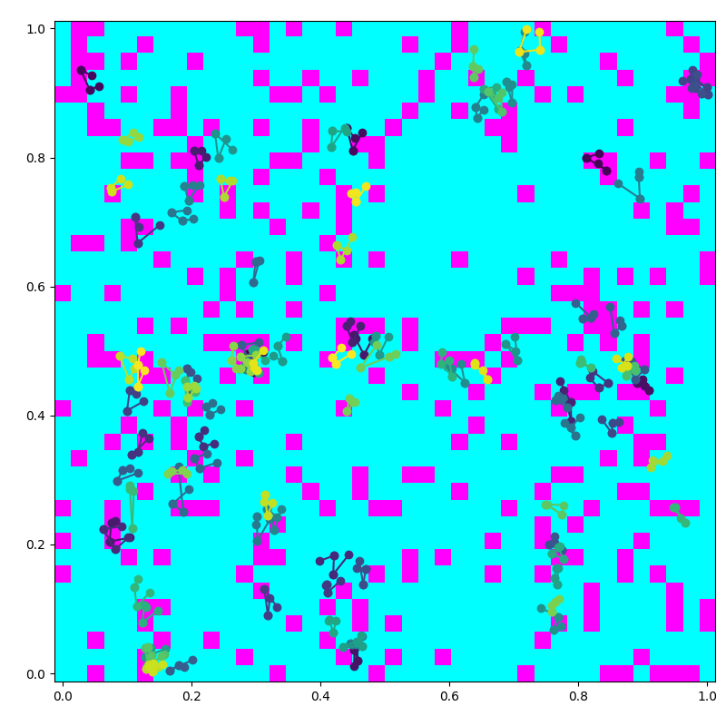
Results, trajectory length 4

