Slide 1

Structure of the minimalist model
Amir Mohammad Esmaieeli Sikaroudi

Slide 2
Structure of data
Synthetic trajectories with fixed length 4 and has lat/lon (4x2)
Trajectories are built on a grid of pixels in [0,1] range
Pixels are either allowed to moved or not
Setup of pixels is random with fixed seed number
Each trajectory is made by a sequence of moves to adjacent allowed pixels
Adjacency is simply defined by 8 neighboring pixels
1000 sample trajectories is generated for training

Slide 3
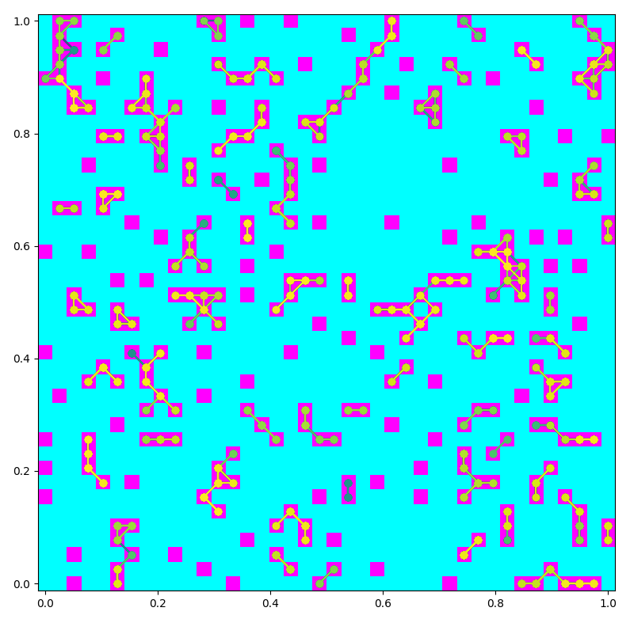
Example dataset
Isolated pixels are excluded so that trajectories with the same lat/lon all along won’t be created.

Slide 4
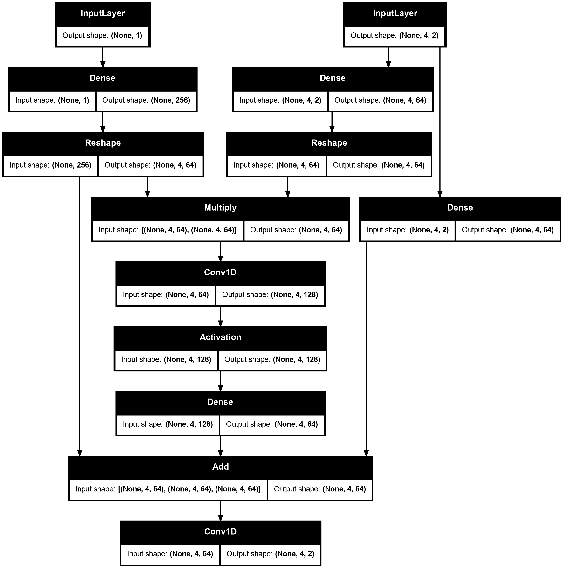
Old design
Runtime: 20 seconds on RTX 3060 Ti
Loss plateaus instead of going to 0

Slide 5
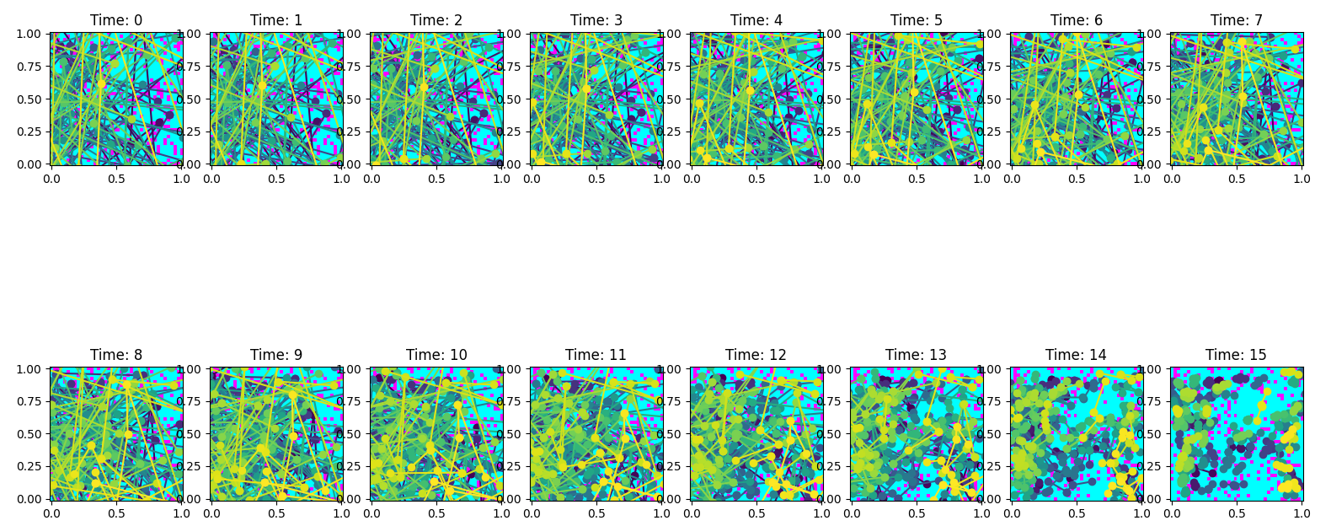
Old results, trajectory length 4

Slide 6
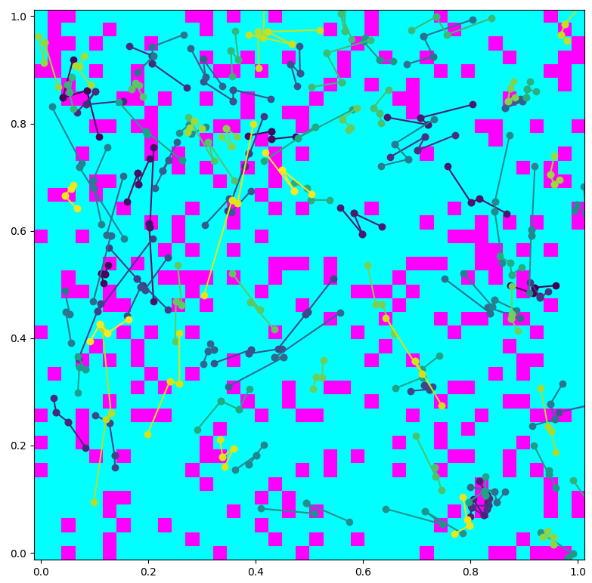
Old results, trajectory length 4

Slide 7
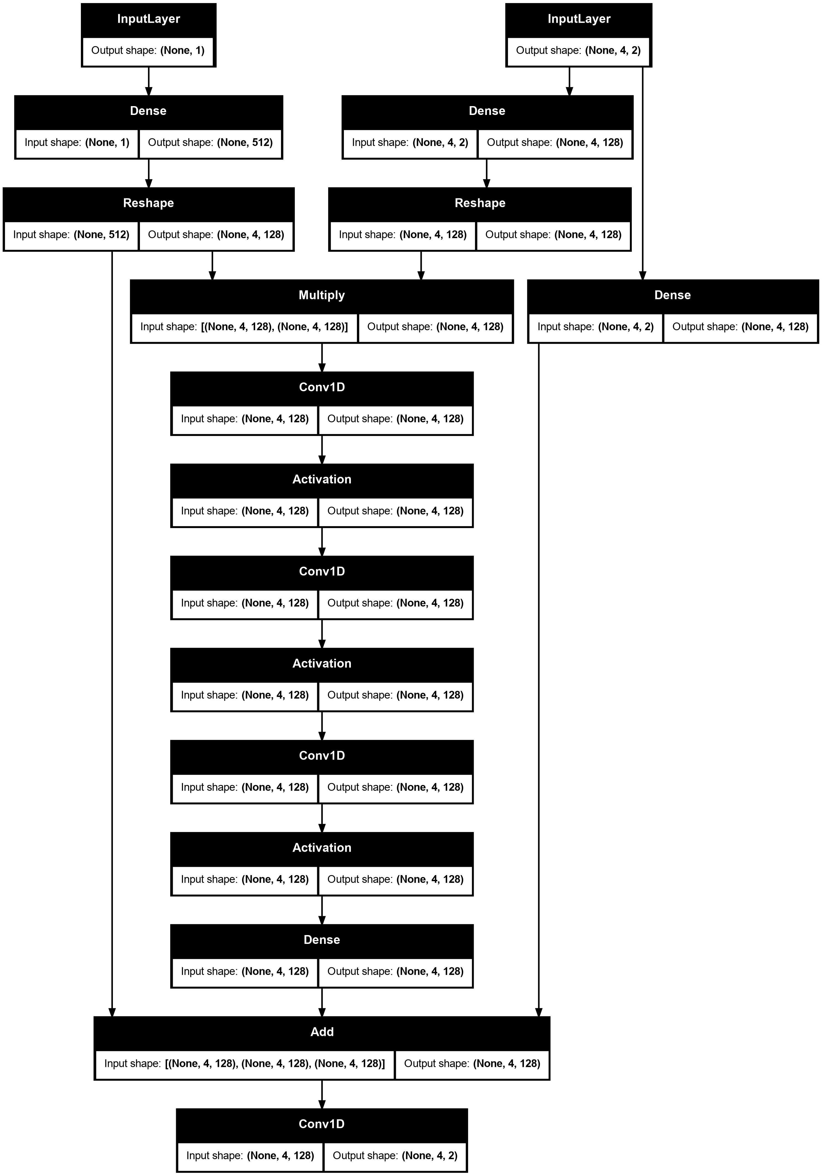
Architecture
Runtime: 30 seconds on RTX 3060 Ti
Loss plateaus instead of going to 0

Slide 8
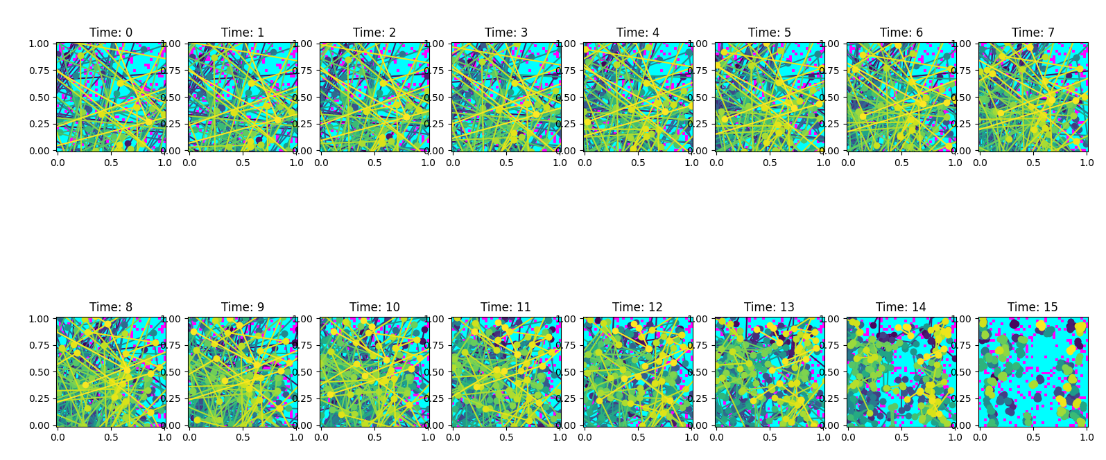
Results, trajectory length 4

Slide 9
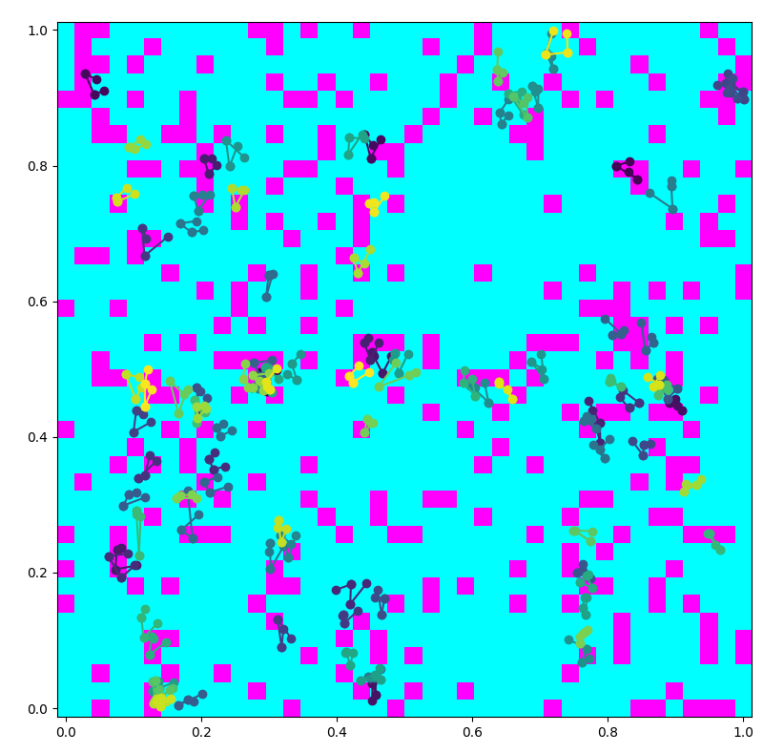
Results, trajectory length 4

Slide 10
Model version 3
Adding logic to avoid forbidden pixels
Investigating two approaches:
  Direct input to the architecture
  Loss function penalty function

Slide 11
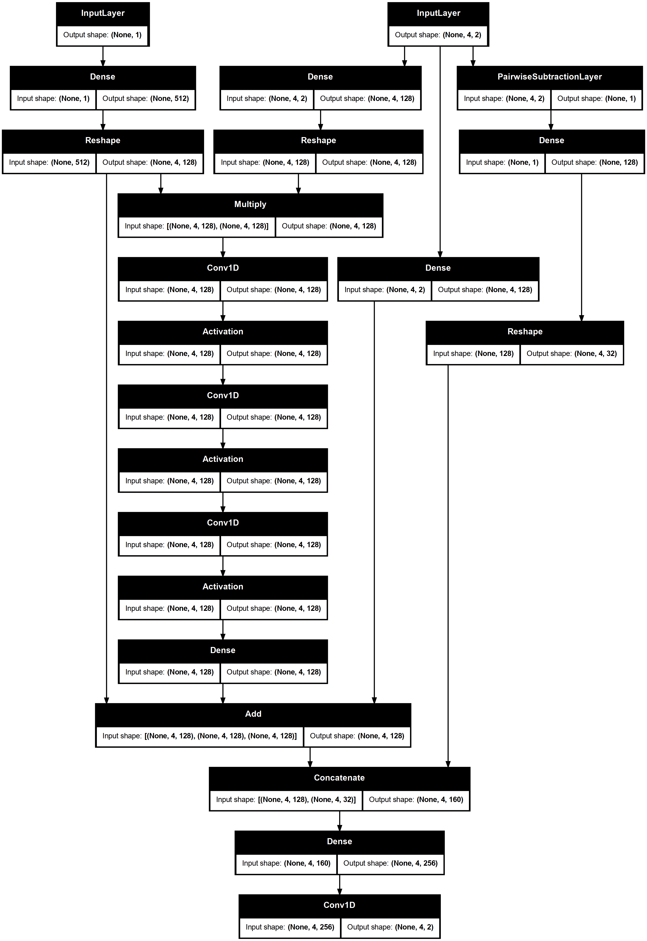
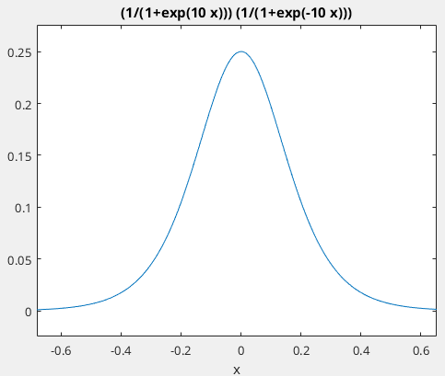
Model version 3 direct input
  A custom layer is added that calculates the pairwise distances between each coordinate of the input trajectories with the allowable pixels.
  The distance is calculated by L1 norm that passes through two mirrored Sigmoid functions to make distance positive and more sensitive value differences.

Slide 12
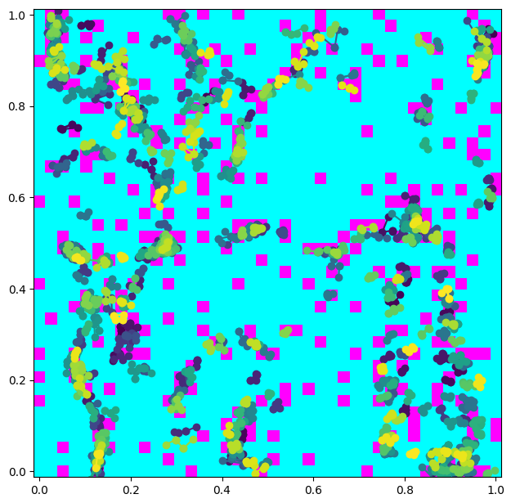
Results, Model version 3 direct input
Runtime: 33 seconds on RTX 3060 Ti
Loss plateaus instead of going to 0

Slide 13
Model version 3 Loss function
A penalty terms added to the L1 loss.
Penalty is the same distance calculated in previous model but the inverse is used because we want to maximize the distance passed through activation fcn.
Loss=MAE+sum(1/(0.01+actFcn(dist_i)))
Adding simple penalty term fails. The model outputs similar to Model version 2.
The “noise time” is added to the penalty term such that if noise is high, the penalty is relaxed.
Loss=MAE+sum(1/(0.01+actFcn(dist_i)*t_i))

Slide 14
Results, Model version 3 Loss function
Runtime: ? seconds on RTX 3060 Ti
Loss ?
In progress

Slide 15
ONNX conversion
The model is converted in ONNX to be used in Java
ONNX can convert both tensorflow and pytorch models into a generic form that can be used in many programming languages.
In progress

