Slide 1
Some error and loss tests
Tests for Tucson

Slide 2
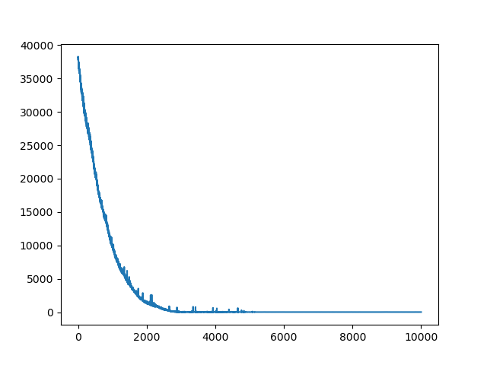
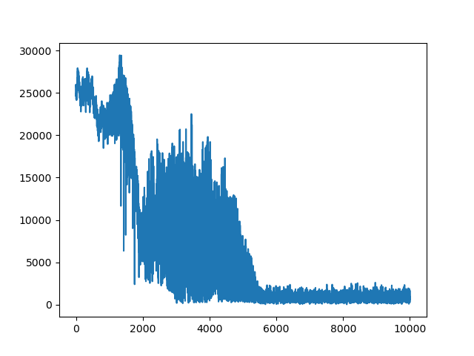
Tucson_renyiElbo_lr 0.001
Min error 50
Min loss 19
Loss (ELBO)
Error

Slide 3
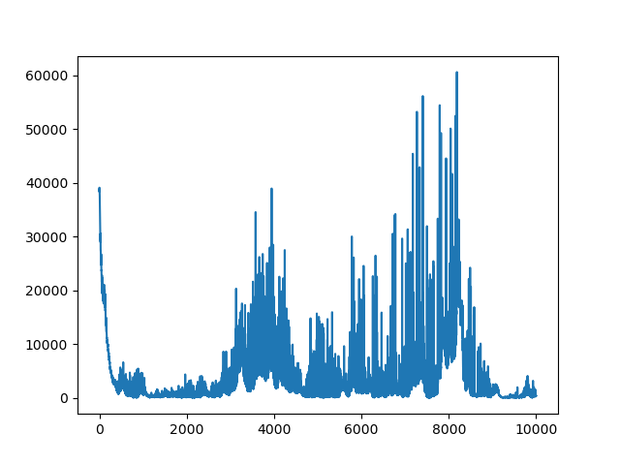
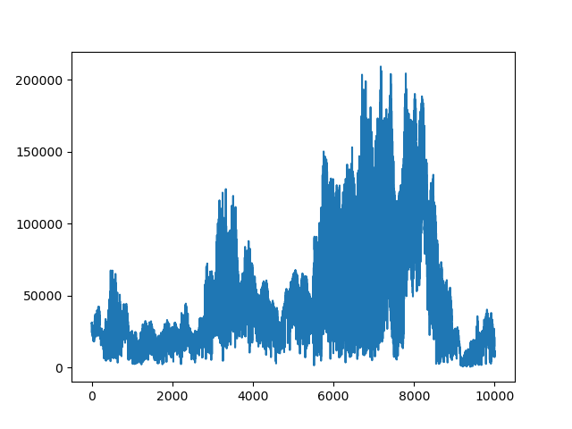
Tucson_renyiElbo_lr 0.1
Min error 600
Min loss 20
Loss (ELBO)
Error

Slide 4
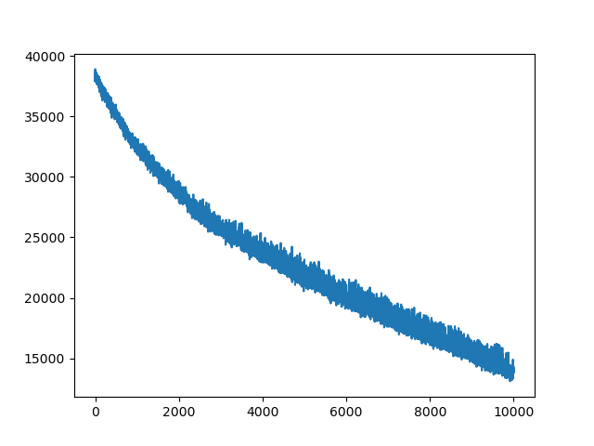
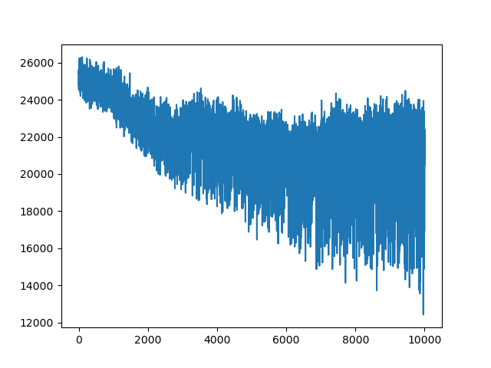
Tucson_renyiElbo_lr 0.0001
Loss (ELBO)
Error

Slide 5
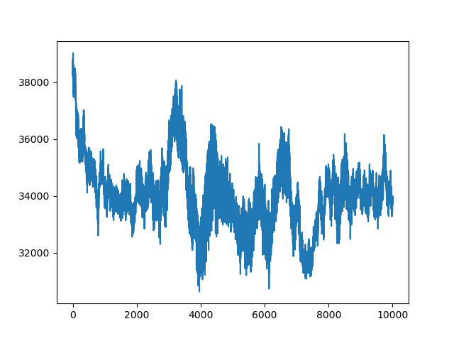
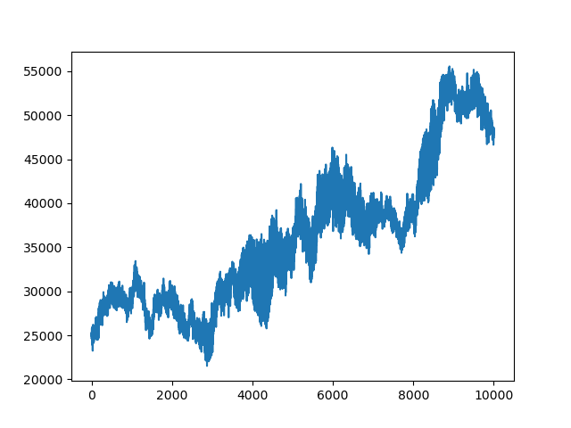
Tucson_traceElbo_lr 0.001
Loss (ELBO)
Error

Slide 6
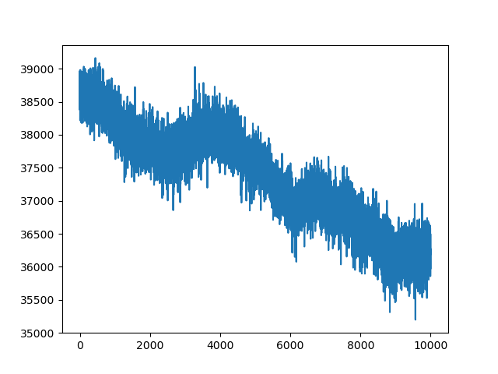
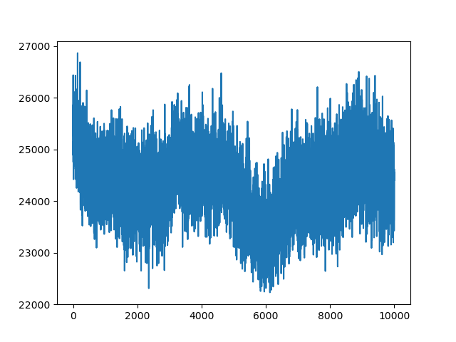
Tucson_traceElbo_lr 0.0001
Loss (ELBO)
Error

Slide 7
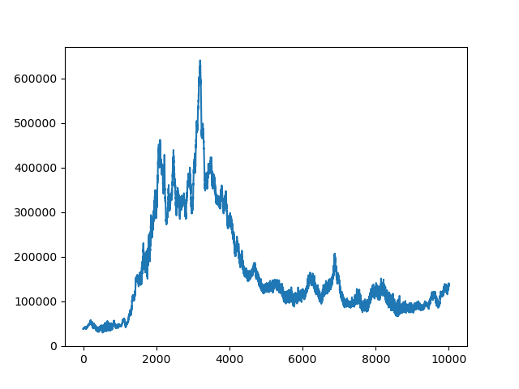
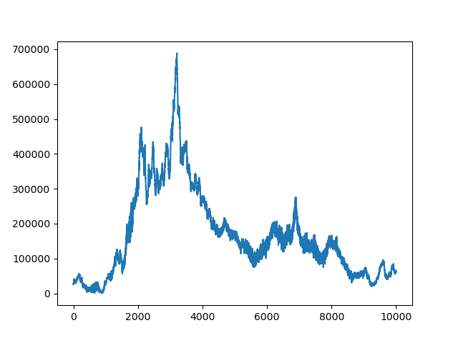
Tucson_traceElbo_lr 0.01
Loss (ELBO)
Error

