Slide 1
Some error and loss tests
Tests for Tucson

Slide 2
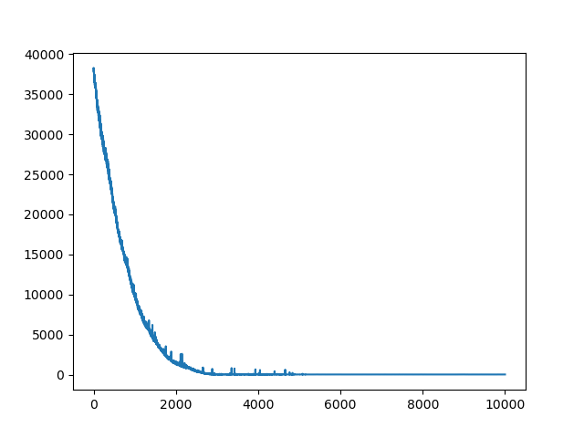
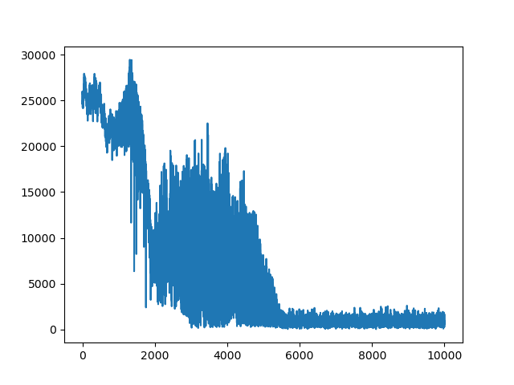
Tucson_renyiElbo_lr 0.001
Min error 50
Min loss 19
Loss (ELBO)
Error

Slide 3
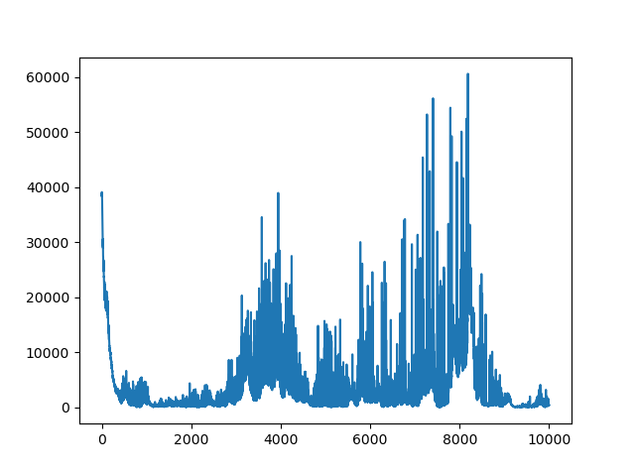
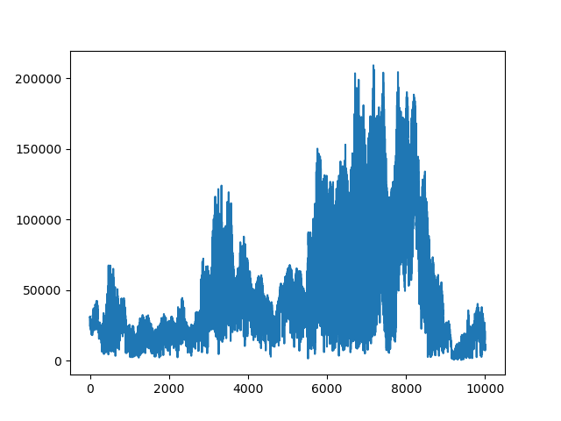
Tucson_renyiElbo_lr 0.1
Min error 600
Min loss 20
Loss (ELBO)
Error

Slide 4
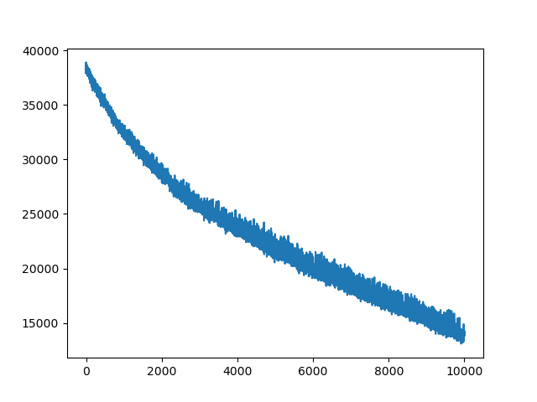
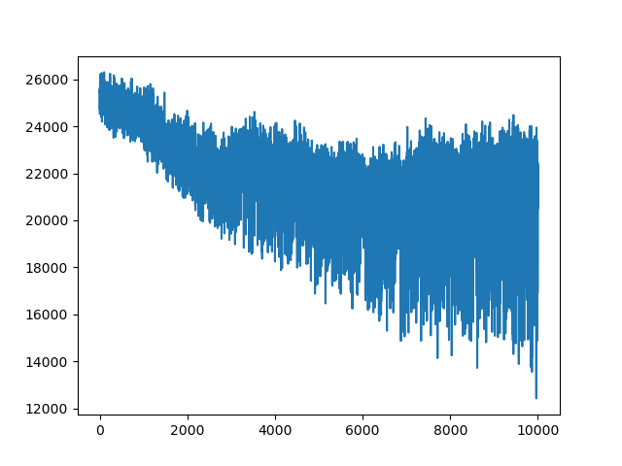
Tucson_renyiElbo_lr 0.0001
Loss (ELBO)
Error

Slide 5
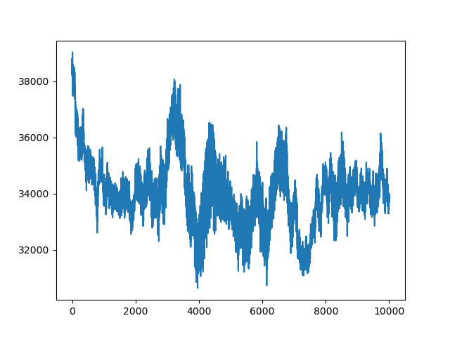
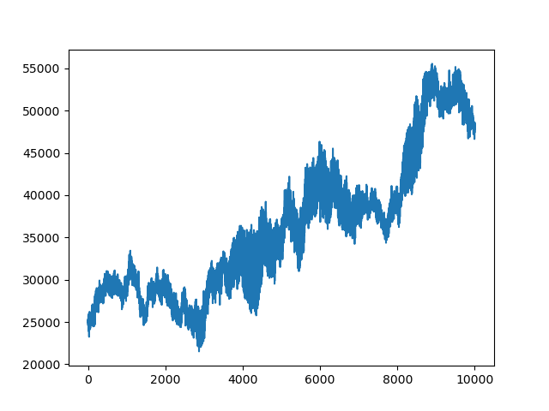
Tucson_traceElbo_lr 0.001
Loss (ELBO)
Error

Slide 6
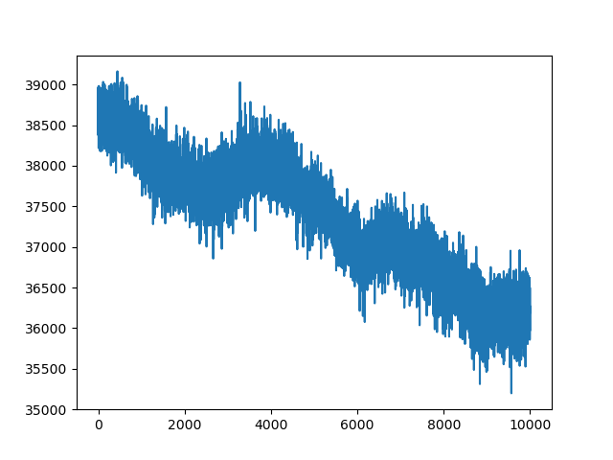
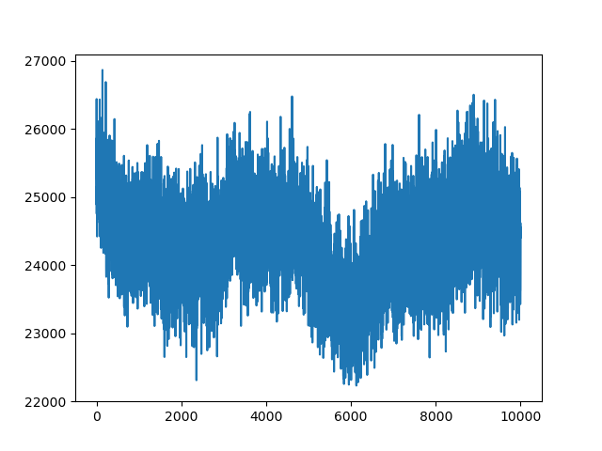
Tucson_traceElbo_lr 0.0001
Loss (ELBO)
Error

Slide 7
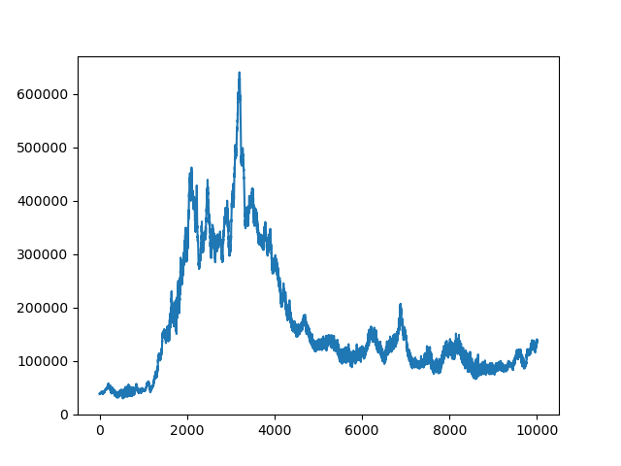
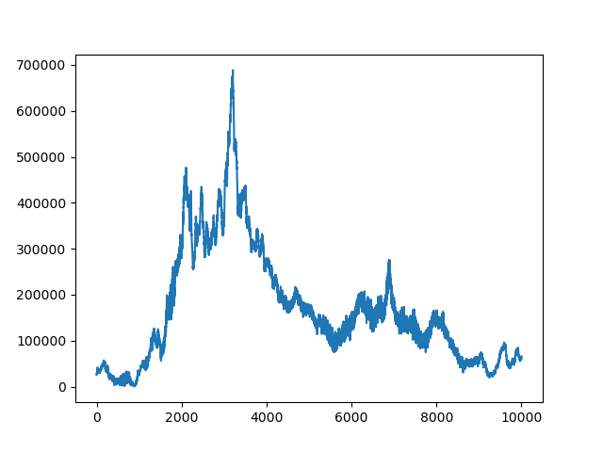
Tucson_traceElbo_lr 0.01
Loss (ELBO)
Error

Slide 8
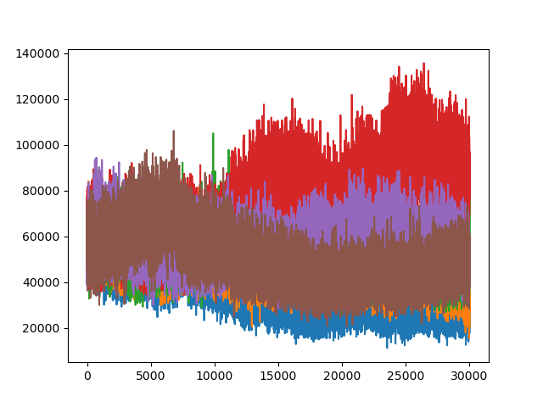
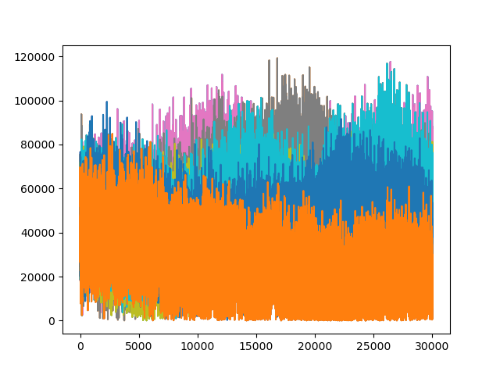
1 particle parallel runs
Tucson_renyiElbo_alpha0.2_lr 0.0008
Loss (ELBO)
Error

Slide 9
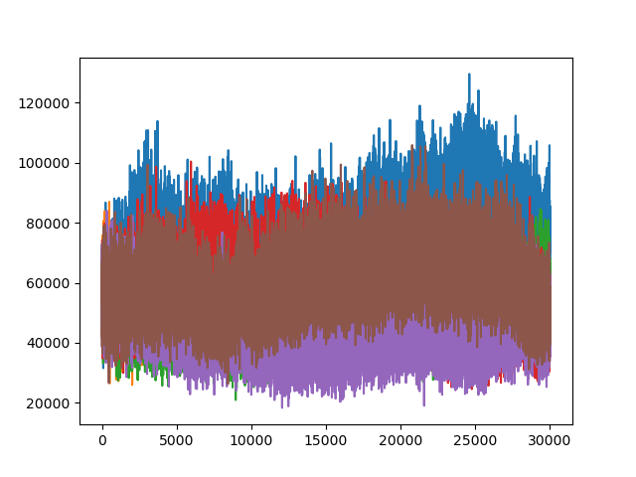
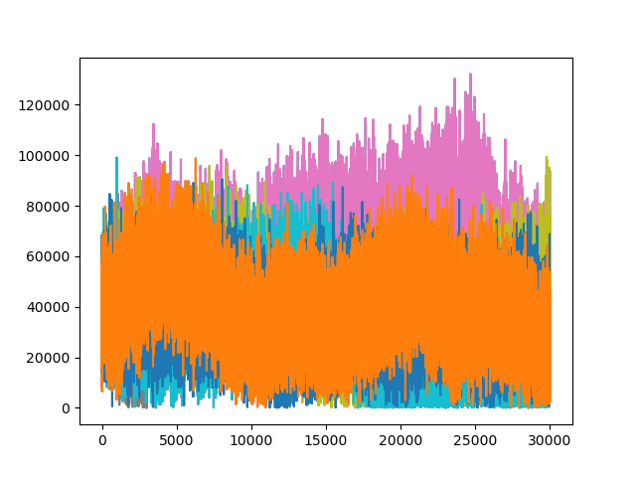
1 particle parallel runs
Tucson_renyiElbo_alpha0.2_lr 0.001
Loss (ELBO)
Error

Slide 10
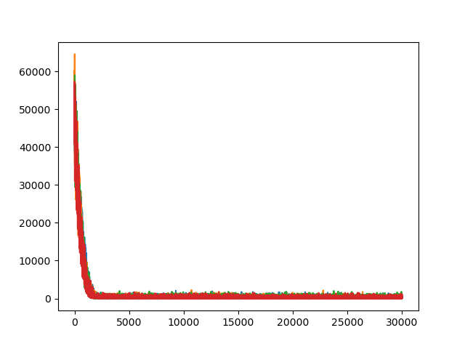
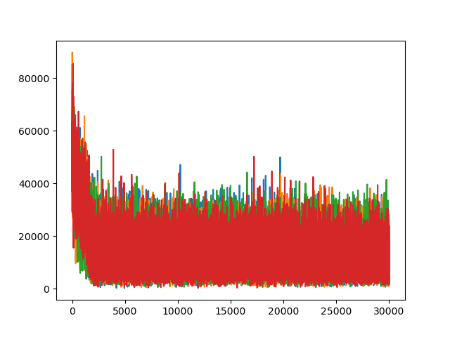
3 particles parallel runs
Tucson_renyiElbo_alpha0.2_lr 0.001
Loss (ELBO)
Error

Slide 11
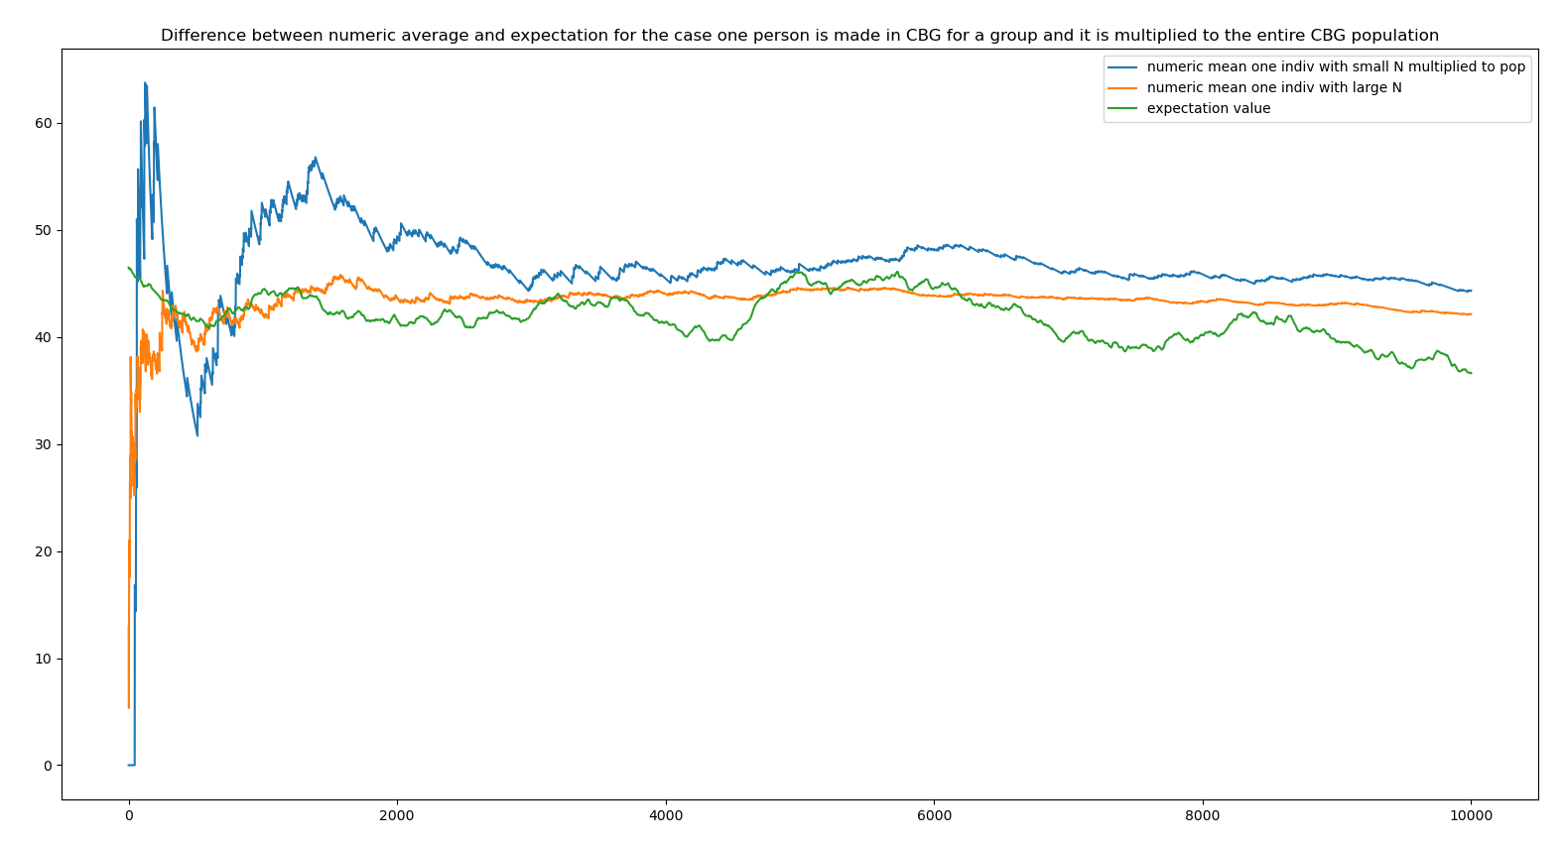
Numeric Expectation vs Analytical Expectation

Slide 12
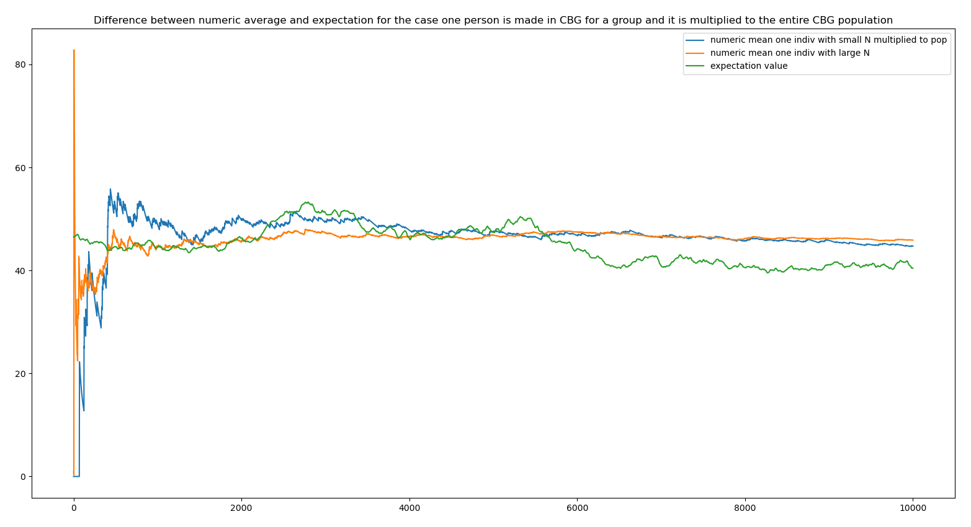
Numeric Expectation vs Analytical Expectation

Slide 13
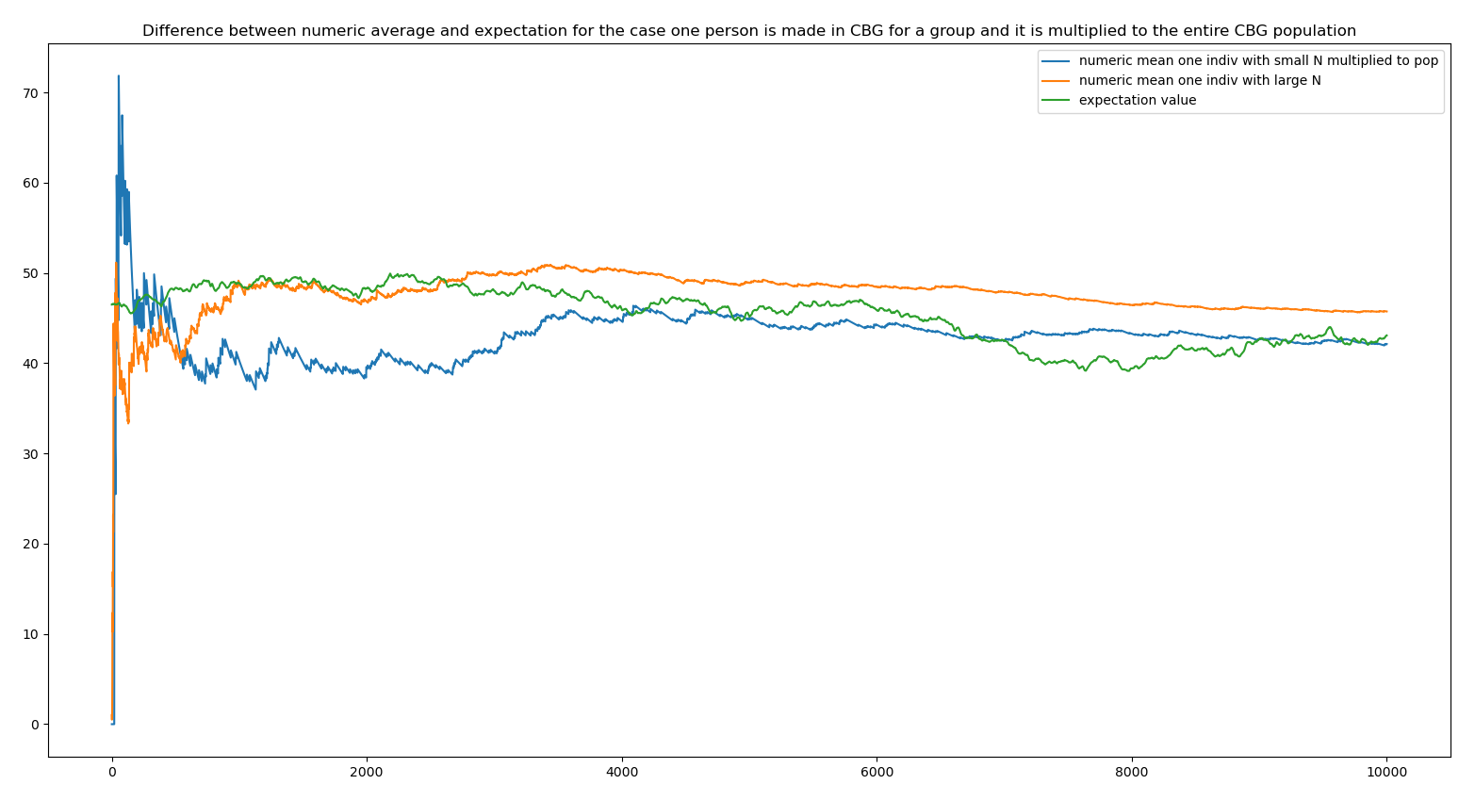
Numeric Expectation vs Analytical Expectation

Slide 14
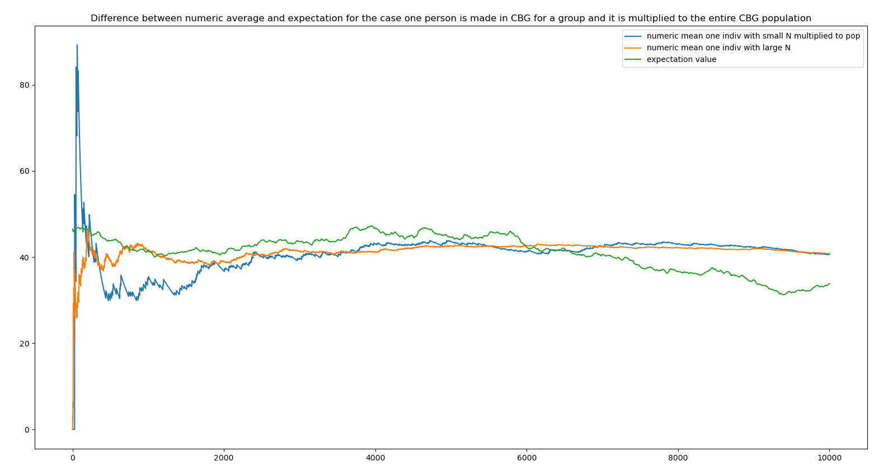
Numeric Expectation vs Analytical Expectation

Slide 15
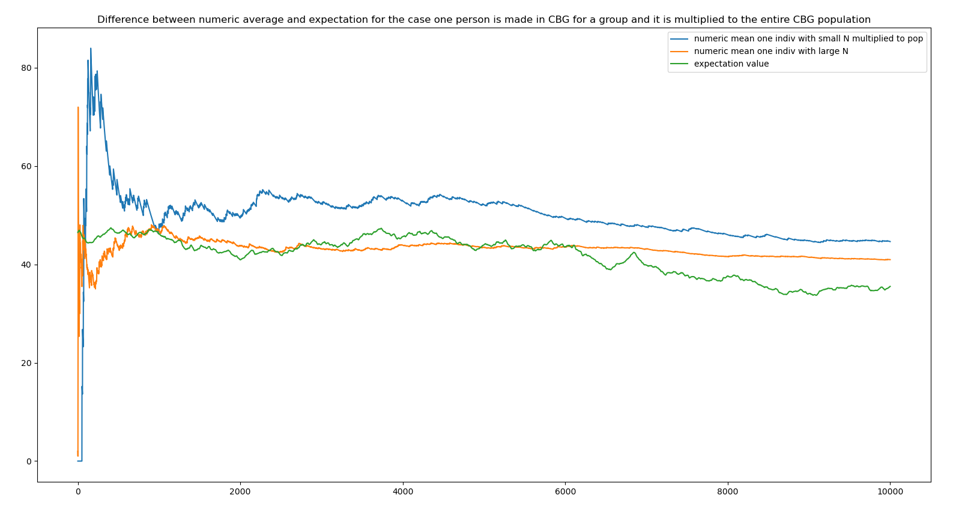
Numeric Expectation vs Analytical Expectation

Slide 16
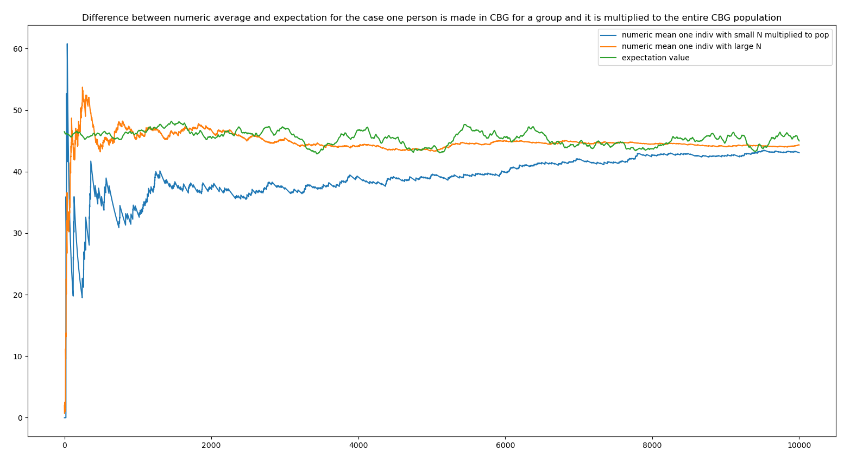
Numeric Expectation vs Analytical Expectation

Slide 17
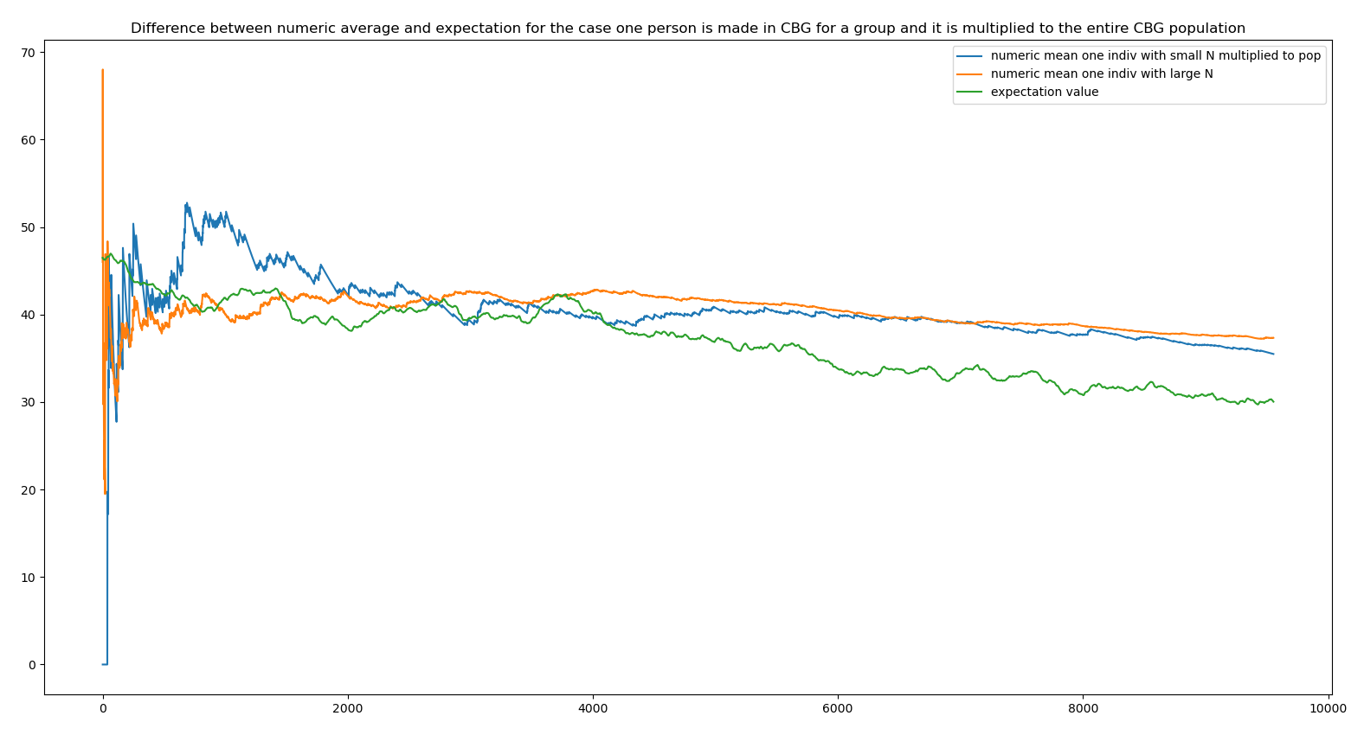
Numeric Expectation vs Analytical Expectation

Slide 18
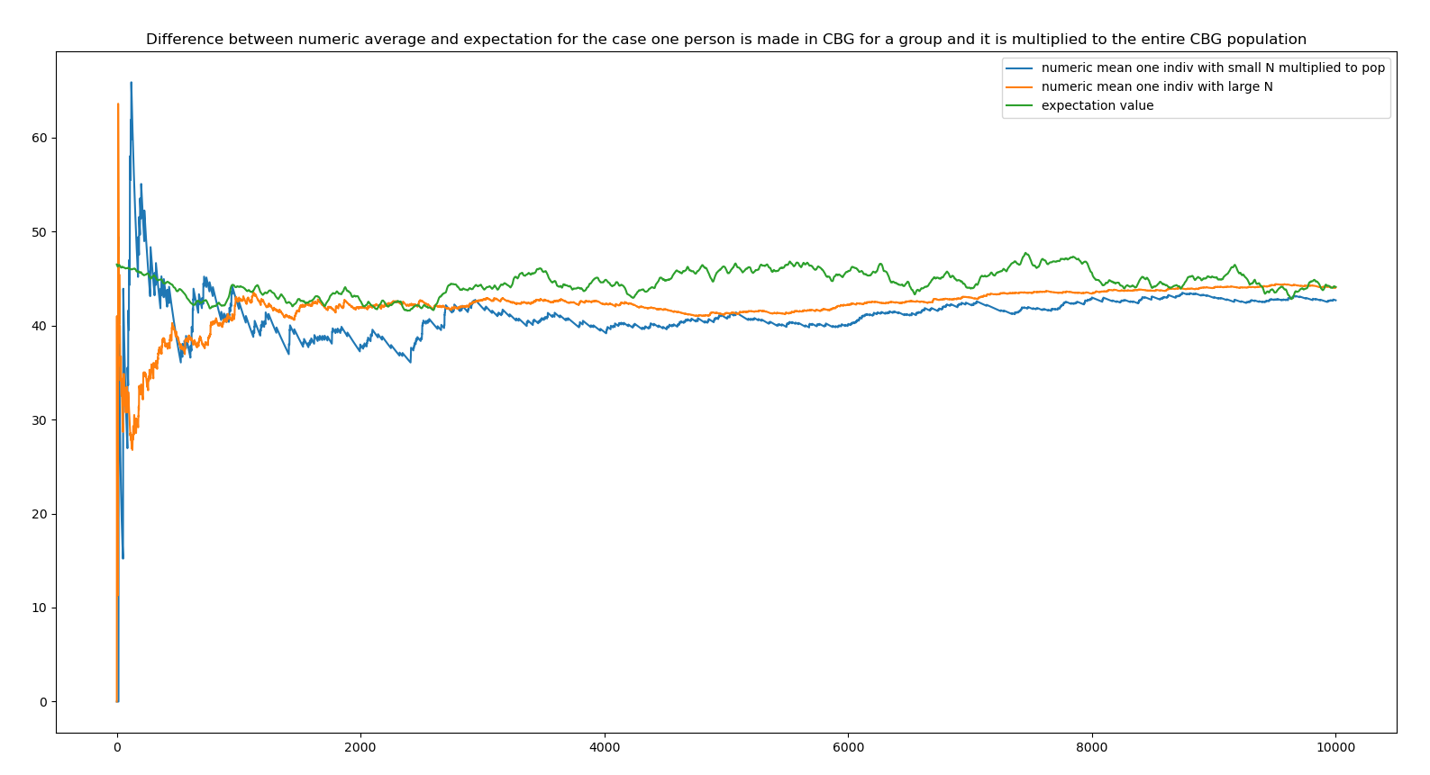
Numeric Expectation vs Analytical Expectation

Slide 19
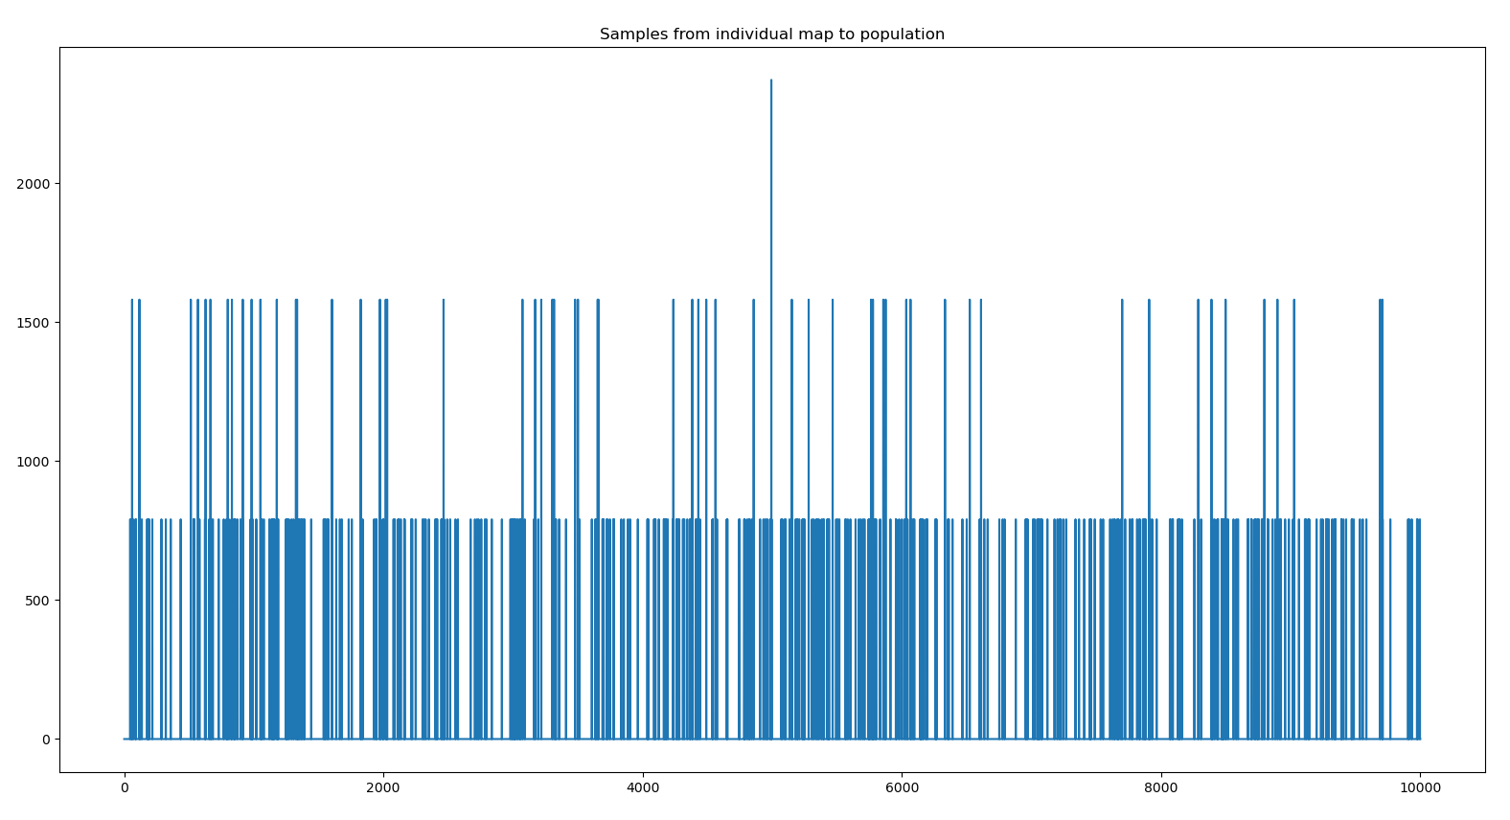
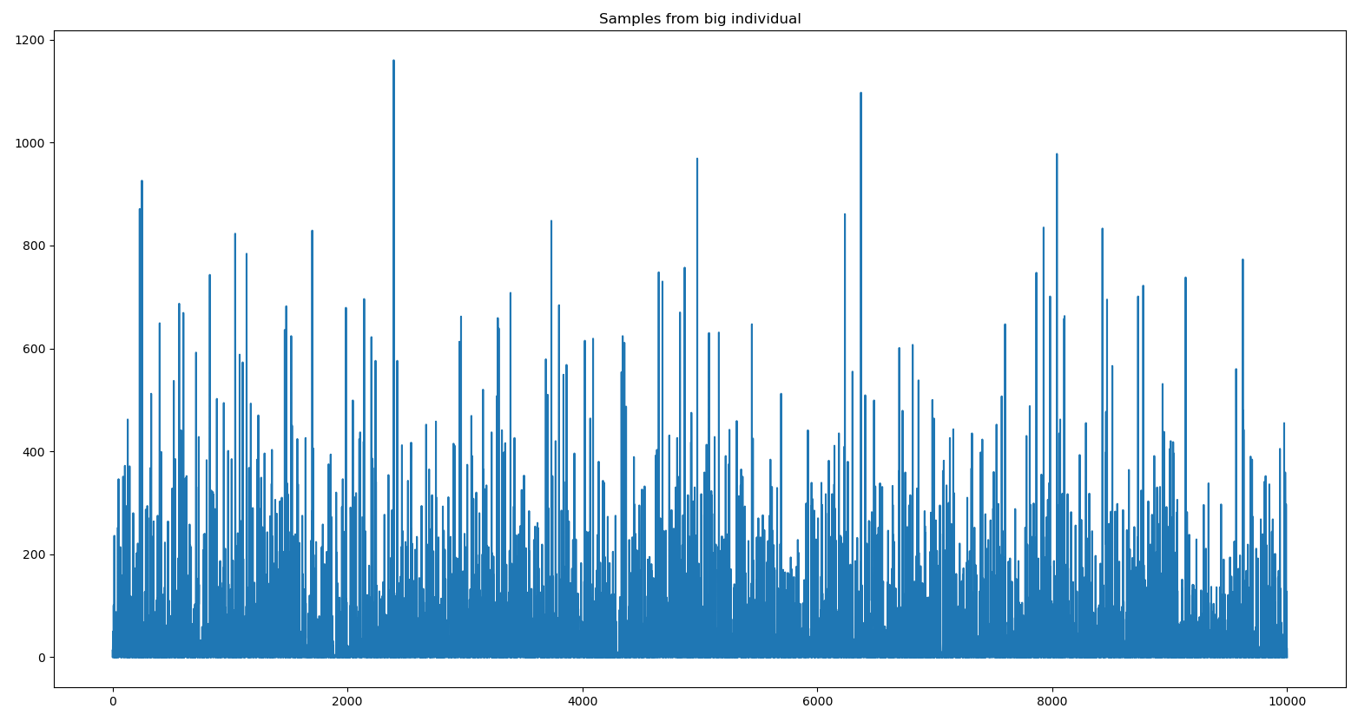
Samples of BetaBinomial
Tucson_renyiElbo_alpha0.2_lr 0.001
Small individual
Big individual

Slide 20
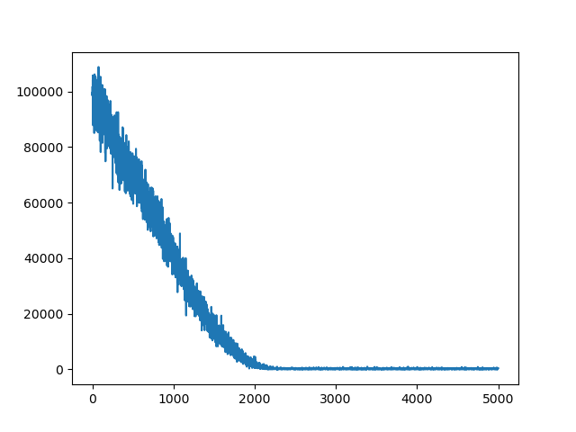
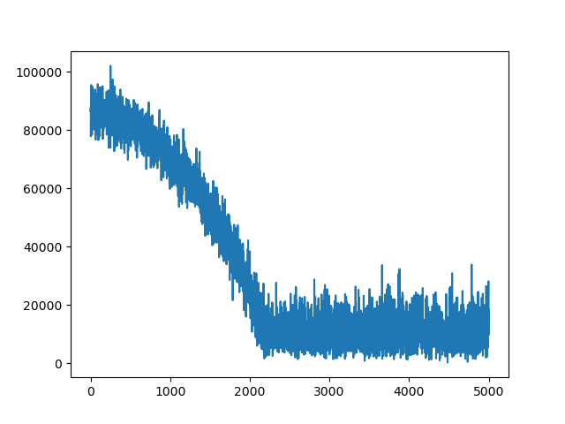
Big individual min error 257
Tucson_renyiElbo_alpha0.2_lr 0.001_3particles (average prior)
Loss (ELBO)
Error

Slide 21
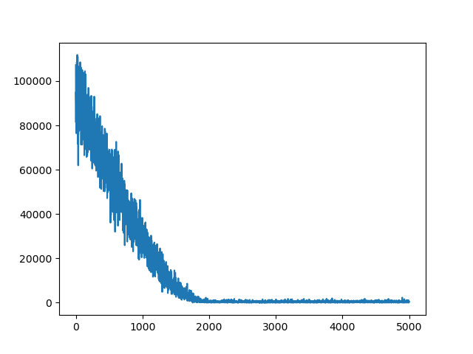
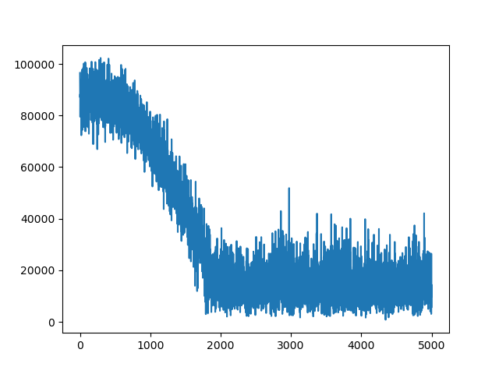
Small individual min error 794
Tucson_renyiElbo_alpha0.2_lr 0.001_3particles
(average prior)
Loss (ELBO)
Error

Slide 22
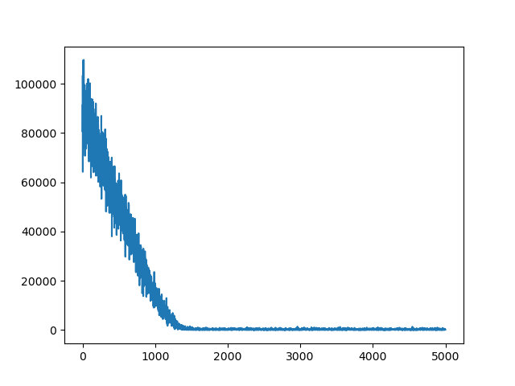
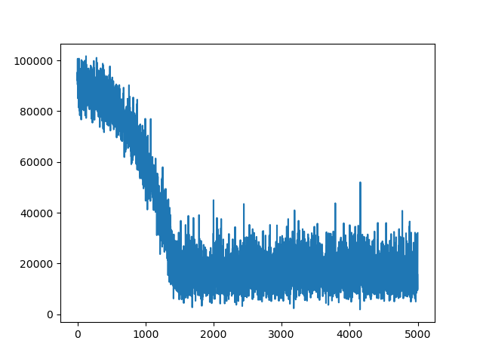
Small individual min error 1608
Tucson_renyiElbo_alpha0.2_lr 0.001_5particles
(average prior)
Loss (ELBO)
Error

Slide 23
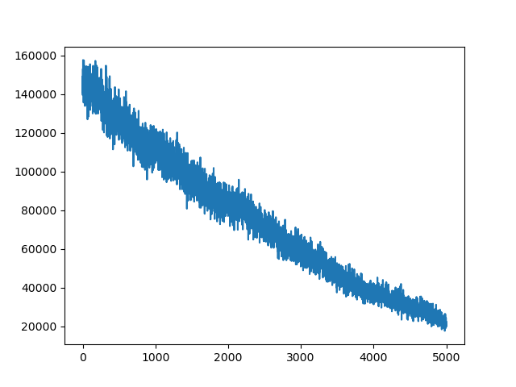
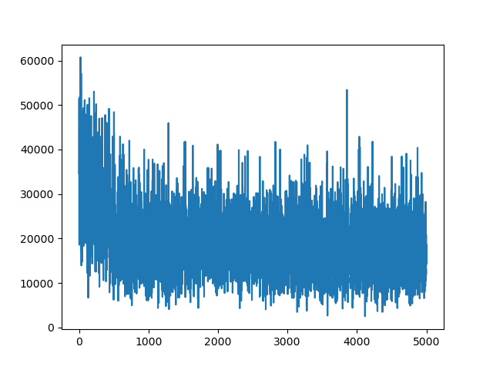
Small individual min error 12200
Tucson_traceElbo_alpha0.2_lr 0.001_3particles
(average prior)
Loss (ELBO)
Error

Slide 24
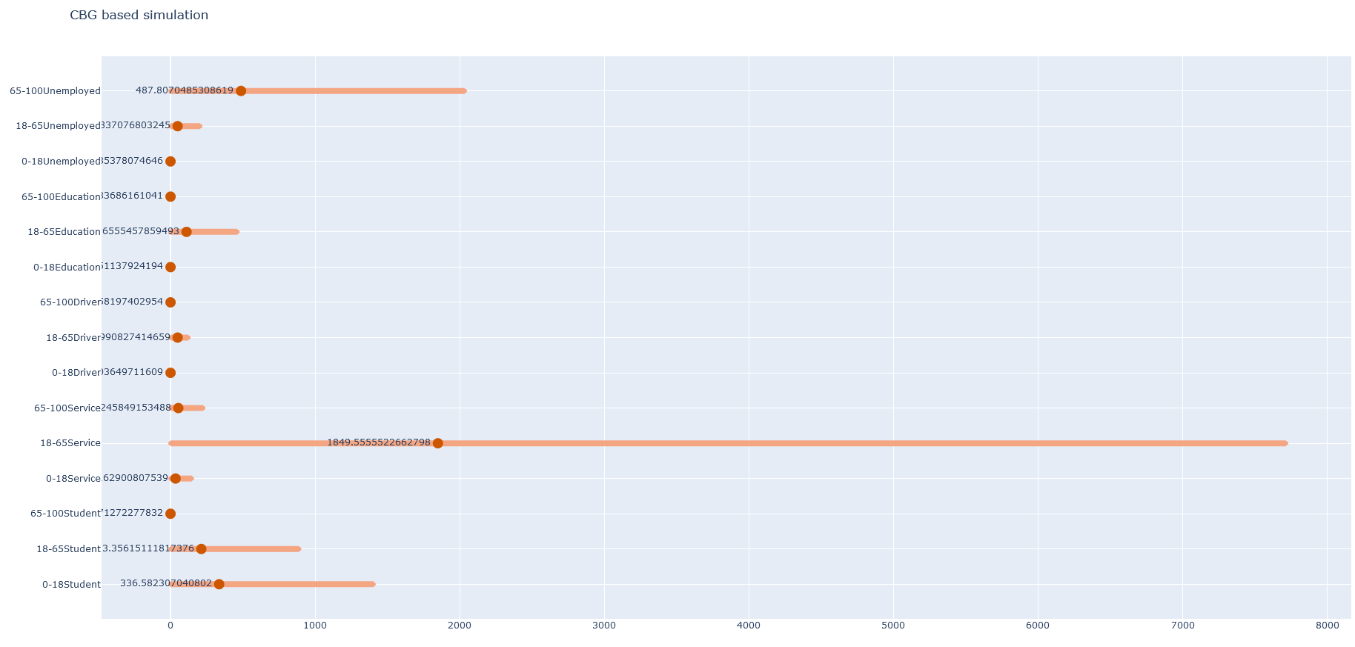

Slide 25
No cross validation

