Slide 1
INFO 656-01 Fall 2022 What is Machine Learning?
Week 1 – Lab
Amir Imani

Slide 2
Initial Setup
Download Anaconda: https://www.anaconda.com/products/individual
Download a text editor: Sublime Text, Atom, etc
Install Git
Create a GitHub account (use your .edu email) https://github.com

Slide 3
python
Libraries
Package management (pip, Env)
Conventions: pep8
Modular
Documentation
Logging
Testing

Slide 4
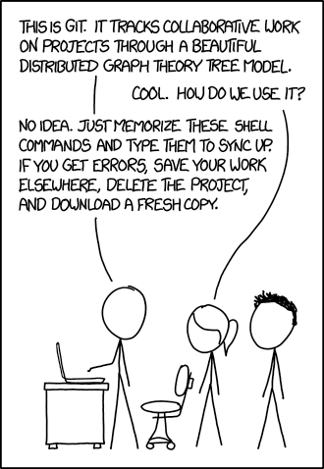
Version Control - Git
Intro to Git

Slide 5
Git
Remember these:
git add <filename>
git commit -m "Commit message”
git push
git pull
git checkout -b <branchname>
git merge <branchname>
Get the cheat sheet here
git init
git status
git config

Slide 6
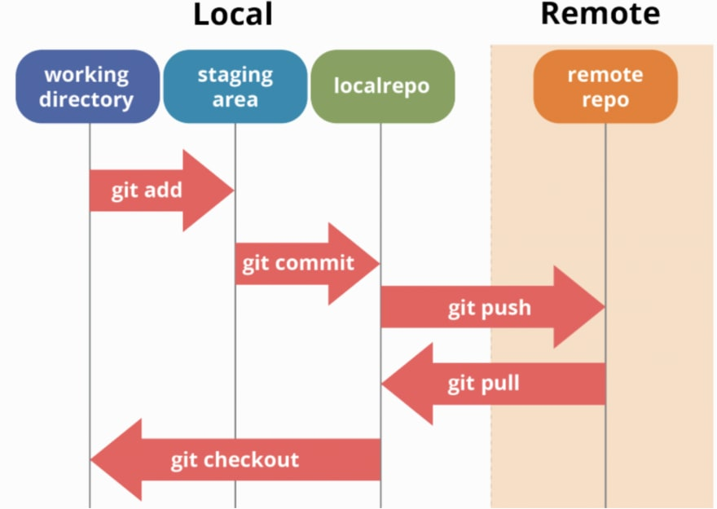
GitHub workflow

Slide 7
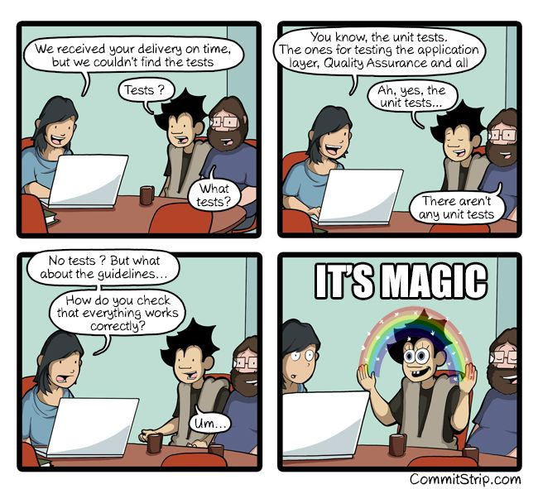
Unit Test

Slide 8
Why Test?
Ensure that code works correctly.
Ensure that changes don’t break anything.
Ensure that bugs are not reintroduced.
Ensure robustness to user errors.
Ensure code is reachable.

