Slide 1
CIFAR-100 Dataset
Haja Amir Rahman
DAAAFT2B06
P2100803

Slide 2
Agenda
01
02
05
03
04
Simple Baseline Model
Exploratory Data Analysis
Resnet50 Architecture
Own Model
Data Augmentation
Notes:
The structure that I covered in Part A is similar to this section aside from the last section regarding the prebuilt architecture that I ran to compare with my own model

Slide 3
01
EDA

Slide 4
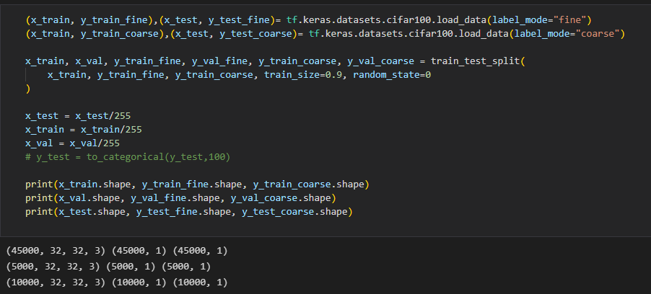
Cifar-100 Dataset
The Cifar-100 dataset consists of 20 labels vs 100 labels
So I loaded 2 versions of y (fine + coarse) that share the same x and extracted the classnames using my own function (from website)
Notes:
For my train test and validation split I decided to split this way because I wanted to apply my models to both coarse and fine labelled data easily. Then I normalized that data so all the data is on the same scale since the data is made of images. So the train data has 45000 data points, the validation data has 5000 data points and the test data has 10000 data points. The input shape for all of them to go into the model is (32, 32, 3)

Slide 5
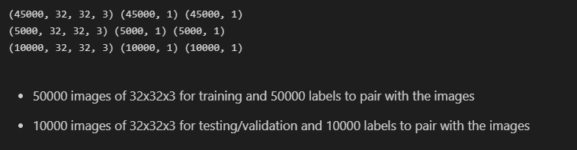
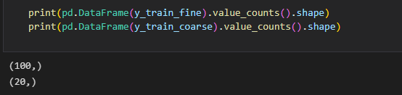
Information about dataset
Notes:
As we can see the coarse labels were derived from cifar 20 and the fine labels will derived from cifar 100

Slide 6
02
Simple Baseline Model

Slide 7
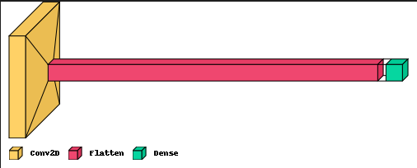
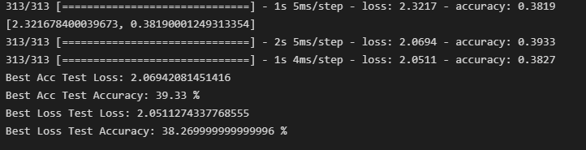
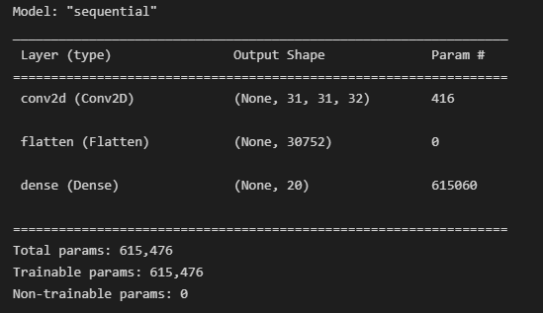
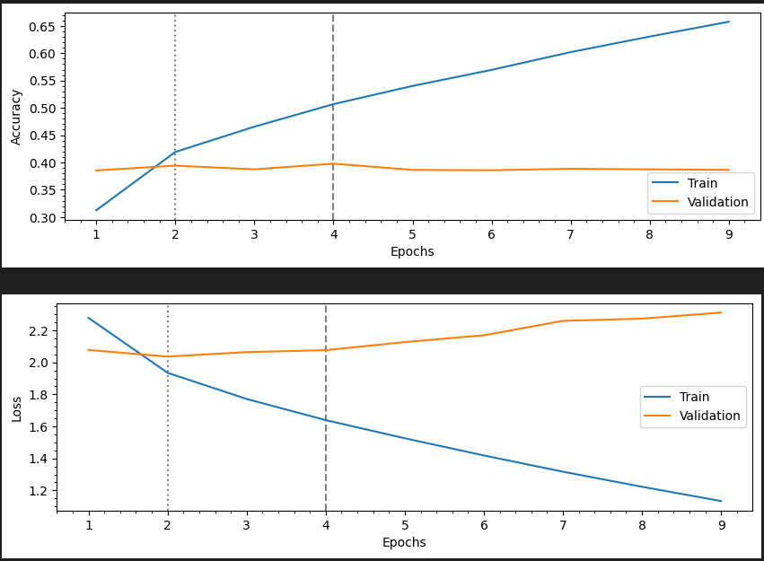
Architecture summary and visual
Notes:
These are the architecture and evaluation results of the baseline model which is simply made up of 1 convolutional, 1 flatten and 1 dense layer. It achieved a test accuracy of 39.33%

Slide 8
03
Own Model

Slide 9
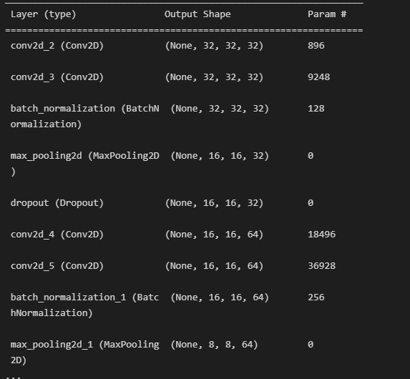
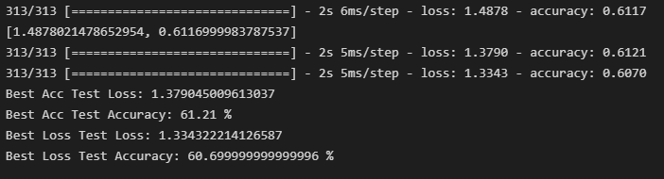
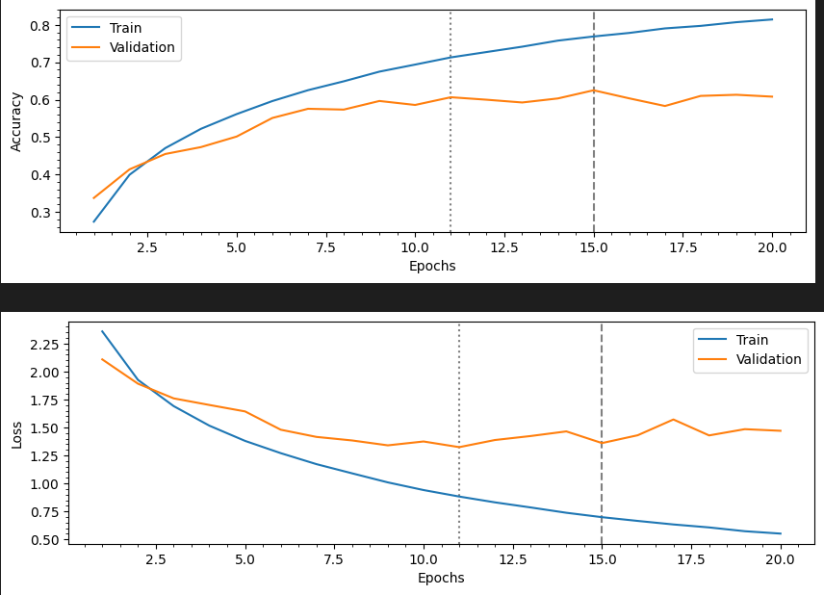
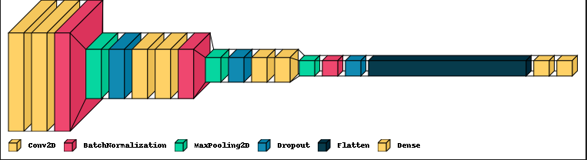
Own Model Architecture and Evaluation
Notes:
These are the architecture and evaluation results for my own model. It is made up of 6 convolutional layers, 3 batch normalization layers for regularization, 3 max pooling layers to shrink the data thrice, 3 dropout layers due to the regularization, followed by 2 flatten and 2 dense layers. The test accuracy achieved was 61.21 though I had re-run after submission and gotten a higher accuracy of 62.19%.

Slide 10
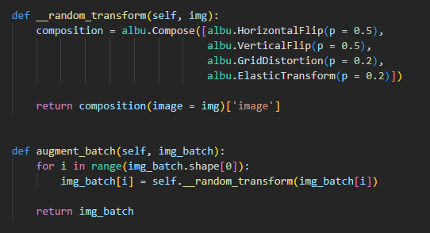
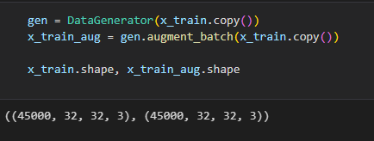
Data Augmentation
I created a custom class called Data Generator in which I created a function called random transform and augment batch.
The random transform function consists of the 4 different augmentation methods mentioned and the augment batch function is the execution function
Notes:
For data augmentation, I essentially quadrupled the data by applying horizontal and vertical flip + grid distortion and elastic transform. I then used the data generator function to generate the data and assigned that to the augment batch function which I used as the executed function

Slide 11
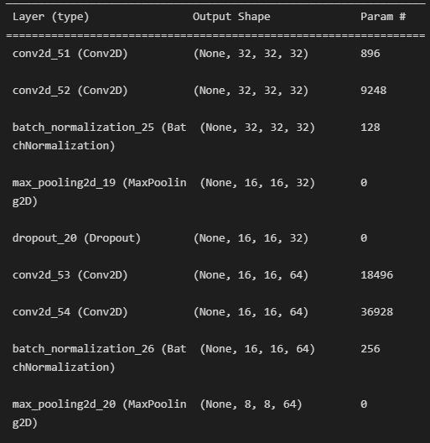
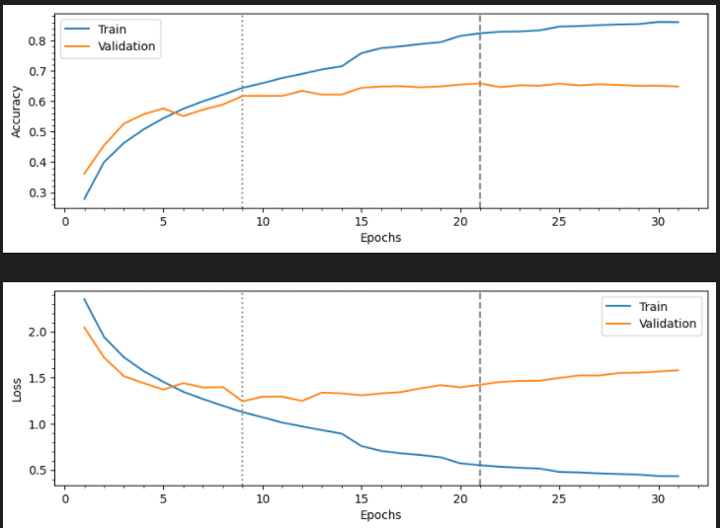

Own Coarse label model fit with augmented data
The highest test accuracy achieved for this model is 67% but I re-ran the model so the accuracy decreased to 66.43%
Notes:
My own model fitted with coarse labelled training and validation data after augmentation was applied performed quite well achieving a test accuracy of 66.43%. As I said, I managed to hit 67% but accidentally re-ran the model and lost the best weight. I decided not to present the results of my own model fitted with fine labelled augmented data as the results were quite poor but the test accuracy achieved for my own fine labelled and augmented model was 53.26%

Slide 12
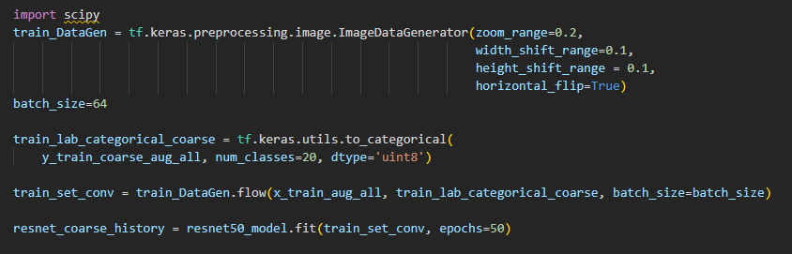
Resnet50 Architecture for coarse labels
Test Accuracy of 45.54% and loss of 0.1942
Notes:
This is the Resnet50 architecture I tried with my augmented data for both coarse and fine labels but I am only presenting the coarse label fitted model as the fine label fitted one did not perform well and took very long to run. Due to there being 5 blocks of layers, I decided to use the Image Data Generator on top of the already augmented data to fit the model as the layers made the model quite deep so I thought more data would help. The highest test accuracy achieved was 45.4% and loss of 0.1942. Evidently this architecture performed worse than my other own models but better than my baseline model. I personally think that the reason is because I did not run it for long enough given the amount of data fitted and the number of layers.

Slide 13
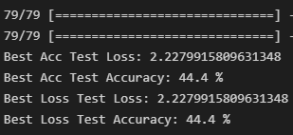
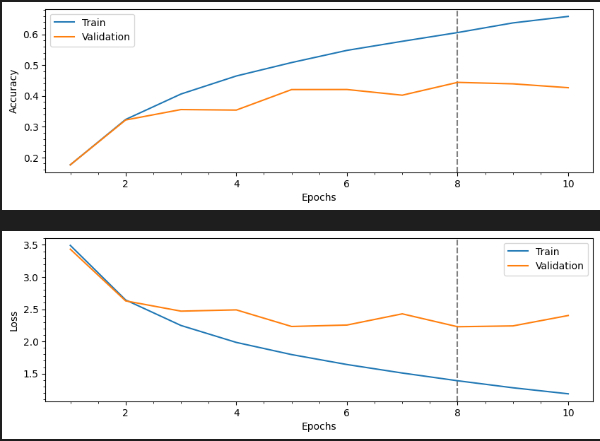
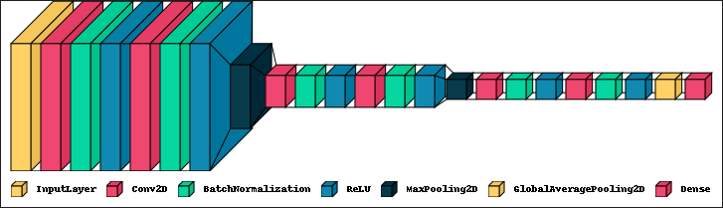
General Model
I tried a different architecture of my own but decided not to use it as my main model as it performed quite poorly. I tried using a custom function involving Progressive Dropout and Random Augmentation. I also made use of Keras efficientnet v2 to import the augment library
Notes:
This is another general model I tried with a slightly different architecture just to compare again the resnet50 architecture and it actually performed almost as well reaching a data accuracy of 44.4%. This model was built on a custom progressive dropout function and random augmentation. I used keras efficientnet v2 module to import the augment library necessary for augmented the data that was fit into this model

Slide 14
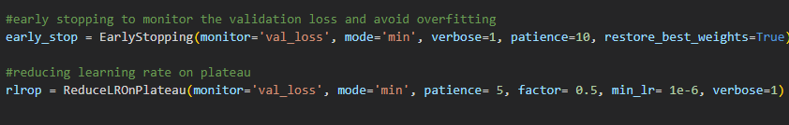
Conclusion
After running all these models, I can conclude that my Own Model with Data Augmentation and extra parameters fit with the coarse labels performed the best, achieving a test accuracy score of over 65%
Furthermore, to achieve efficiency while running my models, I made use of tensorflow keras model checkpoint function to monitor the best weights that give the maximum validation accuracy while fitting the model and saved those weights. Then for the model evaluation, I load those weights from with checkpoints for evaluation so that the evaluation result for Test Accuracy and Loss are the most accurate for all the models.
Notes:
I can conclude after running all these models that my own coarse label fitted model with augmentation performed the best achieving an accuracy of 66%. I used model checkpoint function just like in part A to collect the best weight after monitoring for max validation accuracy. The screenshot shows the parameters I used in callbacks when fitting the model to ensure efficiency. I used a patience of 10, monitoring for the minimum validation loss for early stopping and patience of 5 and monitoring the same thing with ReduceLRonPlateau callback.

Slide 15
Thanks!
Notes:
Thank you

