Slide 1
CIFAR-100 Dataset
Haja Amir Rahman
DAAAFT2B06
P2100803

Slide 2
Agenda
01
02
05
03
04
Simple Baseline Model
Exploratory Data Analysis
Here you could describe the topic of the section
Resnet50 Architecture
Own Model
Data Augmentation
Here you could describe the topic of the section
Here you could describe the topic of the section

Slide 3
01
EDA

Slide 4
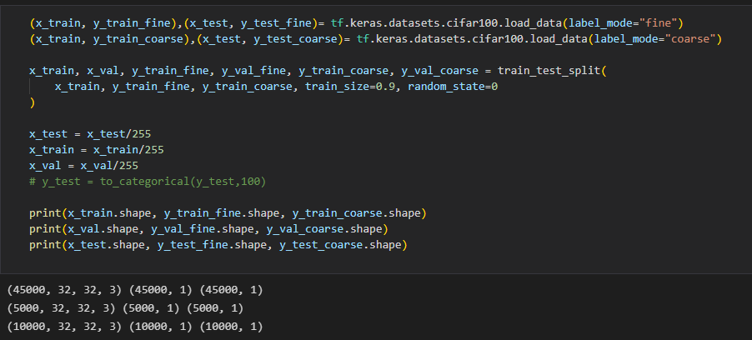
Cifar-100 Dataset
The Cifar-100 dataset consists of 20 labels vs 100 labels
So I loaded 2 versions of y (fine + coarse) that share the same x and extracted the classnames using my own function (from website)

Slide 5
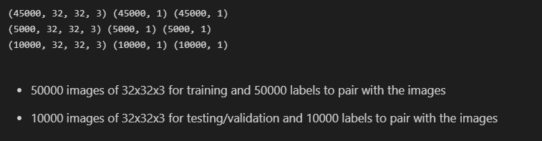
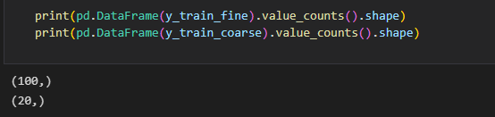
Information about dataset

Slide 6
02
Simple Baseline Model

Slide 7
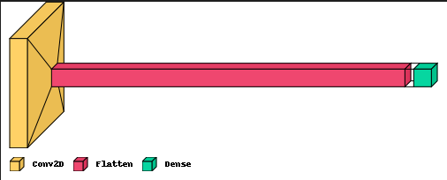
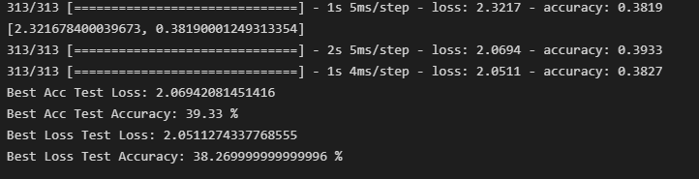
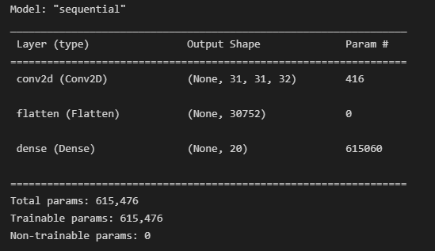
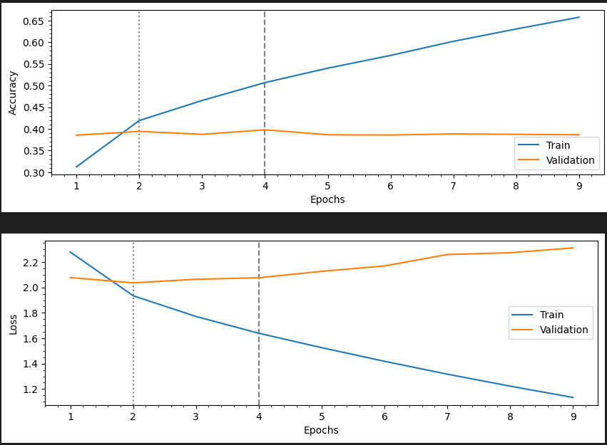
Architecture summary and visual

Slide 8
03
Own Model

Slide 9
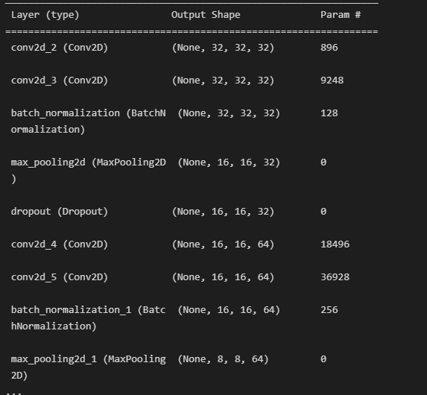
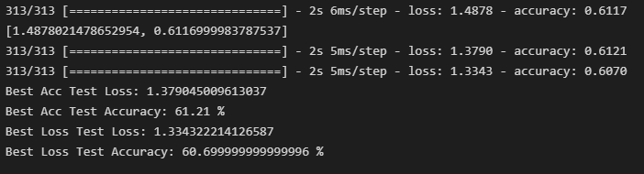
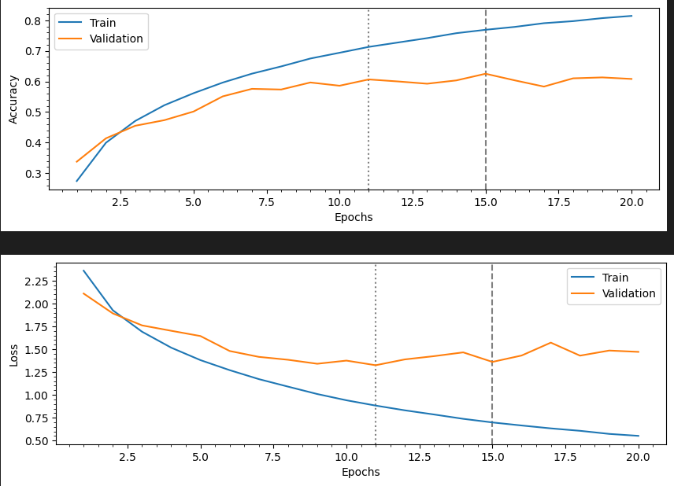
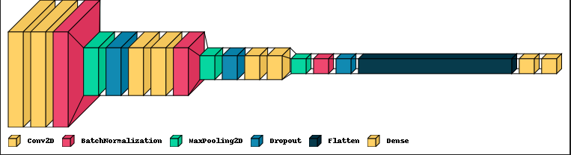
Own Model architecture

Slide 10
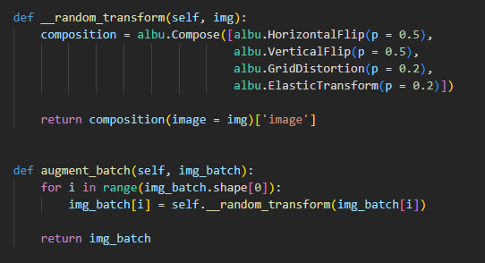
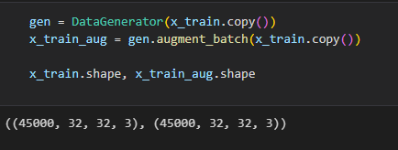
Data Augmentation
I created a custom class called Data Generator in which I created a function called random transform and augment batch.
The random transform function consists of the 4 different augmentation methods mentioned and the augment batch function is the execution function

Slide 11
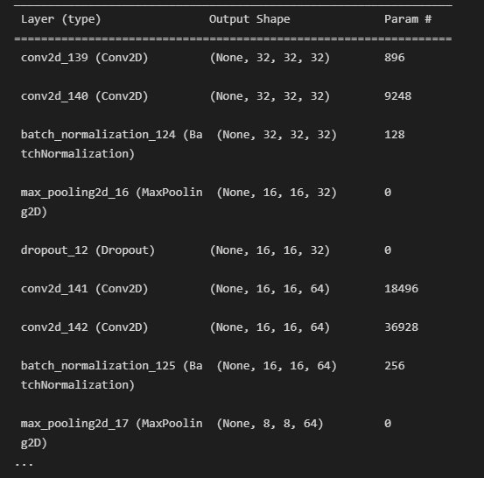
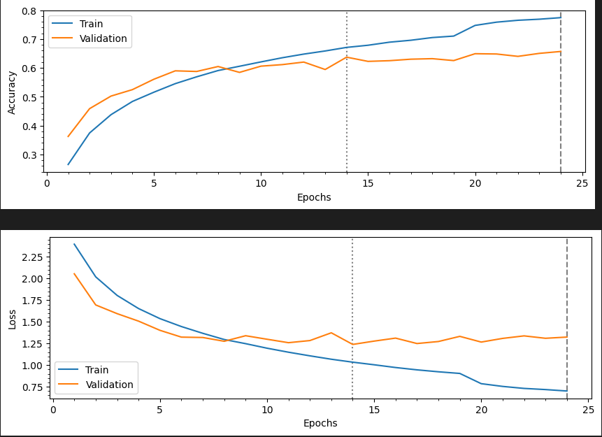
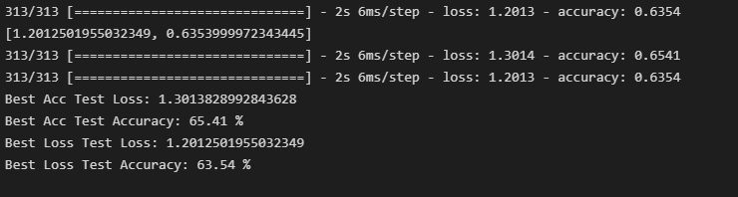
Own Coarse label model fit with augmented data
The highest test accuracy achieved for this model is 67% but I re-ran the model so the accuracy decreased to 65%

Slide 12
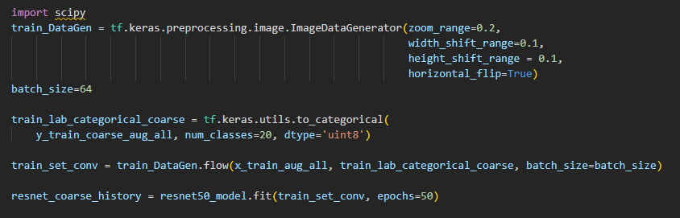
Resnet50 Architecture for coarse labels
Test Accuracy of 45.54% and loss of 19.42%

Slide 13
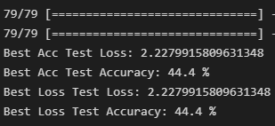
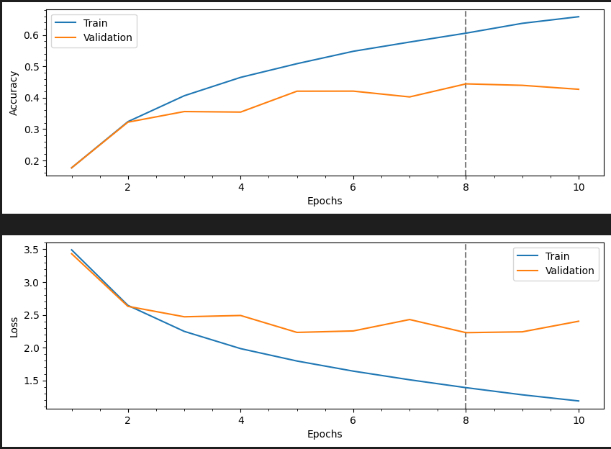
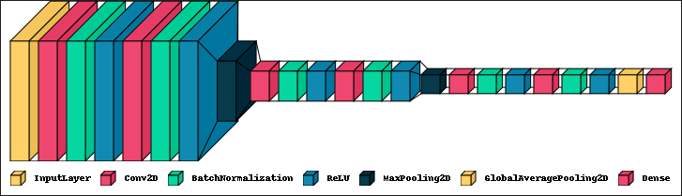
General Model
I tried a different architecture of my own but decided not to use it as my main model as it performed quite poorly. I tried using a custom function involving Progressive Dropout and Random Augmentation. I also made use of Keras efficientnet v2 to import the augment library

Slide 14
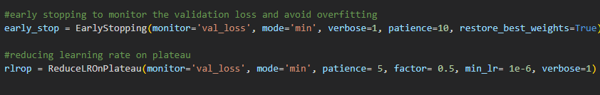
Conclusion
After running all these models, I can conclude that my Own Model with Data Augmentation and extra parameters fit with the coarse labels performed the best, achieving a test accuracy score of over 65%
Furthermore, to achieve efficiency while running my models, I made use of tensorflow keras model checkpoint function to monitor the best weights that give the maximum validation accuracy while fitting the model and saved those weights. Then for the model evaluation, I load those weights from with checkpoints for evaluation so that the evaluation result for Test Accuracy and Loss are the most accurate for all the models.

Slide 15
Thanks!
Do you have any questions?
youremail@freepik.com
+91 620 421 838
yourcompany.com
Please keep this slide for attribution.

