Slide 1
CIFAR-100 Dataset
Haja Amir Rahman
DAAAFT2B06
P2100803

Slide 2
Agenda
01
02
05
03
04
Simple Baseline Model
Exploratory Data Analysis
Here you could describe the topic of the section
Resnet50 Architecture
Own Model
Data Augmentation
Here you could describe the topic of the section
Here you could describe the topic of the section

Slide 3
01
Project Schedule
You can enter a subtitle here if you need it

Slide 4
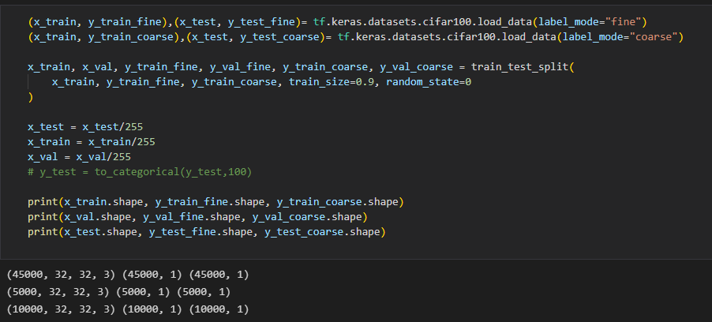
Cifar-100 Dataset
The Cifar-100 dataset consists of 20 labels vs 100 labels
So I loaded 2 versions of y (fine + coarse) that share the same x and extracted the classnames using my own function (from website)

Slide 5
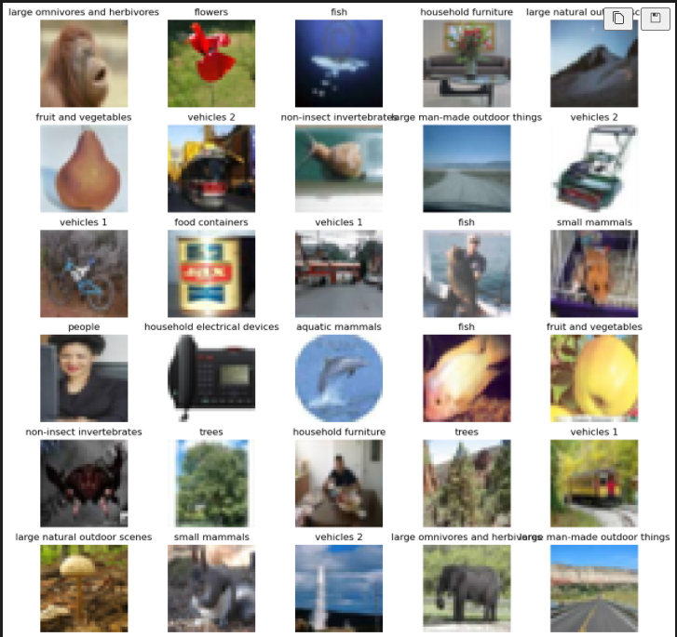
Images in dataset
Venus has a beautiful name and is the second planet from the Sun. It’s terribly hot—even hotter than Mercury—and its atmosphere is extremely poisonous

Slide 6
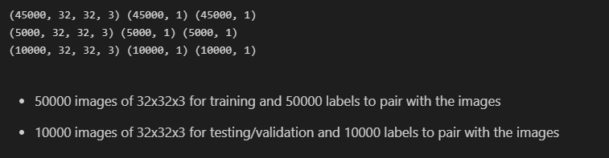
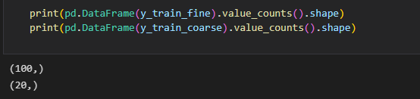
Information about dataset

Slide 7
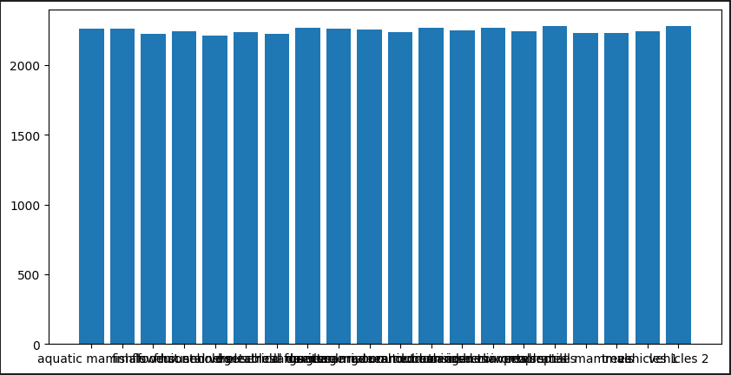
Coarse Labels
There are about 200+ images per class for course labels

Slide 8
02
Simple Baseline Model

Slide 9
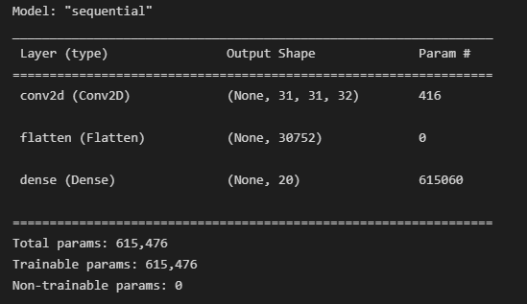
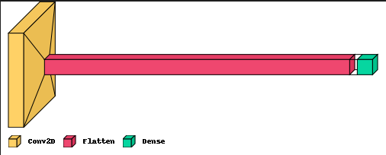
Architecture summary and visual

Slide 10
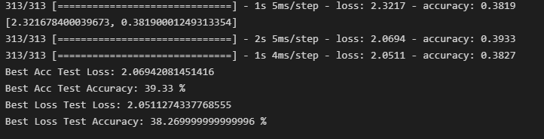
Simple Baseline performance
Accuracy and Loss: 39.33% and 38.27% respectively

Slide 11
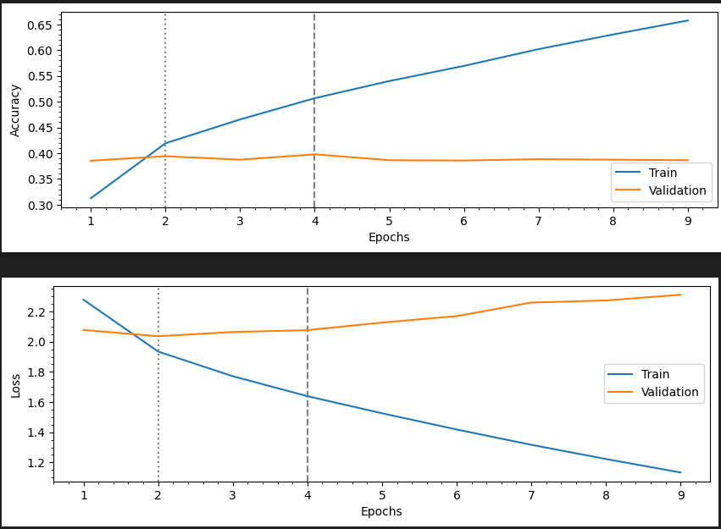
Plot of accuracy and loss for training and validation respectively

Slide 12
03
Own Model

Slide 13
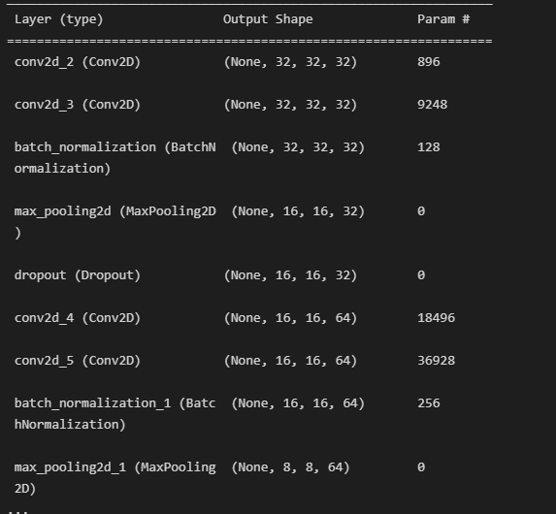
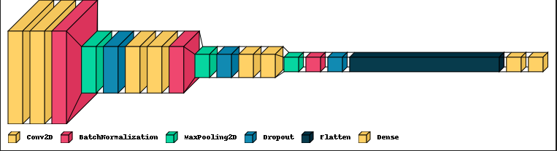
Own Model architecture

Slide 14
Where we are
Where we want to be
Mercury is the closest planet to the Sun and the smallest one in the Solar System—it’s larger than the Moon
Venus has a beautiful name and is the second planet from the Sun. It’s terribly hot, even hotter than Mercury

Slide 15
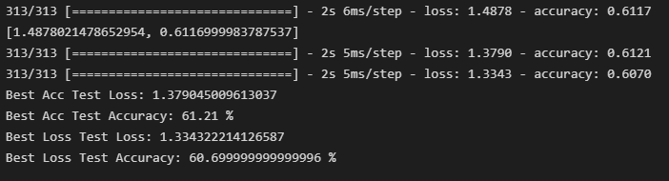
Own Model evaluation
Accuracy and Loss: 61.21% and 60.7% respectively

Slide 16
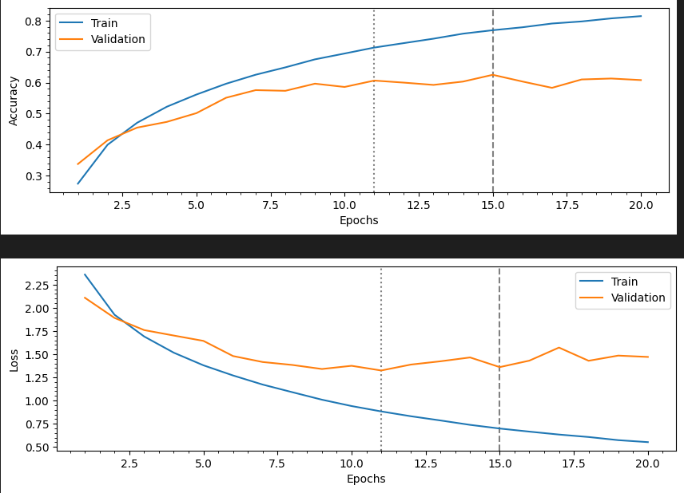
Plot of accuracy and loss for training and validation respectively

Slide 17
Data Augmentation
albumentations library
- random horizontal flip
- vertical flip
- grid distortion
- elastic transform
normal vs augmented
x_train_augmented_all → normal x_train + x_train_aug
y_train_coarse_aug_all
y_train_fine_aug_all

Slide 18
Data Augmentation with albumentations library
Random Horizontal Flip
Vertical Flip
Grid Distortion
Elastic Transform

Slide 19
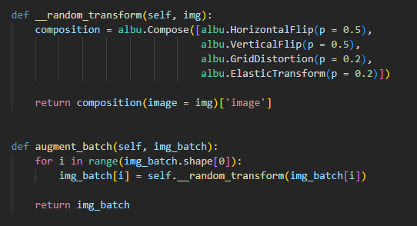
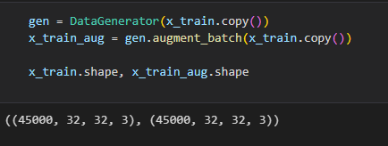
Augmentation of data
I created a custom class called Data Generator in which I created a function called random transform and augment batch.
The random transform function consists of the 4 different augmentation methods mentioned and the augment batch function is the execution function

Slide 20
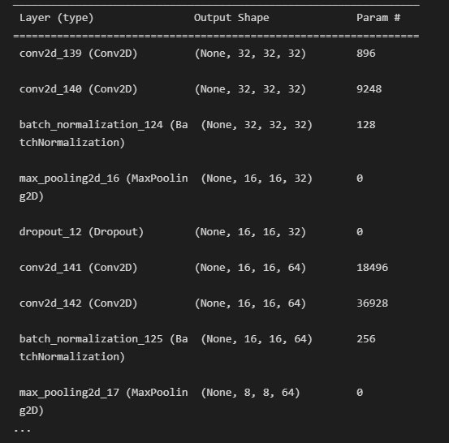
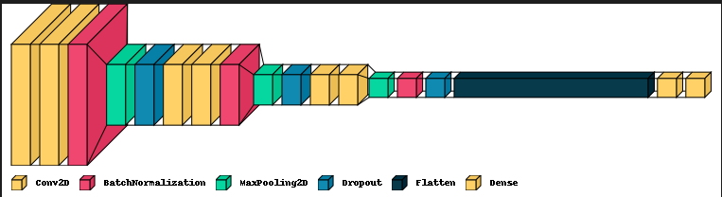
Own Coarse label model fit with augmented data

Slide 21
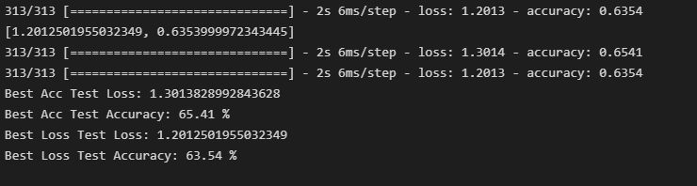
Own Coarse Augmented Model Evaluation
The highest test accuracy achieved for this model is 67% but I re-ran the model so the accuracy decreased to 65%

Slide 22
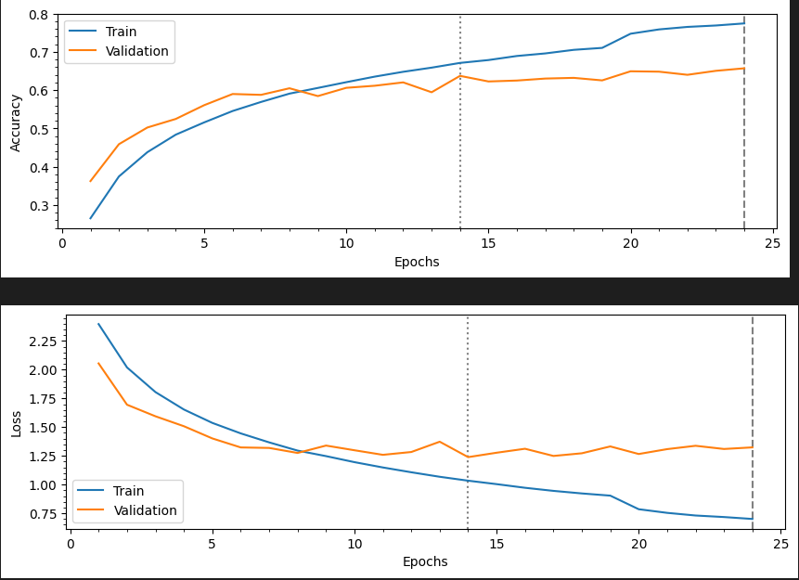
Plot of accuracy and loss for training and validation respectively

Slide 23
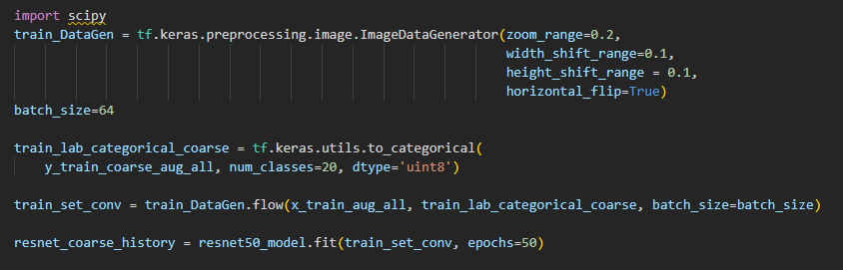
Resnet50 Architecture for coarse labels
Test Accuracy of 45.54% and loss of 19.42%

Slide 24
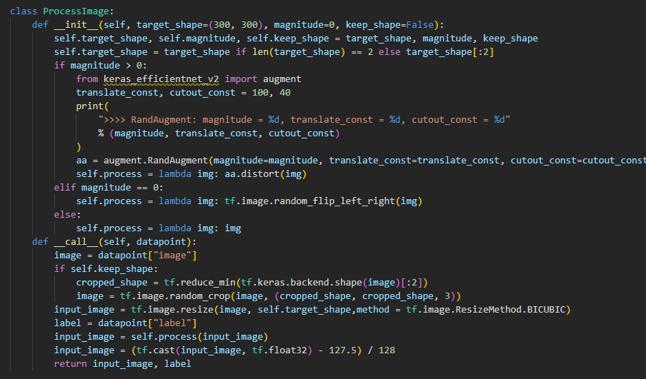
General Model
I tried a different architecture of my own but decided not to use it as my main model as it performed quite poorly. I tried using a custom function involving Progressive Dropout and Random Augmentation. I also made use of Keras efficientnet v2 to import the augment library

Slide 25
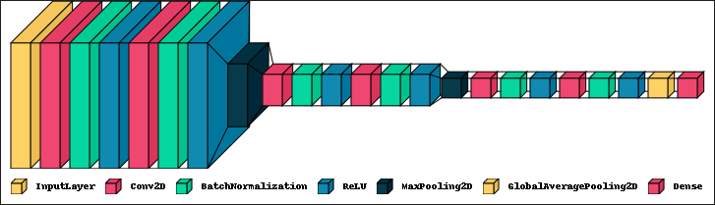
Visualising the architecture of the general model
I used Conv2d, Batch Normalization, Relu activations, Max Pooling 2D, Global Average Pooling and a Dense layers

Slide 26
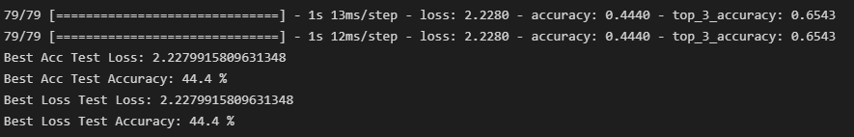
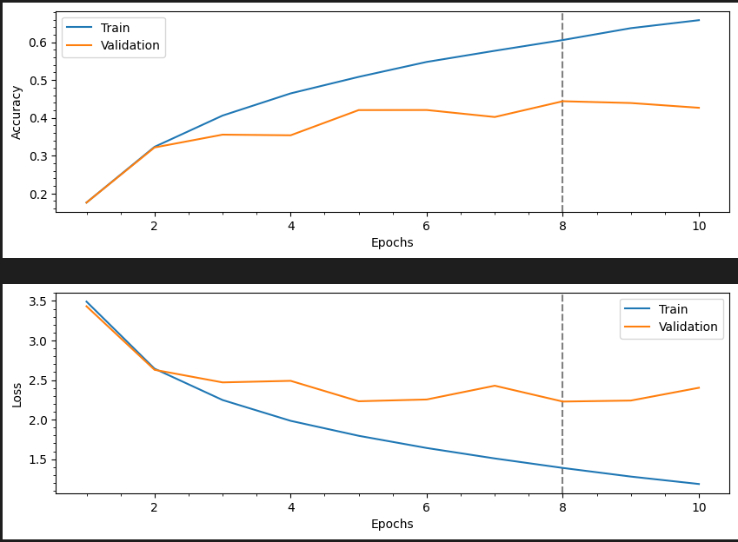
General Model Evaluation

Slide 27
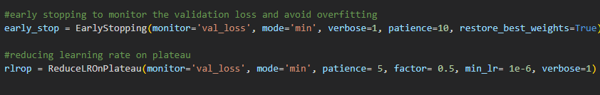
Conclusion
After running all these models, I can conclude that my Own Model with Data Augmentation and extra parameters fit with the coarse labels performed the best, achieving a test accuracy score of over 65%
Furthermore, to achieve efficiency while running my models, I made use of tensorflow keras model checkpoint function to monitor the best weights that give the maximum validation accuracy while fitting the model and saved those weights. Then for the model evaluation, I load those weights from with checkpoints for evaluation so that the evaluation result for Test Accuracy and Loss are the most accurate for all the models.

Slide 28
Thanks!
Do you have any questions?
youremail@freepik.com
+91 620 421 838
yourcompany.com
Please keep this slide for attribution.

