Slide 1
In the name of who created the world
A presentation aiming to teach how to talk about personality
Created by: Amirreza Firoozi
This document is available under Gnu Free Document License
Notes:
1
1

Slide 2
We are going to learn …
what personality means
some words we use to talk about personality
words` meanings aren`t the most complete but They are the simplest.
How to ask questions about personality
Notes:
2
2

Slide 3

Personality
According to the Longman Dictionary the word personality means : Someone`s character, especially the way they behave towards other people.
But here might be a better definition for it:
Personality refers to individual differences in characteristic patterns of thinking, feeling and behaving.
Notes:
3
3

Slide 4
Grammatical Points
We use this structure to talk about personality
Subject | To be verbs | Personality adjectives
I | am | untidy .
You | are | generous .
He | is | polite .
She | is | shy .
We | are | intelligent .
You | are | helpful .
They | are | hard-working .
Notes:
4

Slide 5
Grammatical Points
We use this structure to ask a question about personality
To be verbs | Subject | Personality adjectives
Am | I | untidy ?
Are | you | generous ?
Is | he | polite ?
Is | she | shy ?
Are | we | intelligent ?
Are | you | helpful ?
Are | they | hard-working ?

Slide 6
Grammatical Points
We use this structure to ask a question about personality
What | To be verbs | Subject | Like?
 | am | I
 | are | you
 | is | he
 | is | she
 | are | we
 | are | you
 | are | they

Slide 7
Let`s not make mistakes
When we want to ask about someone`s personality we use :
What is that person like?
But if we use :
What does he like?
We are asking about those things which he enjoys or he wants to have/do (His preference)
Or:
What does he look like?
We are now asking about his appearance
Example:
What do you like ? I like programming a lot / I like to program
As you can see the answer is an activity I like And it`s not my personality.
Notes:
7

Slide 8
What does he look like? He`s tall and slim and has dark hair
We say either He`s brave or He`s a brave man which means If you want to say a/an you must say a noun after the (personality) adjective you say
Example:
He`s helpful
He`s a helpful
He`s a helpful person
Let`s not make mistakes

Slide 9
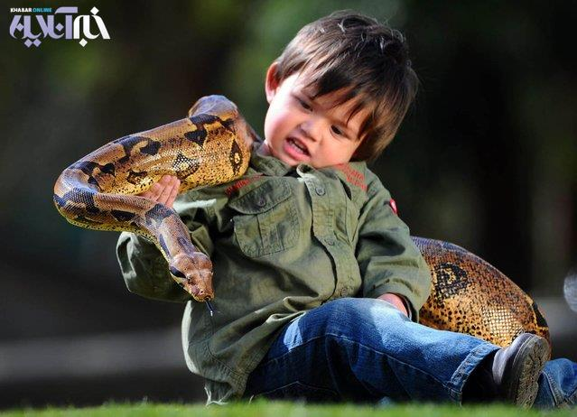
brave
Someone who doesn`t afraid of danger
Example sentence:
Mario is a coastguard. He is very brave. His job is to rescue people.
Notes:
9
9

Slide 10
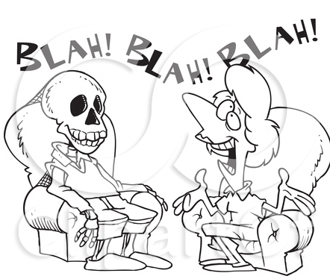
chatty
someone who talks a lot.
Example sentence: Maria is a very chatty person. She is always on the phone to friends
Notes:
10
10

Slide 11

clever
good at learning things.
Example sentence: Gerard is very clever. He always gets top marks in class.
Notes:
11
11

Slide 12

cowardly
(mildly negative) someone who is afraid of things. (often described as "a bit of a coward")
Notes:
12
12

Slide 13
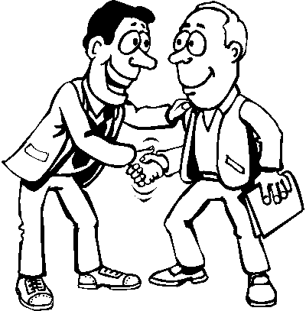
friendly
someone who is nice to other people.
Example sentence: The people in my office are really friendly! I love working there!
Notes:
13
13

Slide 14
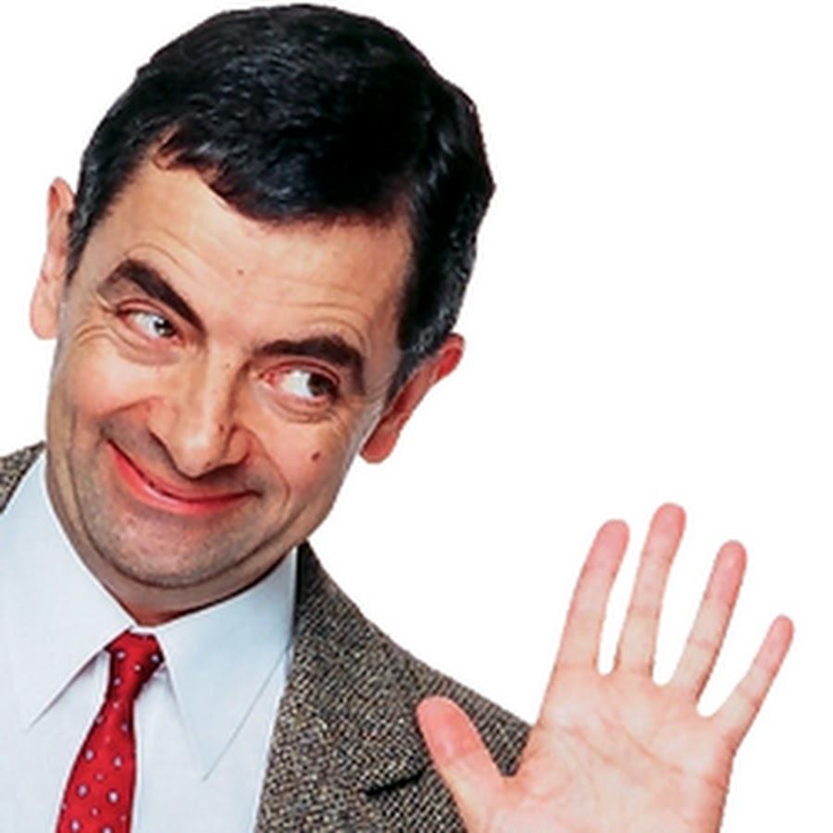
funny
used to describe someone who is amusing.
Example sentence: Salem is really funny! He's always entertaining us with jokes and stories
Notes:
14
14

Slide 15
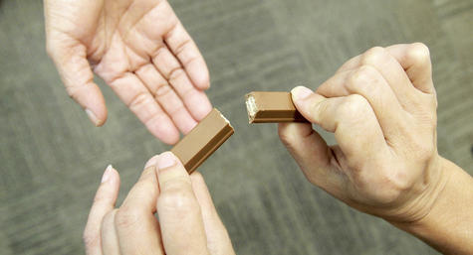
generous
someone who shares their time or things with others.
Example sentence: My parents are very generous. They bought me a car for my birthday!
Notes:
15
15

Slide 16
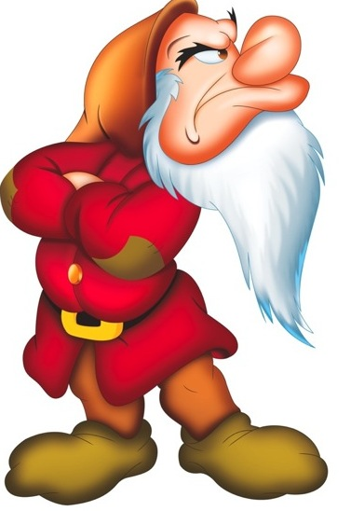
grumpy
bad-tempered.
Example sentence: My boss is really grumpy. He isn't an easy person to get along with
Notes:
16
16

Slide 17
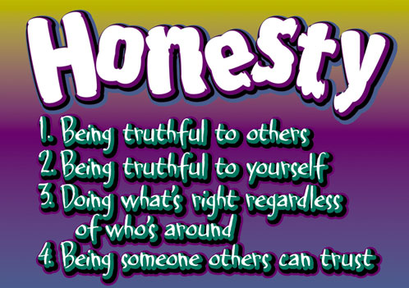
honest
someone who is truthful and who doesn't cheat or steal.
Example sentence: Amina is a very honest. She always tells the truth
Notes:
17
17

Slide 18
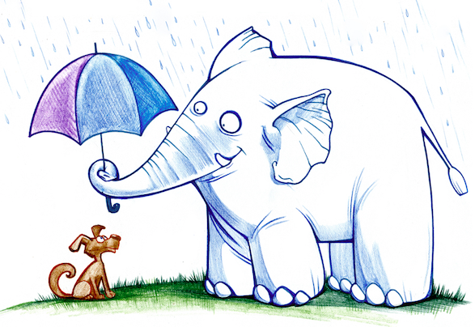
kind
someone who behaves in a caring way towards other people.
Example sentence: Most of the people I've met here have been kind.
Notes:
18
18

Slide 19
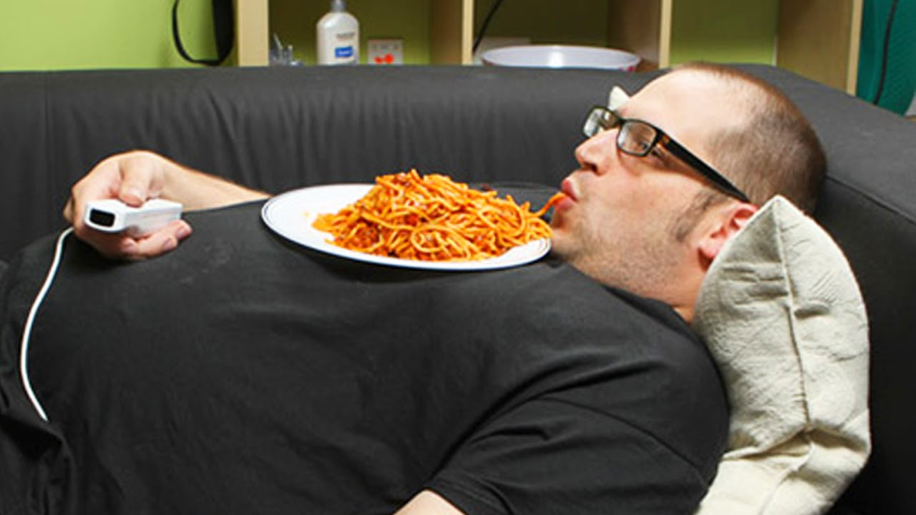
lazy
an inactive person who avoids work.
Example sentence: Pete is very lazy. He rarely gets out of bed before mid-afternoon.
Notes:
19
19

Slide 20

loud
someone who talks really loudly.
Example sentence: Rosita is really loud! When she talks, she drowns everybody else out !!
Notes:
20
20

Slide 21
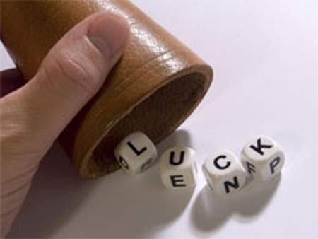
lucky
someone who often has good fortune.
Example sentence: My brother is very lucky. He's always winning prizes in competitions
Notes:
21
21

Slide 22
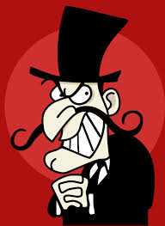
mean
Someone who is a nasty person. 2) Someone who doesn't like spending money.
Example sentence: Phillip is very mean. He never pays for his share of things.
Notes:
22
22

Slide 23
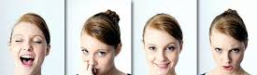
moody
adjective used to describe someone who behaves differently every time you meet them.
Example sentence: Nina is very moody. Yesterday she said hello; today she just ignored me
Notes:
23
23

Slide 24
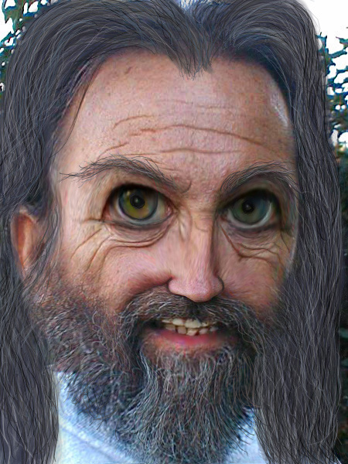
nasty
a mean, unpleasant person. (the opposite of nice)
Example sentence: I don't really know any nasty people. Most people I know are very nice
Notes:
24
24

Slide 25
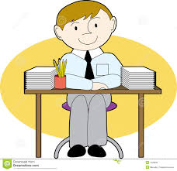
neat
a person who is very tidy.
Example sentence: My flatmate Jorge is very neat and well organised. His room is always tidy
Notes:
25
25

Slide 26
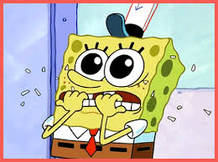
nervous
someone who is easily startled by things.
Example sentence: Anna is a very nervous person. She gets scared easily
Notes:
26
26

Slide 27
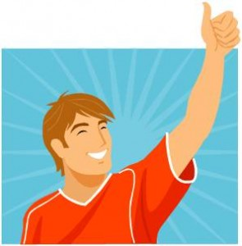
nice
someone who is friendly and kind. (the opposite of nasty)
Example sentence: My best friend Lin is a really nice person. She is always there for me
Notes:
27
27

Slide 28
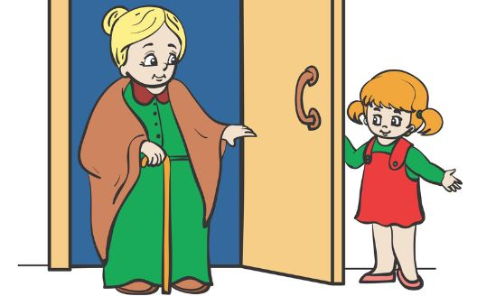
polite
someone who has good manners.
Example sentence: Abdullah is a very polite boy. He always says please and thank you
Notes:
28
28

Slide 29
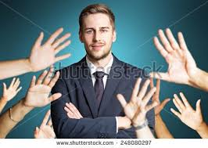
popular
somebody who is liked by many people.
Example sentence: My cousin Ali is very popular. He has a lot of friends
Notes:
29
29

Slide 30
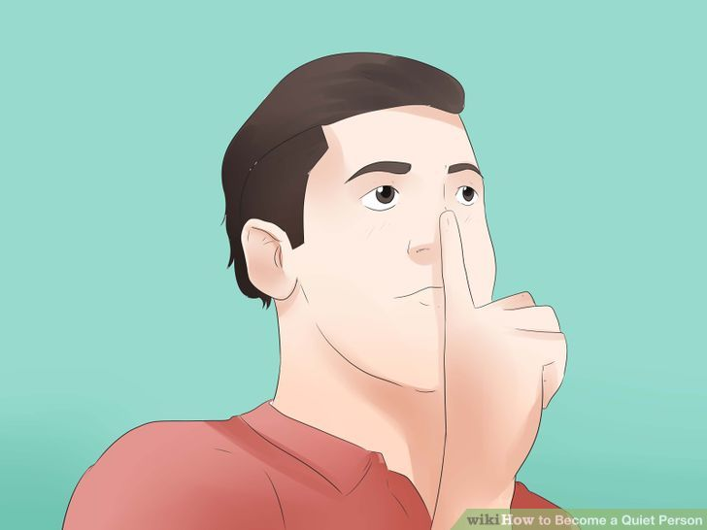
quiet
used to describe someone who doesn't talk very much.
Example sentence: Helen is a quiet person. She isn't very talkative
Notes:
30
30

Slide 31
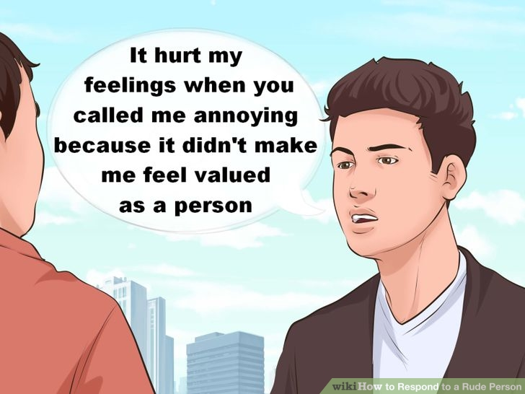
rude
bad mannered, impolite.
Example sentence: James is a very rude person. He always pushes in front of people in queues
Notes:
31
31

Slide 32
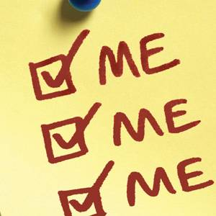
selfish
used to describe someone who only thinks about himself.
Example sentence: Jeremy is very selfish. He never helps out with the housework
Notes:
32
32

Slide 33
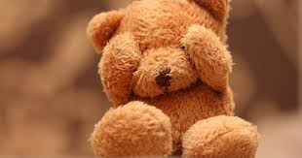
shy
quiet and a little bit nervous around other people.
Example sentence: Claire is very shy. She doesn't speak much in class
Notes:
33
33

Slide 34
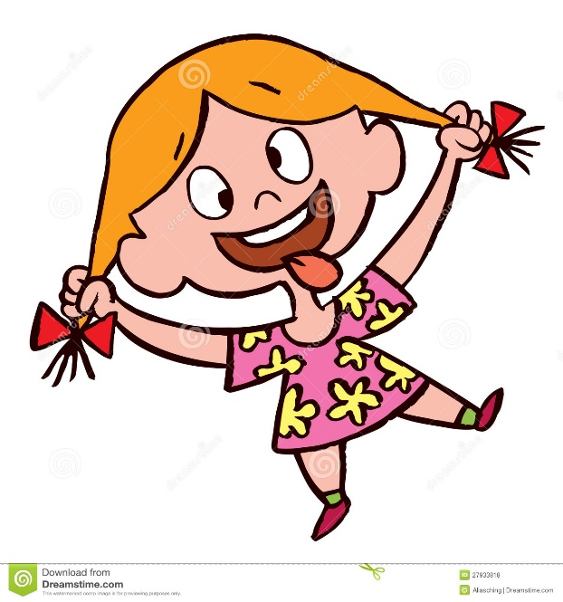
silly
someone who is a bit foolish, or who doesn't behave in a serious way.
Example sentence: Gina is a bit silly. She messes about in class when she should be working
Notes:
34
34

Slide 35
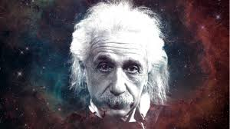
smart
smart - 1) someone who takes a lot of care over their appearance
Example sentence: Anna is very smart. She is always neatly dressed.
smart - 2) someone who is very clever
Example sentence: Chia is very smart. She is one of the most intelligent people I know.
Notes:
35
35

Slide 36
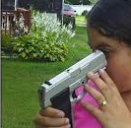
stupid
(very negative and very impolite - sometimes used as an insult) someone who is not clever.
Be careful when using this word! Using neutral adjectives to describe people is much safer
Notes:
36
36

Slide 37
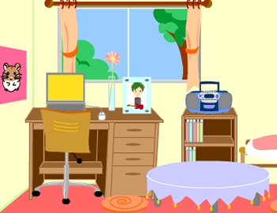
tidy
someone who is very neat and well organised.
Example sentence: My sister is a very tidy person. I'm the opposite; I'm really untidy!
Notes:
37
37

Slide 38
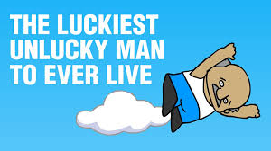
unlucky
someone who often suffers from bad fortune.
Example sentence: Sabrina is very unlucky. Things always seem to go wrong for her
Notes:
38
38

Slide 39
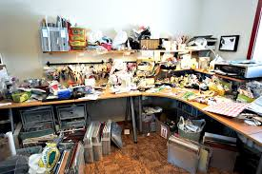
untidy
someone who is very messy.
Example sentence: I'm a very messy person. I always forget to put things away!
Notes:
39
39

Slide 40
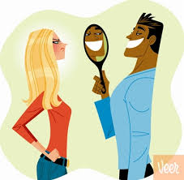
vain
(negative) someone who is a bit too fond of their looks.
Example sentence: Mark is really vain. He spends far too much time looking in the mirror!
Notes:
40
40

Slide 41

wise
someone with a lot of common sense and knowledge.
Example sentence: My grandfather was a very wise man. He taught me many things.
Notes:
41
41

Slide 42
Sources
Words & their meanings are from here
Pronunciations are from Google dictionary .
Grammatical Points are from my own knowledge .
Pictures are from different sources .
You can Always find this document and all other my works at my github page
Notes:
42
42

