Slide 1
THE SHOT WALL
Why a quantum machine-learning device that works on paper
falls apart the moment you try to read it
A reproducible benchmark study — no quantum background needed
Amirshayan Hamidin · July 2026 · github.com/AmirshayanHamidin/qrc-shot-wall
Notes:
Framing: this is a story about an honest benchmark. The punchline is a negative result, and that's the value.

Slide 2
Reservoir computing, in 60 seconds
Machine learning normally trains the whole network. Reservoir computing trains almost nothing: feed your signal into any fixed, complicated dynamical system — the “reservoir” — and train only a simple linear readout on its internal state.
The reservoir (FIXED)
a pond you throw stones into: ripples mix, interact, and carry a fading memory of every past input
Input signal
a time series, one value per step
Readout (TRAINED)
plain linear regression — the only part that learns
Why people love it: no backpropagation, no vanishing gradients — the reservoir does the hard nonlinear work for free.
Notes:
The pond analogy is the anchor for the whole talk. The reservoir is untrained; only the readout is fit.

Slide 3
Why make the reservoir quantum?
A quantum system is an extravagantly rich pond.
The state evolves through genuinely nonlinear-looking, hard-to-imitate dynamics — we later verify no simple classical model can copy its features.
In our tests it carries exactly the kind of nonlinear memory the prediction task needs.
So on paper: a tiny device, a huge reservoir. What could go wrong?
64
dimensions of hidden state from just 6 quantum bits — doubling with every qubit added
(A 60-qubit reservoir would have more dimensions than there are atoms in the visible universe — and can't be simulated classically.)
Notes:
Key setup: the promise is exponential richness. The next slide is the catch.

Slide 4
The catch: you can never see the pond
Reading a quantum state is like polling a country, not photographing it. Each measurement (“shot”) collapses the state and returns one random ballot. To estimate what the state actually was, you repeat thousands of times and average.
1
2
3
One shot
one coin-flip answer per feature: +1 or −1
Many shots
average approaches the true value slowly
Error ∝ 1/√S
10× more accuracy costs 100× more shots
And in reservoir computing the pond is moving: every timestep needs its own fresh poll, and the measurement itself disturbs the water.
Notes:
This slide carries the entire mechanism of the negative result: sampling error decays only as one over root S.

Slide 5
What we actually built
Task
NARMA5 — a standard synthetic time series with nonlinear memory; the model must predict the next value
Quantum reservoir
6 simulated qubits (Qiskit): input injected each step, fixed scrambling dynamics, 84 measured features, linear readout
Honest opponents
a tuned classical echo-state network (same feature count) and plain linear regression on the raw inputs
Rules
same data, same splits, error metric NMSE (0 = perfect, 1 = no better than guessing the mean); all code runs on a laptop CPU in under a minute
Notes:
NMSE: normalized mean squared error. Below ~0.01 is excellent. 1.0 means useless.

Slide 6
Result 1 — Tune your baselines
14×
how much the quantum reservoir “beat” the classical network — before we tuned the classical network.
After tuning: a tie.
Notes:
Meta-lesson for reading any QML paper: ask how hard the classical baseline was tuned. Even with a perfect readout the quantum reservoir only ties a well-tuned ESN here.

Slide 7
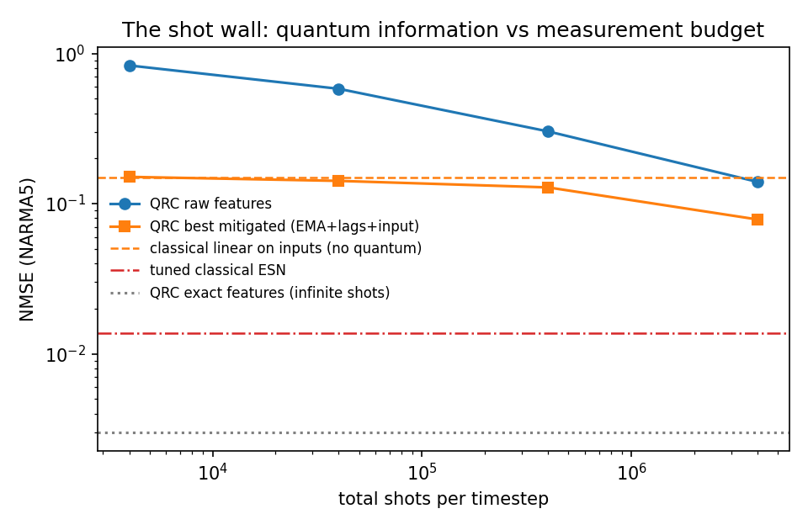
Result 2 — The shot wall
Perfect readout: excellent (0.003).
Realistic readout: even 100,000 polls per timestep leaves the quantum model worse than a classical model that skips the quantum device entirely (orange dashed line).
Reaching the perfect-readout floor extrapolates to ~10⁹ shots per timestep — four to five orders of magnitude beyond practice.
Notes:
Walk the axes: x is measurement budget per timestep (log), y is error (log). The gap between the blue curve and the gray dotted floor is the wall.

Slide 8
Result 3 — Eight rescue attempts, one plateau
Every fix lands on ~0.15.
That number is not a coincidence — it is exactly what a classical model achieves from the raw inputs alone (red bar).
At realistic budgets, measurement noise erases everything the quantum reservoir added.
Notes:
Strategies: smoothing/lag-stacking, PCA subspace projection, errors-in-variables ridge with the analytically known noise covariance, simulation-trained linear and MLP denoisers, and shot reallocation across virtual nodes. All plateau together.

Slide 9
Why nothing downstream can help
The information is real
The reservoir's features are NOT classically fakeable — neither a linear model nor a neural network trained on 2,300 examples could reproduce them from the input history.
…but it dies at the interface
The loss happens at measurement, before any algorithm sees the data. Averaging, filtering, and learned denoisers can only reshape noise — they cannot resurrect information that was never recorded.
Precision beats variety
At a fixed budget, concentrating all shots on fewer measurements beat spreading them across more diverse ones — a design hint, not a fix.
Polling analogy: if a question was never on the ballot, no amount of re-analyzing the ballots answers it.
Notes:
This is the conceptual heart: a data-processing-inequality style argument. The MLP surrogate failure is also good news — the quantum features aren't classically redundant.

Slide 10
So the question changes
Dead end: “how do we clean up noisy quantum features?”
Live question: information per shot as a design criterion — build reservoirs and encodings that concentrate the task-relevant signal into a few strongly-readable measurements.
1
2
3
Design
shape the dynamics so signal lands in few high-magnitude observables
Theory
a fading-memory bound predicting the wall's height before you build
Tasks
classification tolerates noisy features — the wall may sit lower there
Notes:
This reframing is the research proposal: from post-processing to co-design of dynamics, encoding and measurement.

Slide 11
What this study does not show
One task family
NARMA time-series prediction only; other tasks may sit differently relative to the wall
One reservoir design
a single 6-qubit topology; the wall's height is design-dependent (that's the point of the next step)
Optimistic noise
we model only sampling noise — real hardware adds gate errors, making the real wall higher
Matched features, not cost
classical baselines matched on feature count, not wall-clock or energy
Every number is reproducible: seeds, splits, and raw JSON are in the repository.
Notes:
Being explicit about limitations is what makes the negative result credible.

Slide 12
The quantum advantage was real.
It never survived the measurement.
Small quantum reservoirs match — but don't beat — honest classical baselines, and realistic measurement budgets erase even that parity. The path forward is not better post-processing; it is designing quantum dynamics around the measurement bottleneck.
Code, write-ups, figures: github.com/AmirshayanHamidin/qrc-shot-wall
Amirshayan Hamidin · hamideinamirshayan@gmail.com
Notes:
End on the redirected question — invite collaboration.

