Slide 1
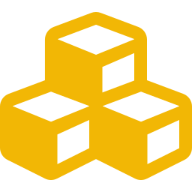
SEMINAR
Blockchain Technology
& Decentralized Applications
A secure, transparent way to store data and power applications without a central authority.
Decentralized ledger • Blocks & chains • Smart contracts
Blockchain Technology & Decentralized Applications
1

Slide 2





HOW IT WORKS
How Blockchain Works
From a single transaction to a permanent record on the chain
1. Transaction Created
2. Shared with Network
3. Verified
A user initiates a transaction to send data or value.
The transaction is broadcast to participants across the network.
Network participants validate that the transaction is genuine.
4. Added to a Block
5. Block Joins the Chain
6. Made Permanent
Verified transactions are grouped together into a new block.
The block is linked to the existing blockchain.
The record becomes secure and extremely difficult to alter.
Blockchain Technology & Decentralized Applications
2

Slide 3

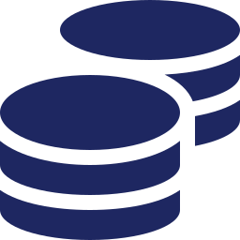



BEYOND BLOCKCHAIN
Decentralized Applications (DApps)
Common Examples
An application that runs on a blockchain network instead of a single central server.
DeFi
Blockchain Games
Decentralized finance — lending, saving, trading without banks
Games with player-owned in-game assets
Does not depend on one central authority
Uses smart contracts to run its operations
Users interact directly with the blockchain
NFT Marketplaces
Decentralized Exchanges
Buying and selling unique digital assets
Peer-to-peer trading of digital currencies
Blockchain Technology & Decentralized Applications
3

Slide 4






AUTOMATION ON-CHAIN
Smart Contracts & Applications
Where Blockchain & DApps Apply
Smart Contract
Banking & Finance
Healthcare
Education
Supply Chain
A program stored directly on a blockchain
Automatically executes when conditions are met
Reduces the need for intermediaries
Voting
Gaming
NFTs
Provides transparency and automation
Blockchain Technology & Decentralized Applications
4

Slide 5






WRAPPING UP
Advantages, Challenges & Conclusion
Advantages
Challenges
High security
Scalability issues
Transparency
High energy consumption in some networks
Decentralization
Transaction fees
Automation
Regulatory concerns
Reduced dependency on intermediaries
Technical complexity
Conclusion
Blockchain provides a secure, decentralized way to store and exchange information. DApps build on this foundation to deliver services without depending entirely on a central authority — and together, they hold real potential to transform industries from finance to healthcare.
Blockchain Technology & Decentralized Applications
5

