Slide 1

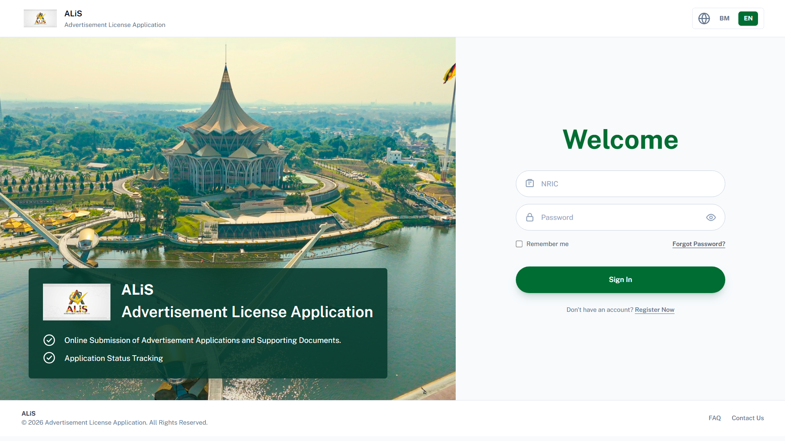
Advertisement License Application System
Online Submission of Advertisement Applications and Supporting Documents.
Application Status Tracking
DBKU Advertisement License Application System
01

Slide 2
SYSTEM PURPOSE
What ALiS is built to solve
1
11+
QR
single source of truth for advertisement license applications
internal and approval roles participating in one workflow
e-license output for applicant download and verification
Replace fragmented handoffs
Tasks move through named units with visible ownership and status.
Make decisions traceable
Recommendations, remarks, signatures, dates, and generated documents stay with the application.
Close the loop with applicants
Applicants receive documents, upload receipts, and download the QR e-license from ALiS.
DBKU Advertisement License Application System
02

Slide 3
USERS
Role-based workspaces
Applicant
Submit application, upload documents, pay, download QR.
PT(IKL)
Returned cases, letters, bills, receipts, e-license.
KU(IKL)
Initial screening and final technical checking.
IKL Technical
Site visit, fee/deposit calculation, recommendation.
BLG/GPM/MNE/IMT/LNP/ENG
Specialist technical reviews and remarks.
KB(LES)
Verification and unit support before approval.
TP(RES)/PGH
Final approval recommendation and management decision.
MPHLG
External review or approval stage where required.
DBKU Advertisement License Application System
03

Slide 4
OPERATIONAL FLOW
End-to-end license workflow
1
2
3
4
Applicant submits form
KU(IKL) screens
Technical review
KU(IKL) final check
5
6
7
8
KB(LES) verifies
TP(RES)/PGH approves
PT(IKL) bill and receipt
QR e-license issued
Every step is linked to a status label, task queue, decision log, and department permission.
DBKU Advertisement License Application System
04

Slide 5
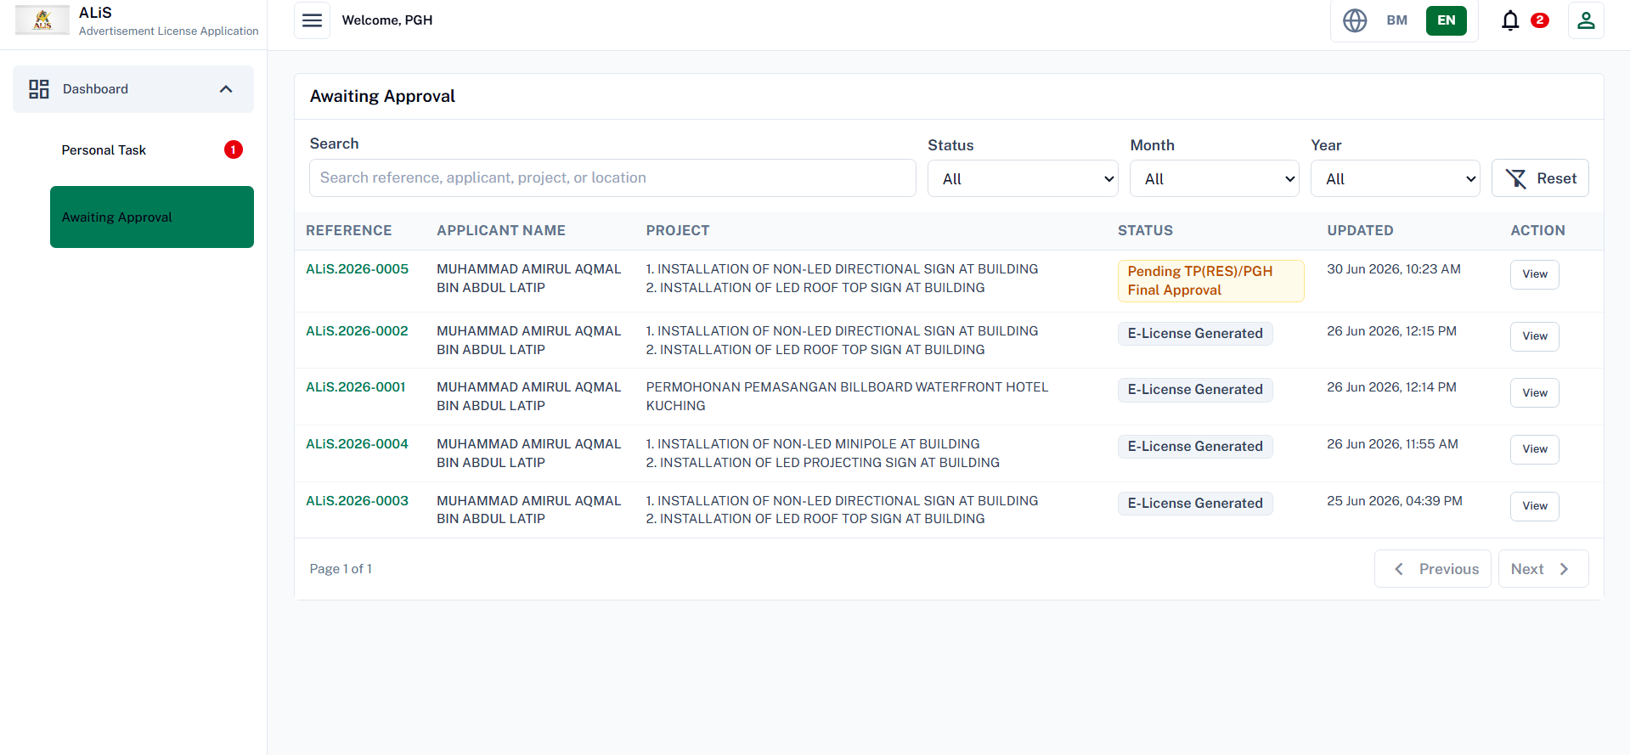
TASK MANAGEMENT
Dashboards show the next action clearly
Process list
Users see their unit and task count before opening the queue.
Personal task queue
Only records waiting for the current unit are actionable.
Stage-aware statuses
For example, after KB(LES) verifies, PGH sees Pending TP(RES)/PGH Final Approval.
Personal Task
Awaiting Approval
View Form
DBKU Advertisement License Application System
05

Slide 6
TECHNICAL ROUTE
Technical review converts site evidence into decisions
IKL Technical
BLG
GPM
MNE
Site visit
Support / condition / reject
Support / condition / reject
Support / condition / reject
Record visit details, location evidence, and site photo.
Fee calculation
Capture advertisement size, license fee, deposit, and processing fee.
IMT
LNP
ENG
Final technical recommendation
Support / condition / reject
Support / condition / reject
Support / condition / reject
Compile department feedback before KU(IKL) final checking.
External technical units record scoped remarks; IKL Technical consolidates the full site review.
DBKU Advertisement License Application System
06

Slide 7
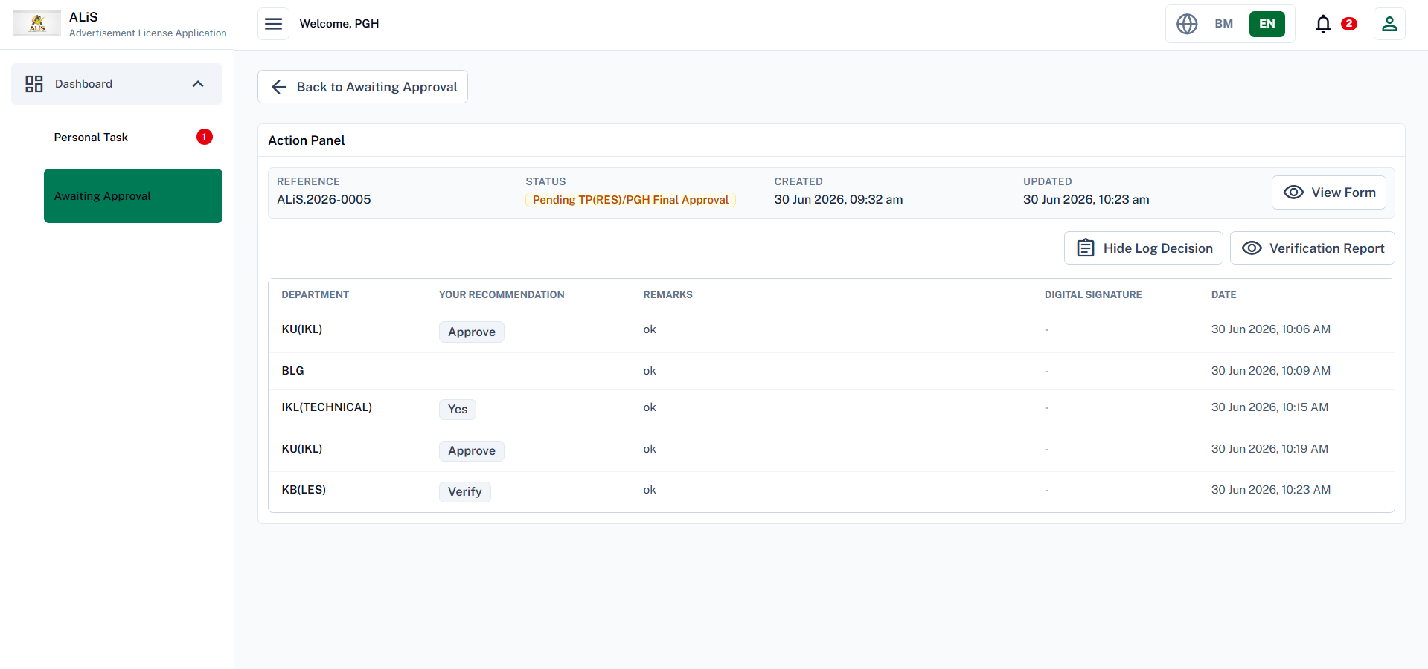
VERIFICATION AND APPROVAL
Approval governance is visible and auditable
KB(LES)
Verify
TP(RES)/PGH
Final approval
MPHLG
Review when required
Decision log captures department, recommendation, remarks, date, and signature reference.
DBKU Advertisement License Application System
07

Slide 8

DOCUMENTS
Payment and e-license complete the applicant journey
Approval letter and bill
PT(IKL) uploads approved documents for applicant action.
Receipt proof
Applicant uploads payment receipt; PT(IKL) verifies valid or rejected payment.
Official receipt and advertisement license
Once verified, PT(IKL) uploads final documents and issues the QR e-license.
Issued document package
QR e-license
Downloadable by applicant after license issuance.
DBKU Advertisement License Application System
08

Slide 9
MONITORING
Controls continue after the license is issued
01
02
03
04
Decision history
Notifications
Renewal monitoring
Cancellation route
Every DBKU and MPHLG decision is retained with remarks, officer, date, and document context.
The system supports web notifications and can release renewal reminders by email and WhatsApp.
Issued licenses are monitored at 3, 2, and 1 months before expiry.
After expiry without payment, PT(IKL) prepares notice, supervisor confirms, KB(LES) supports, applicant is notified.
DBKU Advertisement License Application System
09

Slide 10
TECHNOLOGY STACK
Framework and technical architecture
Frontend
Backend
Runtime
React 19 + Vite 8
Django 5.2 + DRF 3.17
Gunicorn and Docker
Single-page web application with fast build tooling.
REST API layer for applications, accounts, and notifications.
Backend can run as a production WSGI service.
React Router
SimpleJWT
Nginx frontend
Role-based navigation for applicant, admin, and supervisor journeys.
Bearer-token authentication with rotating refresh tokens.
Frontend includes nginx config for static delivery.
UI and document tools
PostgreSQL-ready
CORS configured
CKEditor, qrcode.react, jsPDF/html2canvas, Mapbox/MapLibre.
psycopg2-binary dependency, media/static handling with WhiteNoise.
Allowed origins include localhost and fastrack.sapotlokal.my.
Architecture pattern: React client -> authenticated REST API -> Django domain modules -> database, media, and notification services.
DBKU Advertisement License Application System
10

Slide 11
SECURITY CONTROLS
Rate limiting as backend traffic rules
If a user, browser, or IP sends too many requests, Django temporarily blocks the request with 429 Too Many Requests.
Normal API traffic
Login protection
Anonymous API: 120/min
Public pages, register, and login-page API calls before the user signs in.
Login per IP: 120/min
Blocks obvious login flooding from one internet address.
Logged-in API: 1000/min
High enough for normal staff/applicant work, but still stops loops or spam clicks.
Login username+IP: 10/min
Example: someone keeps guessing the password for ptikl from the same computer.
Account recovery
File upload protection
Register: 20/hour
Helps stop fake account creation from one IP.
Upload: 60/hour
A logged-in user can upload files up to 60 times per hour.
Reset request: 5/hour
Stops email or WhatsApp OTP spam.
Why it matters
Protects storage and server resources from repeated upload spam.
OTP verify: 30/hour
Limits repeated OTP guessing attempts.
Reset confirm: 10/hour
Limits final password changes.
For ALiS, the defaults are balanced: strict on login/reset, generous for normal logged-in usage.
DBKU Advertisement License Application System
11

Slide 12
IMPACT
Recommended presentation close
ALiS gives DBKU an auditable operating model for advertisement licensing.
Confirm standard operating ownership
Validate each queue, permission, and status label with department leads.
Train by real user journey
Run one sample application from submission to QR e-license.
Use the live system screenshots during the talk to anchor discussion in actual DBKU workflows.
Track operational metrics
Monitor pending tasks, resubmissions, approval duration, payment completion, and renewals.
DBKU Advertisement License Application System
12

