Slide 1





Give me Some Credits-Default Prediction
Presented By:
Richa Sinha-2401020973
Amisa Amrin-2401021086
Jashmine Naik-2401021099
Sakshi Jaiswal-2401021131

Slide 2




Problem Statement
The Give Me Some Credit dataset (from Kaggle) focuses on predicting whether a borrower will face serious financial distress within the next 2 years. Financial distress usually means the borrower is likely to default on loan payments (e.g., 90+ days past due).
OBJECTIVE
To build a classification model that predicts.
1 → Financial Distress (Default)
0 → No Financial Distress
This is a binary classification problem where the goal is to estimate the probability that a borrower will default.
Predict whether a customer will default (SeriousDlqin2yrs = 1) within the next 2 years.Why it is Important?
Reduces financial loss
Improves credit risk management
Helps in better loan approval decisions

Slide 3



DataSet Used:Train.CSV
Target Variable:
SeriousDlqin2yrs (0 = No Default, 1 = Default)
Important Features:
Age
RevolvingUtilizationOfUnsecuredLines
DebtRatio
MonthlyIncome
NumberOfTimes90DaysLate
NumberOfDependents
NumberOfOpenCreditLinesAndLoans
Dataset Size:
~150,000 records

Slide 4


Data Preprocessing And Data Cleaning Steps
Removed unrealistic ages (age = 0 and age > 100)
Handled missing values in:
MonthlyIncome
NumberOfDependents
Checked for outliers
Split data into:
Training set
Testing set
Why preprocessing?
Clean data improves model accuracy and reliability.

Slide 5


Logistic Regression
Strengths and Limitations
Why Used ?
Evaluation Metric
Suitable for binary classification
Simple and interpretable
Provides probability output
Easy to understand
Fast to train
Works well with scaled data
Cannot capture complex non-linear relationships
ROC-AUC Score

Slide 6




Why Used ?
Strengths
Handles non-linear relationships
Works well with complex datasets
Reduces overfitting using multiple decision trees
High accuracy
Handles outliers better
No need for feature scaling
Random Forest Classifier
Limitations
Evaluation Metric
Less interpretable
Slightly slower than logistic regression
ROC-AUC Score

Slide 7
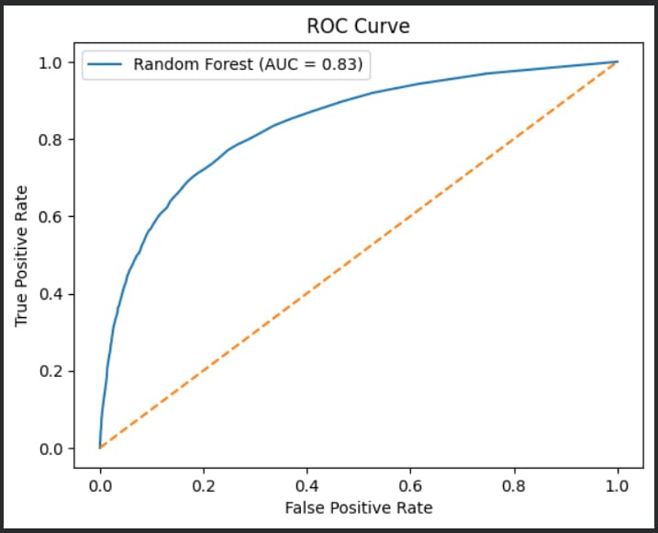

Slide 8
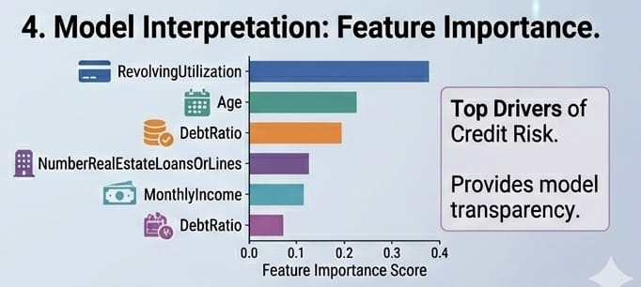
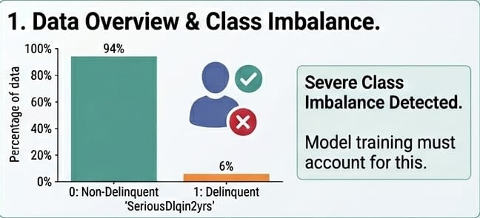

Slide 9
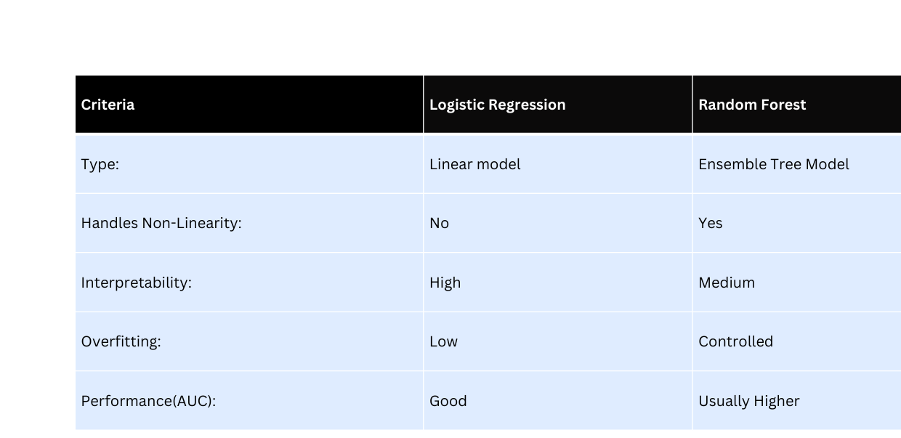

Logistic Vs Random Forest
Final Observation:
Logistic Regression is simple and interpretable.
Random Forest captures complex patterns and often gives higher ROC-AUC.
Random Forest performed better for default prediction.

Slide 10



