Slide 1
CUDA-Accelerated Parallelized Stochastic Gradient Descent
Amish Faldu (af557)

Slide 2
Problem Statement
SGD is a widely used optimization algorithm in machine learning and deep learning due to its efficiency on large datasets
Traditional sequential implementation are slow when training large models on massive datasets
Develop a highly optimized, CUDA-based SGD implementation
Leverage massive parallelism and high memory bandwidth of GPUs
Benchmark CUDA methods against CPU baselines

Slide 3

Data
Data source: https://www.kaggle.com/c/new-york-city-taxi-fare-prediction/
Data info:
Rows: ~55M records
Feature: 6 features and 1 label
Data subset:
Rows: 10M records (~8.34M after pre-processing)
Feature: 6 features after feature engineering and 1 label

Slide 4
Methods implemented
Method | Description
cuBLAS-based | Uses NVIDIA cuBLAS library for matrix operations
Custom kernels | CUDA kernels written for SGD operations
Memory Coalesced | Custom kernels with coalesced memory access
Python SGD Regression | Uses scikit-learn SGDRegressor implementation

Slide 5
cuBLAS SGD Implementation
Leverages the highly optimized cuBLAS library for matrix multiplication and vector operations
Operations in each epoch
Compute predictions from SGEMM (Single-precision General Matrix Multiply) function
Error calculation using SAXPY (Single-precision A·X Plus Y) function
Compute gradients using SGEMM function
Finally, apply the weight updates using SAXPY function
Benefits: Maximum GPU throughput for dense, large data

Slide 6
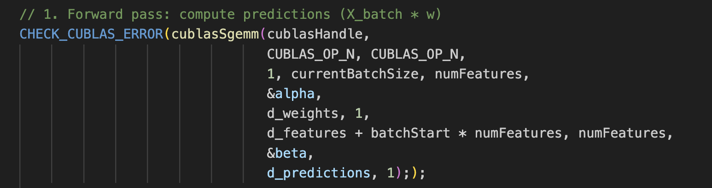
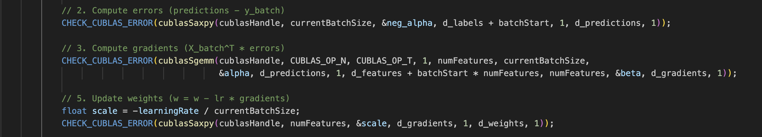
cuBLAS SGD Implementation
Forward Pass
Backward Pass

Slide 7
Custom Kernels SGD Implementation
Implements SGD steps using custom CUDA kernels:
predictKernel: Computes predictions for a batch using current weights
computeGradientsKernel: Calculates gradients and mean squared error (MSE) using shared memory for partial reductions
updateWeightsKernel: Atomically updates weights in global memory
Focuses on parallelizing gradient computation and weight updates across threads and blocks
Benefits: Fine-grained control over computation and memory access patterns

Slide 8

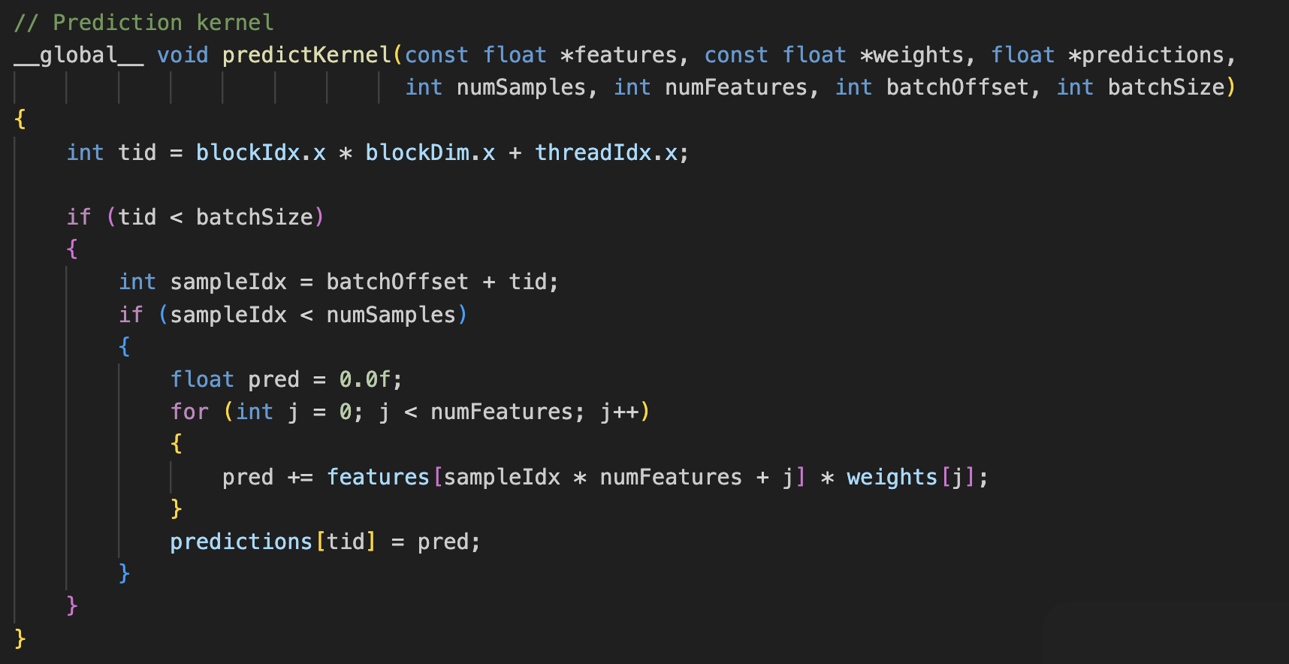
Custom Kernels SGD Implementation
Forward Pass

Slide 9
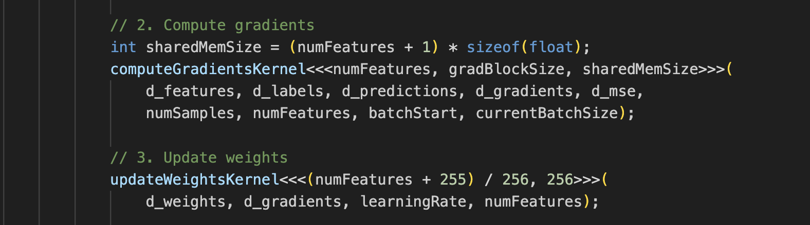
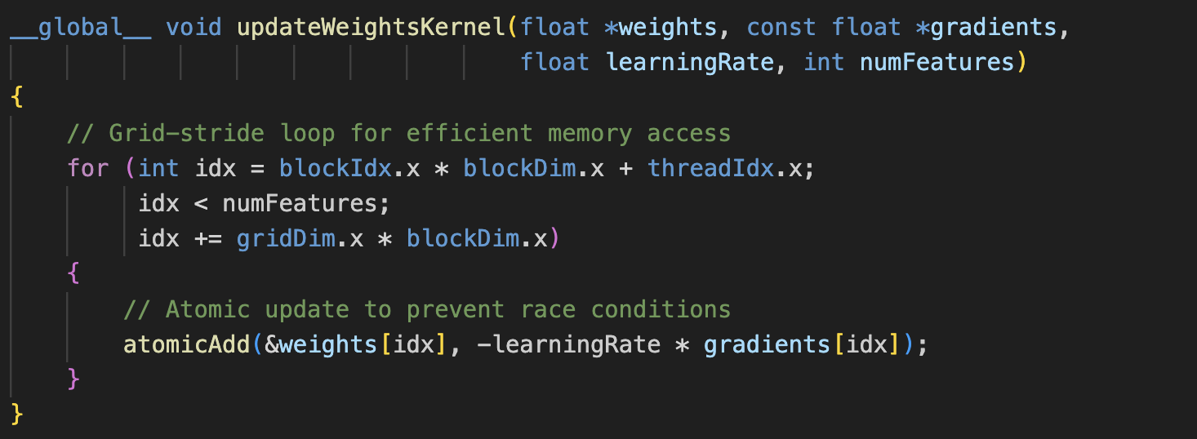
Custom Kernels SGD Implementation
Backward Pass

Slide 10
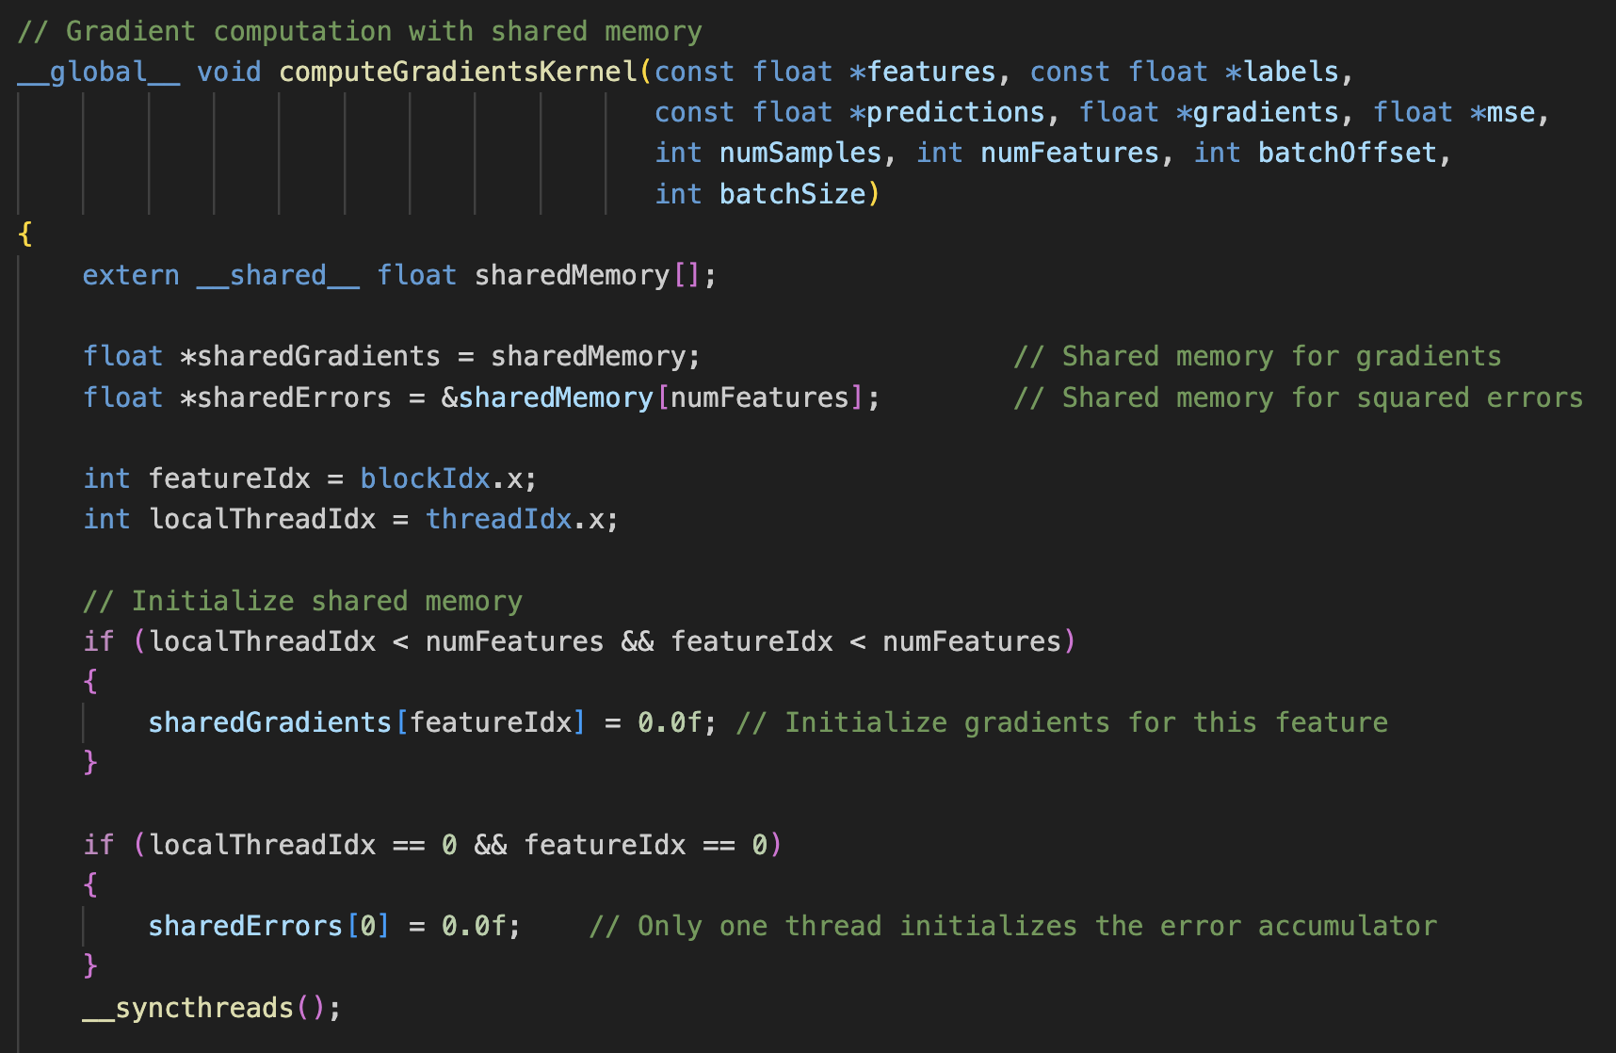
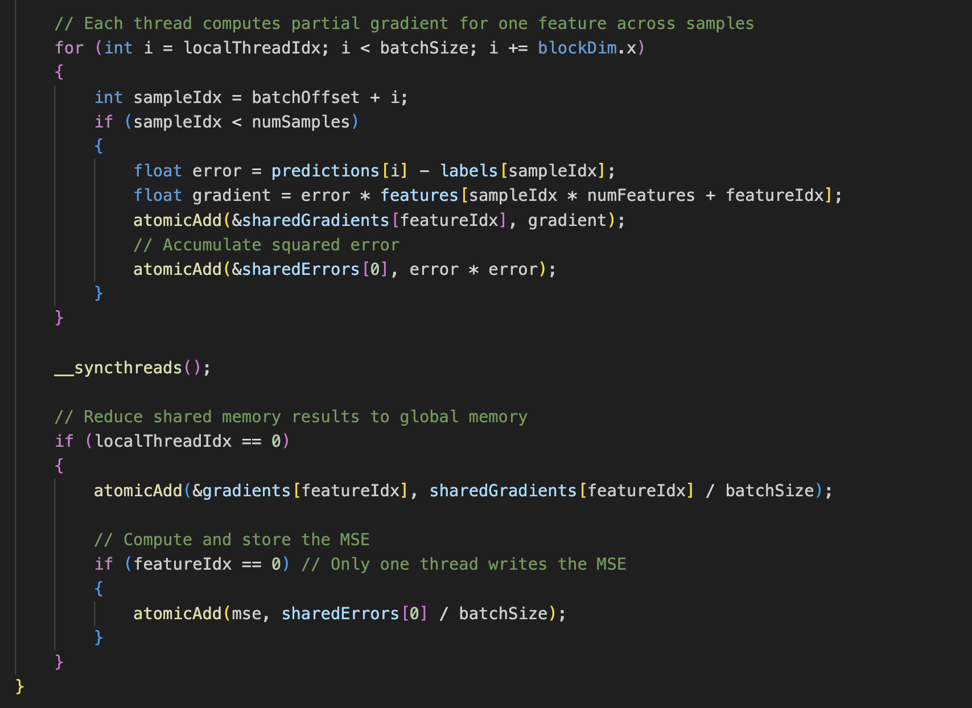
Custom Kernels SGD Implementation
Backward Pass

Slide 11
Memory Coalesced SGD Implementation
Enhances the custom kernel approach by optimizing memory access:
Uses a transposed feature matrix so that threads in a warp access consecutive memory locations, maximizing memory bandwidth
Loads weights into shared memory for faster access
Benefits: Results in improved throughput and reduced memory latency, especially for large batch sizes

Slide 12
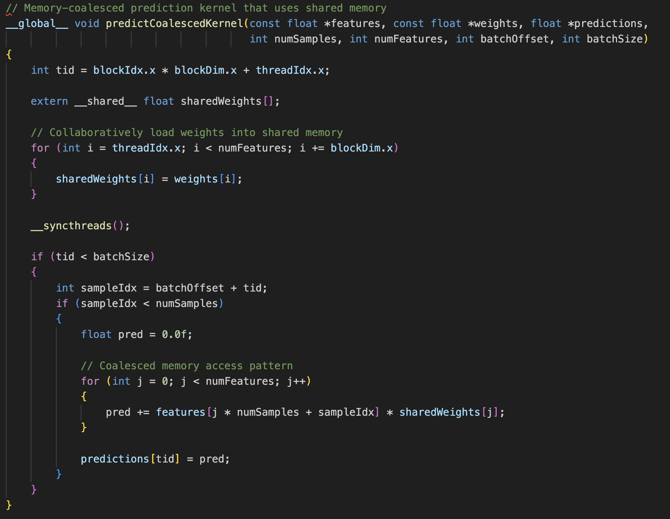
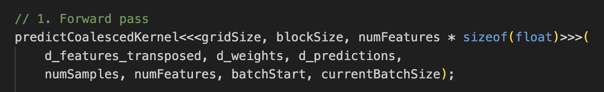
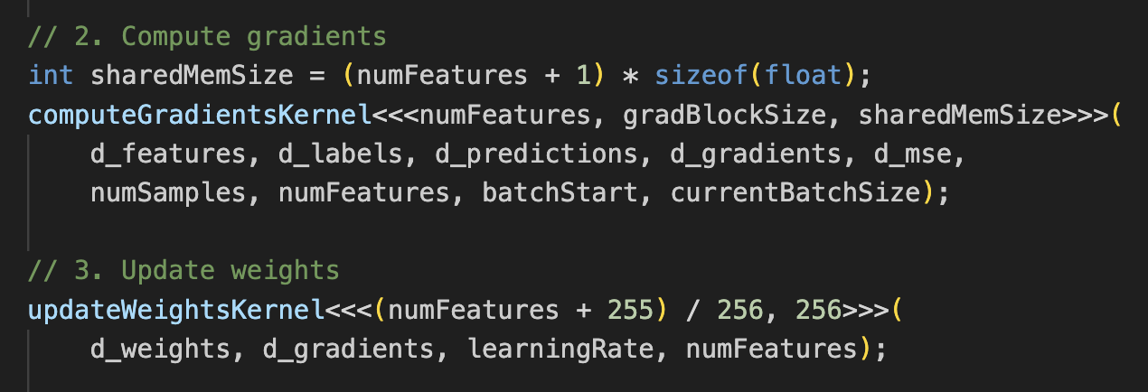
Memory Coalesced SGD Implementation
Forward Pass

Slide 13
Scikit-learn SGD Implementation
A reference implementation using Scikit-learn SGDRegressor is included for comparison
The python implementation:
Loads the same dataset
Trains a linear regression model using SGDRegressor
Serves as a baseline for correctness and performance against CUDA implementations

Slide 14
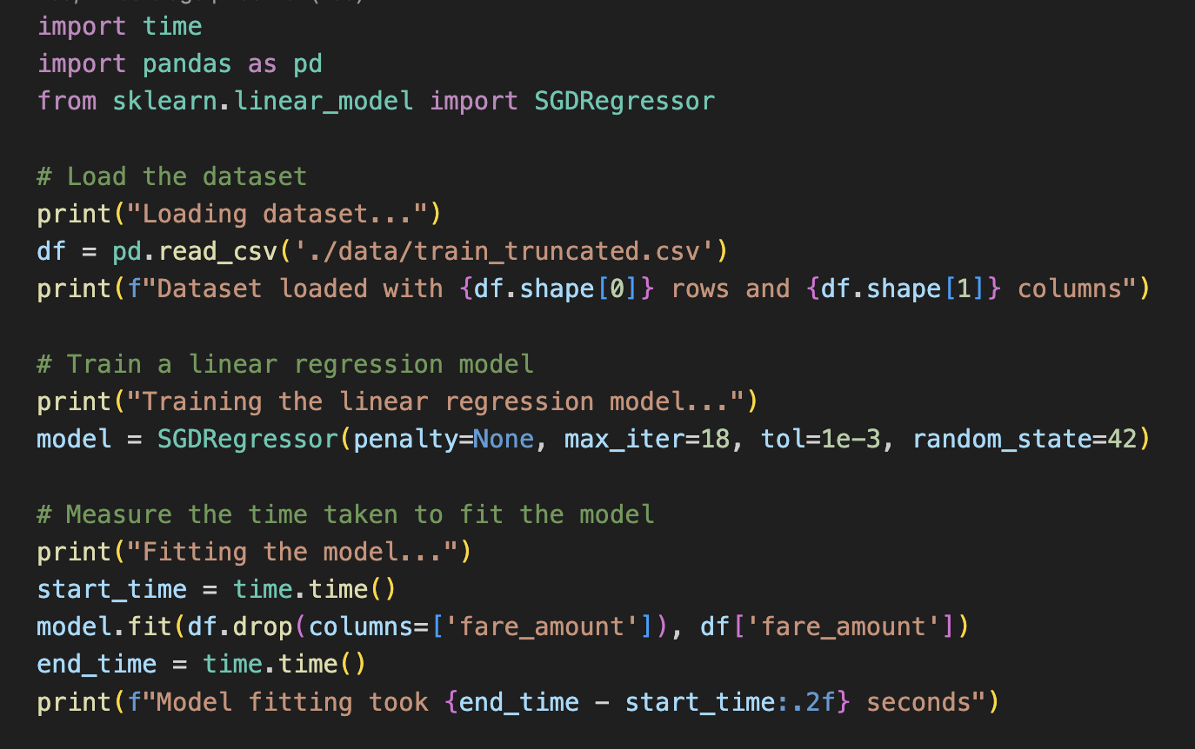
Scikit-learn SGD Implementation

Slide 15
Benchmarks
NOTE – Scikit-learn SGDRegressor doesn’t batch the data

Slide 16
Conclusion
From the benchmarks, the cuBLAS based CUDA implementation outperformed all the methods with
2.8 seconds execution time
18 iterations over ~8.4M records and 6 features
Scikit-learn based implementation outperformed all the CUDA implementations (except cuBLAS) for smaller batch size of 128
Takeaway from the benchmarks, for smaller datasets it is still better to use simple implementations available as CUDA would be overkill

Slide 17
What’s next?
Further improvements
Throttle all the kernels to their max grid and block sizes
Use shared memory for forward pass in custom kernel
Implement async Hogwild CUDA and warp-based kernels
Gather benchmarks for
Multi-threaded OpenMP implementation
Async Hogwild CUDA implementation
Memory bandwidth utilization
Performance when using shared memory for forward pass in custom implementation
Warp implementation
GitHub link - https://github.com/AmishFaldu/cuda-parallel-sgd

Slide 18
Questions?

