Slide 1
Understanding coding guidelines and architecture design patterns
Presented by
Muhammad Afzal
Twitter:goldytech
Blog: http://goldytech.wordpress.com
Notes:
Speak about yourself in brief showcasing your technical expertise.

Slide 2
Agenda
Solution structure.
Code Analysis and Stylecop.
C# Async programming.
Dependency Injection with IoC (Unity).
Entity Framework Code First.
Repository and Unit of Work design pattern.
Fluent Validation.
Auto mapper.

Slide 3
Solution structure
Always start with blank solution
Enable nuget package restore on the solution.
Packages folder should be never committed to source code repository.
All files of nuget should be committed in the repository.
All the projects in the solution should be under src folder.
Use proper conventions in naming the projects file.
The .sln file should be outside of src directory
All common files related to the projects must be kept in the solutionItems folder.
Use file linking feature for common files.
Use solution folder in solution explorer to segregate your layers.
Notes:
Lesson descriptions should be brief.

Slide 4
Code Analysis and Stylecop
Code Analysis feature of Visual Studio performs static code analysis on code to help developers identify potential design, globalization, interoperability, performance, security, and a lot of other categories of potential problems.
These rules that mainly targets best practices in writing code.
A custom ruleset file must be added in the solutionItems folder and all projects must follow it. The UI project should follow Recommended ruleset.
No rule should be suppressed until the proper justification is given and discussed with me first.
Avoid duplicate code by using ‘Code Clone’ feature of Visual Studio.
Stylecop helps to beautify your code and recommended coding style as per Microsoft Design guidelines.
No code should be committed until all warnings of code analysis and stylecop are solved.

Slide 5
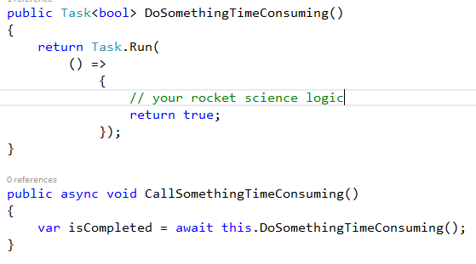
Async Programming (Task)
Introduced with .net Framework 4.0
The task class represents the ongoing operation.
A generic version of Task<T> acts like a promise which will be available in the future once the operation is completed. The result of this operation will be of type T.
Any method which invokes the task should be prefixed by async keyword.
All methods that returns tasks must be called by prefixing await keyword.

Slide 6
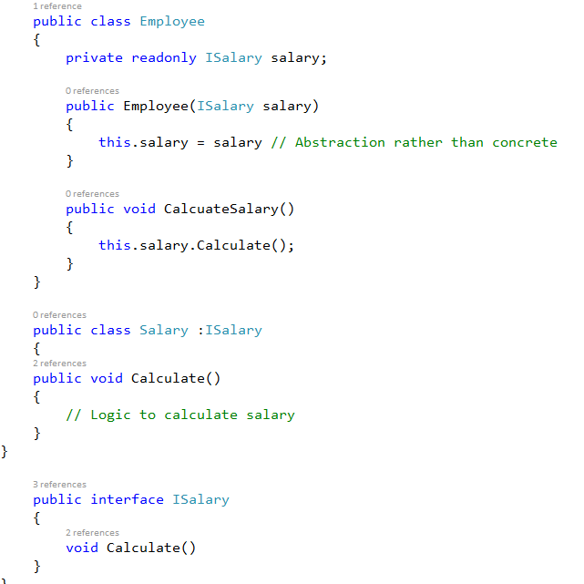
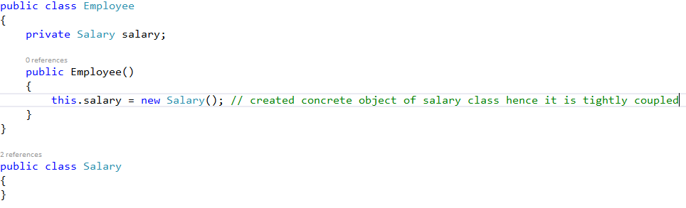
Dependency Injection & IoC
Classes depends on other classes for their functionalities to achieve. (E.g. Employee depends on Salary. Employee creates concrete object of Salary.)
The Dependency injection says that components that depend on each other should interact via an abstraction and not directly with a concrete implementation.
IoC uses the concept of separating the execution of code from problem-specific code. This approach allows the different components of the application to be developed independently of each other. For example, in an MVC application, the model, view, and controller layers can be designed and built independently.
A service locator relies on the caller to invoke and ask for a dependency, while dependency injection is done by injecting a dependency into a class by either populating its constructor, setting one of its properties, or executing one of its methods.

Slide 7
Entity Framework (Code First)
Replaces the old tradition of designing the database. Use POCO (Plain Old Clr Objects) for creating your domain classes and behind the scenes the database gets created.
Gives you more granular control on your db schema as there is no auto generated code.
Frees developer from managing the different SQL script versions on production and development environments.
Supports both Attribute and Fluent Apis for managing database.

Slide 8
Repository and Unit Of Work pattern
Use a repository to separate the logic that retrieves the data and maps it to the entity model from the business logic that acts on the ViewModel.
The business logic should be agnostic to the type of data that comprises the data source layer. For example, the data source layer can be a database, a SharePoint list, or a Web service.
One of the best ways to use the Unit of Work pattern is to allow disparate classes or services to take part in a single logical object.

Slide 9
Lesson 2: Wrap-up
Summarize important points.
Allow time for questions.

Slide 10
Lesson 3: Objectives
List the intended outcomes for this training session.
Each objective should be concise, should contain a verb, and should have a measurable result.

Slide 11
Lesson 3: Content
Add text here.
To add a picture, chart, or other content in the right column, click the appropriate icon.
To add a slide, click New Slide on the Insert menu, or press CTRL+M.

Slide 12
Lesson 3: Wrap-up
Summarize important points.
Allow time for questions.

Slide 13
Summary of Training
List important points from each lesson.
Provide resources for more information on subject.
List resources on this slide.
Provide handouts with additional resource material.

Slide 14
Assessment and Evaluation
Prepare a quiz or challenge to assess how much information participants learned.
Survey participants to see if they found the training beneficial.

