Slide 1
Predicting Los Angeles Home Values Using
Mortgage Interest Rates
Impact of Mortgage Rates on Housing Trends
Amish Nanda
300408947
CSIS-4260-002

Slide 2




Predicting Next Month's Home Value
Objective
Method
Forecast next month’s Los Angeles home value mortgage rates and lagged housing variables.
Evaluated Linear Regression against Random Forest for trend extrapolation.
Data Source
Output
Merged Zillow housing trends with FRED 30-year fixed mortgage rates.
Interactive Streamlit application for real-time inference and visualization.

Slide 3


High-Quality Data from Zillow and FRED
Zillow Metro ZHVI
FRED MORTGAGE30US
Source
Zillow Research
Source
Federal Reserve
Frequency
Monthly
Frequency
Weekly → Monthly
Variable
Home Value (LA)
Variable
30-Year Fixed Mortgage Rate

Slide 4
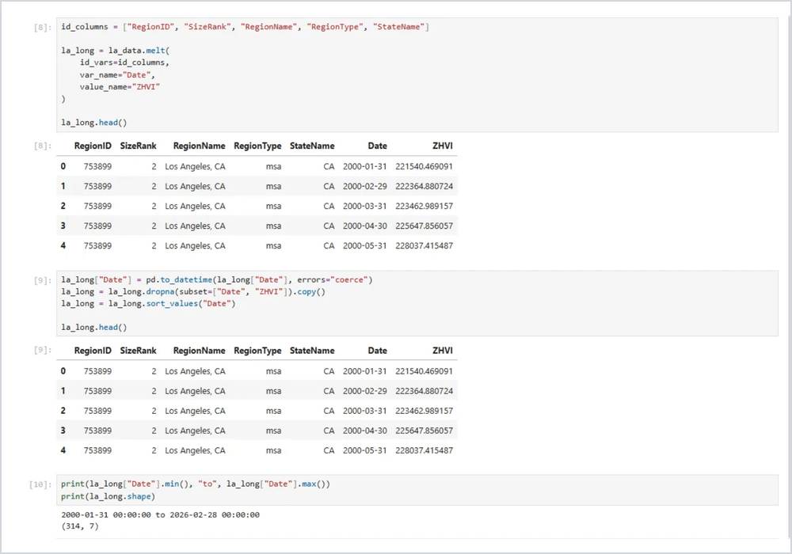
Transforming Raw Data into a Unified Pipeline
1
Isolated Los Angeles, CA metro area from national data.
2
Converted Zillow's wide format into a time-series long format using pd.melt().
3
Averaged weekly mortgage rates to align with monthly housing data.
4
Joined both datasets by date to create the final modelling dataset
Data Transformation: Reshaping and Cleaning with Pandas

Slide 5

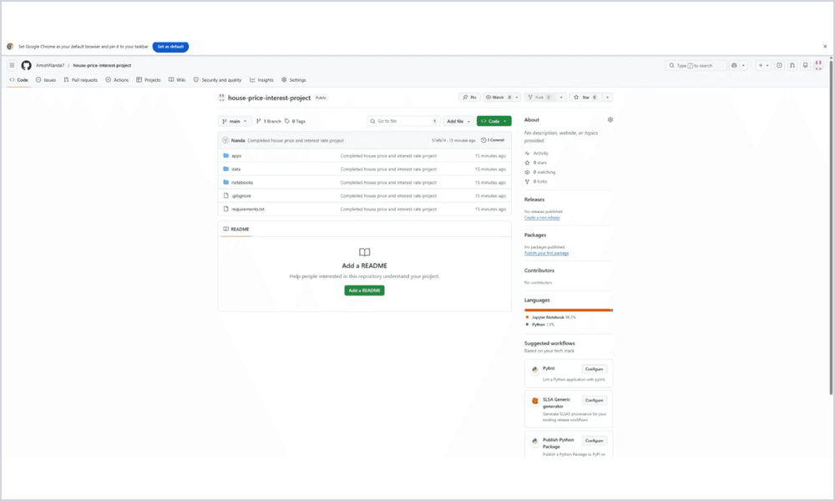


Lagged Variables Capture Market Momentum
Inputs (X)
Current month ZHVI and Mortgage Rate.
Lag-1: Previous month ZHVI and Mortgage Rate.
Target (y)
Next month's ZHVI (1-step ahead forecasting).
Project Structure: Modular Features & Notebooks

Slide 6



Market Trends and Rate Volatility
Growth
Relationship
LA home values show consistent long-term appreciation with strong demand.
The relationship was not perfectly simple so more models were tested.
Volatility
Mortgage rates exhibit sharp fluctuations, especially post-2022.

Slide 7



Preserving Time Order for Realistic Evaluation
Split Details
Purpose
Set
Months
Period
Chronological Split: No random shuffling to maintain sequence.
249
Older history
Train
Real-world Mirror: Training on the past, testing on the future.
63
Most recent
Test
No data Leakage: Future data was not used during training.

Slide 8
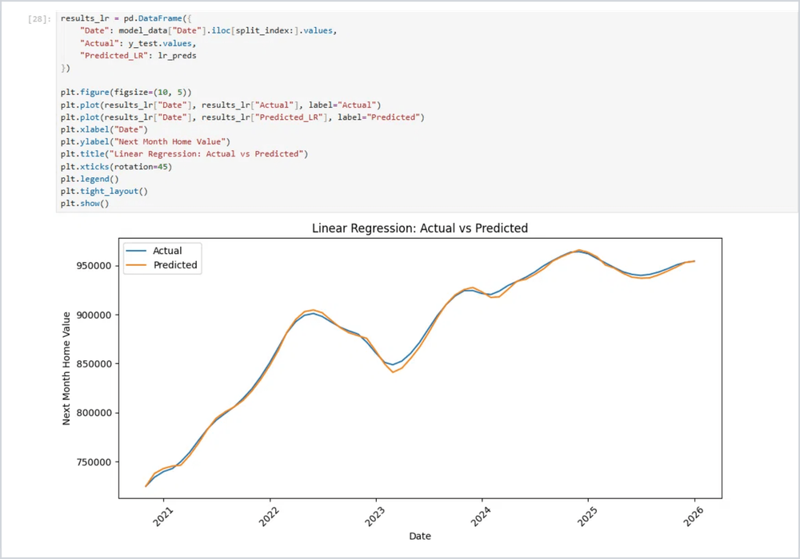



Superior Accuracy with Linear Modeling
Metric
Value
R² Score
0.9982
MAE
$2,365
Minimal error relative to property values.
Captures the long-term upward trajectory perfectly.
Highly reliable for short-term forecasting.
Actual vs. Predicted: Exceptional Trend Tracking

Slide 9

Complexity Fails to Capture Growth Trends
Metric
Value
Extrapolation Issue
R² Score
-8.8291
Random Forest struggles to predict values beyond the training range. Since LA home values were trending upward, the ensemble mechanism could not project into unseen higher price levels.
Performance
Sub-baseline
The model produced flat predictions, failing to capture the significant market uptrend.

Slide 10

Simplicity Wins for Trended Data
Model
MAE
R²
Decision
Selected Linear Regression for deployment.
Linear Regression
$2,365
0.9982
Random Forest
$198,713
-8.83
Reasoning
Housing trends are dominated by momentum. Linear models track this growth best, whereas complexity can lead to poor extrapolation.

Slide 11

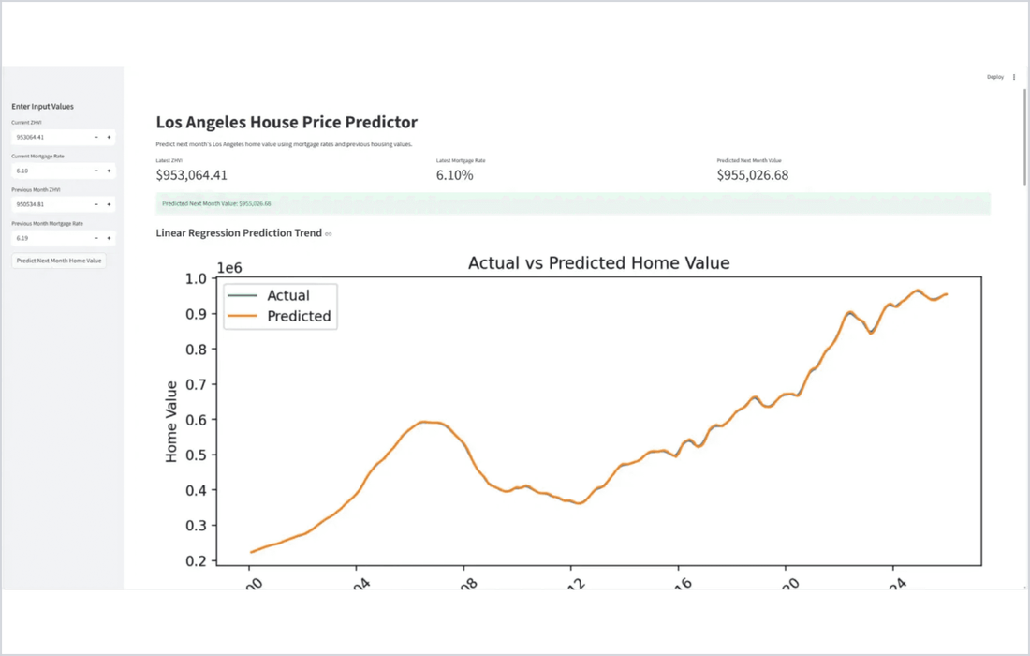



StreamLit app for Prediction and Visualization
App Functionality
Input current rates and values for instant forecasts.
Integrated actual vs. predicted trend charts.
Real-time summary of model metrics.
User-friendly interface for non-technical stakeholders.
Live Application: Predictive Interface for LA Housing

Slide 12
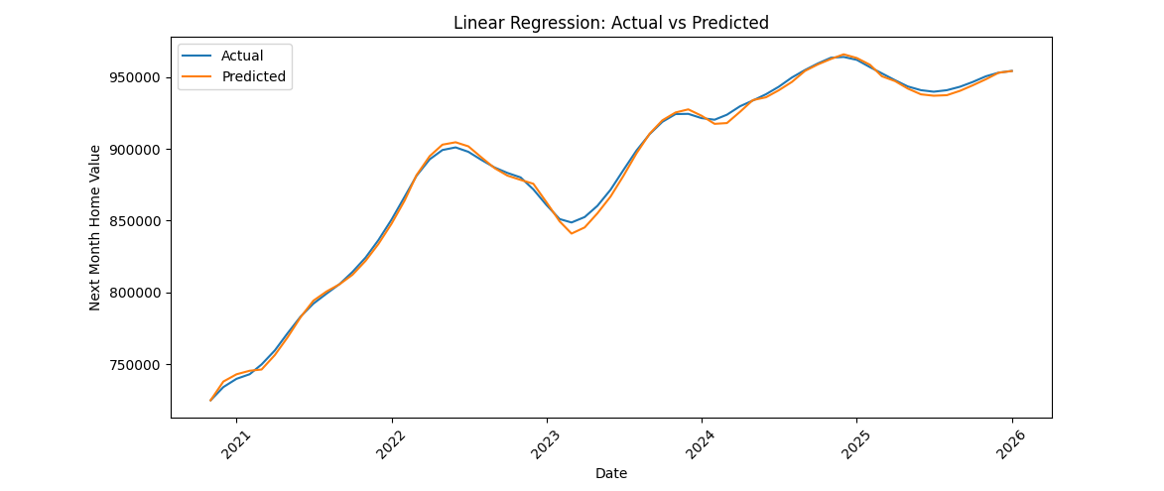
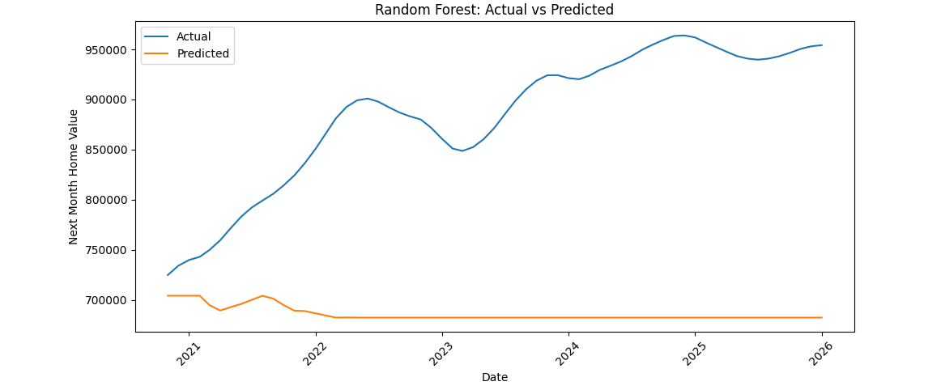
Conclusion
Successfully merged Zillow and FRED datasets by date Built and compared Linear Regression and Random Forest
Linear Regression performed best with R² = 0.9982 Streamlit app made the project interactive and practical

Slide 13



Key Learnings and Future Directions
Takeaways
Future Scope
High-accuracy forecasting achieved via simple, robust linear modeling.
Future Improvements
Expand to multiple cities, integrate more economic indicators (inflation, supply), and explore deep learning (LSTM) for deeper forecasting.
Data preparation and feature engineering outweigh model complexity.
Interactive Streamlit app successfully bridged technical results and practical use

