Slide 1
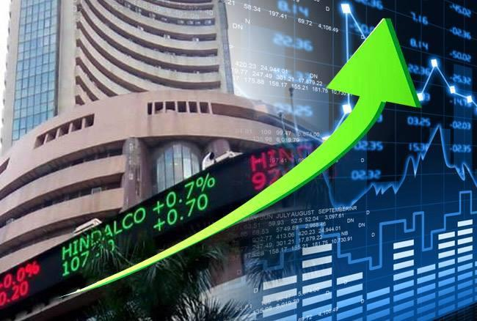
Stock Market Trend Analysis
Final Year Project
End-term presentation
Supervised by: . Dr. Vivek Chaturvedi
Amish Ranjan | 111501032

Slide 2
Objective
To develop a method for prediction of stock price direction, that
Creates and selects the best features
Creates different models
Produces a descriptive result
Shall be robust
Could be used for Commercial purpose

Slide 3
Motivation
Lots of literature
Not very much commercialization of research
Mathematical confidence is better than random guess
Risks are high
Challenging data
New things to learn about stock market
Understanding statistical approach
Use of coding expertise, data structure, machine learning
Notes:
Clean and correct code:- even a slight up and down in array index would result in total loss.

Slide 4
Tools used
Python
Numpy
Pandas
Matplotlib
Ta-lib
Sk-learn
Keras
StatsModel
Tkinter
Notes:
Clean and correct code:- even a slight up and down in array index would result in total loss.

Slide 5
Key-steps
Analyzing different stock market data
Reviewing current literature
Finding flaws with current literature
Providing Solution to those
Creating features
Feature selection
Defining new better models
Understanding the time-series characteristic of data
Developing model solely based on that
Comparison of models
Result analysis

Slide 6
Background
Raw data contains Open, Low, High, Close, Volume for each working day.
Two types of prediction : Open/Close, Close/Close(more preferred?).
Single day prediction/Multiple day prediction(more easy?)
How do most of the traders currently work?
Use their business understanding.
Try to analyze impact of international market to local market.
Closely watch the govt. Decisions, upcoming festivals, occasional events, companies policy etc.
Often indulge in improper means to gain information like insider trading.
They also use some statistical tool(??) to analyze the trend.

Slide 7
Statistical tool
Technical indicators used by traders
Mathematical formulas in terms of OHLCV.
Indicate different states of stocks
Few of them are:-Relative Strength Indicator, Stochastic %K, STochastic %D, Slow %D, Momentum, Rate of Change, Williams %R, A/D oscillator, Disparity, Price Oscillator(OSCP), Commodity Channel Index, Triple Exponential Moving Average etc.
A lot more of them, each holding some particular significance.
Can be calculated over variable number of days to fit our prediction need(short-term/long-term).
Notes:
1- for large scale buy sell directly

Slide 8
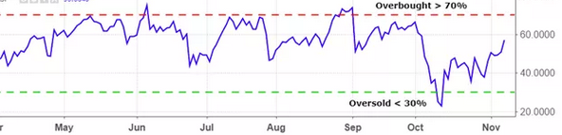
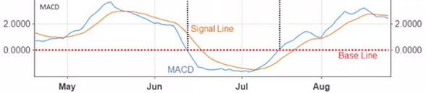
Relative Strength Indicator(RSI)
Moving Average Convergence Divergence(MACD)
RSI = 100 – [100 / ( 1 + (Average of Upward Price Change / Average of Downward Price Change ) ) ] where the Upward and Downward price change may be calculated over variable number of days( preferrably in multiple of week days).
Lies between 0-100, >70 indicating overbought(?) and <30 indicating oversold(?)
Traders use this directly to buy and sell stocks during extreme condition.
MACD is calculated by subtracting the 26-period EMA from the 12-period EMA.
9-period EMA is considered as signal line
Above the signal line represents the buying condition while below it represents selling condition..

Slide 9
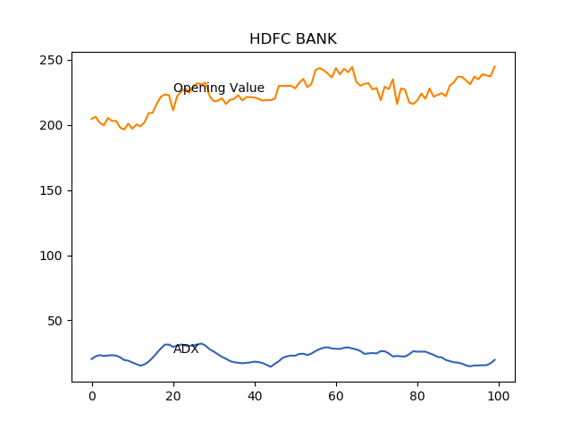
Why should we use these indicators?
Almost all researchers suggest this
Bad performance over OHLCV
Improved performance over these indicators
Each indicators have their own importance and in models like random forest, it is like taking a vote from different features.
Most important, it cancels the short term noise(daily noise)
Notes:
Point 2 not for neural network, we shall see it later
ADX= average directional index

Slide 10
Literature Survey
[1] Xienji Di. Stock Trend Prediction with Technical Indicators using SVM. SCPD Apple. 2011.
[2] Jia-Yann Leu Jung-Hua Wang. Stock Market Trend Prediction Using ARIMA-based Neural Networks. International Conference on neural network. 2016.
[3] Fangyan Dai Kai Chen Yi Zhou. A LSTM-based method for stock returns prediction: A case study of China stock market. IEEE International Conference on Big Data.2015.
[4] M. Thenmozhi Manish Kumar. FORECASTING STOCK INDEX MOVEMENT: A COMPARISON OF SUPPORT VECTOR MACHINES AND RANDOM FOREST. Indian Institute of Capital Markets 9th Capital Markets Conference Paper. 2006.
[5] M. Thenmozhi Manish Kumar. Stock Index Return Forecasting and Trading Strategy Using Hybrid ARIMA-Neural Network Model.
[6] Luckyson Snehanshu Sudeepa. Predicting the direction of stock market prices using random forest. Applied Mathematical FInance. 2016.

Slide 11
Literature Survey(contd.)
Each paper gives a different idea. Some of them are:-
Use of technical indicators.
Varying hyperparameter to fit a model particularly in a dataset.
Predicting over a longer interval rather than day-to-day prediction.
Retraining model over and over again with a rolling window.
Exponential smoothing of data.
Creating ensemble of different models.
Feature Selection.
Time series analysis of data
Making data stationary
Use of ARIMA model

Slide 12
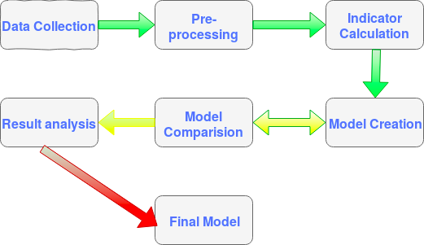
Workflow

Slide 13
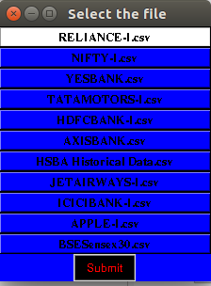
Data Collection
Indian Dataset(after 2005).
BSE SENSEX
Nifty 50
HDFC BANK
ICICI BANK
AXIS BANK
YES BANK
HSBC
TATA MOTORS
APPLE(USA)
All of the datas are available on in.investing.com free for any commercial and non-commercial use.
Any new data should must be saved in data/raw_data folder in csv format.

Slide 14
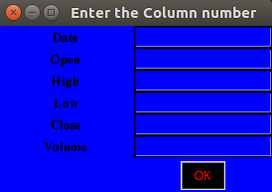
Data pre-processing
All files have Date, Open, High, Low, Close, Volume columns.
Enter the correct column number for Date | Day | Open | High | Low | Close | Volume.
The NA values are replaced to mean.
The pre-processed data is then saved to data/proc_data folder
Notes:
Point 2, the data is then converted to a fixed format for any further use.

Slide 15

Indicator Calculation
Calculated using Ta-lib.
Two types of indicator file yoc and ycc are generated.
YOC files contain indicators for prediction of Open/Close type.
YCC files contain indicators for prediction of Close/Close type.
Total around 110 indicators generated using IndicatorCalculator class.
Created new indicator, Lag(a normalized comparison of today’s closing vs n days earlier closing).(Relevance?)
The calculated files are saved in indicators/ folder
Notes:
Point 5 same indicators are generated over various time intervals

Slide 16
Feature creation and Selection
All technical indicators(110) used as feature
Left to Recursive Feature Elimination(RFE) for feature selection
RFE eliminates features recursively based on weight of features
Total 27 features are being used
Lag1, Lag2, Lag5 is being selected repeatedly
From YOC/YCC the particular 27 are selected for use
Notes:
Point 3 like in linear regression we have coefficient corresponding to each features

Slide 17
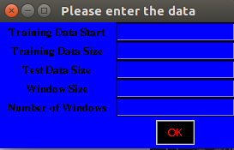
Model Creation
LASSO and RIDGE
Linear Discriminant Analysis
Naive Bayes
K Nearest Neighbour
Support Vector Machine(RBF kernel) with GridSearchCV applied over C(penalty constant) and Gamma(Kernel coefficient)
Random Forest with GridSearchCV(?) applied over number of estimators, minimum sample splits.
Ensemble model (Random Forest + SVM)
Long Short Term Memory
The data is passed to models by splitting in two parts training and testing

Slide 18
Model Comparison and Result analysis
For comparison I used Nifty 50 data set.
Model | Accuracy
Lasso | 55.3%
Ridge | 54.2%
Naive Bayes | 52.0%
K Nearest Neighbour | 53.9%
Linear Discriminant Analysis | 56.7%
Support Vector Machine | 60.8%
Random Forest | 63.7%
LSTM | 63.1%
Ensemble Model(RF+SVM) | 62.4%

Slide 19
Model Comparison and Result analysis(contd.)
Except for Random forest and Support Vector Machine there is not much to do with these models.
But with Random Forest and SVM we have several hyper-parameters to tune.
Results vary as we vary the parameters.
Hyperparameters control the tendency of overfit or underfit

Slide 20
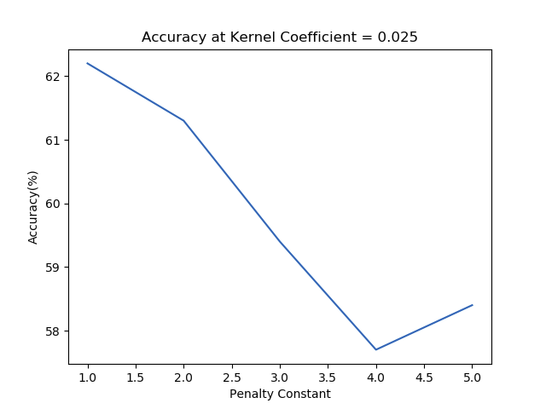
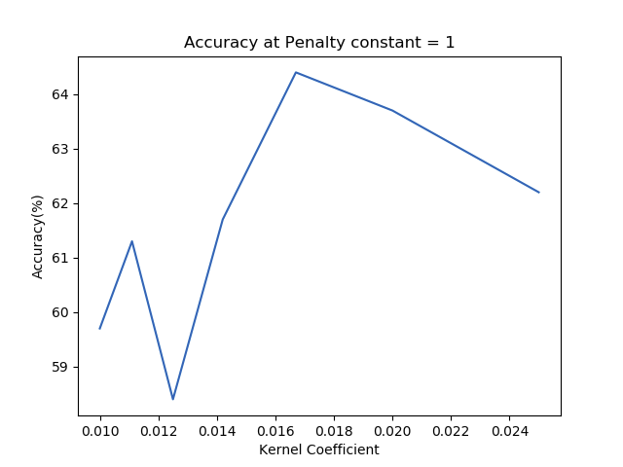
Support Vector Machine
Linear SVM just have penalty constant to vary but with kernelized SVM we also have kernel coefficient.
Penalty constant determines, how much loss could we allow to classify a data point correctly.
Kernel coefficient more or less decides the influence radius of data point.

Slide 21
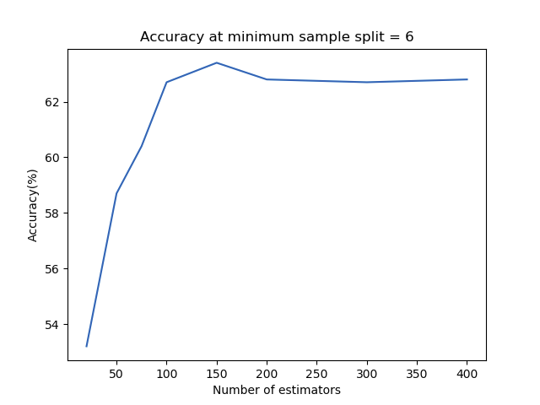
Random Forest
There are lot of parameters to vary in Random Forest like number of estimators, minimum sample split, max depth, max features, max leaf nodes etc.
Mainly number of estimators and minimum sample split affect the result, however extreme value of others may also affect.

Slide 22
Ensemble Model
LSTM
Tried several like (RF+SVM, RF+LR, RF+SVM+LR, SVM+LR etc.)
Accuracy less than the best of all models used .
Hard voting/Soft Voting
Accuracy slightly better with Soft voting
Out of 100, only 78 classified, 62 accurate.
Better return with hard voting
Two layer of LSTM (27 nodes ->300 nodes).
Output layer, 1 node of Dense
Option to store or forget information.
Not required to train with indicators
Easy to catch festival trends, seasonal market
Notes:
Point 3 define hard and soft

Slide 23
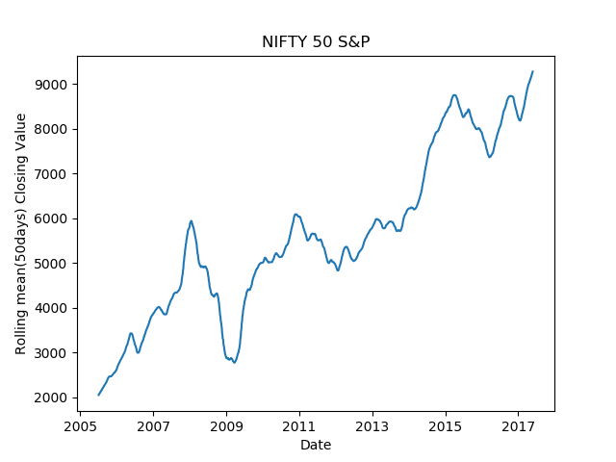
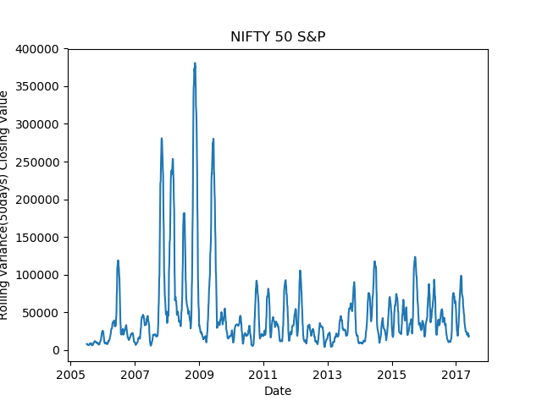
Time-series property
Ever growing data
Variable mean and variance
Non-stationary by Dickey-Fuller test

Slide 24
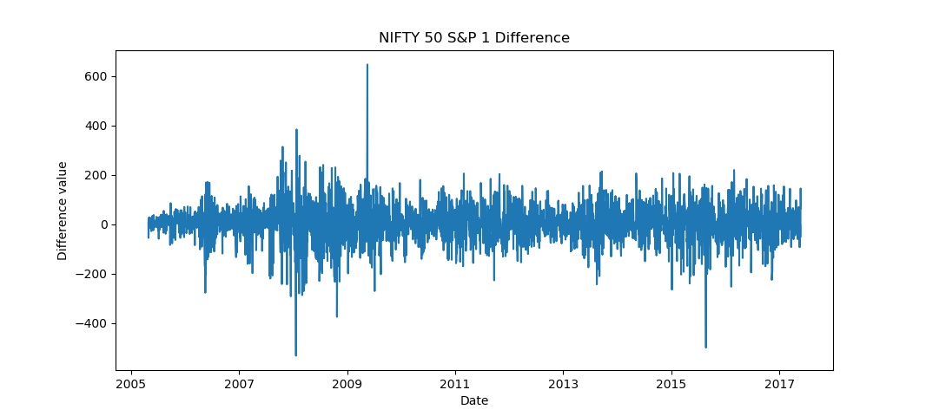
Stationary Data
Zero mean and constant variance
First/Second order difference to make data stationary
Nifty data becomes stationary after first difference
Dickey-Fuller test suggests same
Notes:
Fluctuation upto 5% is permitted

Slide 25
ARIMA model
Three parameters
Auto-regressive(p) :- Dependency on its own prior value
Integrated(d) :- Difference order to make data stationary
Moving Average(q) :- Dependency of observation on residual error
Literature suggests trial and hit method to select (p,d,q)
Not correct way
Accuracy may be result of some other influencing factors
Mathematical ways to select (p,d,q)
(d) can be selected by doing Dickey Fuller test of data.
(p) by Autocorrelation Function
(q) by Partial Autocorrelation Function
With proper (p,d,q), accuracy obtained around 67%
Notes:
Last point:- much greater for datas like jetairways, around 71%

Slide 26
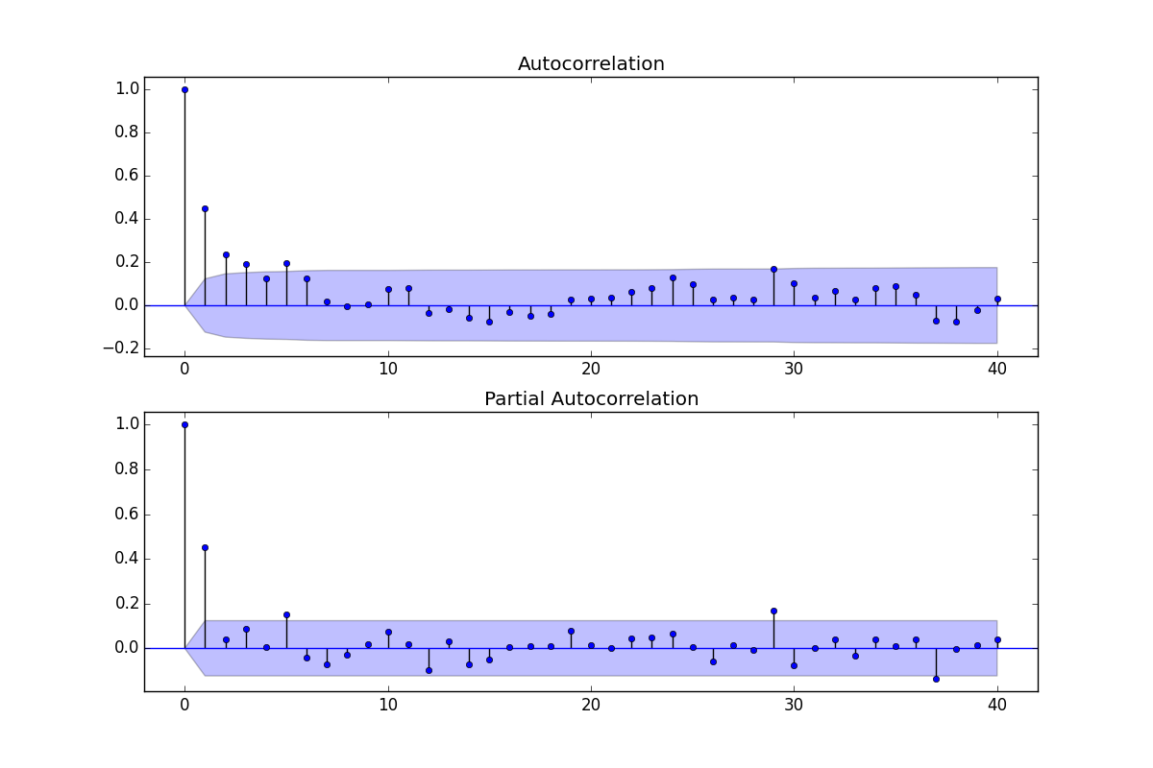
ACF and PACF
ACF :- a bar chart of the coefficients of correlation between a time series data and priors of itself
PACF :- Partial correlation between same
Notes:
Last point:- much greater for datas like jetairways, around 71%

Slide 27
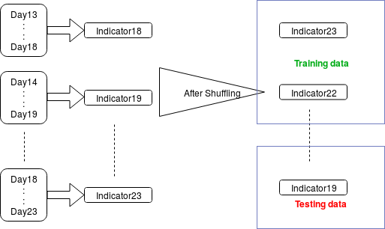
Flaws in research papers
ill representation of accuracy(next slide)
Noise-less data (Ex. Swiss stocks, Japan’s stock) or time period selection for validation of model where data was stagnant. Same can’t be generalized.
Biased data, even 100% positive/negative prediction might give great results.
Impure data
Notes:
Point 1 -Does accuracy mean profit

Slide 28
Does High Accuracy means benefits?
Even the papers somehow show high accuracy, it may not certainly lead to benefits.
Returns on each day may be different.
Higher returns on wrong prediction and lower on correct.(maybe)
Better to have false negatives than false positives.(?)
False negative means lowering price(prediction), so you buy nothing you lose nothing
False Positive means increasing price(prediction), so you buy but you have to sell at lower price
Even a greater accuracy with high false positives may result into bad returns

Slide 29
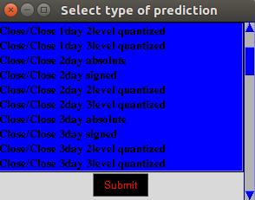


Overcoming flaws
Analyse results well
Check for overfitting
Check if result is biased(higher positives/negatives)
Check for false positives and true positives
Quantize the results for increasing true positive confidence(1/2/3 level)
Check over longer period of time before generalizing

Slide 30
Whats next?
Using Garch Model try to predict in a less volatile time period
Easing the process to predict quantized direction
Creating a interface for real-time prediction
Making tool capable of generating PDF report based on data performance
Creating a business plan for investing of money considering the lowered risk

Slide 31
Github repo: https://github.com/AmishRanjan/MarketAnalysis
Questions/Suggestions

Slide 32
Thanks!

