Slide 1
Toxic Comment Classification
Amish Ranjan
Vishal Chaudhary
Parth Patel

Slide 2
Intro
Nowadays Comments are part of almost every Social Website or E-commerce website as rating.
People sometimes use toxic language
Website administrators have to close the comment section just to avoid these things
We are trying Machine Learning’s magic to solve this problem
Toxicity may be of different types:- Basically, we are making binary classification over six classes:- Toxic, threat, insult, identity hate, severe toxic, obscene

Slide 3
Data Collection
Published by Google-Jigsaw
0.17 million wikipedia talk page edits
Labels for all six classes given

Slide 4
Data Pre-processing
Most API are not able to recognize f**k or a$$hole as toxic comment
We have processed these non-standard english words to their actual form
Removed stop words
Removed numbers, dates and other symbols

Slide 5
Feature Extraction
Used tf-idf vector for feature representation of words
To incorporate word-word relation in a sentence we have used n-gram = 5
Tuned max_dif and min_dif to reflect toxic words in feature space

Slide 6
Models Used
Logistic Regression
MLP
Deep Neural Network
LSTM

Slide 7
Logistic Regression

Slide 8
Result Of Logistic Regression Model
 | Test Accuracy(%)
Toxic | 93.31
Severe Toxic | 98.98
Obscene | 96.88
Threat | 99.72
Insult | 96.25
Identity Hate | 99.08
Due to sigmoid function property, it separates the toxic word with other words by large margin
Due to lesser computational complexity, companies tend to use it over other models

Slide 9
MULTI LAYER PERCEPTRON

Slide 10
Result Of MLP
 | Test Accuracy(%)
Toxic | 93.25
Severe Toxic | 98.79
Obscene | 96.96
Threat | 99.54
Insult | 96.3
Identity Hate | 98.98
5 hidden layers
Each layer has node with non-linear activation function
Feed forward
Uses back propagation

Slide 11
DEEP NEURAL NETWORK

Slide 12
Result : Deep Neural Network
 | Test Accuracy(%)
Toxic | 94.45
Severe Toxic | 98.94
Obscene | 97.25
Threat | 99.74
Insult | 96.62
Identity Hate | 99.07
Input Layer : 100 nodes, ReLU activation
Hidden Layer : 10 nodes, ReLU activation
Output Layer : A Output Node, sigmoid activation.
Have advantage over MLP and Logistic Regression as we could have recurrent network

Slide 13
LSTM : Long Short-Term Memory

Slide 14
Result : LSTM
 | Test Accuracy(%)
Toxic | 94.43
Severe Toxic | 99.01
Obscene | 97.28
Threat | 99.74
Insult | 96.67
Identity Hate | 99.1
Input layer : 300 LSTM cells
Hidden Layer : Dense Layer
Output Node : One Output Layer
Performs better than Deep Neural network as it solves the vanishing gradient and exploding gradient problem.

Slide 15
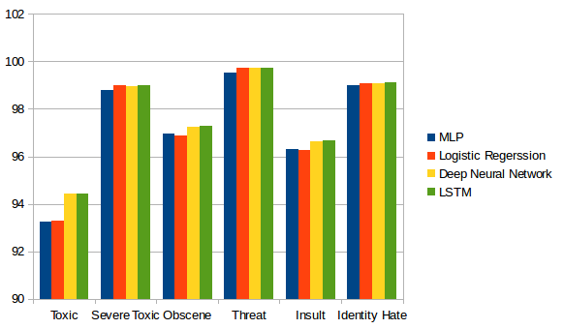
Results Comparison

Slide 16

Few examples

Slide 17
Summary
Tried other existing models presented by other research scholars
Our LSTM model tends to outperform most of the existing models on this dataset
Many research paper suggests LSTM outperforms all the models for this specific problem

