Slide 1
DEEP LEARNING
ASSIGNMENT 3
SUBMITTED BY - AMISHA ASRANI
USN - ENG19CS0029

Slide 2
Deep Neural Networks (DNN)
A deep neural network (DNN) is an artificial neural network (ANN) with multiple layers between the input and output layers.^{[13][2]} There are different types of neural networks but they always consist of the same components: neurons, synapses, weights, biases, and functions.^{[110]} These components functioning similar to the human brains and can be trained like any other ML algorithm.
An artificial network consists of a pool of simple processing units which communicate by sending signals to each other over a large number of weighted connections. Many Neural networks together forms DNN.
It mainly has dense layers which consists of input, output and dense neurons.

Slide 3
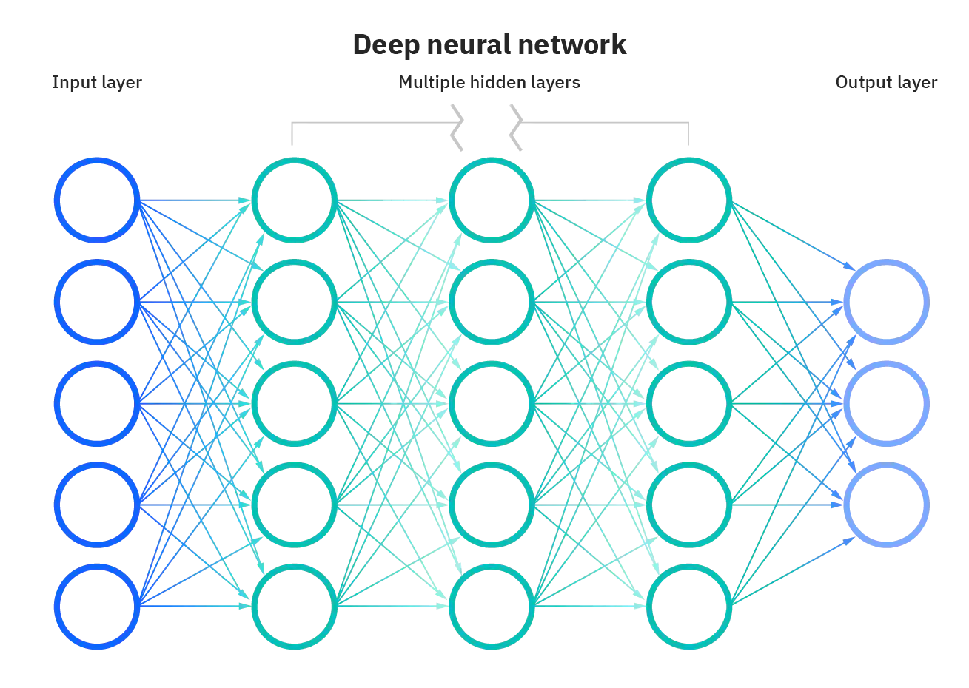

Slide 4
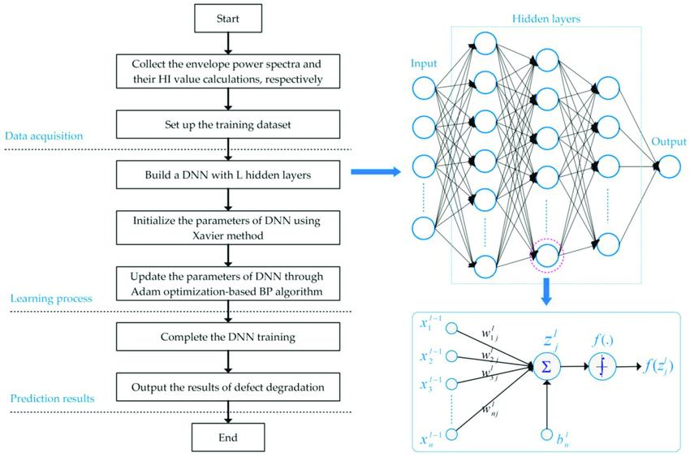

Slide 5
Convolution Neural Network (CNN)
Convolutional Neural Network or CNN is a type of artificial neural network, which is widely used for image/object recognition and classification. Deep Learning thus recognizes objects in an image by using a CNN.
convolutional neural networks (ConvNets or CNNs) are more often utilized for classification and computer vision tasks. Prior to CNNs, manual, time-consuming feature extraction methods were used to identify objects in images. However, convolutional neural networks now provide a more scalable approach to image classification and object recognition tasks, leveraging principles from linear algebra, specifically matrix multiplication, to identify patterns within an image. That said, they can be computationally demanding, requiring graphical processing units (GPUs) to train models.

Slide 6


Slide 7
APPLICATIONS OF CNN
Decoding Facial Recognition
Analyzing Documents
Historic and Environmental Collections
Understanding Climate
Advertising
Grey Areas
Video analysis
Recognize obstacles in self-driving cars

Slide 8
RECURRENT NEURAL NETWORK (RNN)
A recurrent neural network (RNN) iLike feedforward and convolutional neural networks (CNNs), recurrent neural networks utilize training data to learn. They are distinguished by their “memory” as they take information from prior inputs to influence the current input and output. While traditional deep neural networks assume that inputs and outputs are independent of each other, the output of recurrent neural networks depend on the prior elements within the sequence. While future events would also be helpful in determining the output of a given sequence, unidirectional recurrent neural networks cannot account for these events in their predictions.
s a type of artificial neural network which uses sequential data or time series data.

Slide 9
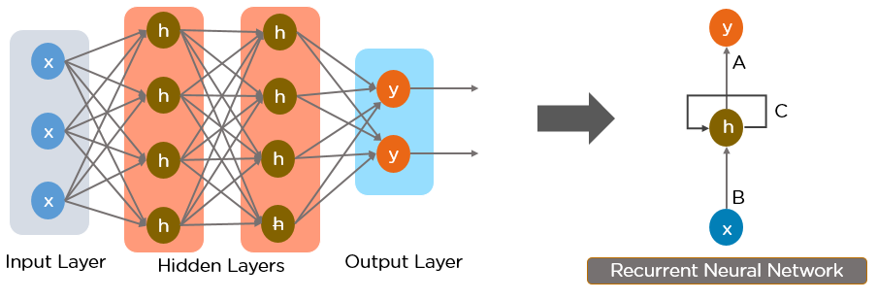

Slide 10
APPLICATIONS OF RNN
Prediction problems.
Machine Translation.
Speech Recognition.
Language Modelling and Generating Text.
Video Tagging.
Generating Image Descriptions.
Text Summarization.
Call Center Analysis.

Slide 11
Generative Adversarial Networks (GAN)
Generative Adversarial Networks, or GANs for short, are an approach to generative modeling using deep learning methods, such as convolutional neural networks.
GANs are basically made up of a system of two competing neural network models which compete with each other and are able to analyze, capture and copy the variations within a dataset.
Generative Adversarial Networks (GANs) can be broken down into three parts:
Generative: To learn a generative model, which describes how data is generated in terms of a probabilistic model.
Adversarial: The training of a model is done in an adversarial setting.
Networks: Use deep neural networks as the artificial intelligence (AI) algorithms for training purpose.

Slide 12
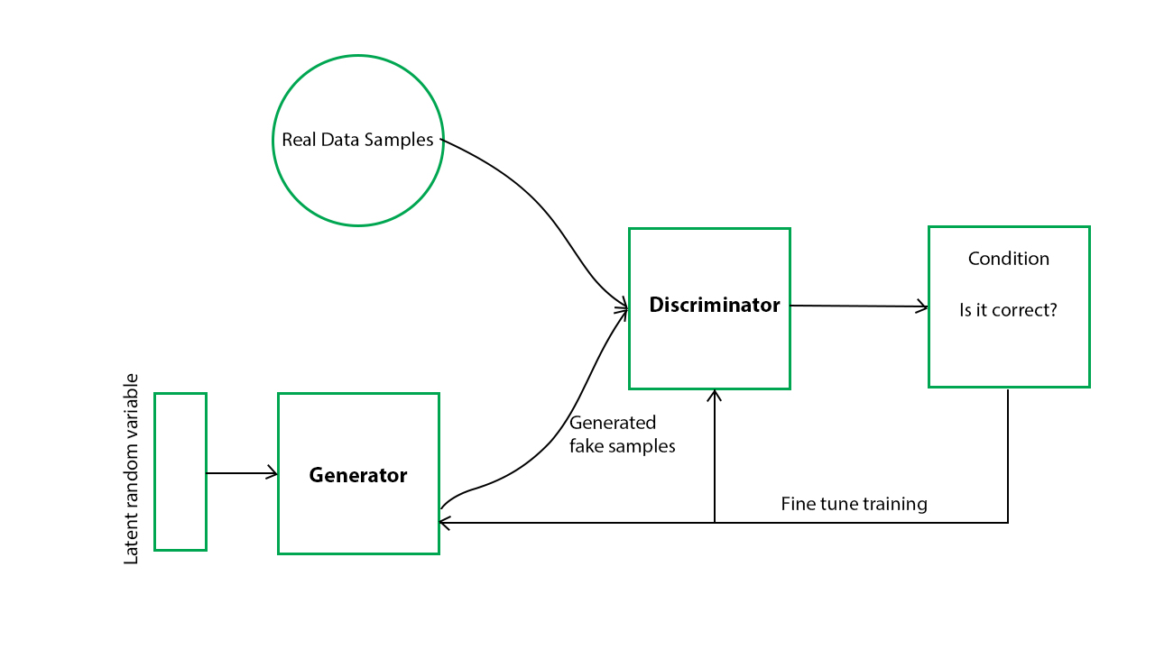

Slide 13
APPLICATIONS OF GAN
Generate Examples for Image Datasets
Generate Photographs of Human Faces
Generate Realistic Photographs
Generate Cartoon Characters
Image-to-Image Translation
Text-to-Image Translation
Semantic-Image-to-Photo Translation
Face Frontal View Generation
Generate New Human Poses
Photos to Emojis
Photograph Editing
Face Aging
Photo Blending

Slide 14
GITHUB - https://github.com/Amisha-A/Deep-Learning.git
COLAB - https://colab.research.google.com/drive/1EiJxW_D8atDprEHgm-3Rff5XtGm5UJuc?usp=sharing

Slide 15
THANKYOU..

