Slide 1

DAYANANDA SAGAR UNIVERSITY
ASSIGNMENT 1 OF DEEP LEARNING
SUBMITTED BY-
AMISHA ASRANI
USN:ENG19CS0029
SEM/SECTION: V ‘A’

Slide 2
MACHINE LEARNING
Machine learning (ML) is a type of artificial intelligence (AI) that allows software applications to become more accurate at predicting outcomes without being explicitly programmed to do so.
Machine learning involves the use of machine learning algorithms and models.
Machine learning algorithms use historical data as input to predict new output values.
Classical machine learning is often categorized by how an algorithm learns to become more accurate in its predictions.
There are four basic approaches: supervised learning, unsupervised learning, semi-supervised learning and reinforcement learning.
The type of algorithm data scientists choose to use depends on what type of data they want to predict.

Slide 3
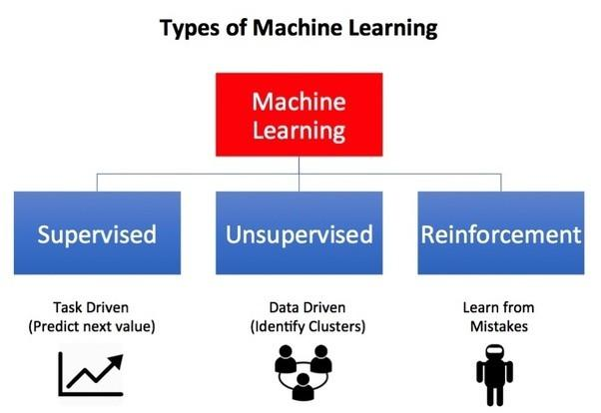

Slide 4
Supervised Learning: In this type of machine learning, data scientists supply algorithms with labeled training data and define the variables they want the algorithm to assess for correlations. Both the input and the output of the algorithm is specified.
Learning from someone(teacher or supervisor)Inputs are called features and Output is called label.
Unsupervised Learning: This type of machine learning involves algorithms that train on unlabeled data. The algorithm scans through data sets looking for any meaningful connection. The data that algorithms train on as well as the predictions or recommendations they output are predetermined.
Learning on your own(without any external guidance)Consists of features only.
Reinforcement Learning: Data scientists typically use reinforcement learning to teach a machine to complete a multi-step process for which there are clearly defined rules. Data scientists program an algorithm to complete a task and give it positive or negative cues as it works out how to complete a task. But for the most part, the algorithm decides on its own what steps to take along the way.
This is the kind of ML where reward is given when the task is completed else penalty is issued.

Slide 5
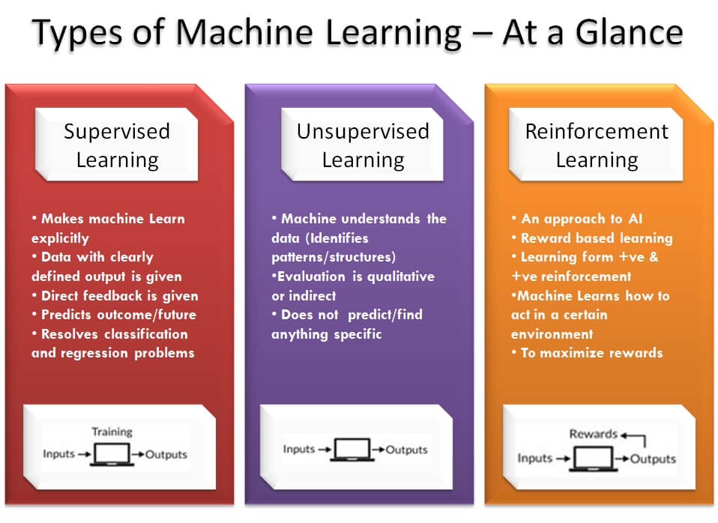

Slide 6
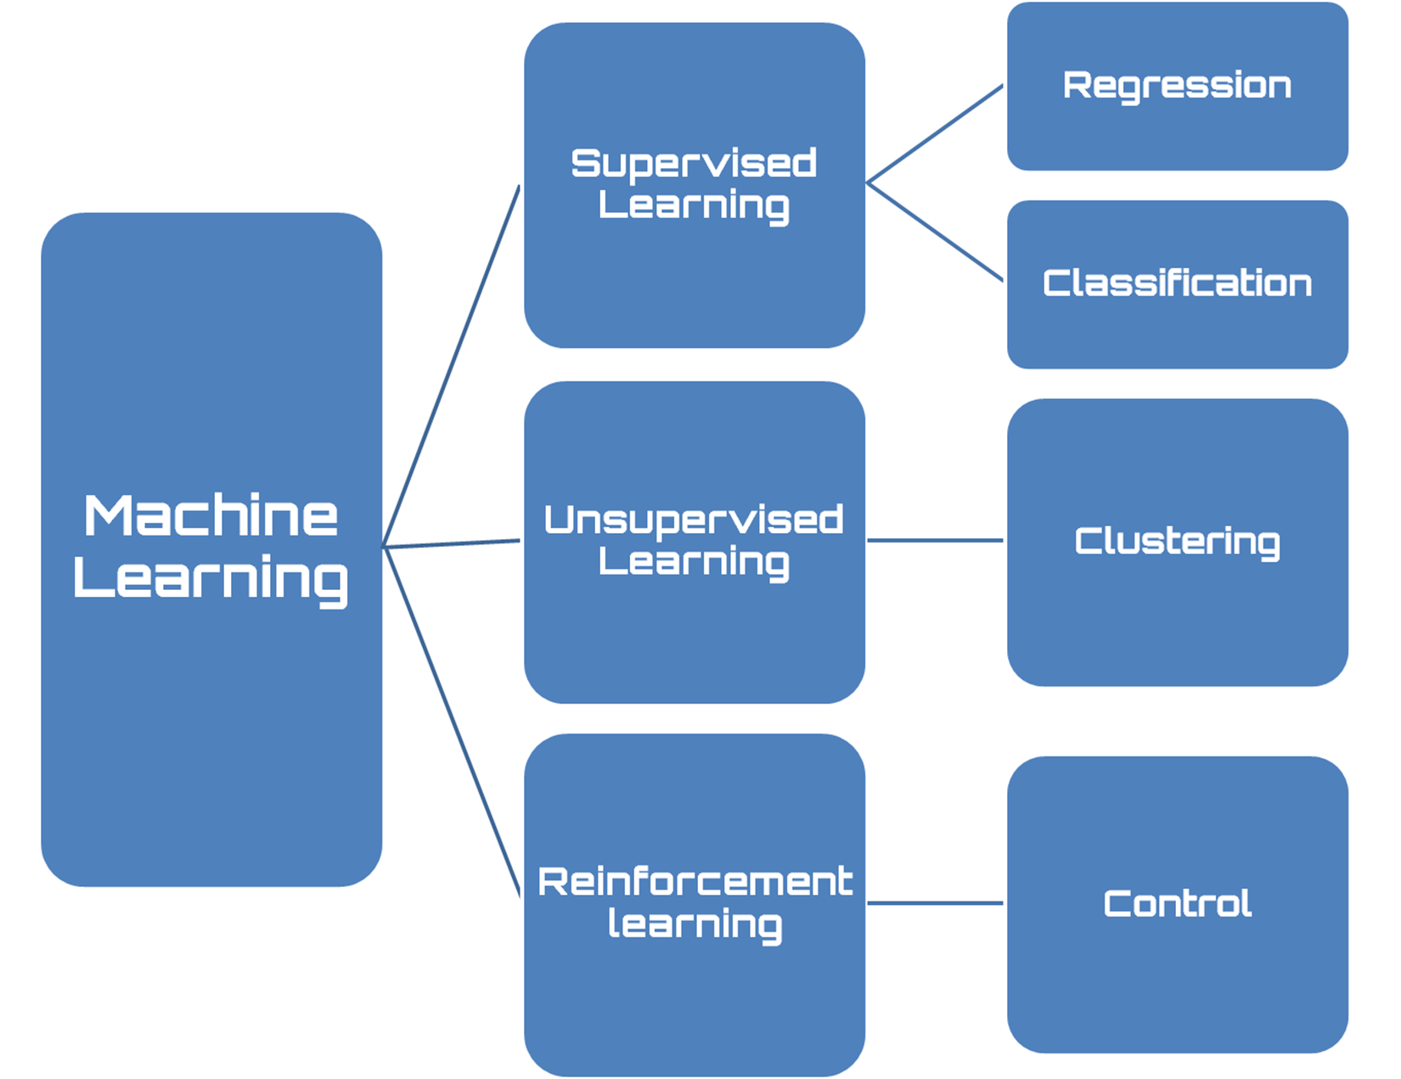

Slide 7
SUPERVISED MACHINE LEARNING
Supervised learning, also known as supervised machine learning, is defined by its use of labeled datasets to train algorithms that to classify data or predict outcomes accurately. As input data is fed into the model, it adjusts its weights until the model has been fitted appropriately. This occurs as part of the cross validation process to ensure that the model avoids overfitting or underfitting. Supervised learning helps organizations solve for a variety of real-world problems at scale, such as classifying spam in a separate folder from your inbox.
Supervised learning can be separated into two types of problems when data mining—classification and regression:
Classification uses an algorithm to accurately assign test data into specific categories. It recognizes specific entities within the dataset and attempts to draw some conclusions on how those entities should be labeled or defined. Common classification algorithms are linear classifiers, support vector machines (SVM), decision trees, k-nearest neighbor, and random forest, which are described in more detail below.
Regression is used to understand the relationship between dependent and independent variables. It is commonly used to make projections, such as for sales revenue for a given business. Linear regression, logistical regression, and polynomial regression are popular regression algorithms.

Slide 8
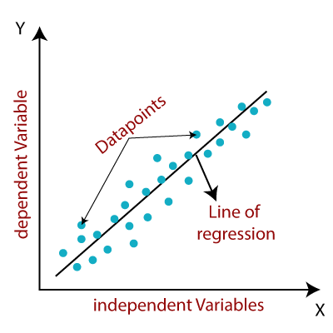
LINEAR REGRESSION
Linear regression is used to identify the relationship between a dependent
variable and one or more independent variables and is typically leveraged to
make predictions about future outcomes. When there is only one independent
variable and one dependent variable, it is known as simple linear regression.
As the number of independent variables increases, it is referred to as multiple
linear regression. For each type of linear regression, it seeks to plot a line of
best fit, which is calculated through the method of least squares. However,
unlike other regression models, this line is straight when plotted on a graph.

Slide 9
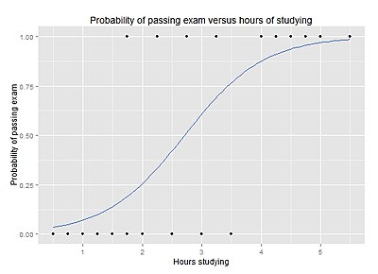
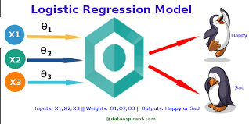
LOGISTIC REGRESSON
While linear regression is leveraged when dependent variables are continuous, logistical regression is selected when the dependent variable is categorical, meaning they have binary outputs, such as "true" and "false" or "yes" and "no." While both regression models seek to understand relationships between data inputs, logistic regression is mainly used to solve binary classification problems, such as spam identification.

Slide 10
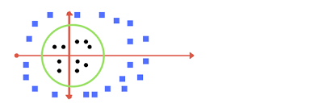
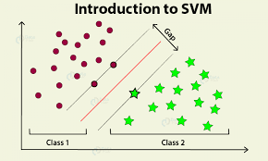
SUPPORT VECTOR MACHINE(SVM)
A support vector machine is a popular supervised learning model developed by Vladimir Vapnik, used for both data classification and regression. That said, it is typically leveraged for classification problems, constructing a hyperplane where the distance between two classes of data points is at its maximum. This hyperplane is known as the decision boundary, separating the classes of data points (e.g., oranges vs. apples) on either side of the plane.
Is the algorithm in which we plot each data as just a point in n – dimensional space. Where n is the number of features(input or dataset). Then we classify the output from the given space

Slide 11
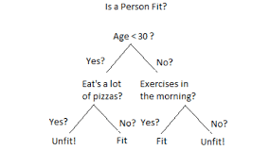
DECISION TREE
It belongs to supervised learning algorithm. Decision tree can be used to classification and regression both having a tree like structure. In a decision tree building algorithm first the best attribute of dataset is placed at the root, then training dataset is split into subsets. Splitting of data depends on the features of datasets. This process is done
until the whole data is classified and we find leaf node at each
branch. Information gain can be calculated to find which feature
is giving us the highest information gain. Decision trees are built
for making a training model which can be used to predict class
or the value of target variable.

Slide 12
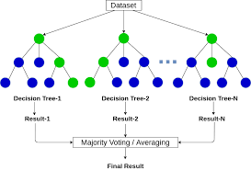
RANDOM FOREST
Random forest is another flexible supervised machine learning algorithm used for both classification and regression purposes. The "forest" references a collection of uncorrelated decision trees, which are then merged together to reduce variance and create more accurate data predictions.
A random forest algorithm consists of many decision trees. The ‘forest’ generated by the random forest algorithm is trained through bagging or bootstrap aggregating. Bagging is an ensemble meta-algorithm that improves the accuracy of machine learning algorithms.The (random forest) algorithm establishes the outcome based on the predictions of the decision trees. It predicts by taking the average or mean of the output from various trees. Increasing the number of trees increases the precision of the outcome.A random forest eradicates the limitations of a decision tree algorithm. It reduces the overfitting of datasets and increases precision.

Slide 13
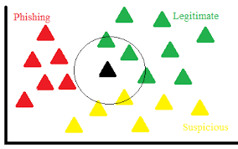
K NEAREST NEIGHBOUR (KNN)
K-nearest neighbor, also known as the KNN algorithm, is a non-parametric algorithm that classifies data points based on their proximity and association to other available data. This algorithm assumes that similar data points can be found near each other. As a result, it seeks to calculate the distance between data points, usually through Euclidean distance, and then it assigns a category based on the most frequent category or average.
Its ease of use and low calculation time make it a preferred algorithm by data scientists, but as the test dataset grows, the processing time lengthens, making it less appealing for classification tasks. KNN is typically used for recommendation engines and image recognition.The value of K is the most crucial part in this algorithm

Slide 14
COLAB-
https://colab.research.google.com/drive/1JxM_akpcbh1QLMDX_Qn4u45qgWkPkq4p?usp=sharing
GITHUB-
Github-https://github.com/Amisha-A/machine-learning.git

