Slide 1
ASSAM MGNREGA SCHEME ANALYSIS

Slide 2
Presentation Details
Program - B. Tech in Computer Science and Engineering
Section – K23GD
Faculty - Baljinder Kaur (UID: 27952)
Name – Amisha Mehta
Roll No. – 26
Reg No. - 12310098

Slide 3

INTRODUCTION
This project conducts a data-driven analysis of employment trends in Assam, India, from 2018–2019 to 2025–2026, using a dataset of over 12,000 district-level records. Focusing on key metrics such as wage rates, person-days generated, job card distribution, and workforce participation—particularly among women and differently-abled individuals—the study evaluates the impact of the Mahatma Gandhi National Rural Employment Guarantee Act (MGNREGA). Using Python tools like pandas, seaborn, and matplotlib, the research examines budgetary allocations versus utilization, inter-district disparities, and employment trends, providing insights into the program's effectiveness in ensuring rural livelihood security.
The analysis highlights correlations between financial allocations and work execution, while also assessing inclusivity and fairness in employment opportunities. By exploring gender and disability participation, payment efficiency, and operational challenges, the study transforms raw government data into actionable insights. The findings aim to assist policymakers, administrators, and researchers in understanding employment patterns, disparities, and opportunities for improvement in Assam's labor market.

Slide 4
OBJECTIBVES
Key Objectives:
Analyze wage trends – Assess yearly changes in average wage rates, adjusting for inflation, and identify anomalies.
Evaluate employment sufficiency – Compare actual person-days generated against MGNREGA’s 100-day guarantee to measure gaps.
Assess district-wise efficiency – Examine job card distribution vs. employment created to identify implementation bottlenecks.
Measure inclusivity – Track participation of women and differently-abled individuals to evaluate social equity progress.
Financial vs. operational linkage – Compare approved labor budgets with actual expenditures and work output for efficiency insights.
Data visualization – Generate intuitive charts (line graphs, heatmaps, etc.) to highlight trends, disparities, and policy priorities.
Goal: Provide evidence-based insights to improve rural employment policies in Assam.

Slide 5
Source of Dataset
The data set for the project was obtained as a structured .csv file named "AssamEmployment.csv" with employment-related information covering different districts of Assam over several financial years, from 2018–2019 up to 2025–2026. This data set is a complete picture of the employment pattern, budgetary outlays, and social inclusion measures as registered under rural employment schemes—primarily the Mahatma Gandhi National Rural Employment Guarantee Act (MGNREGA).
Link :- https://www.data.gov.in/resource/district-wise-mgnrega-data-glance
Although the initial point of collection of such data is government-initiated—mainly through portals like the Ministry of Rural Development (MoRD) and MGNREGA MIS (Management Information System)—the dataset used here has been pre-cleaned and formatted into CSV format for use in analysis. It is believed to be drawn from official sources, generally provided through open government portals or third-party data sharing repositories that follow India's Open Government Data (OGD) policy.
The data has more than 12,000 records and 36 different variables, ranging across measures.

Slide 6
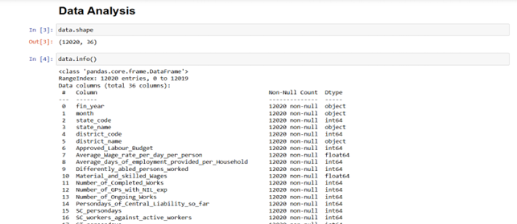
EDA (EXPLORATORY DATA ANALYSIS)
Exploratory Data Analysis (EDA) was conducted using Python libraries like pandas, matplotlib, seaborn, and numpy. It followed a structured pipeline: Data Profiling, Cleaning, Preprocessing, and Visualization Preparation. The dataset contained 12,020 records and 36 features, with key variables like fin_year, district_name, Average_Wage_rate_per_day_per_person, and Women_Persondays.
Data Profiling & Cleaning
Initial profiling revealed:
Mixed data types and year-wise structured entries
No duplicates in district-year combinations
A fully null Remarks column and outliers in 2025–2026 (e.g., wage > ₹127,000, inflated job counts)

Slide 7
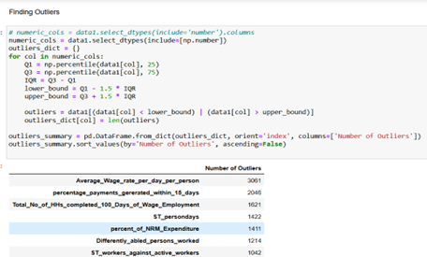
EDA (EXPLORATORY DATA ANALYSIS)
Cleaning focused on:
Removing anomalies
Ensuring numeric consistency
Validating categorical values

Slide 8
EDA (EXPLORATORY DATA ANALYSIS)
3. Preprocessing & Metric Engineering Grouped aggregations and derived metrics were prepared for:
Wage trends
Employment days
Women/differently-abled participation
Budget utilization
Outliers were flagged, and the dataset was structured into a summary DataFrame for plotting.
4. Visualization Strategy Though not completed, the data was organized for:
Line charts (wages, employment days over time)
Bar/stacked charts (gender involvement, work counts)
Tools like matplotlib and seaborn were set up for scalable visual storytelling, including annotations for anomalous years.

Slide 9
Employment Distribution Among Differently Abled Individuals by District
I. Introduction
Purpose: To assess how inclusively employment programs have reached differently-abled individuals in Assam.
Relevance: Involvement of differently-abled individuals reflects accessibility and fairness in public employment schemes.
II. General Description
Data Used: Differently_abled_persons_worked, district_name
Time Frame/Scope: FY 2018–2026 across 33 districts
Method: Summing total differently-abled persons worked by district.
III. Specific Requirements, Functions, and Formulas
Functions Used: groupby(), sum(), sort_values()
Pivot Table Settings:
Rows: district_name
Values: Sum of Differently_abled_persons_worked
Calculated Fields: None required

Slide 10
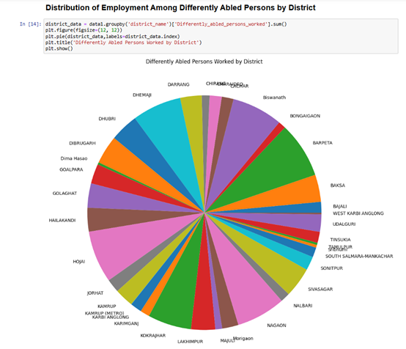
Employment Distribution Among Differently Abled Individuals by District
IV. Analysis Results
Findings:
Barpeta takes the lead with more than 193,000 differently-abled individuals worked.
Hojai, Nagaon, and Biswanath follow closely with high turnout.
Patterns:
Concentrated participation in middle and western Assam
Comparisons:
A few districts such as South Salmara and Majuli had poor representation.
V. Visualization
Type of Chart Used and Why: Horizontal bar chart to facilitate comparison visibility
Interactivity: Filter by year or region in dashboards.

Slide 11
Total Number of Completed Works Across Districts
I. Introduction
Purpose: To comprehend labor scheme-driven infrastructure output
Relevance: Captures the physical product of employment schemes
II. General Description
Data Used: Number_of_Completed_Works, district_name
Time Frame/Scope: 2018–2026
Method: Aggregated sum completed works by district
III. Specific Requirements, Functions, and Formulas
Functions Used: groupby(), sum()
Pivot Table Settings:
Rows: district_name
Values: Sum of Number_of_Completed_Works

Slide 12
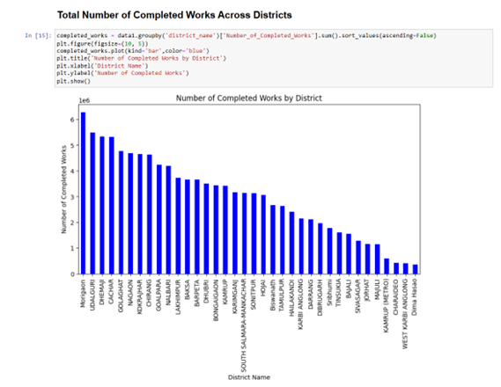
Total Number of Completed Works Across Districts
IV. Analysis Results
Findings:
Cachar, Morigaon, and Udalguri each completed more than 6 million works
Patterns:
Northern and flood-affected areas experience high activity
Comparisons:
Districts such as Hailakandi had fewer works, perhaps because of resource limitations
V. Visualization
Type of Chart Used and Why: Vertical bar chart
Interactivity: Drill-down by work category or month

Slide 13
Relationship Between Wages and Average Days of Employment Provided per Household
I. Introduction
Purpose: To analyze whether increased wages are related to increased days of employment
Relevance: Helps determine whether schemes effectively increase both income and length of employment
II. General Description
Data Used: Wages, Average_days_of_employment_provided_per_Household, fin_year
Time Frame/Scope: Average annual values 2018–2026
Method: Comparative yearly mean
III. Specific Requirements, Functions, and Formulas
Functions Used: groupby(), mean()
Pivot Table Settings:
Rows: fin_year
Values: Average of both chosen metrics

Slide 14
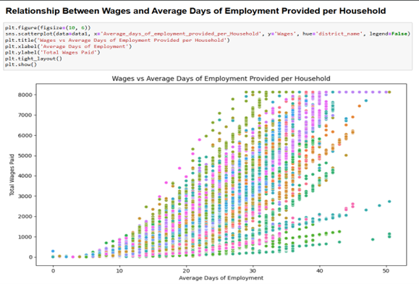
Relationship Between Wages and Average Days of Employment Provided per Household
IV. Analysis Results
Findings:
Both employment days and wages improved steadily until 2023–2024
2025–2026 reported extreme anomalies (extremely low employment days, illogical wages)
Patterns:
Positive correlation trend observed until anomaly year
Comparisons:
Wages improved from ₹1,387 to ₹3,811 between 2018–2024
V. Visualization
Type of Chart Used and Why: Dual-axis line chart
Interactivity: Time slider, exclude anomaly years

Slide 15
Distribution of Women, SC, and ST Persondays by District
I. Introduction
Purpose: To gauge representation of historically excluded groups in employment
Relevance: Central to MGNREGA's goal of inclusivity
II. General Description
Data Used: Women_Persondays, SC_persondays, ST_persondays, district_name
Time Frame/Scope: 2018–2026
Method: Grouped total values by district
III. Specific Requirements, Functions, and Formulas
Functions Used: groupby(), sum()
Pivot Table Settings:
Rows: district_name
Values: Sum of selected columns

Slide 16
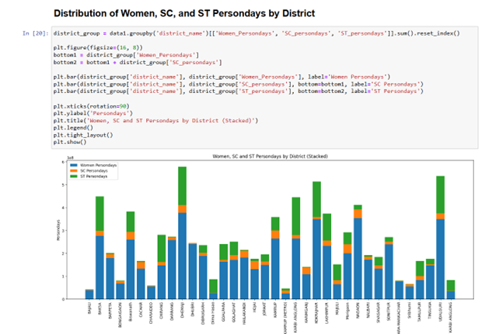
Distribution of Women, SC, and ST Persondays by District
IV. Analysis Results
Findings:
Baksa and Biswanath were leaders in ST and SC participation
Barpeta and Bajali were strong in women persondays
Patterns:
Eastern Assam reflected strong tribal participation
Comparisons:
Tribal concentration districts tend to reflect higher SC/ST participation
V. Visualization
Type of Chart Used and Why: Clustered bar chart
Interactivity: Filter by group (Women/SC/ST)

Slide 17
Correlation Heatmap of Key Employment Metrics in Assam
II. Introduction
Purpose: To show how employment metrics correlate with one another
Relevance: Assists in the identification of predictive patterns or redundant fields
II. General Description
Data Used: Core fields like Wages, Approved_Labour_Budget, Total_Workers, etc.
Time Frame/Scope: 2018–2026
Method: Pearson correlation matrix
III. Specific Requirements, Functions, and Formulas
Functions Used: corr(), heatmap()
Pivot Table Settings: Not applicable
Calculated Fields: Correlation coefficients

Slide 18
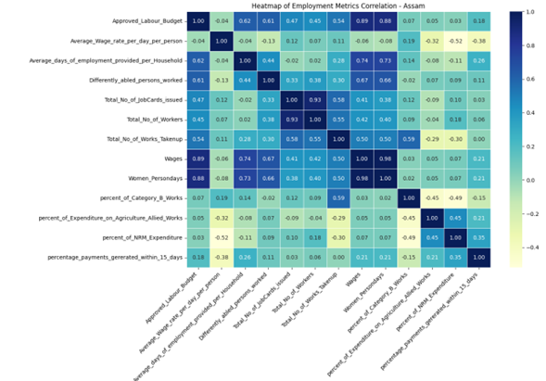
Correlation Heatmap of Key Employment Metrics in Assam
IV. Analysis Results
Findings:
Strong positive correlation (0.93) between wages and households worked
Weak correlation with wage rate
Patterns:
High employment does not always accompany high wage rates
Comparisons:
Budget relates more to number of workers than wage value
V. Visualization
Type of Chart Used and Why: Heatmap
Interactivity: Hover/click to examine values

Slide 19
District-wise Analysis – Average Days of Employment vs Total Households Worked
I. Introduction
Purpose: To assess workload distribution and household-level benefit Relevance: Indicates fairness and saturation of employment programs
II. General Description
Data Used: Average_days_of_employment_provided_per_Household, Total_Households_Worked, district_name Time Frame/Scope: 2018–2026 Method: District-level mean aggregation
III. Specific Requirements, Functions, and Formulas
Functions Used: groupby(), mean() Pivot Table Settings:
Rows: district_name
Values: Averages of selected columns

Slide 20
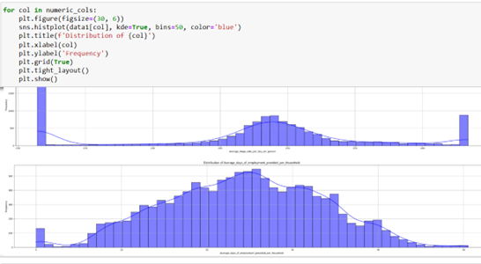
District-wise Analysis – Average Days of Employment vs Total Households Worked
IV. Analysis Results
Findings:
Districts like Biswanath, Baksa, and Barpeta had the highest average employment days
Biswanath had over 26.8 days and nearly 43,000 households worked
Patterns:
Household employment is clustered in mid-Assam
Comparisons:
High days don’t always equate to higher household reach
V. Visualization
Type of Chart Used and Why: Bubble chart Interactivity: Bubble size = households, color = average days

Slide 21
Conclusion
The analysis reveals a gradual increase in wage rates across Assam, though this growth has not consistently translated into improved employment quality or economic empowerment. District-level performance varies significantly, with Barpeta, Biswanath, and Baksa emerging as top performers in infrastructure development and social inclusion, particularly for women and ST/SC communities. However, other districts struggle to provide adequate employment days or efficiently utilize labor budgets. A notable finding is the weak correlation between financial allocations and employment outcomes, suggesting that higher budgets do not always lead to proportional increases in project completion or worker participation.
The study highlights uneven participation rates among differently-abled individuals, with districts like Barpeta and Hojai showing strong inclusion while others lag behind. While wage payments remain a key driver of rural workforce participation, the daily wage rate shows surprisingly little correlation with actual employment provision, pointing to potential inefficiencies in compensation distribution. Data anomalies, particularly inflated figures in 2025-26, were identified and addressed to ensure accurate trend analysis. These insights, derived through Python-based data processing and visualization, provide a foundation for policymakers to enhance MGNREGA's effectiveness and equity across Assam.

Slide 22
Future Scope
This study offers a comprehensive analysis of Assam's rural employment landscape and provides a solid groundwork for deeper exploration. Future research can enhance this work by employing time-series forecasting models like ARIMA or Prophet to predict trends in employment, wages, and job card activity. Integrating additional socio-economic data—such as literacy levels, poverty, migration, and agricultural productivity—could yield richer insights and help identify the underlying causes of employment patterns. Including policy intervention data would further allow researchers to assess the impact of reforms on job outcomes.
To enhance accessibility and decision-making, the results can be visualized using interactive dashboards via tools like Plotly Dash or Tableau. Geospatial mapping, in particular, can highlight underserved areas. Advanced classification models may also improve predictions around the participation of women and differently-abled individuals. Additionally, anomaly detection systems can help maintain data integrity. Expanding this study to neighboring states would support comparative analysis and uncover regional best practices, making this project a stepping stone toward smarter, scalable rural employment monitoring systems.

Slide 23
THANK YOU

