Slide 1
CSYE 7374: Design Patterns
Apple product App | team-10
Vidish kale - 002194756 - decorator, command pattern
PRANAV KULKARNI - 002743955 – façade, factory pattern
AMISHA GOKHALE - 002743313 – observer, state, strategy pattern

Slide 2
Libraries/ Frameworks
FRONTEND – REACT AND BOOTSTRAP
DATABASE – MYSQL
DATABASE CONNECTIVITY – HIBERNATE
BACKEND – JAVA EE, SPRING, APACHE TOMCAT

Slide 3
Implementation of Design Patterns
Singleton Pattern – To instantiate the model objects
Abstract Factory – To Obtain the objects for UDP
Decorator Pattern– Creating the final purchase order that includes the merchandise
State pattern – To implement strategies for designated roles
Façade pattern – To generate a PDF and send notifications
Command pattern – USED To facilitate communication between the client and the server
Strategy pattern – USED To alter the approach for crud operations while they are running
Observer pattern – To inform all buyers who have registered for the new product

Slide 4
Applied learning from CSYE-7374 lecture
Command Pattern – Command Pattern is a type of design pattern, that turns the requests into a standalone object. This standalone object is called a command. it can enhance flexibility and extensibility in designing systems that involve requests and actions.
Decorator pattern - The Decorator Pattern is a structural design pattern that allows behavior to be added to an individual object, either statically or dynamically, without affecting the behavior of other objects from the same class. Decorator Pattern allows dynamic attachment of additional responsibilities to an object in a reusable way without modifying the original structure.

Slide 5
Applied learning from CSYE-7374 lecture
Factory Pattern – The Factory Pattern is a creational design pattern that provides an interface for creating objects in a super class, but allows subclasses to alter the type of objects that will be created.
facade pattern – façade pattern make it easier to use and reduce the complexity of interactions with the subsystem. Façade pattern is particularly useful while working with large or complex subsystem.

Slide 6
Applied learning from CSYE-7374 lecture
observer Pattern – The Observer Pattern is a behavioral design pattern that defines a one-to-many dependency between objects so that when one object changes state, all its observers are notified and updated automatically. Observer Pattern facilitates a loosely coupled communication between objects.
strategy pattern – strategy pattern is particularly used when a family of algorithms have to share a common interface. Strategy pattern has the ability to dynamically switch behaviors at runtime and supports encapsulation and modularity

Slide 7
Applied learning from CSYE-7374 lecture
state Pattern – The State Pattern is a behavioral design pattern that allows an object to alter its behavior when its internal state changes. provides a clean and flexible way to model objects that exhibit different behaviors based on internal states. THE state pattern makes it easier to add new states and extend the behavior of object without modifying existing code

Slide 8
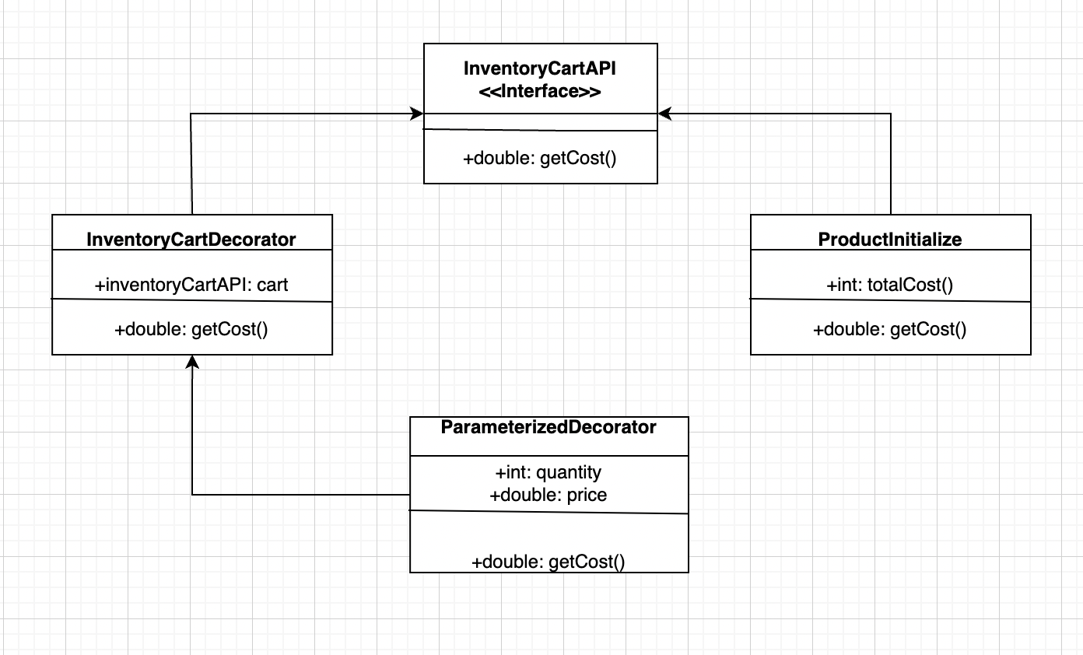
UML – Decorator Pattern
Decorator Pattern is implemented to add products for the creation of new purchase order

Slide 9
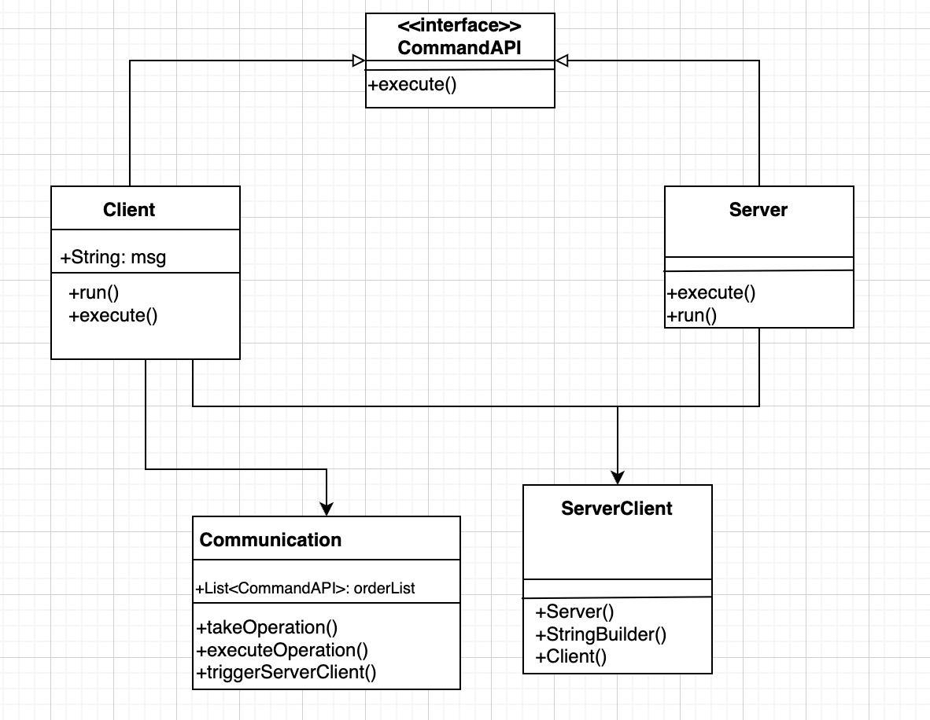
UML – Command Pattern
Through the uml-command pattern, the server sends an alert, when the quantity is low

Slide 10
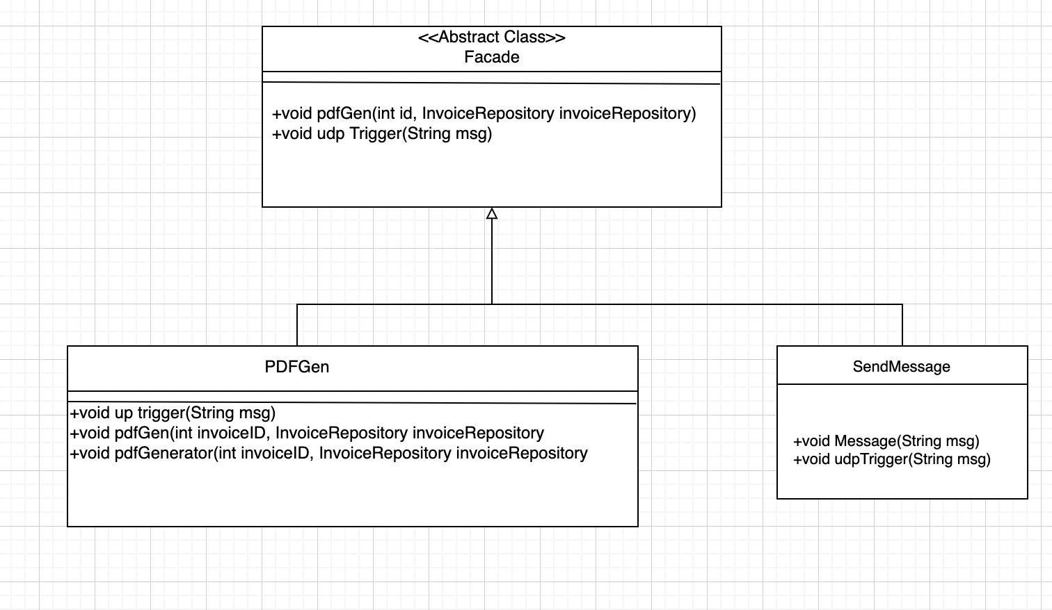
UML – Facade Pattern
Façade pattern is executed here, to generate a pdf of the transaction, once the payment is done

Slide 11
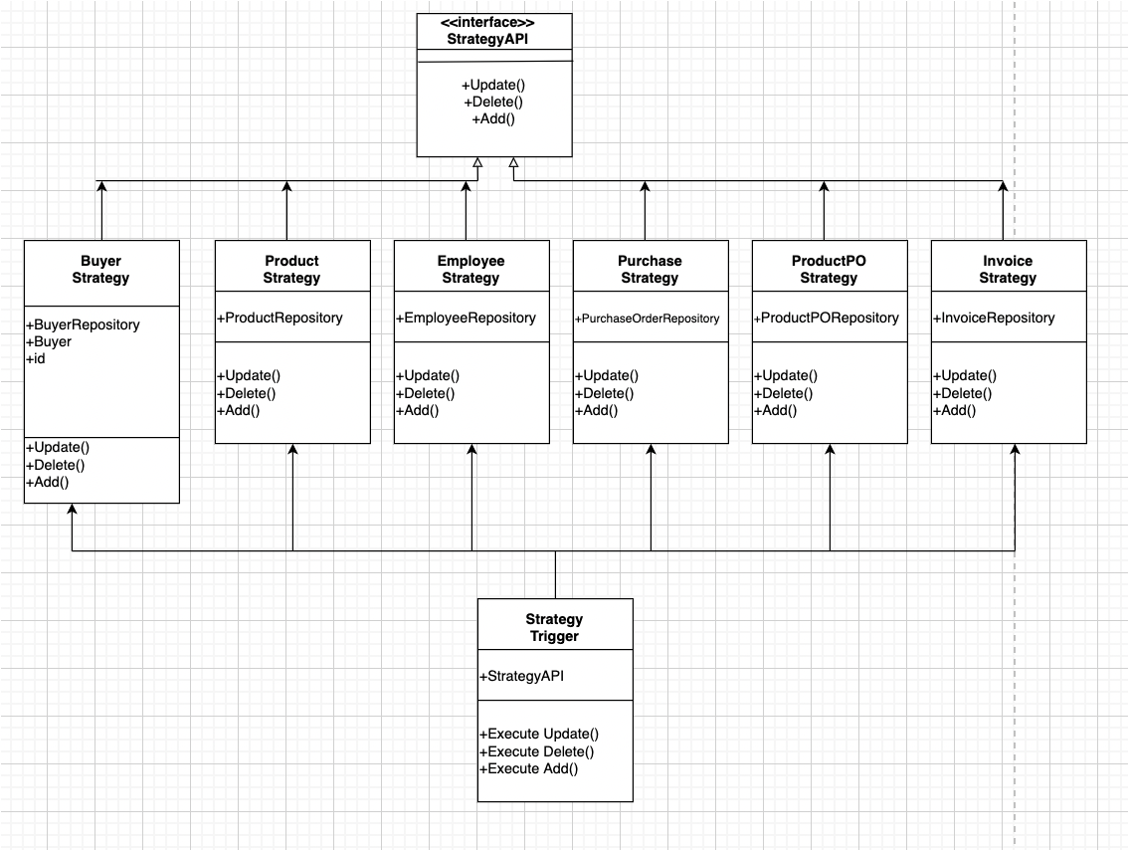
UML – Strategy Pattern
Strategy Pattern is implemented for carrying out CRUD operations on all entities

Slide 12
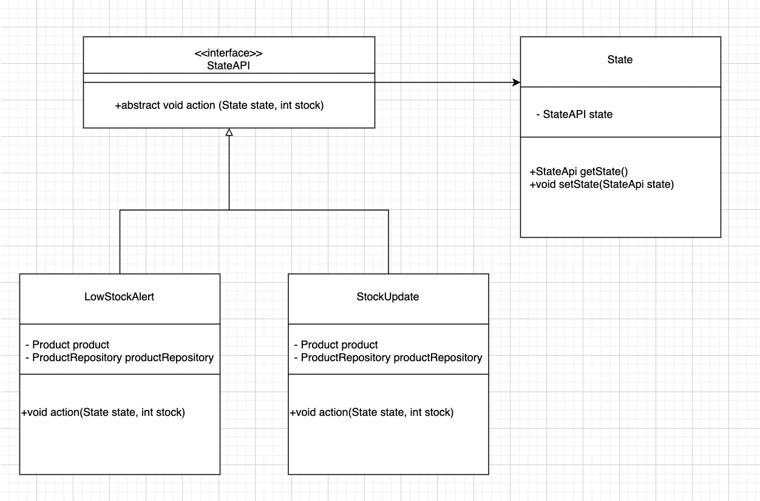
UML – State Pattern
State Pattern allows an object to alter its behavior when its internal state changes by delegating the behavior to separate state classes.

Slide 13
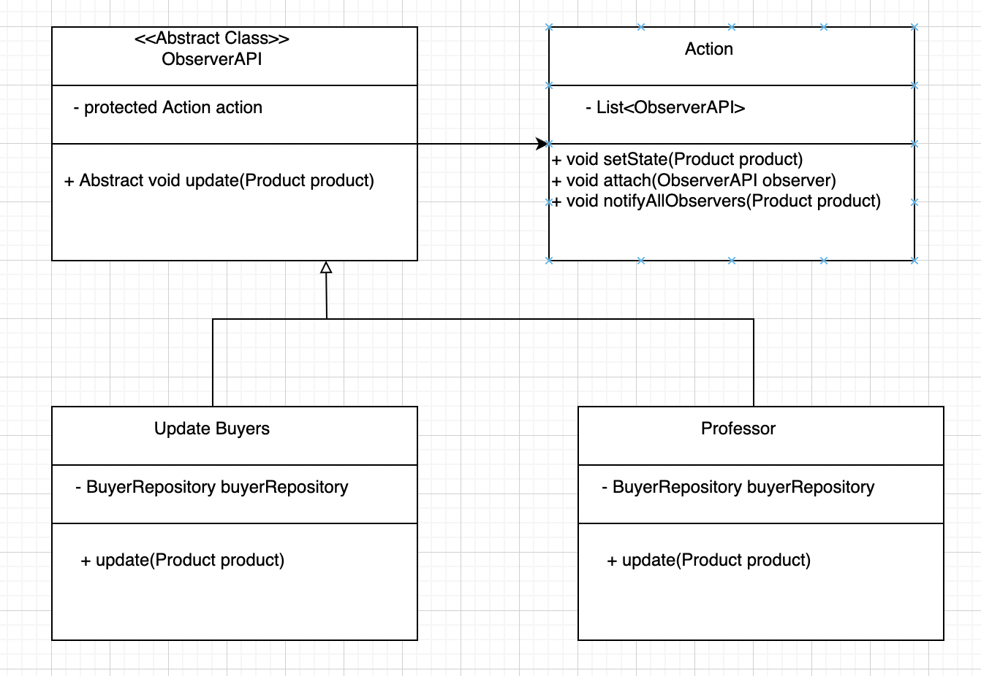
UML – Observer Pattern
Through UML – observer pattern, we can send the Notification of new products to all the buyers

Slide 14
Future enhancements
SENDING EMAIL AND PHONE NOTIFICATION TO ALL PURCHASERS
ACCEPTING ONLINE PAYMENTS
GENERATING REAL-TIME CHAT SYSTEMS FOR THE CLIENTS

Slide 15
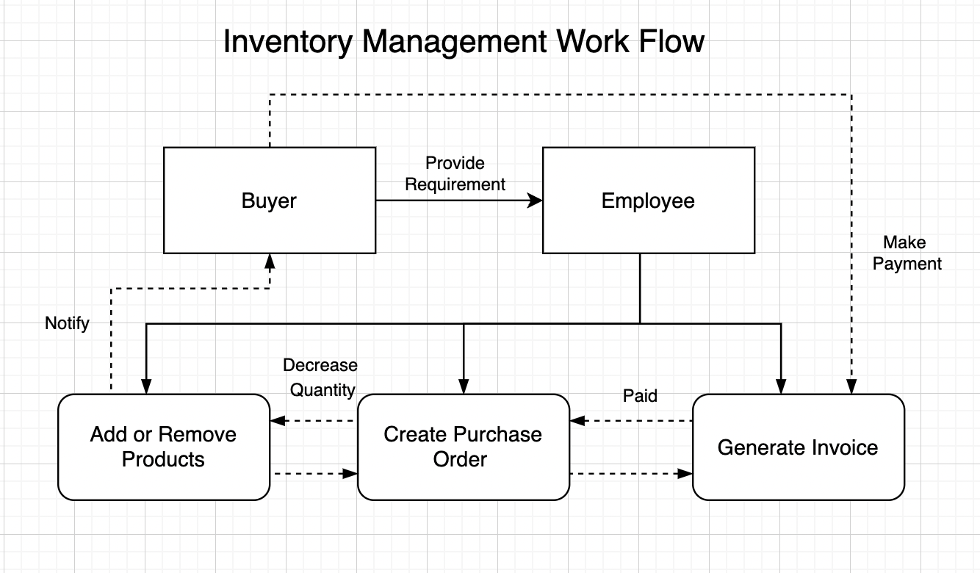
Workflow of Inventory Management

Slide 16
Thank You!

