Slide 1
LCR Radar Calculations

Slide 2
Specifications
F-T plot:
Parameter (Given) | Value
Bandwidth (B) | Only use 80 MHz
ADC Sampling Rate (Fs) | 1.4 MHz
Sample Rate | 700 kHz
Sweep Repetition Interval (SRI) | 625 Hz
No. of Samples | 1008
No. of sweeps in one burst | 256
9.975 GHz
475 MHz total Bandwidth but using 80 MHz
9.5 GHz
1.44 ms 1.68 ms

Slide 3
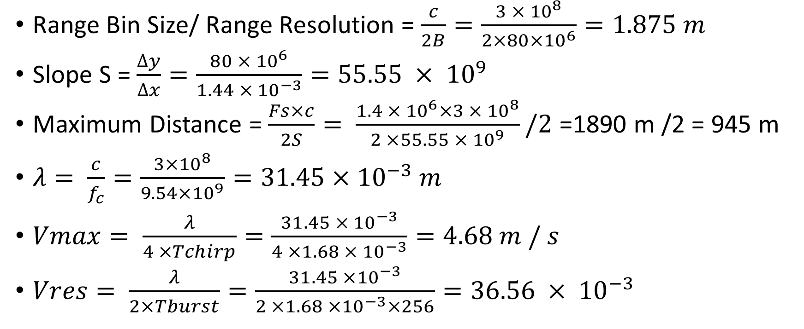
Calculations
Range Bin Size/ Range Resolution = $\frac{c}{2B}=\frac{3 × {10}^{8}}{2×80×{10}^{6}}=1.875 m$
Slope S = $\frac{∆y}{∆x}=\frac{80 × {10}^{6}}{1.44 × {10}^{−3}}=55.55 × {10}^{9}$
Maximum Distance = $\frac{Fs×c}{2S}= \frac{1.4 × {10}^{6}×3 × {10}^{8}}{2 ×55.55 × {10}^{9}}/2$ =1890 m /2 = 945 m
$λ= \frac{c}{f_{c}}=\frac{3×{10}^{8}}{9.54×{10}^{9}}=31.45×{10}^{−3} m$
$Vmax= \frac{λ}{4 ×Tchirp}=\frac{31.45 × {10}^{−3}}{4 ×1.68 × {10}^{−3}}=4.68 m / s$
$Vres= \frac{λ}{2×Tburst}=\frac{31.45 ×{10}^{−3}}{2 ×1.68 ×{10}^{−3}×256}=36.56 × {10}^{−3}$
The first 2 in the equation is round trip. The second divide is Nyquist. Because we sampling real.. The third is the 700kHz correction.

Slide 4

Baseband Signal
Transmit Signal
Received Signal
$τ= \frac{2d}{c}$
$∆f = \frac{2S∆d}{c}$
An observation window of Tc, can separate frequency components that are separated by more than 1/Tc Hz.
$∆f > \frac{1}{Tc} →\frac{2S∆d}{c} and S= \frac{B}{Tc}$
$$∆d= \frac{c}{2B}$$
Frequency
80 MHz
S
∆f
∆f
∆t
∆t
τ
1.68ms
Time
Tc
Beat frequency
1.44ms
∆f
Time

Slide 5
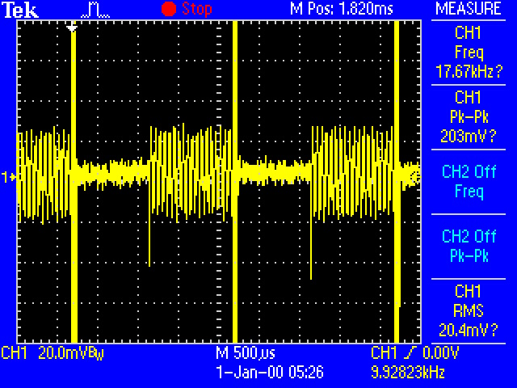
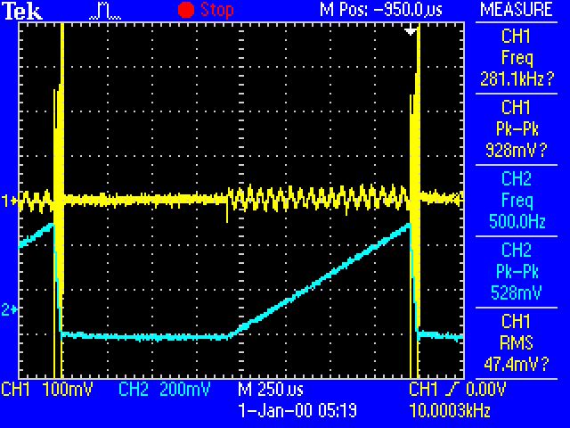
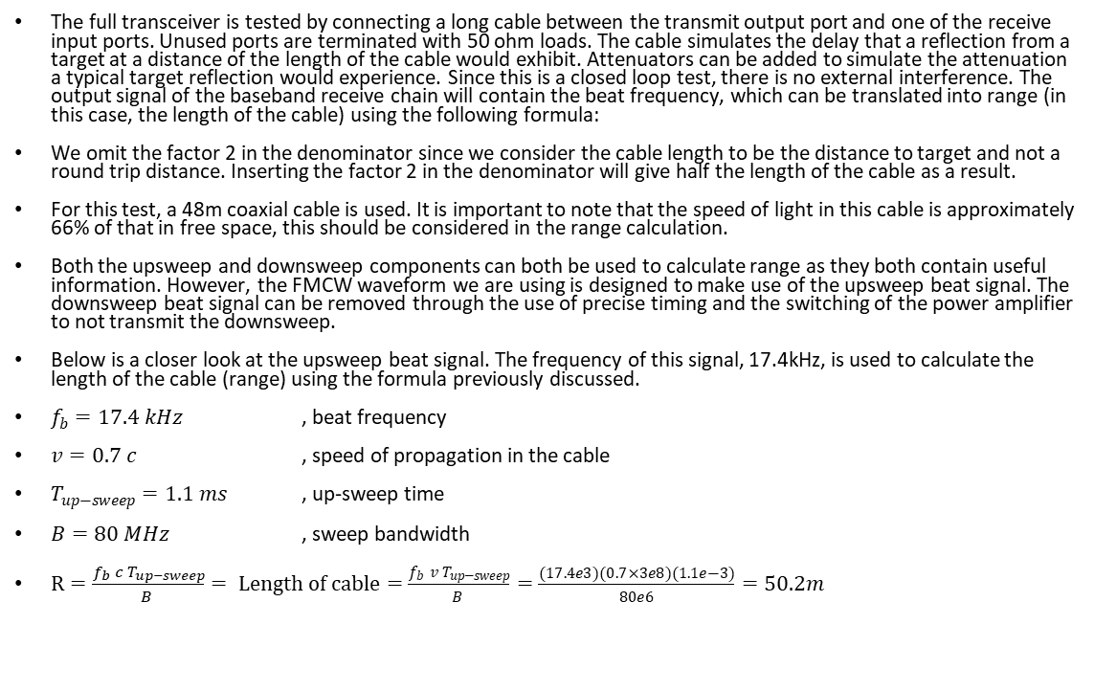
Cable Target Simulation Test
The full transceiver is tested by connecting a long cable between the transmit output port and one of the receive input ports. Unused ports are terminated with 50 ohm loads. The cable simulates the delay that a reflection from a target at a distance of the length of the cable would exhibit. Attenuators can be added to simulate the attenuation a typical target reflection would experience. Since this is a closed loop test, there is no external interference. The output signal of the baseband receive chain will contain the beat frequency, which can be translated into range (in this case, the length of the cable) using the following formula:
We omit the factor 2 in the denominator since we consider the cable length to be the distance to target and not a round trip distance. Inserting the factor 2 in the denominator will give half the length of the cable as a result.
For this test, a 48m coaxial cable is used. It is important to note that the speed of light in this cable is approximately 66% of that in free space, this should be considered in the range calculation.
Both the upsweep and downsweep components can both be used to calculate range as they both contain useful information. However, the FMCW waveform we are using is designed to make use of the upsweep beat signal. The downsweep beat signal can be removed through the use of precise timing and the switching of the power amplifier to not transmit the downsweep.
Below is a closer look at the upsweep beat signal. The frequency of this signal, 17.4kHz, is used to calculate the length of the cable (range) using the formula previously discussed.
$f_{b}=17.4 kHz$ , beat frequency
$v=0.7 c$ , speed of propagation in the cable
$T_{up−sweep}=1.1 ms$ , up-sweep time
$B=80 MHz$ , sweep bandwidth
$R=\frac{f_{b} c T_{up−sweep}}{B }= Length of cable=\frac{f_{b} v T_{up−sweep}}{B }=\frac{(17.4e3)(0.7×3e8)(1.1e−3)}{80e6}=50.2m$

Slide 6
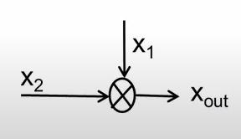
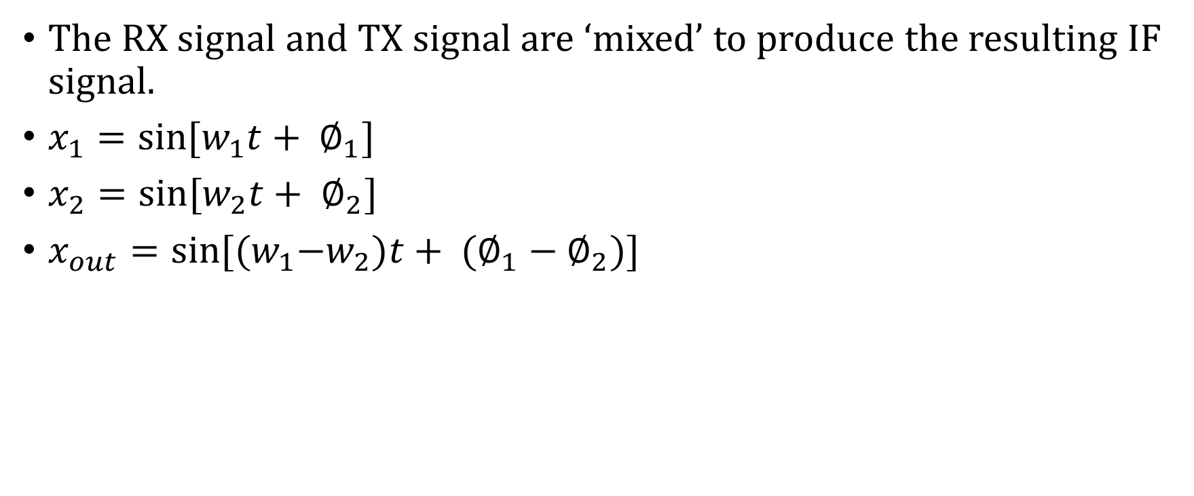
Mixer
The RX signal and TX signal are ‘mixed’ to produce the resulting IF signal.
$x_{1}=sin⁡[w_{1}t+ ∅_{1}]$
$x_{2}=sin⁡[w_{2}t+ ∅_{2}]$
$x_{out}=sin⁡[{(w}_{1}{−w}_{2})t+ {(∅_{1}−∅}_{2})]$
Difference of the Instantaneous Frequencies of the two input sinusoids
Difference of the phase of the two input sinusoids

Slide 7
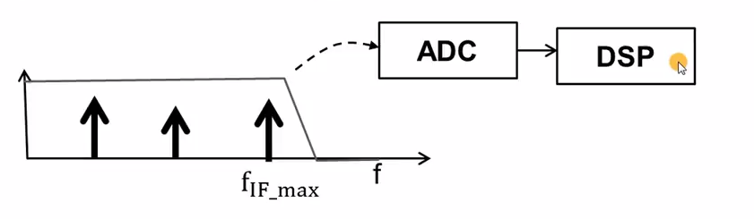
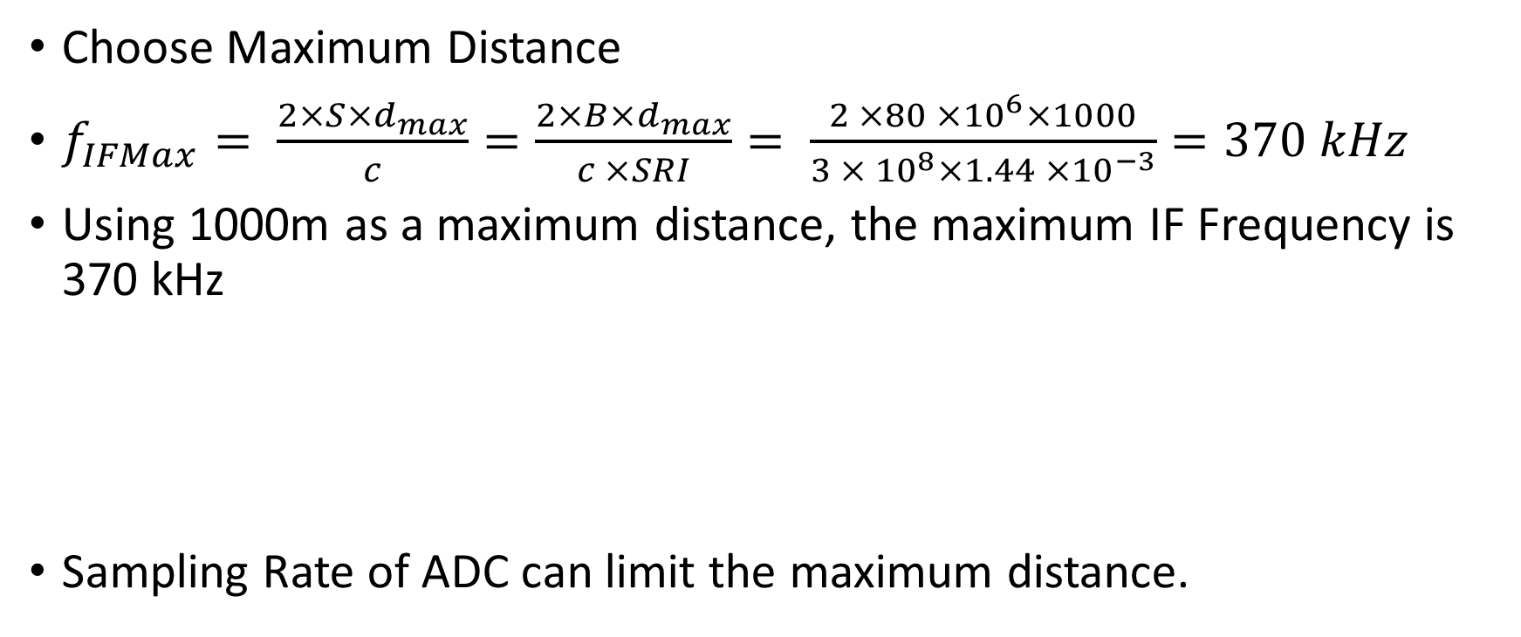
Digitizing Beat Signal
Choose Maximum Distance
$f_{IFMax}= \frac{2×S×d_{max}}{c}=\frac{2×B{×d}_{max}}{c ×SRI}= \frac{2 ×80 ×{10}^{6}×1000}{3 × {10}^{8}×{1.44 ×10}^{−3}}=370 kHz$
Using 1000m as a maximum distance, the maximum IF Frequency is 370 kHz
Sampling Rate of ADC can limit the maximum distance.
1.4 MHz
350 kHz

