Slide 1
Project Overview
Demand Prediction - Machine Learning Team
Chris Chen
Tony Reina
Kyle Shannon
Suman Gunnala
Anil Luthra

Slide 2
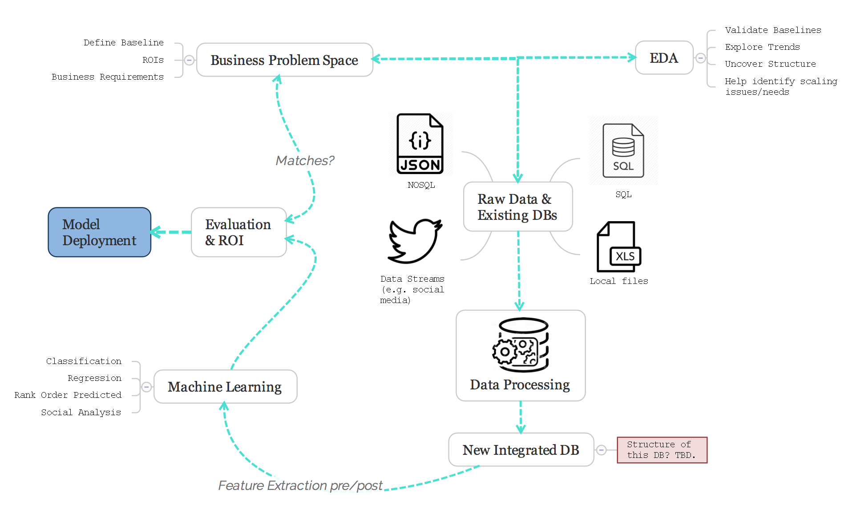
Our CRISP Approach

Slide 3
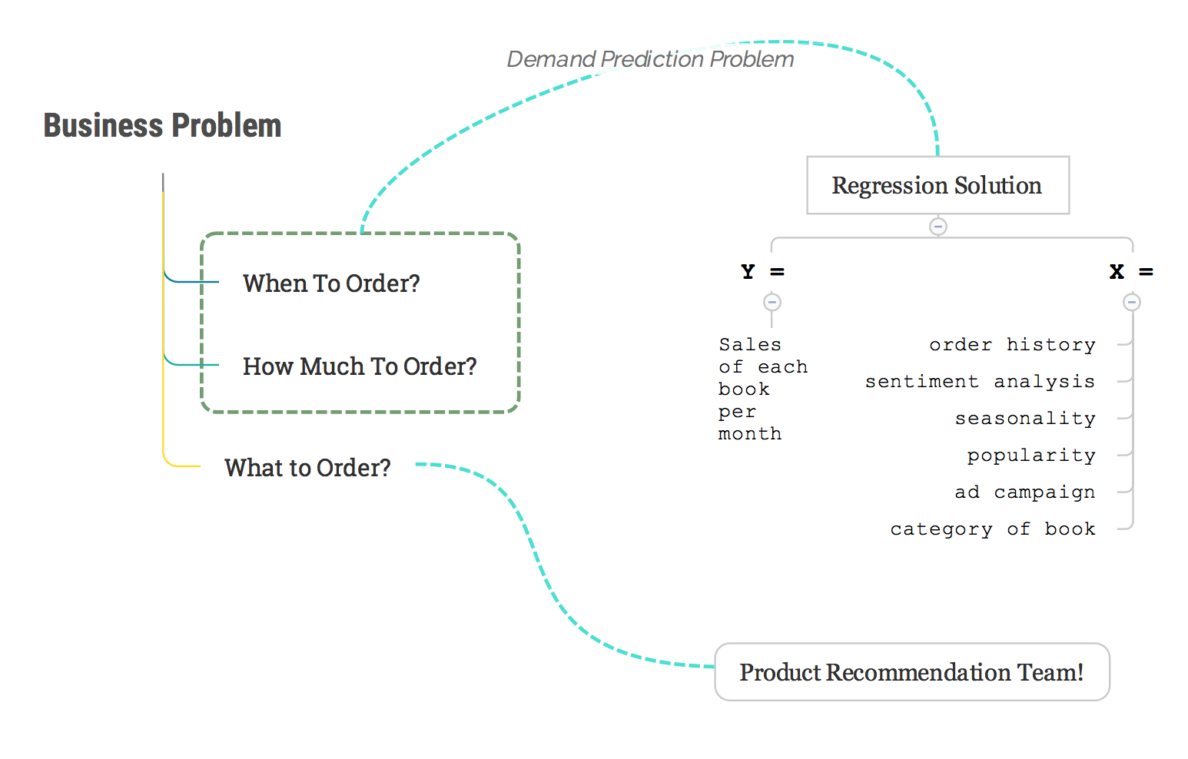
Machine Learning

Slide 4
Regression Model…
Why?
Predict a continuous variable (# books sold/month)
Rank Order from (Regression output - current Inventory)
Gradient Boosted Regression Trees (XGBoost)
Does not worry about variable scaling
Handles continuous / discrete variables
Easier to explain!

Slide 5
Team Requirements
EDA
explore ML team’s identified features
find new trends in data (e.g. categories, seasonality and campaigns)
Schema Integration
Format of data required by ML models (e.g. One Hot Encoding)
Querying
Data delivery from integrated DB (e.g. Views or Triggers)

Slide 6
Steps Moving Forward
Additional Feature Engineering
is_book_movie, has_book_won_award, etc.
EDA - Feature variance study, Visualizations
Schema Design and Data Processing
Campaign Study. Effective or not?

Slide 7
Thank You

