Slide 1
Engineering a Model
Demand Prediction - Machine Learning Team
Chris Chen
Tony Reina
Kyle Shannon
Suman Gunnala
Anil Luthra

Slide 2
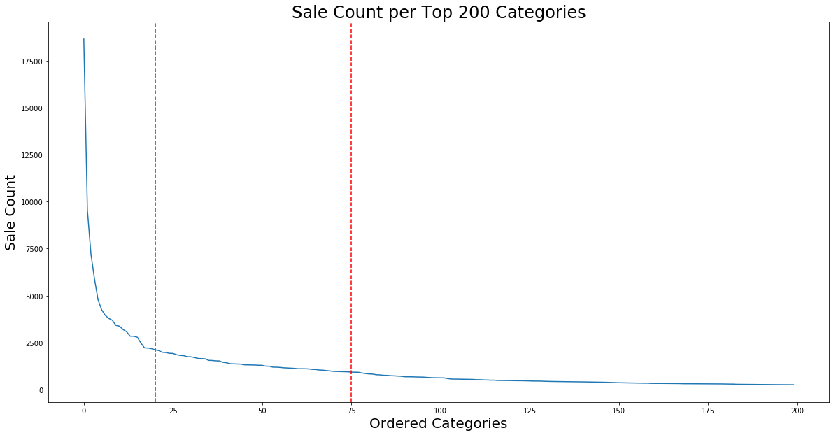
Model Constraints
Unique Postrgres
category IDs = 3368
Using 75
Categories
Elbow
Remaining 3168 is the long tail

Slide 3
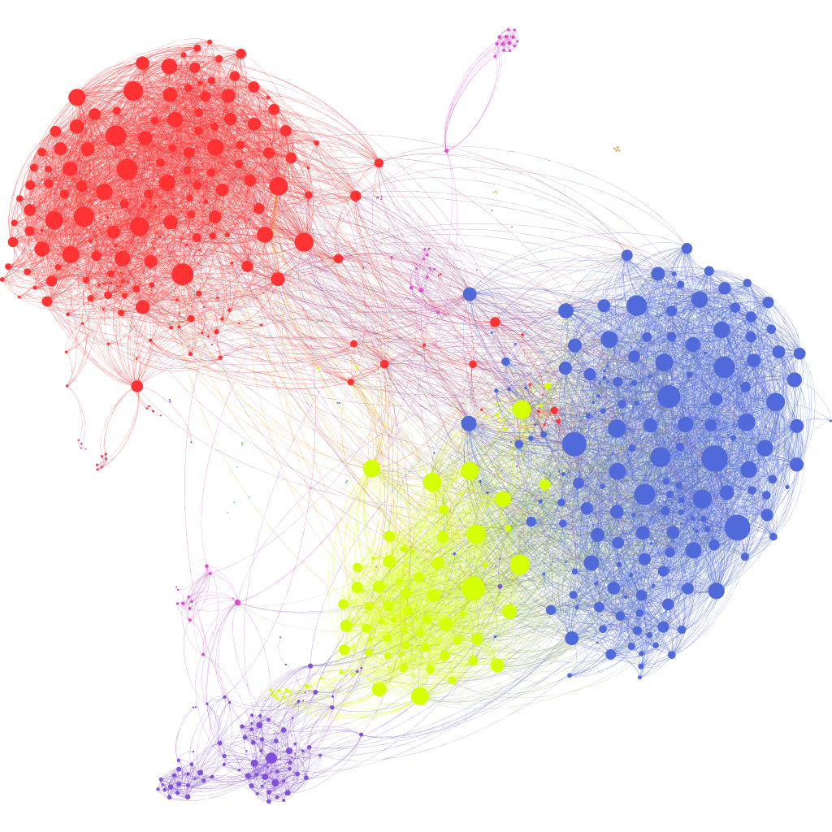
Cluster Top 75 Categories
Invariant
Seasonal
Undetermined?

Slide 4
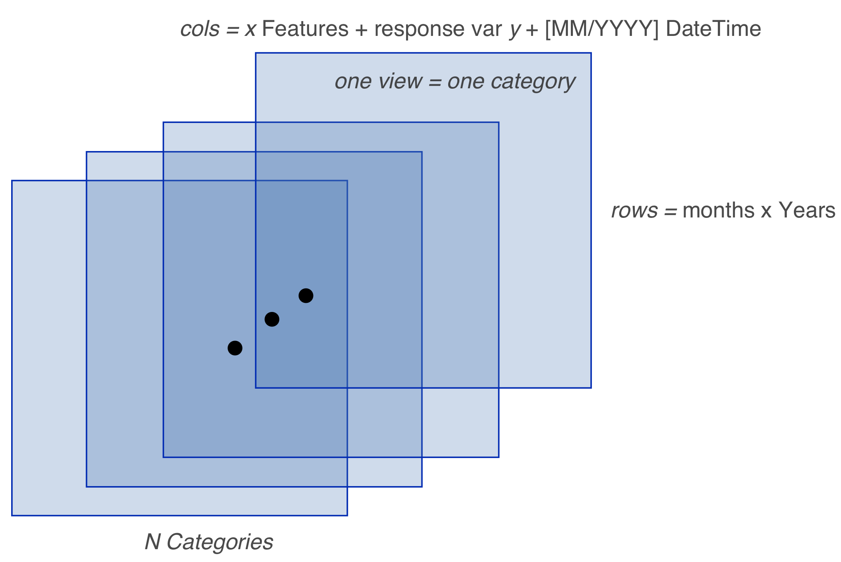
How we would like Data?

Slide 5

Features
inventory_sold_ratio
dollar_sold_ratio
volume_moved
product_rating_average
product_rating_delta
total_sales
contains_sold_out_product
large_inventory_drop
is_pos_sentiment
is_neg_sentiment
is_neutral_sentiment
count_of_nodeIDs
is_in_campaign

Slide 6
Testing Training Regimens
The Problem. Latent Temporal Components.
The Solution. Walk-Forward Validation.
Does not assume independence or identical distributions.
Therefore…

Slide 7
Collaborations
EDA team
Cluster Analysis of Top 75 Categories
Correlation heat map matrix
Schema & Query Team
Given accepted/answerable queries, ensure mediated schema will return from wrappers/source DBs in the correct format.

Slide 8
Thank You

