Slide 1
Name – Amisha Vaman Das
College-Shah and Anchor Kutchhi Engineering College
Subject-Data Science
Topic-Customer Segmentation

Slide 2
What is Customer Segmentation?
Customer segmentation is the process of dividing customers into groups based on common characteristics so companies can market to each group effectively and appropriately.
The goal of segmenting customers is to decide how to relate to customers in each segment in order to maximize the value of each customer to the business.
Since the dataset is totally a business-to-consumer marketing, companies segment customers according to demographics that include:
Age
Gender
Marital status
Location (urban, suburban, rural)
Life stage (single, married, divorced, empty-nester, retired, etc.)
Customer segmentation can be practiced by all business regardless of size and industry and whether they sell online or in person. It begins with gathering the information and ending with implementing some measures based on the gathered information.

Slide 3
Mall Customers Dataset
The provided dataset consists of some basic data about customers like Customer Id, age, gender, annual income and spending score. Spending score is something that is assigned for customer behavior and their purchasing data. The dataset consists of 200 rows of data. We can get customer segmentation using machine learning (K-means Clustering ) in python. It is also useful to target customers with whom we can start marketing strategy.

Slide 4
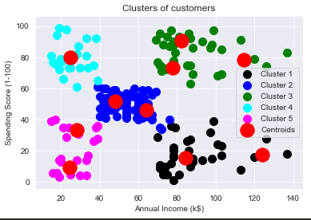
K-means Clustering
Customer Segmentation is a popular application of unsupervised learning. Using K-means clustering we can identify the segments of customers based on their demographic, geographical, psychographics and behavioral data. K-means clustering can be used to compare customers annual income, spending income. There can be few clusters which can be done using K-means . There can be 5 clusters for annual income high spending low ,vice versa and some which have same like annual and spending are equal and some for annual and spending is high and for some annual and spending is low. Through which it will easier to target customers for their marketing business.

Slide 5
Data Visualization
Data Visualization is the graphical representation of the provided data. By using charts, plots, graphs we can easily see the outliers and understand the patterns.
A box plot is represented for annual income and spending scores through which we get to know that the range of spending score is more than annual income.
A bar plot is used for representing the genders and from that graph we an see that female population does more purchasing.
A bar plot is used for representing the distribution of ages in which age 26-35 has more contribution.
And then come for k-means clustering.

Slide 6
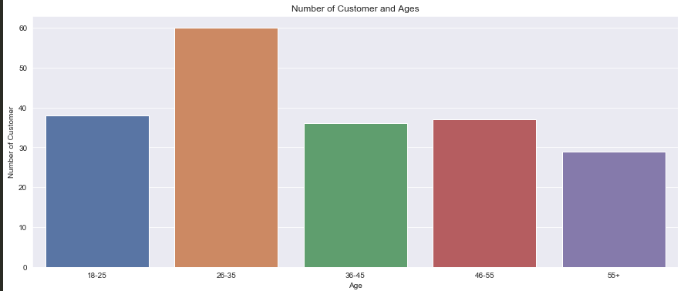
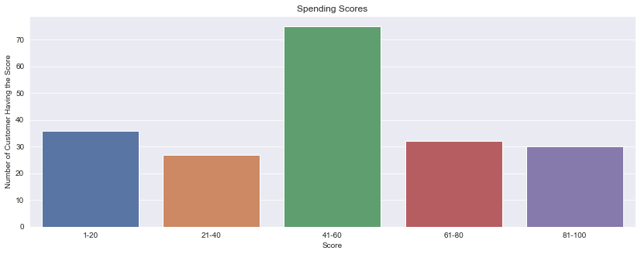
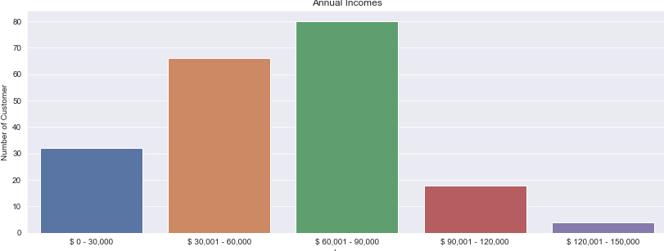

Slide 7
THANK YOU

