Slide 1
HTML/CSS Overview
• Structured the website layout using HTML.
• Designed the site with CSS for styling and responsiveness.
• Focused on creating a user-friendly interface.
• Team Member(s): [Add names]

Slide 2
JavaScript for Interactivity
• Added dynamic functionality to the site using JavaScript.
• Features include dynamic image loading and user interactions.
• Solved issues related to event handling and animations.
• Team Member(s): [Add names]

Slide 3
HTTP Requests Integration
• Used HTTP requests to fetch and display data.
• Implemented using [e.g., Fetch API or Axios].
• Connected the frontend to external APIs.
• Team Member(s): [Add names]

Slide 4
Database Integration with Postgres
• Set up a PostgreSQL database to store images and user data.
• Designed efficient schemas for faster querying.
• Managed database connections and security.
• Team Member(s): [Add names]

Slide 5
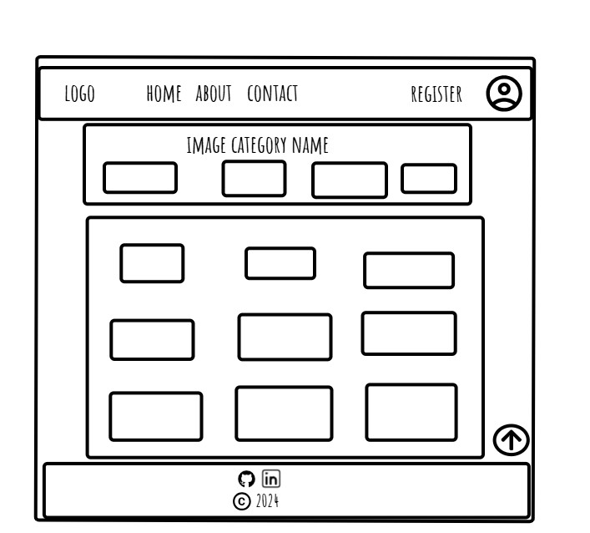
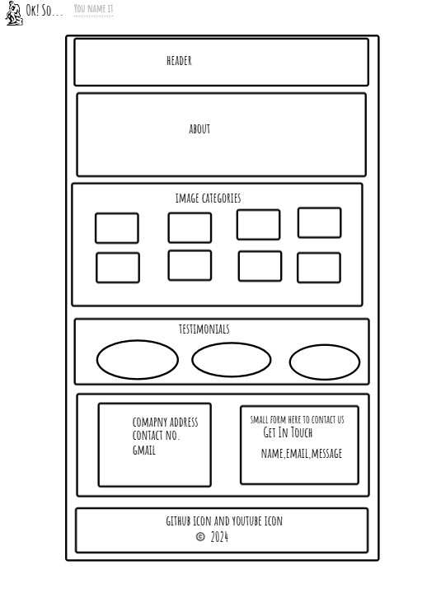
Wireframe Design

Slide 6
Project Management with Trello
• Used Trello to organize tasks and track progress.
• Each member was assigned tasks based on their expertise.
• Regular updates and feedback ensured timely completion.
• Screenshot of Trello board: [Add image if needed].

