Slide 1
Evaluating Variants of Uncertain Significance in BRCA1
Empirical Foundation Model Splicing Benchmarks & Decision Support
Ivana Sánchez Olivares & Shachi Bhavsar
Women in AI Hackathon — AlphaGenome × SpliceVarDB Clinical Project
Notes:
Hello, everyone. Have you ever wondered what happens when someone takes a genetic test for cancer risk, and the answer comes back as: 'We don't know'? My name is Ivana, and together with Shachi, today we will talk about evaluating Variants of Uncertain Significance in BRCA1 using foundation models and experimental splicing benchmarks.

Slide 2
BACKGROUND
What is RNA splicing?
All cells contain the same DNA
Our cells read genes like BRCA1 to make essential cancer protection proteins.
What makes genes different from plain text?
Genes are not continuous. They are interrupted by long non-coding regions called introns.
RNA splicing cuts out introns and stitches coding exons together
How does it happen?
Cellular machinery recognizes precise chemical signals (donor and acceptor sites) at exon boundaries to guide the cut-and-paste process.
Roles & Health Impact
Disruptions break the reading frame, inducing premature stop codons. Loss of BRCA1 splicing causes hereditary breast and ovarian cancer.
1
Notes:
[Slide 1: What is RNA splicing?]
All our cells contain exactly the same DNA, reading genes to produce essential proteins that protect us from cancer, like BRCA1. So what makes reading genes complex? Genes are not continuous stories; they are interrupted by long non-coding sequences called introns. RNA splicing is the cellular process that cuts out these non-coding interruptions and stitches the coding exons together into one functional message.
It happens when microscopic cellular machinery recognizes precise chemical signals at exon boundaries. When a mutation disrupts these signals, the cell cuts out vital parts of the gene or keeps broken fragments, destroying the protein and dramatically raising the risk of cancer.

Slide 3
PROBLEM
Measuring splicing impact in genetic testing
Before
Standard genetic testing only checked simple protein coding changes.
Now (New multigene panels!)
Comprehensive panels sequence entire loci, identifying thousands of non-coding and splice-region variants.
Challenges
• Up to 30% of multigene panel findings are classified as Variants of Uncertain Significance (VUS), leaving clinicians unable to act.
• Conventional software uses distance heuristics that miss deep-intronic mutations and trigger false alarms on benign mimics.
• No calibrated dataset with known answers to translate raw algorithm predictions into clinical decisions.
Goal: Benchmark AlphaGenome against experimental ground truth and build an interactive clinical decision report.
2
Notes:
[Slide 2: Problem]
Until recently, standard genetic testing only checked simple protein coding changes. New technology now lets us sequence entire multigene panels, capturing thousands of non-coding and splice-region variants. However, this comes with major challenges.
Up to 30% of variants are classified as Variants of Uncertain Significance. Traditional prediction tools rely on simple distance heuristics, missing mutations that hide thousands of letters deep inside introns while raising false alarms on benign mimics. And there is no calibrated dataset with known answers to test software and guide surgical decisions. That is why my goal was to benchmark DeepMind’s AlphaGenome foundation model against experimental ground truth and build a clinical decision support report.

Slide 4
SOLUTION: METHODOLOGY
Experimental ground truth from SpliceVarDB
446 BRCA1 Variants
Curated single-nucleotide variants evaluated against experimental ground truth in SpliceVarDB across the complete BRCA1 genomic locus.
Physical Laboratory Assays
Minigene functional splicing assays & patient RNA-seq transcript sequencing physically confirming whether each variant alters splicing.
Experimental Labels
• 230 Not splice-altering (neutral)
• 131 Splice-altering (damaging)
• 85 Low-frequency / complex
(SpliceVarDB Consortium, 2024) — SpliceVarDB: A comprehensive database of experimentally validated human splicing variants. Am J Hum Genet.
3
Notes:
[Slide 3: Data]
To do this, I obtained experimental ground truth from SpliceVarDB across 446 human BRCA1 variants. In these laboratory studies, scientists physically tested human cells using minigene splicing assays and patient RNA sequencing to measure whether each mutation truly breaks RNA splicing or leaves it completely intact. This gave us our gold-standard answer key of 230 verified neutral variants and 131 verified splice-altering mutations.

Slide 5
SOLUTION: METHODOLOGY
AlphaGenome 100 kb sequence context model
Google DeepMind Foundation Model
• 100,000-letter sequence context window across the BRCA1 locus (GRCh38).
• Predicts disruptions to splice donor sites, splice acceptor sites, and junction usage.
• Captures long-range chromatin and regulatory interactions invisible to local tools.
What the Model Predicts
1. Loss of Canonical Splice Sites
Destruction of invariant +1/+2 donor or -1/-2 acceptor dinucleotides.
2. Cryptic Site Activation
Creation of de novo splice sites deep in introns that cause pseudoexon inclusion.
(Avsec et al., 2026) — Advancing regulatory variant effect prediction with AlphaGenome. Nature.
4
Notes:
[Slide 4: Model]
I evaluated Google DeepMind's AlphaGenome foundation model. Unlike traditional tools that only look at one or two letters right at the boundary, AlphaGenome reads 100,000 letters of human DNA context at once. It predicts disruptions to donor sites, acceptor sites, and splice junctions, allowing it to capture long-range regulatory effects and cryptic splice activations that local tools completely miss.

Slide 6
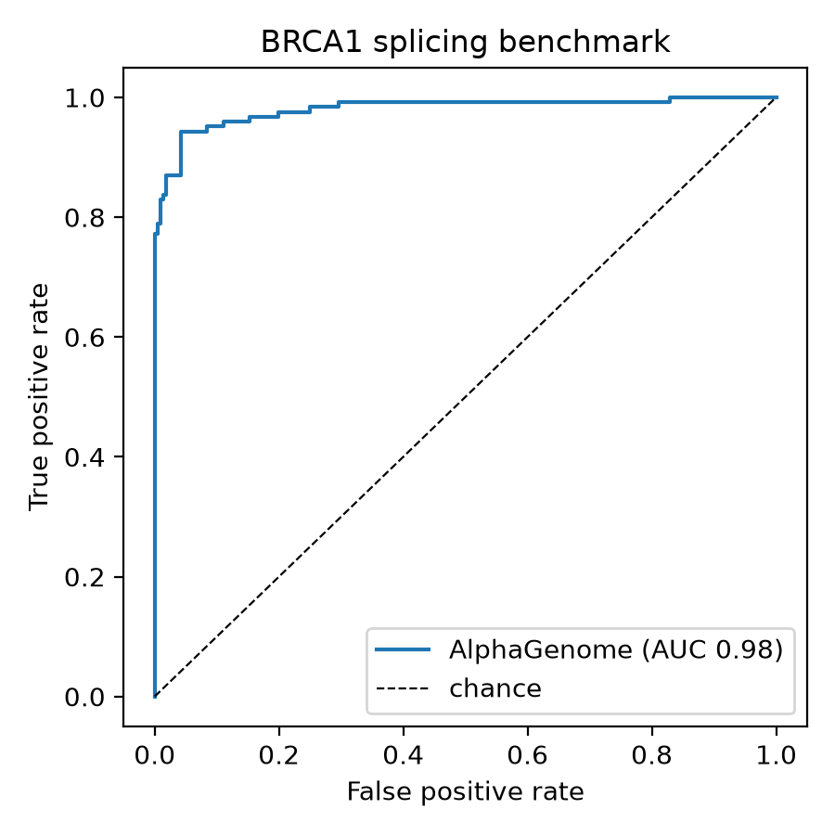
SOLUTION: METHODOLOGY & RESULTS
Benchmark performance & 5-tier empirical calibration
Benchmark Accuracy (n = 339)
• Overall ROC AUC = 0.980 (95% CI: [0.962 – 0.993])
• Intronic ROC AUC = 0.993 (outperforms distance baseline 0.914)
• Optimal Cutoff (0.276): 94.3% Sensitivity, 95.8% Specificity
The 5 Clinical Tiers (Empirical PPV)
Tier 5: Definitive Risk (100.0% PPV)
68 / 68 True Positives. Score > 2.164. Reclassify to Likely Pathogenic.
Tier 4: High Risk (72.1% PPV)
49 / 68 True Positives. Prioritize for functional RNA-seq confirmation.
Tier 1: Minimal Risk (1.5% PPV)
1 / 67 Positives. Score < 0.057. Splicing defect safely excluded.
5
Notes:
[Slide 5: Results]
When evaluated against the experimental ground truth, AlphaGenome achieved an overall ROC AUC of 0.980, and reached 0.993 on intronic variants, significantly beating the distance baseline of 0.914. At the optimal cutoff of 0.276, it achieved 94.3% sensitivity and 95.8% specificity.
To make this actionable for doctors, I converted the scores into 5 empirical calibration tiers with 95% Wilson confidence intervals. In Tier 1, the risk of a splicing defect is under 1.5%, safely ruling out damage. In Tier 5, 68 out of 68 variants were experimentally confirmed to disrupt splicing—giving 100% precision to support clinical reclassification.

Slide 7
CLINICAL APPLICATION
Multigene panel triage: Sarah Jenkins (39F)
Finding #1: Driver
NM_007294.4:c.4986+1G>T
• Tier 5 (100.0% PPV)
• Exon 15 canonical donor collapse
• Recommendation: Reclassify to Likely Pathogenic (PVS1/PS3/PP3); initiate breast MRI surveillance and RRSO.
Finding #2: Mimic
NM_007294.4:c.2077G>A
• Tier 1 (1.5% PPV)
• Exonic silent substitution
• Recommendation: De-escalate splicing; rule out splicing defect; avoid unnecessary prophylactic surgery.
Finding #3: Candidate
NM_007294.4:c.4185+4105C>T
• Tier 4 (72.1% PPV)
• 4,105 bp deep inside intron
• Recommendation: Prioritize for functional RNA-seq minigene validation.
6
Notes:
[Slide 6: Clinical Application]
I implemented this in a hospital-grade decision report for a representative patient, Sarah Jenkins, a 39-year-old woman with personal and maternal breast cancer history whose panel test returned three uncertain BRCA1 findings. The report triages all three on one screen:
Finding 1 is placed in Tier 5 as the true pathogenic driver, directing high-risk surveillance and prophylactic counseling. Finding 2 is in Tier 1, ruling out splicing and preventing an unnecessary mastectomy. Finding 3 is in Tier 4, flagging a hidden mutation for expedited RNA validation. A side-by-side AI assistant answers clinical questions at zero API cost, and a 1-click button exports notes straight into the hospital's health record.

Slide 8
CONCLUSION
Calibrated foundation models empower precision cancer decisions
Problem
Genetic multigene testing frequently produces uncertain splicing findings, with no answer key to guide surgical and screening decisions.
Solution
An empirical benchmark connecting AlphaGenome's 100 kb context to 446 experimental SpliceVarDB results, calibrated into 5 reliable clinical tiers and rendered in an interactive report.
Impact
A practical decision support tool that prevents unnecessary prophylactic surgeries for benign mimics, uncovers deep hidden cancer drivers, and accelerates life-saving care.
7
Notes:
[Slide 7: Conclusion]
To summarize: genetic testing frequently produces uncertain splicing findings with no answer key to guide clinical decisions. My solution is an empirical benchmark connecting AlphaGenome's 100 kb foundation model to 446 experimental SpliceVarDB results, calibrated into 5 reliable tiers within an interactive report. The impact is actionable precision medicine: preventing unnecessary prophylactic surgeries for benign mimics, uncovering hidden deep-intronic cancer drivers, and giving doctors the confidence to act when every day counts.

Slide 9
CONTACT
Ivana Sánchez Olivares
Email: ivana.schz27@gmail.com
Shachi Bhavsar
Email: shachimbhavsar@gmail.com
ACKNOWLEDGEMENT
Thank you for your attention!
• Google DeepMind AlphaGenome Team
• UCSC SpliceVarDB Research Consortium
Notes:
[Thank you]
I would like to acknowledge Google DeepMind and the SpliceVarDB Consortium for their open scientific datasets. Thank you very much for your attention. I am driven to make an impact in health, and I would love to help translate foundation AI into compassionate, life-saving clinical decisions.

