Slide 1
Data Mining and Predictive Analytics
Chapter 2
Data Preprocessing

Slide 2
Why Do We Preprocess Data?
Raw data often incomplete, noisy
May contain:
  Obsolete fields
  Missing values
  Outliers
  Data in form not suitable for data mining
  Erroneous values

Slide 3
Why Do We Preprocess Data? (cont’d)
For data mining purposes, database values must undergo data cleaning and data transformation
Data often from legacy databases where values:
  Not looked at in years
  Expired
  No longer relevant
  Missing
Minimize GIGO (Garbage In Garbage Out)
  IF garbage input minimized → THEN garbage in results minimized
Data preparation is 60% of effort for data mining process (Pyle)

Slide 4
Data Cleaning
Data errors in Table 2.1 examined:
Five-numeral U.S. Zip Code?
  Not all countries use same zip code format, 90210 (U.S.) vs. J2S7K7 (Canada)
  Should expect unusual values in some fields
  For example, global commerce
Four Digit Zip Code?
  Leading zero truncated, 6269 vs. 06269 (New England states)
  Database field numeric and chopped-off leading zero

Slide 5
Data Cleaning (cont’d)
Income Field Contains $10,000,000?
  Assumed to measure gross annual income
  Possibly valid
  Still considered outlier (extreme data value)
  Some statistical and data mining methods affected by outliers
Income Field Contains -$40,000?
  Income less than $0?
  Value beyond bounds for expected income, therefore an error
  Caused by data entry error?
  Discuss anomaly with database administrator

Slide 6
Data Cleaning (cont’d)
Income Field Contains $99,999?
  Other values appear rounded to nearest $5,000
  Value may be completely valid
  Value represents database code used to denote missing value?
  Confirm values in expected unit of measure, such as U.S. dollars
  Which unit of measure for income?
  Customer with zip code J2S7K7 in Canadian dollars?
  Discuss anomaly with database administrator

Slide 7
Data Cleaning (cont’d)
Age Field Contains “C”?
  Other records have numeric values for field
  Record categorized into group labeled “C”
  Value must be resolved
  Data mining software expects numeric values for field
Age Field Contains 0?
  Zero-value used to indicate missing/unknown value?
  Customer refused to provide their age?

Slide 8
Data Cleaning (cont’d)
Age Field?
  Date-type fields may become obsolete
  Use date of birth, then derive Age
Marital Status Field Contains “S”?
  What does this symbol mean?
  Does “S” imply single or separated?
  Discuss anomaly with database administrator

Slide 9
Handling Missing Data
Missing values pose problems to data analysis methods
More common in databases containing large number of fields
Absence of information rarely beneficial to task of analysis
In contrast, having more data almost always better
Careful analysis required to handle issue

Slide 10
Handling Missing Data (cont’d)
Examine cars dataset containing records for 261 automobiles manufactured in 1970s and 1980s
Delete Records Containing Missing Values?
  Not necessarily best approach
  Pattern of missing values may be systematic
  Deleting records creates biased subset
  Valuable information in other fields lost
Three Alternate Methods Available
  Insightful Miner (http://www.insightful.com) specifies method to replace values

Slide 11
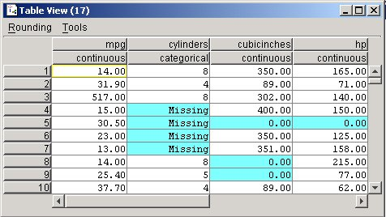
Handling Missing Data (cont’d)
(1) Replace Missing Values with User-defined Constant
  Missing numeric values replaced with 0.0
  Missing categorical values replaced with “Missing”

Slide 12
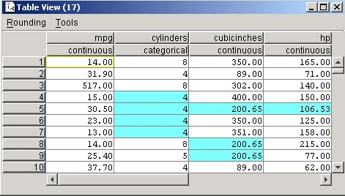
Handling Missing Data (cont’d)
(2) Replace Missing Values with Mode or Mean
  Mode of categorical field cylinders = 4
  Missing values replaced with this value
  Mean for non-missing values in numeric field cubicinches = 200.65
  Missing values replaced with 200.65

Slide 13
Handling Missing Data (cont’d)
  Substituting mode or mean for missing values sometimes works well
  Mean not always best choice for “typical” value
  Resulting confidence levels for statistical inference become overoptimistic (Larose)
  Domain experts should be consulted regarding approach to replace missing values
  Benefits and drawbacks resulting from the replacement of missing values must be carefully evaluated

Slide 14
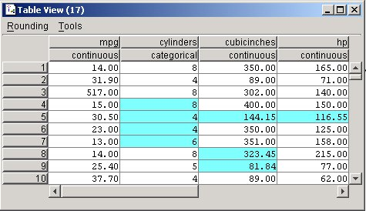
Handling Missing Data (cont’d)
(3) Replace Missing Values with Random Values
  Values randomly taken from underlying distribution
  Value for cylinders, cubicinches, and hp randomly drawn proportionately from each field’s distribution
  Method superior compared to mean substitution
  Measures of location and spread remain closer to original

Slide 15
Handling Missing Data (cont’d)
  No guarantee resulting records make sense
  Suppose randomly-generated values cylinders = 8 and cubicinches = 82
  A strange engine size?
  Alternate methods strive to replace values more precisely
  What is likely value, given record’s other attribute values?
  For example, American car has 300 cubic inches and 150 horsepower
  Japanese car has 100 cubic inches and 90 horsepower
  American car expected to have more cylinders

Slide 16
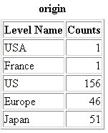
Identifying Misclassifications
  Verify values valid and consistent
  Frequency distribution shows five classes: USA, France, US, Europe, and Japan
  Count for USA = 1 and France = 1?
  Two records classified inconsistently with respect to origin of the manufacturer
  Maintain consistency by labeling USA → US, and France → Europe

Slide 17
Graphical Methods for Identifying Outliers
Outliers are values that lie near extreme limits of data range
Outliers may represent errors in data entry
Certain statistical methods very sensitive to outliers and may produce unstable results
Neural Networks and k-Means benefit from normalized data

Slide 18
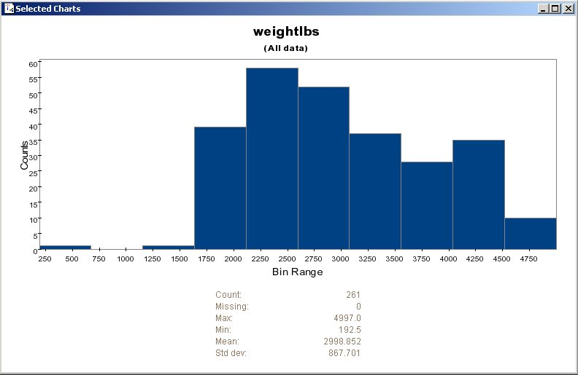
Graphical Methods for Identifying Outliers (cont’d)
  A histogram examines values of numeric fields
  This histogram shows vehicle weights for cars data set
  The extreme left-tail contains one outlier weighing several hundred pounds (192.5)
  Should we doubt validity of this value?

Slide 19
Graphical Methods for Identifying Outliers (cont’d)
  Analysis of weightlbs field shows remaining records contain whole-numbered (no decimal) values
  Perhaps value of 192.5 is an error
  Should it be 1925?
  Cannot know for sure and requires further investigation
  Discuss the meaning of the value with someone familiar with database content

Slide 20
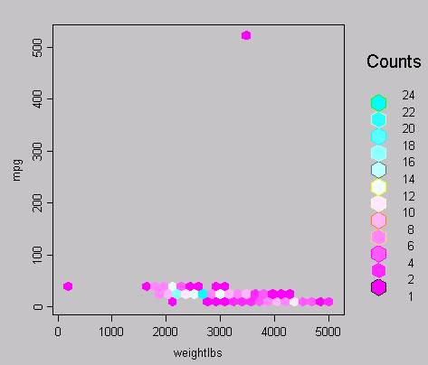
Graphical Methods for Identifying Outliers (cont’d)
  Two-dimensional scatter plots help determine outliers between variable pairs
  Scatter plot of mpg against weightlbs shows two possible outliers
  Most data points cluster together along x-axis
  However, one car weighs 192.5 pounds and other gets over 500 miles per gallon?

Slide 21

MEASURES OF CENTER AND SPREAD
Measures of center are a special case of measures of location, numerical summaries that indicate where on a number line a certain characteristic of the variable lies
  Percentiles
  Quantiles
The mean of a variable is simply the average of the valid values taken by the variable
For extremely skewed data sets, the mean becomes less representative of the variable center
Also, the mean is sensitive to the presence of outliers
An alternative measure is the median, defined as the field value in the middle when the field values are sorted into ascending order
The median is resistant to the presence of outliers
Another measure is the mode, which represents the field value occurring with the greatest frequency
The mode may be used with either numerical or categorical data, but is not always associated with the variable center

Slide 22

MEASURES OF CENTER AND SPREAD - cont
Measures of spread (variability) include the range (maximum — minimum), the standard deviation, the mean absolute deviation, and the interquartile range
The sample standard deviation is perhaps the most widespread measure of variability and is defined by
The standard deviation can be interpreted as the “typical” distance between a field value and the mean, and most field values lie within two standard deviations of the mean

Slide 23
Data Transformation
Variables tend to have ranges different from each other
In baseball, two fields may have ranges:
  Batting average: [ 0.0, 0.400 ]
  Number of home runs: [ 0, 70 ]
Some data mining algorithms adversely affected by differences in variable ranges
Variables with greater ranges tend to have larger influence on data model’s results
Therefore, numeric field values should be normalized
Standardizes scale of effect each variable has on results

Slide 24





MIN-MAX NORMALIZATION
Min-max normalization works by seeing how much greater the field value is than the minimum value min(X), and scaling this difference by the range
For example, an ultra-light vehicle, weighing only 1613 pounds (the field mini­mum), the min–max normalization is:
The midrange equals the average of the maximum and minimum values in a data set:
The heaviest vehicle has a min-max normalization value of

Slide 25



Z-SCORE STANDARDIZATION
Z-score standardization works by taking the difference between the field value and the field mean value, and scaling this difference by the standard deviation of the field values
For example, a vehicle weighing only 1613 pounds, the Z-score standard­ization is:
For the heaviest car, the Z-score standardization is:

Slide 26
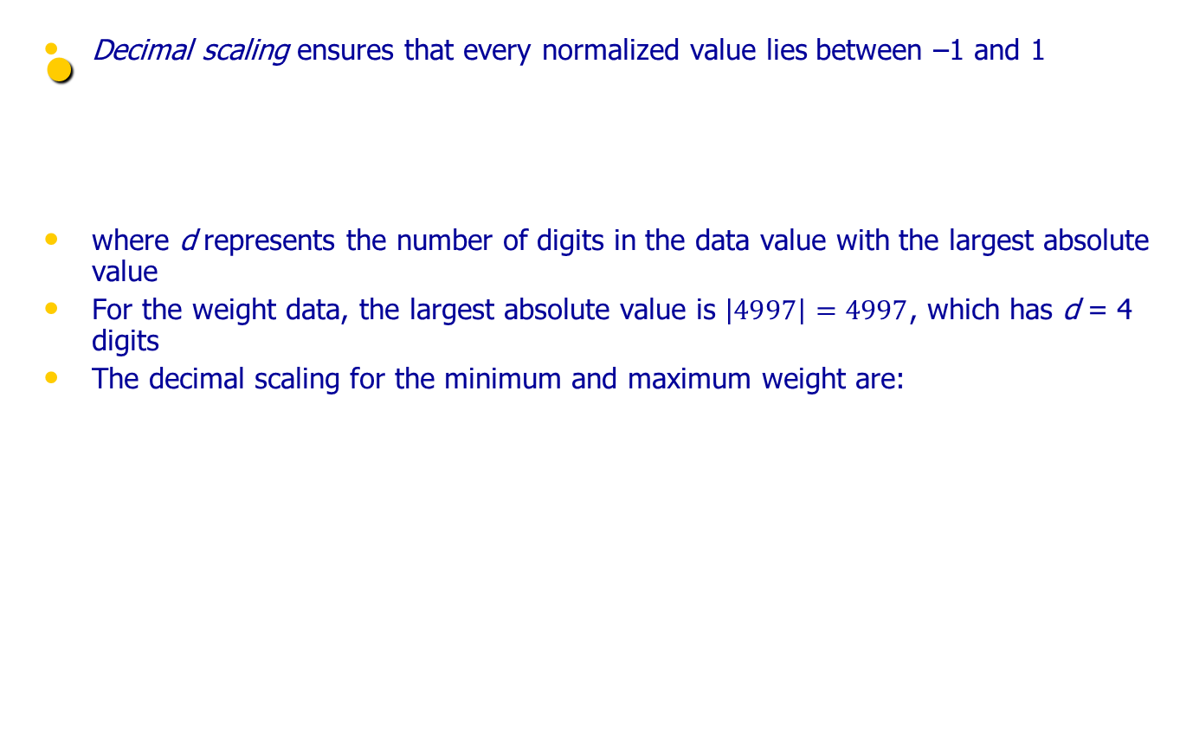


DECIMAL SCALING

Slide 27
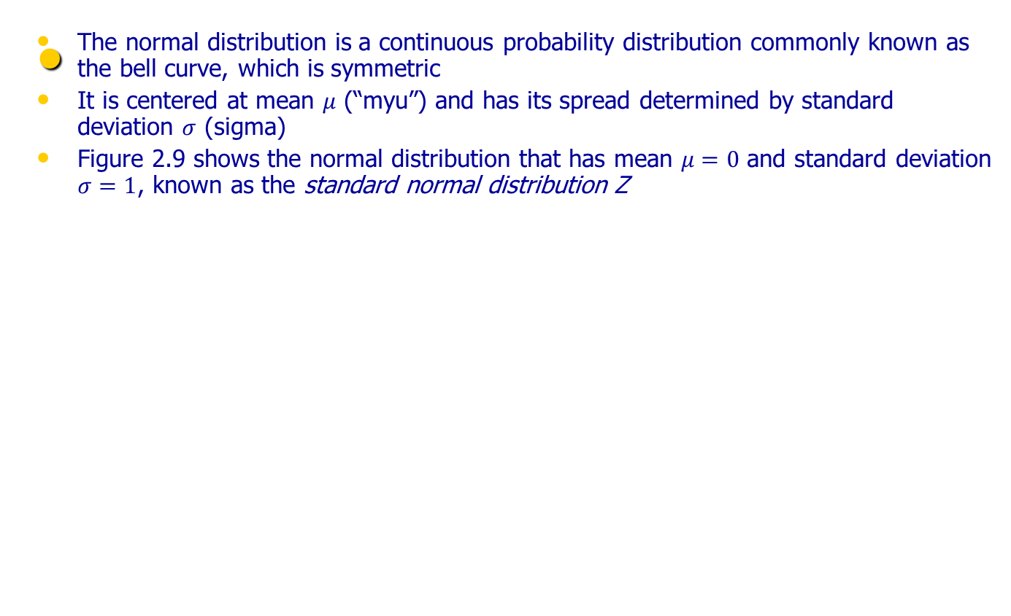
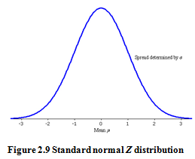
TRANSFORMATIONS TO ACHIEVE NORMALITY

Slide 28
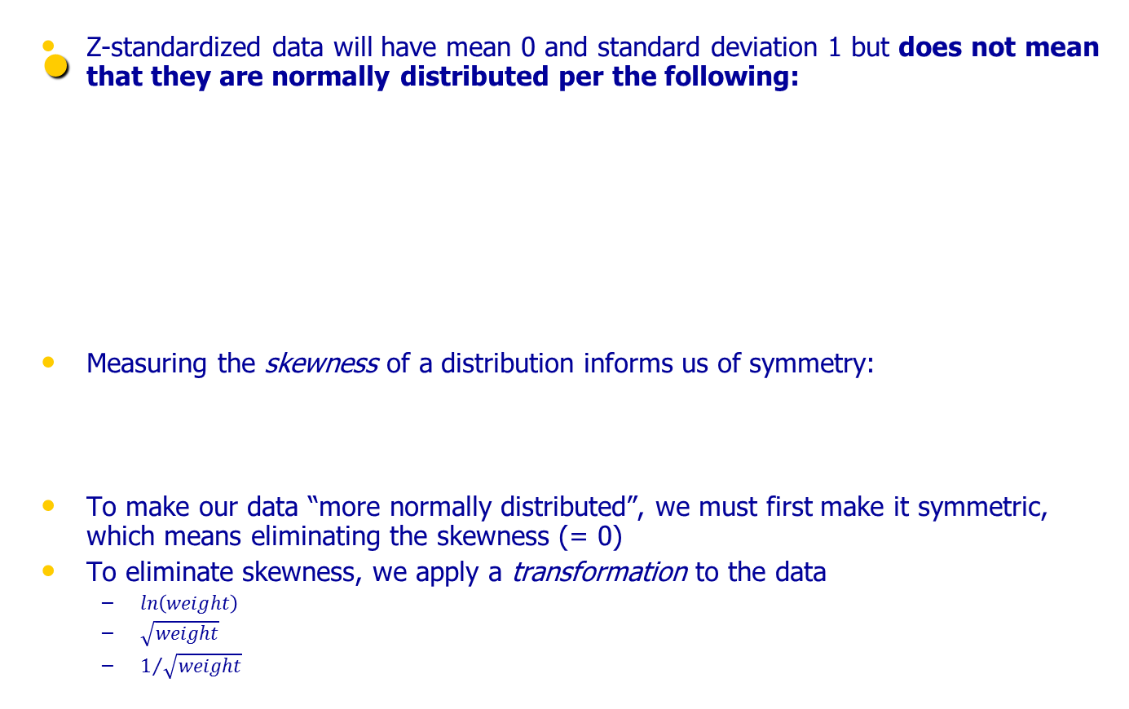
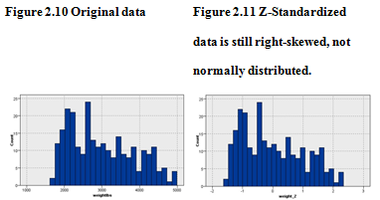

TRANSFORMATIONS TO ACHIEVE NORMALITY - cont

Slide 29
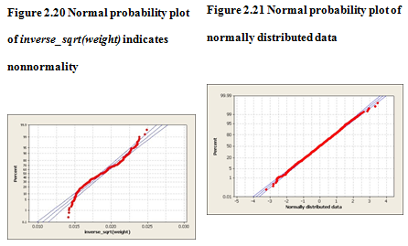

TRANSFORMATIONS TO ACHIEVE NORMALITY - cont
Depending on the variable, the 3 transformations may produce a more normal distribution than one another
To check for normality, we construct a normal probability plot, which plots the quantiles of a particular distribution against the quantiles of the standard normal distribution
In a normal probability plot, if the distribution is normal, the bulk of the points in the plot should fall on a straight line; systematic deviations from linearity in this plot indicate nonnormality
Finally, when the algorithm is done with its analysis, don’t forget to “de-transform” the data

Slide 30
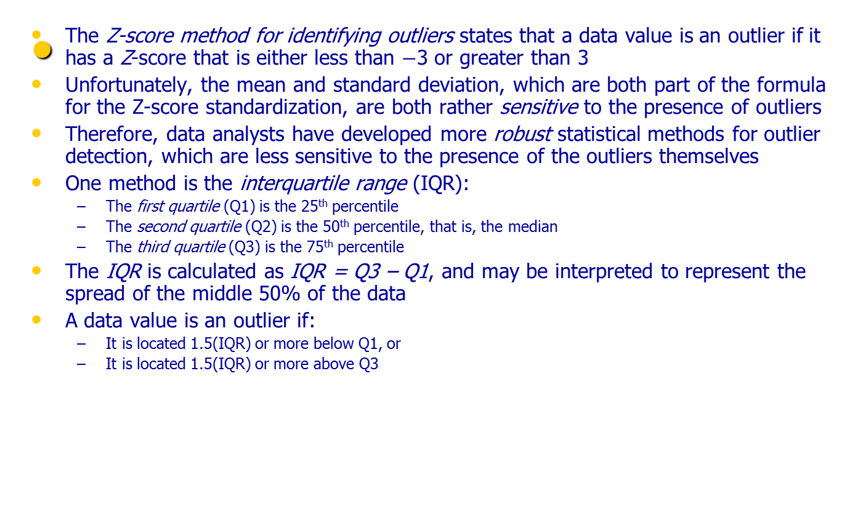
NUMERICAL METHODS FOR IDENTIFYING OUTLIERS

Slide 31
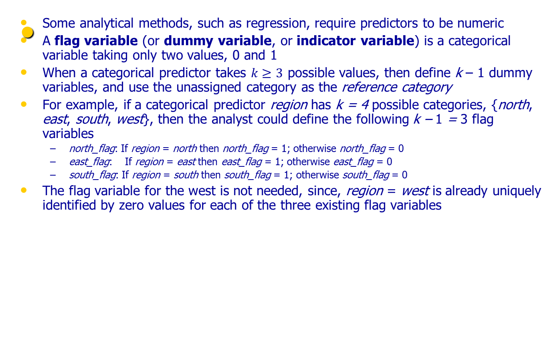
FLAG VARIABLES

Slide 32
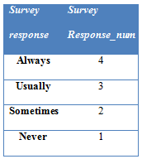
TRANSFORMING CATEGORICAL VARIABLES INTO NUMERICAL VARIABLES
In most instances, the data analyst should avoid transforming categorical variables to numerical variables
The exception is for categorical variables that are clearly ordered, such as the variable survey_response, taking values always, usually, sometimes, never
Should never be “0” rather than “1”? Is always closer to usually than usually is to sometimes?

Slide 33
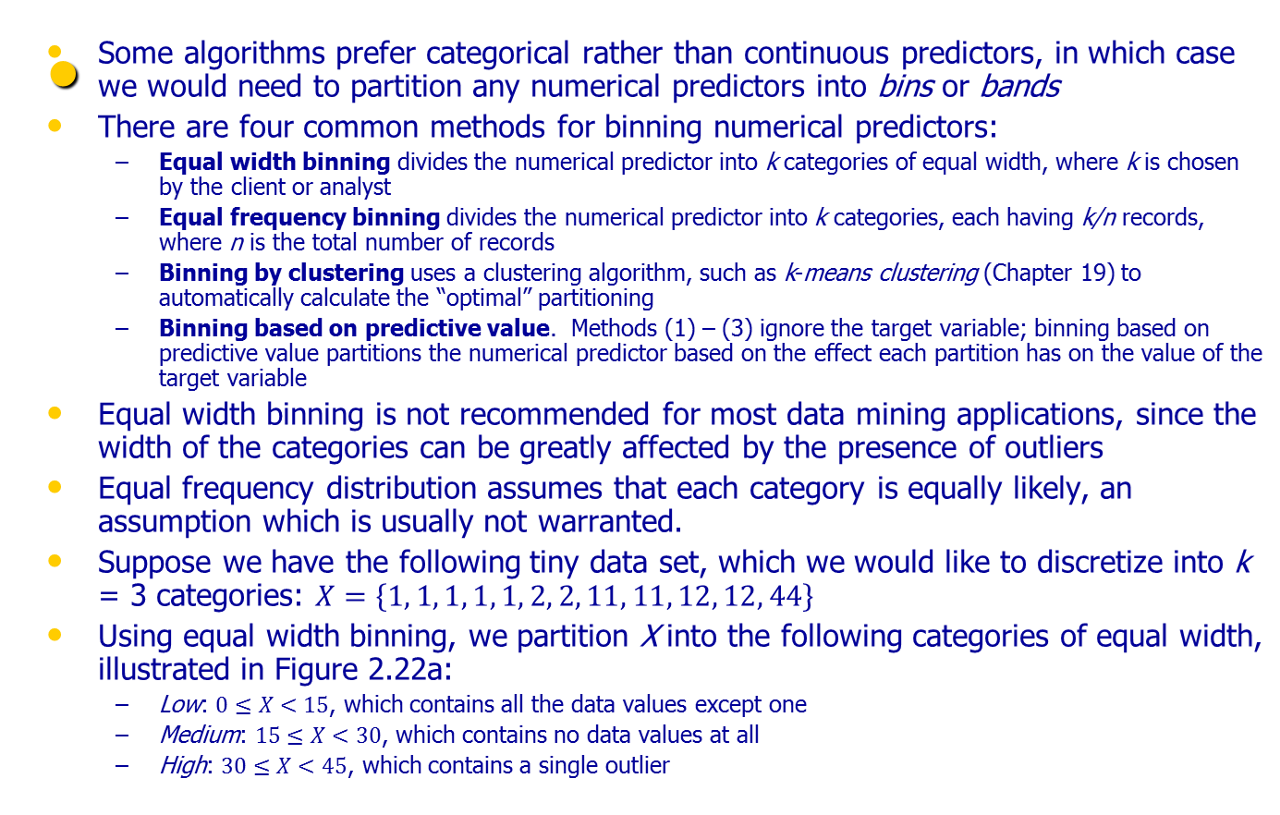
BINNING NUMERICAL VARIABLES

Slide 34
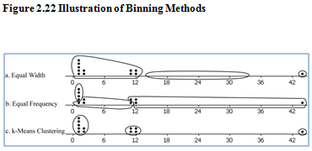
BINNING NUMERICAL VARIABLES
Using equal frequency binning, we have n = 12, k = 3, and n/k = 4. The partition is illustrated in Figure 2.22b
  Low: Contains the first four data values, all X = 1
  Medium: Contains the next four data values, {1, 2, 2, 11}
  High: Contains the last four data values, {11, 12, 12, 44}
Finally, k-means clustering identifies what seems to be the intuitively correct partition, as shown in Figure 2.22c

Slide 35
RECLASSIFYING CATEGORICAL VARIABLES
Reclassifying categorical variables is the categorical equivalent of binning numerical variables
Often, a categorical variable will contain too many field values to be easily analyzable
Data mining methods such as logistic regression and the C4.5 decision tree algorithm perform suboptimally when confronted with predictors containing too many field values
In such a case, the data analyst should reclassify the field values
For example, the 50 states could each be reclassified as the variable region, containing field values Northeast, Southeast, North Central, Southwest, and West
Alternatively, the 50 states could be reclassified as the variable economic_level, with three field values containing the richer states, the midrange states, and the poorer states

Slide 36
ADDING AN INDEX FIELD
It is recommended that the data analyst create an index field, which tracks the sort order of the records in the database
Data mining data gets partitioned at least once (and sometimes several times)
It is helpful to have an index field so that the original sort order may be recreated
For example, using IBM / SPSS Modeler, you can use the @Index function in the Derive node to create an index field

Slide 37
REMOVING VARIABLES THAT ARE NOT USEFUL
The data analyst may wish to remove variables that will not help the analysis, regardless of the proposed data mining task or algorithm
  Unary variables
  Variables which are very nearly unary
Unary variables take on only a single value, so a unary variable is not so much a variable as a constant
Sometimes a variable can be very nearly unary
For example, suppose that 99.95% of the players in a field hockey league are female, with the remaining 0.05% male
While it may be useful to investigate the male players, some algorithms will tend to treat the variable as essentially unary

Slide 38
VARIABLES THAT SHOULD PROBABLY NOT BE REMOVED
It is (unfortunately) a common – though questionable – practice to remove from analysis the following types of variables
  Variables for which 90% or more of the values are missing
  Variables which are strongly correlated
Variables which contain 90% missing values present a challenge to any strategy for imputation of missing data (see Chapter 27)
Conceivably, those who donate a lot would be inclined to report their donations, while those who do not donate much may be inclined to skip this survey question
Thus, the 10% who report are not representative of the whole
In this case, it may be preferable to construct a flag variable, donation_flag, since there is a pattern in the missingness which may turn out to have predictive power
Inclusion of correlated variables may at best double-count a particular aspect of the analysis, and at worst lead to instability of the model results
Instead, it is suggested that principal components analysis be applied, where the common variability in correlated predictors may be translated into a set of uncorrelated principal components

Slide 39
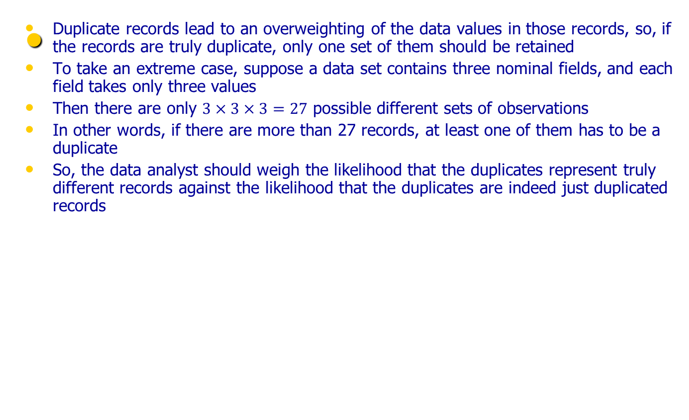
REMOVAL OF DUPLICATE RECORDS

Slide 40
A WORD ABOUT ID FIELDS
Because ID fields have a different value for each record, they will not be helpful for your downstream data mining algorithms
They may even be hurtful, with the algorithm finding some spurious relationship between ID field and your target
Thus it is recommended that ID fields should be filtered out from the data mining algorithms, but should not be removed from the data, so that the data analyst can differentiate between similar records

