Slide 1

Data Mining and Predictive Analytics
Chapter 3
Exploratory Data Analysis

Slide 2
Hypothesis Testing Versus Exploratory Data Analysis
Analyst may have “a priori” (presupposed by
experience) hypothesis to test
For example, has increasing fee-structure led to decreasing market share?
Hypothesis Testing: test hypothesis market share has decreased

Slide 3
Hypothesis Testing Versus Exploratory Data Analysis (cont’d)
However, not always have a priori notions about data
In this case, use Exploratory Data Analysis (EDA)
Approach useful for:
  Delving into data
  Examining important interrelationships between attributes
  Identifying interesting subsets or patterns
  Discovering possible relationships between predictors and target variable

Slide 4
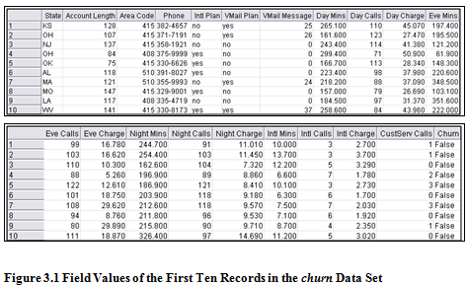
Getting to Know the Data Set
  Graphs, plots, and tables often uncover important relationships in data
  The 3,333 records and 20 variables in churn data set are explored
  Simple approach looks at field values of records

Slide 5
Getting to Know the Data Set (cont’d)
  Eight attributes shown in Figure 3.1:
    State: categorical
    Account Length: numeric
    Area Code: categorical
    Phone: categorical
    Intl Plan: Boolean
    VMail Plan: Boolean
    Vmail Messages: numeric
    Day Mins: numeric
  “churn” attribute (not shown) indicates customers leaving one company in favor of another company’s products or services
Data Mining and Predictive Analytics, By Daniel Larose and Chantal Larose John Wiley & Sons, Inc, Hoboken, NJ, 2022.

Slide 6
Exploring Categorical Variables
Goals: Exploratory Data Analysis
  Investigate variables as part of the Data Understanding Phase
    Numeric → Analyze Histograms, Scatter Plots, Statistics
    Categorical → Examine Distributions, Cross-tabulations,
    Web Graphs
  Become familiar with data
  Explore relationships among variable sets
  While performing EDA, remain focused on objective
  That is, creating data mining model of customer likely to “churn”
Data Mining and Predictive Analytics, By Daniel Larose and Chantal Larose John Wiley & Sons, Inc, Hoboken, NJ, 2022.

Slide 7
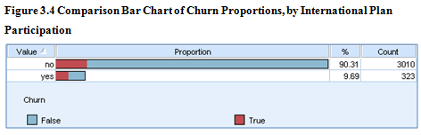
Exploring Categorical Variables (cont’d)
International Plan
  Figure 3.4 shows proportion of customers in International Plan with churn overlay
  International Plan: yes = 9.69%, no = 90.31%
  Possibly, greater proportion of those in International Plan are churners?
Data Mining and Predictive Analytics, By Daniel Larose and Chantal Larose John Wiley & Sons, Inc, Hoboken, NJ, 2022.

Slide 8
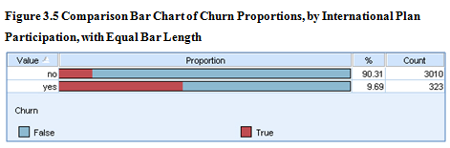
Exploring Categorical Variables (cont’d)
  Again, Proportion of customers in International Plan with churn overlay
  This time, same-sized bars used for each category (normalized)
  Graphically, proportion of “churners” in each category more apparent
  Those selecting International Plan more likely to churn
  However, relationship not quantified
Data Mining and Predictive Analytics, By Daniel Larose and Chantal Larose John Wiley & Sons, Inc, Hoboken, NJ, 2022.

Slide 9
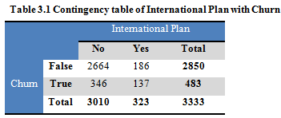
Exploring Categorical Variables (cont’d)
  Cross-tabulation quantifies relationship between Churn and International Plan
  International plan and Churn variables both categorical
    First column: total → International plan = “no”
    Second column: total → International plan = “yes”
    First row: total → Churn = “False”
    Second row: total → Churn = “True”
  Data set contains 346 + 137 = 483 churners, and 2,664 + 186 = 3,010 non-churners
Data Mining and Predictive Analytics, By Daniel Larose and Chantal Larose John Wiley & Sons, Inc, Hoboken, NJ, 2022.

Slide 10
Exploring Categorical Variables (cont’d)
  Therefore, quantifying the relationship:
  42.4% of customers in International Plan churned (137 / (137 + 186))
  11.5% of customers not in International Plan churned (346 / (346 + 2,664))
  Customers selecting International Plan more than 3X likely to leave company, as compared to those not in plan
  Why does International Plan apparently cause customers to leave?
  Data models predicting churn will likely include International Plan as predictor
Data Mining and Predictive Analytics, By Daniel Larose and Chantal Larose John Wiley & Sons, Inc, Hoboken, NJ, 2022.

Slide 11
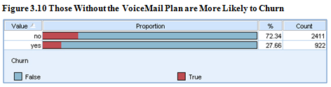
Exploring Categorical Variables (cont’d)
Voice Mail Plan
  Figure 3.10 shows proportion of customers in Voice Mail Plan with churn overlay (normalized)
  Voicemail Plan: yes = 27.66%, no = 72.34%
  Those not participating in Voice Mail Plan appear more likely to churn
Data Mining and Predictive Analytics, By Daniel Larose and Chantal Larose John Wiley & Sons, Inc, Hoboken, NJ, 2022.

Slide 12
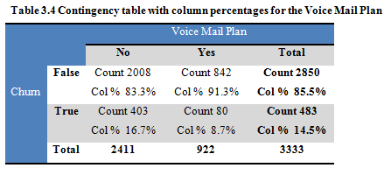
Exploring Categorical Variables (cont’d)
  Voice Mail Plan has 842 + 80 = 922 customers
  Remaining 2,008 + 403 = 2,411 customers not in plan
Data Mining and Predictive Analytics, By Daniel Larose and Chantal Larose John Wiley & Sons, Inc, Hoboken, NJ, 2022.

Slide 13
Exploring Categorical Variables (cont’d)
  Only 8.7% = 80/922 of those in plan are churners
  Of those not in plan, 16.7% = 403/2,411 are churners
  Therefore, those not participating in plan ~2X likely to churn, as compared to those in plan
  Perhaps customer loyalty can be increased by simplifying enrollment into Voice Mail Plan?
  Data models predicting churn likely to include Voice Mail Plan as predictor
Data Mining and Predictive Analytics, By Daniel Larose and Chantal Larose John Wiley & Sons, Inc, Hoboken, NJ, 2022.

Slide 14
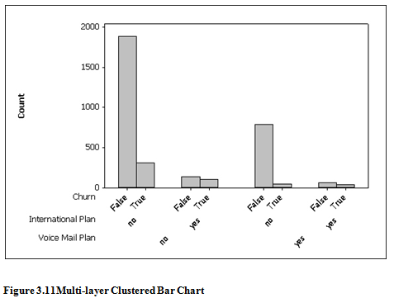
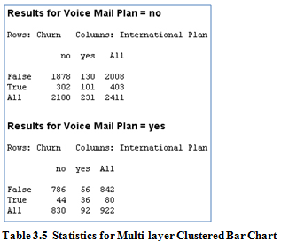
Exploring Categorical Variables (cont’d)
  Two-way Interactions between Voice Mail Plan and International Plan, with respect to churn shown
  Voice Mail Plan = no (constant)
  Many customers have neither plan: 1,878 + 302 = 2,180
  Of those, 302/2,180 = 14% are churners
  Customers in International Plan and not in Voice Mail Plan churn at rate 101/231 = 44%
Data Mining and Predictive Analytics, By Daniel Larose and Chantal Larose John Wiley & Sons, Inc, Hoboken, NJ, 2022.

Slide 15
Exploring Categorical Variables (cont’d)
  Many customers have Voice Mail Plan only: 786 + 44 = 830
  Those in both plans: 56 + 36 = 92
  Churn rate only 44/830 = 5% when customers participate in Voice Mail Plan only
  However, those enrolled in both plans churn at 36/92 = 39%
  Customers in International Plan churning at higher rate, regardless of Voice Mail Plan participation
Data Mining and Predictive Analytics, By Daniel Larose and Chantal Larose John Wiley & Sons, Inc, Hoboken, NJ, 2022.

Slide 16
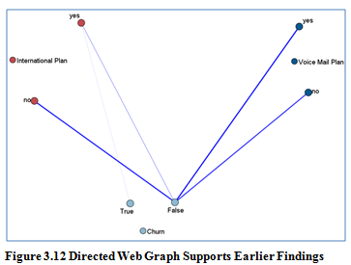
Exploring Categorical Variables (cont’d)
  Directed Web Graph shows relationships between International Plan, Voice Mail Plan, and Churn attributes (Clementine)
  Examine connections from Voice Mail Plan = yes node to Churn = True and Churn = False
  Heavier line connecting Churn = False indicates greater proportion of those in plan not churners
Data Mining and Predictive Analytics, By Daniel Larose and Chantal Larose John Wiley & Sons, Inc, Hoboken, NJ, 2022.

Slide 17
Exploring Numeric Variables
  Numeric summary measures for several variables shown
  Includes min and max, mean, median, and standard deviation
  For example, Account Length has min = 1 and max = 243
  Mean and median both ~101, which indicates symmetry
  Voice Mail Messages not symmetric; mean = 8.1 and median = 0
Data Mining and Predictive Analytics, By Daniel Larose and Chantal Larose John Wiley & Sons, Inc, Hoboken, NJ, 2022.

Slide 18
Exploring Numeric Variables (cont’d)
  Median = 0 indicates half of customers had no voice mail messages
  Recall use of correlated variables should be avoided
  Correlations of Customer Service Calls and Day Charge with other numeric variables shown
  All correlations are “Weak” except for Day Charge and Day Minutes, where r = 1.0
  Indicates perfect linear relationship
Data Mining and Predictive Analytics, By Daniel Larose and Chantal Larose John Wiley & Sons, Inc, Hoboken, NJ, 2022.

Slide 19
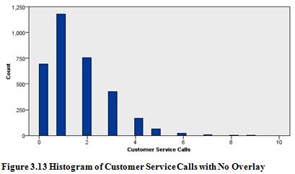
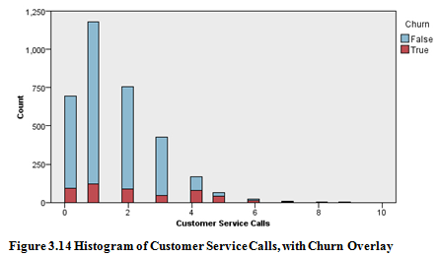
Exploring Numeric Variables (cont’d)
  Histogram for Customer Service Calls attribute shown
  Increases understanding of attribute’s distribution
  Distribution is right-skewed and has mode = 1
  However, relationship to Churn not indicated (Left)
  Figure (Right) shows identical histogram including Churn overlay
  Determining whether Churn proportion varies across number of Customer Service Calls difficult to discern
Data Mining and Predictive Analytics, By Daniel Larose and Chantal Larose John Wiley & Sons, Inc, Hoboken, NJ, 2022.

Slide 20
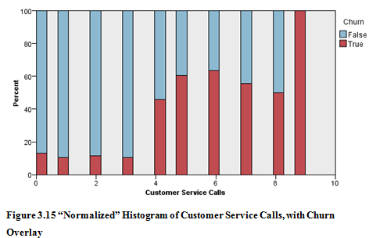
Exploring Numeric Variables (cont’d)
  Again, histogram of Customer Service Calls shown
  Normalized values enhance pattern of churn
  Customers calling customer service 3 or fewer times, far less likely to churn
  Results: Carefully track number of customer service calls made by customers; Offer incentives to retain those making higher number of calls
  Data mining model will probably include Customer Service Calls as predictor
Data Mining and Predictive Analytics, By Daniel Larose and Chantal Larose John Wiley & Sons, Inc, Hoboken, NJ, 2022.

Slide 21
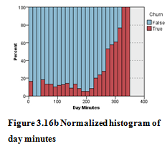
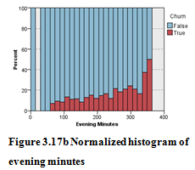
Exploring Numeric Variables (cont’d)
  Normalized histogram of Day Minutes shown with Churn overlay (Top)
  Indicates high usage customers churn at significantly greater rate
  Results: Carefully track customer Day Minutes as total exceeds 200
  Investigate why those with high usage tend to leave
  Normalized histogram of Evening Minutes shown with Churn overlay (Bottom)
  Higher usage customers churn slightly more
  Results: Based on graphical evidence, no specific conclusions drawn
Data Mining and Predictive Analytics, By Daniel Larose and Chantal Larose John Wiley & Sons, Inc, Hoboken, NJ, 2022.

Slide 22
Exploring Numeric Variables (cont’d)
  Additional EDA concludes no obvious association between Churn and remaining numeric attributes (not shown)
  These numeric attributes probably not strong predictors in data model
  However, they should be retained as input to model
  Important higher-level associations/interactions may exist
  In this case, let model identify which inputs are important
  Different EDA task may encounter huge number of inputs
  Data mining performance adversely affected by many inputs
  Possibly exclude inputs not associated with target variable
  Or, use dimension-reduction technique such as principal components analysis
Data Mining and Predictive Analytics, By Daniel Larose and Chantal Larose John Wiley & Sons, Inc, Hoboken, NJ, 2022.

Slide 23
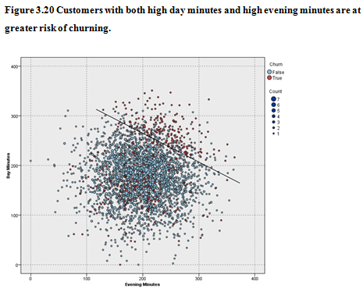
Exploring Multivariate Relationships
Multivariate graphics can uncover new interaction effects which our univariate exploration missed
Figure 3.20 shows a scatter plot of day minutes vs. evenings minutes, with churners indicated by the darker circles
Data Mining and Predictive Analytics, By Daniel Larose and Chantal Larose John Wiley & Sons, Inc, Hoboken, NJ, 2022.

Slide 24
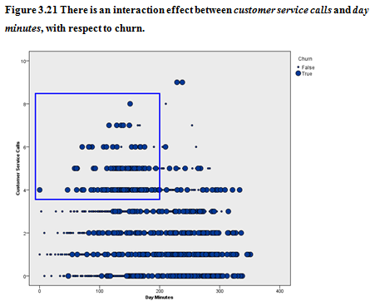
SELECTING INTERESTING SUBSETS OF THE DATA FOR FURTHER INVESTIGATION
Graphical EDA can uncover subsets of records that call for further investigation, as the rectangle in Figure 3.21 illustrates
IBM/SPSS Modeler allows the user to click and drag a box around data points of interest, and select them for further investigation
Data Mining and Predictive Analytics, By Daniel Larose and Chantal Larose John Wiley & Sons, Inc, Hoboken, NJ, 2022.

Slide 25
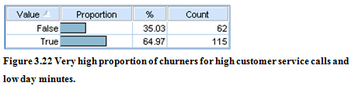
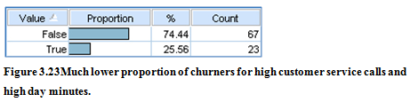
SELECTING INTERESTING SUBSETS OF THE DATA FOR FURTHER INVESTIGATION - cont
Figure 3.22 shows that about 65% (115 of 177) of the selected records are churners
Those with high customer service calls and low day minutes have a 65% probability of churning
Figure 3.23 shows that only about 26% of customers with high customer service calls and high day minutes are churners
Red-flag customers with high customer service calls and low day minutes
Data Mining and Predictive Analytics, By Daniel Larose and Chantal Larose John Wiley & Sons, Inc, Hoboken, NJ, 2022.

Slide 26

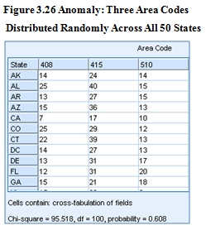
USING EDA TO UNCOVER ANOMALOUS FIELDS
Exploratory data analysis will sometimes uncover strange or anomalous records or fields which the earlier data cleaning phase may have missed
For ex, the area code field contains only three different values for all the records, 408, 415, and 510 (which all happen to be California area codes), as shown by Figure 3.24
However, the three area codes seem to be distributed more or less evenly across all the states and the District of Columbia (be wary of using the area code field as input)
Data Mining and Predictive Analytics, By Daniel Larose and Chantal Larose John Wiley & Sons, Inc, Hoboken, NJ, 2022.

Slide 27
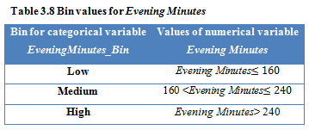
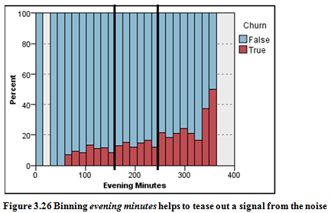
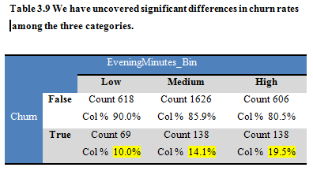
BINNING BASED ON PREDICTIVE VALUE
Trying to determine whether there is a relationship between evening minutes and churn
Setting 3 bin values of evening minutes reveals the High bin at 19.5% churn rate which beats the baseline churn rate of 14.49% for all customers.
Data Mining and Predictive Analytics, By Daniel Larose and Chantal Larose John Wiley & Sons, Inc, Hoboken, NJ, 2022.

Slide 28
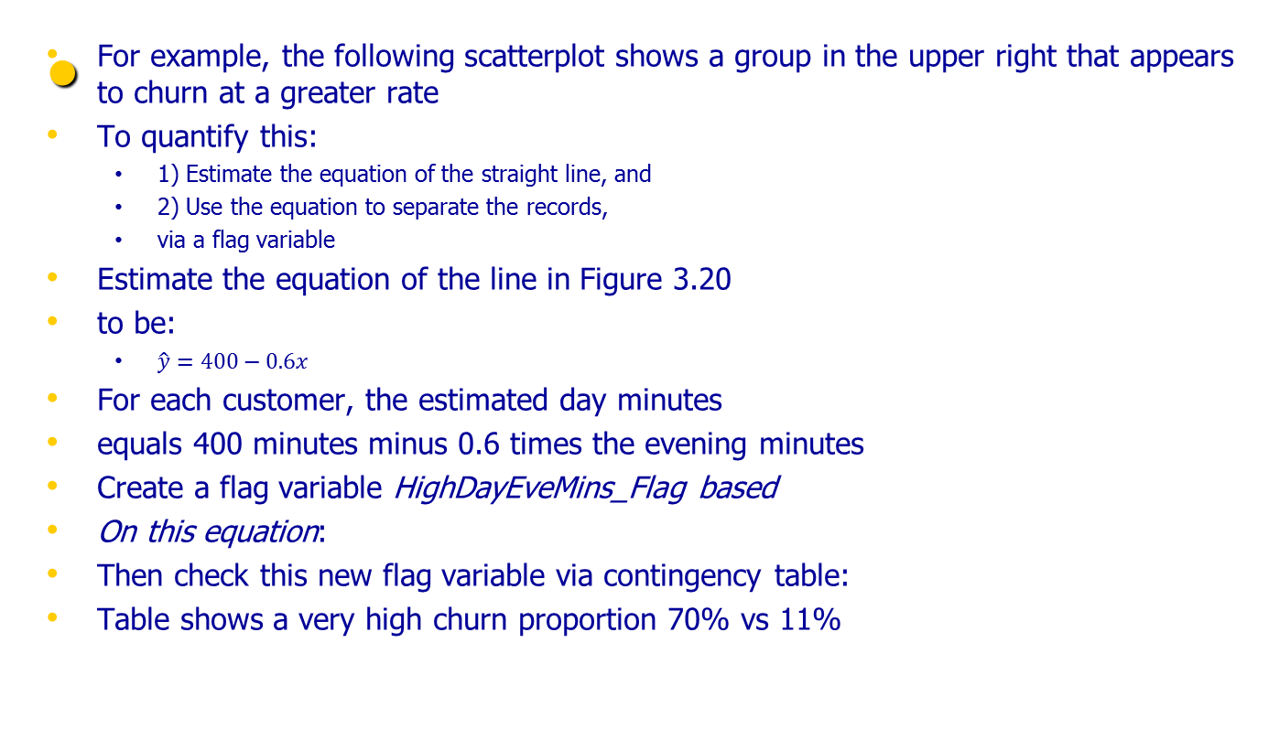
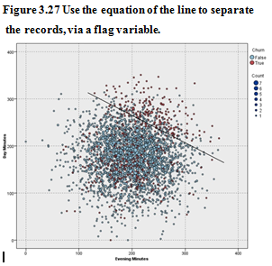
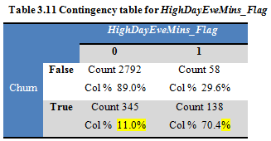
DERIVING NEW VARIABLES: FLAG VARIABLES
Data Mining and Predictive Analytics, By Daniel Larose and Chantal Larose John Wiley & Sons, Inc, Hoboken, NJ, 2022.

Slide 29

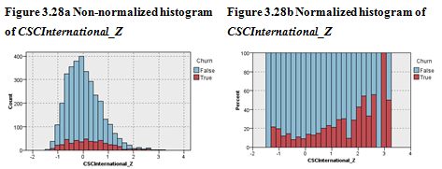
DERIVING NEW VARIABLES: NUMERICAL VARIABLES
When combining numerical variables, we first need to standardize
For example to combine International Calls and Customer Service Calls:
The resulting normalized histogram of CSCInternational_Zindicates that it will be useful for predicting churn
Data Mining and Predictive Analytics, By Daniel Larose and Chantal Larose John Wiley & Sons, Inc, Hoboken, NJ, 2022.

Slide 30
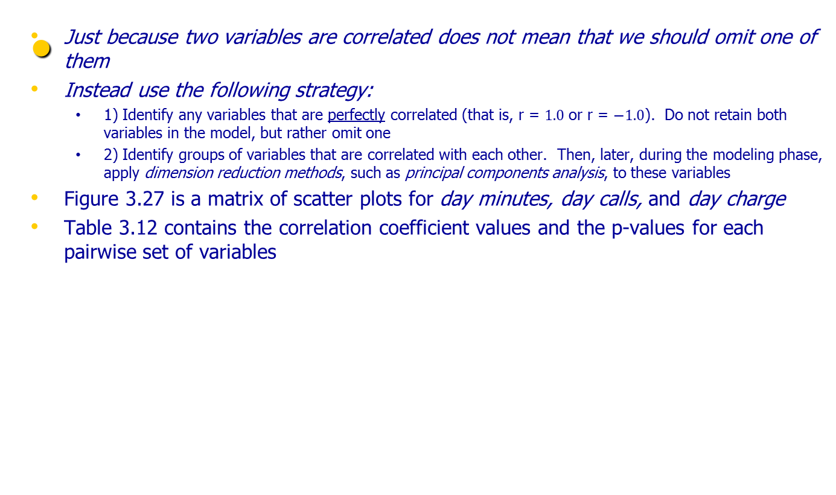
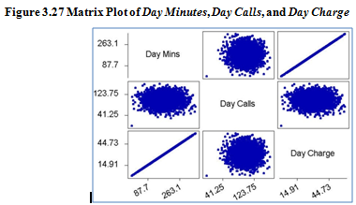
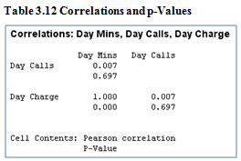
USING EDA TO INVESTIGATE CORRELATED PREDICTOR VARIABLES
Data Mining and Predictive Analytics, By Daniel Larose and Chantal Larose John Wiley & Sons, Inc, Hoboken, NJ, 2022.

Slide 31
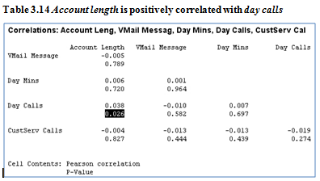
USING EDA TO INVESTIGATE CORRELATED PREDICTOR VARIABLES - cont
There does not seem to be any relationship between day minutes and day calls, nor between day calls and day charge
On the other hand, there is a perfect linear relationship between day minutes and day charge, indicating that day charge is a simple linear function of day minutes only
We may express this function as the estimated regression equation:
  “Day charge equals 0.000613 plus 0.17 times Day minutes.”
Since day charge is perfectly correlated with day minutes, then we should eliminate one of the two variables
After dealing with the perfectly correlated predictors, the correlation of each numerical predictor with every other numerical predictor should be checked:
Data Mining and Predictive Analytics, By Daniel Larose and Chantal Larose John Wiley & Sons, Inc, Hoboken, NJ, 2022.

