Slide 1
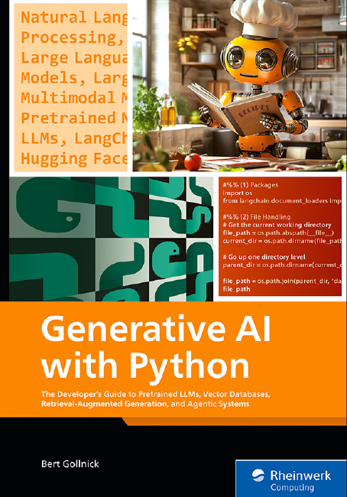
Chapter-1
Introduction to Generative AI
Prepared By
Dr. Rasmita Rautray

Slide 2
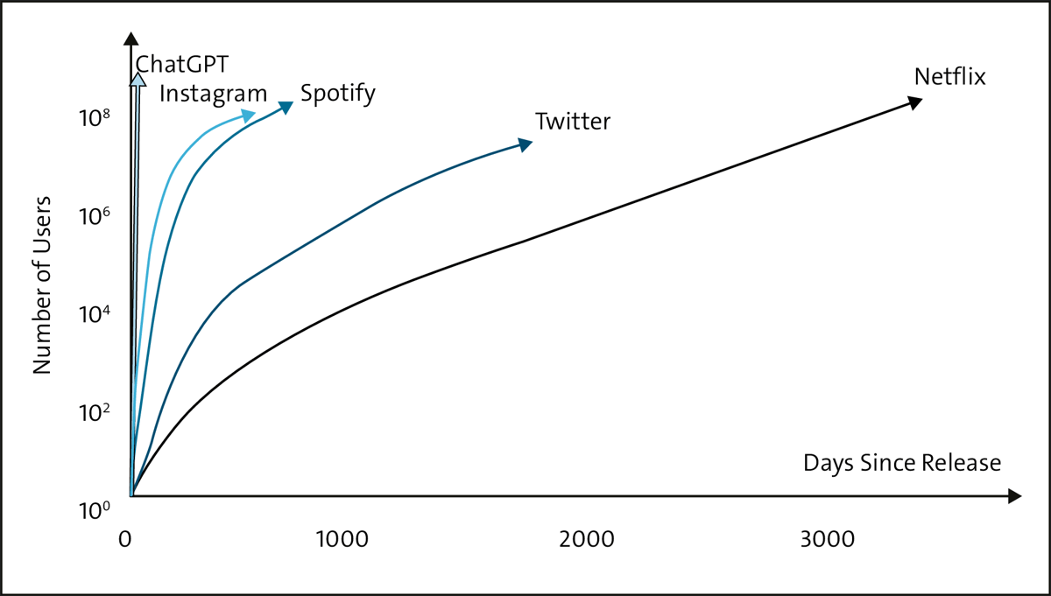
1.1 Introduction to Artificial Intelligence
Rise of ChatGPT

Slide 3
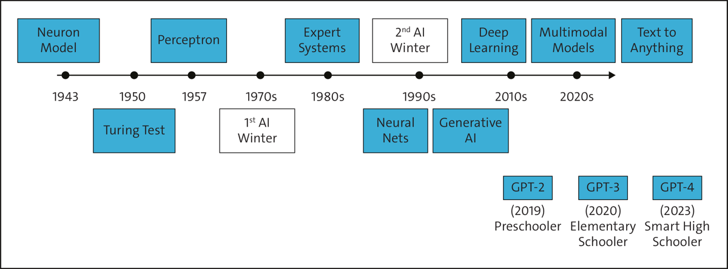
Evolution of AI and it’s importance

Slide 4
1.2 Pillars of Generative AI Advancement
Computational Power
Model and Data Size
Investments
Algorithmic Improvements

Slide 5
  1.3 Deep Learning
Traditional Programming vs Machine Learning
Deep Learning: Model Training

Slide 6
1.4 Narrow AI
Narrow AI Achievements

Slide 7
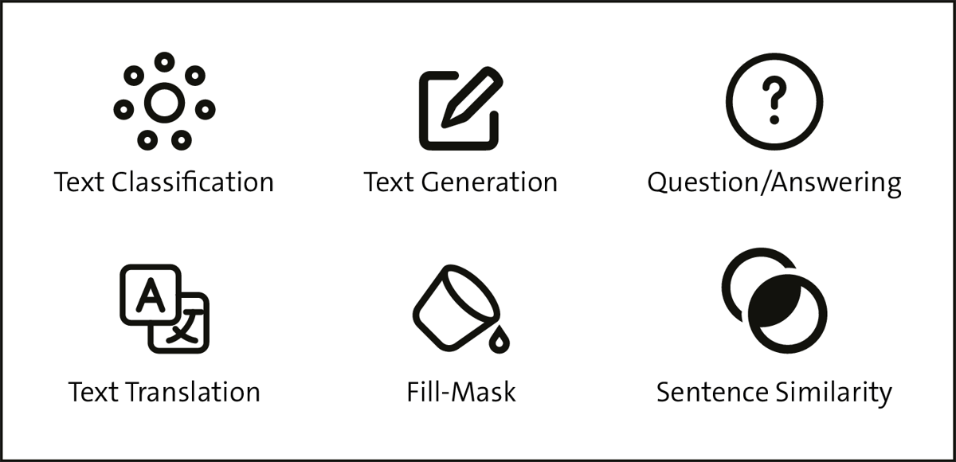
1.5 Natural Language Processing Models
What is NLP?
NLP Tasks

Slide 8
1.6 Large Language Models
LLM Training Process

Slide 9
Use Cases of LLMs
Creative Writing
Summarization
Chatbots and Virtual Assistants
Translation
Content Creation
Education
Limitations of LLMs
Hallucinations
Bias
Context Window and Token Limitations

Slide 10
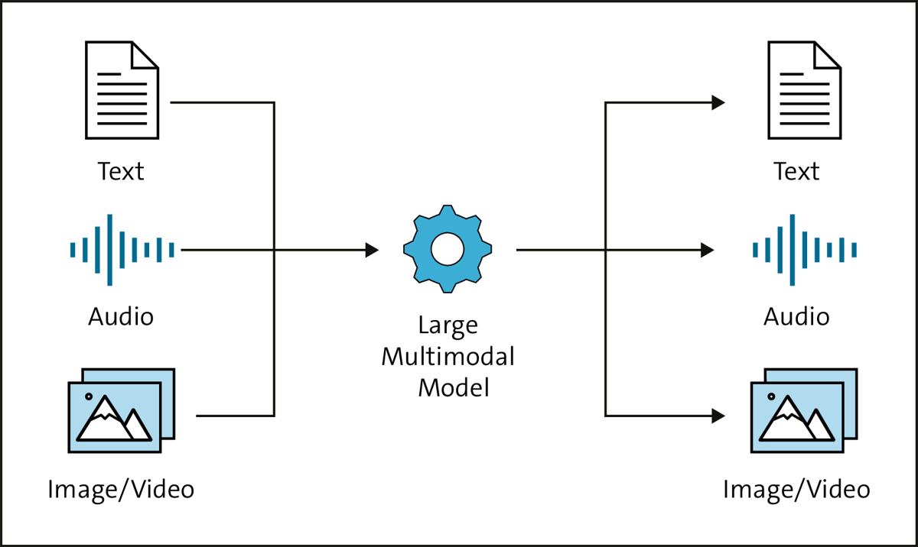
1.7 Large Multimodal Models (LMMs)

Slide 11
1.8 Generative AI Applications
Consumer Applications
Enterprise – Horizontal Applications
Enterprise – Vertical Applications
Prosumer Applications

