Slide 1

ISLAMIC UNIVERSITY OF TECHNOLOGY
PROJECT NAME : ATHENA
PROJECT TYPE : LIBRARY MANAGEMENT SYSTEM
COURSE : STRUCTURE PROGRAMMING II
Page 01

Slide 2
Team Members
A N M ZAHID HOSSAIN MILKAN
ID : 200041202
LAB GROUP : 2B
FAHIM FARHAD AHMED
ID : 200041256
LAB GROUP : 2B
AMIT BIN TARIQUL
ID : 200041214
LAB GROUP : 2B
Page 02

Slide 3
A BRIEF EXPLANATION
A sophisticated management system facilitated with opportunities of registration and login with data security and much more apart from usual functionalities associated with the conventional system with user friendly interface.
Page 03

Slide 4
IMPLEMENTED FEATURES
Registration and Login System
Maintenance of User Profile
Password System and Data Security and verification facilities
File System Management
Multiple Book Profile Entry
View Book Inventory
Searching by different criteria(ISBN, Name, Author , Genre)
Editing Book Profile by aforementioned criteria
Load from different Inventory Files
Saving in Default and User defined Files
Deleting Book Profile from any Inventory
Borrow and Return System
User Friendly Interface
Page 04

Slide 5
What they perform?
The Registration System and Login System
Allows Users to create their own Profile in the Library by which they can get access to the applications
System of Password Verification and Reset System
All user’s data will be in binary file which isn’t human readable
While entering the password it will show *(asterisk) symbol which will ensure privacy
Page 05

Slide 6

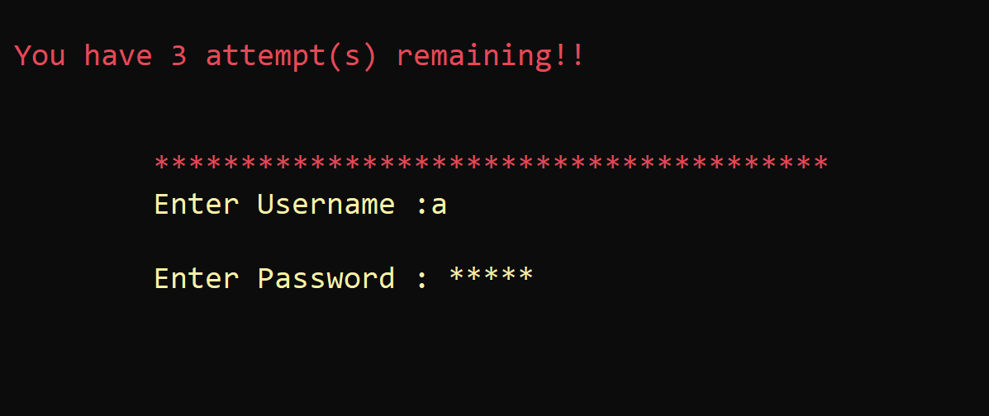
Page 06

Slide 7
Adding Books Profile
What they perform?
Book entry into Inventory with International Standard of Book Number(ISBN) code , Name , Author , Genre , Quantity and Shelf number.
Same Book profile can’t be created only Quantity can be increased
View Book Inventory
Display books present in the Files at the moment and load from other files
Page 07

Slide 8
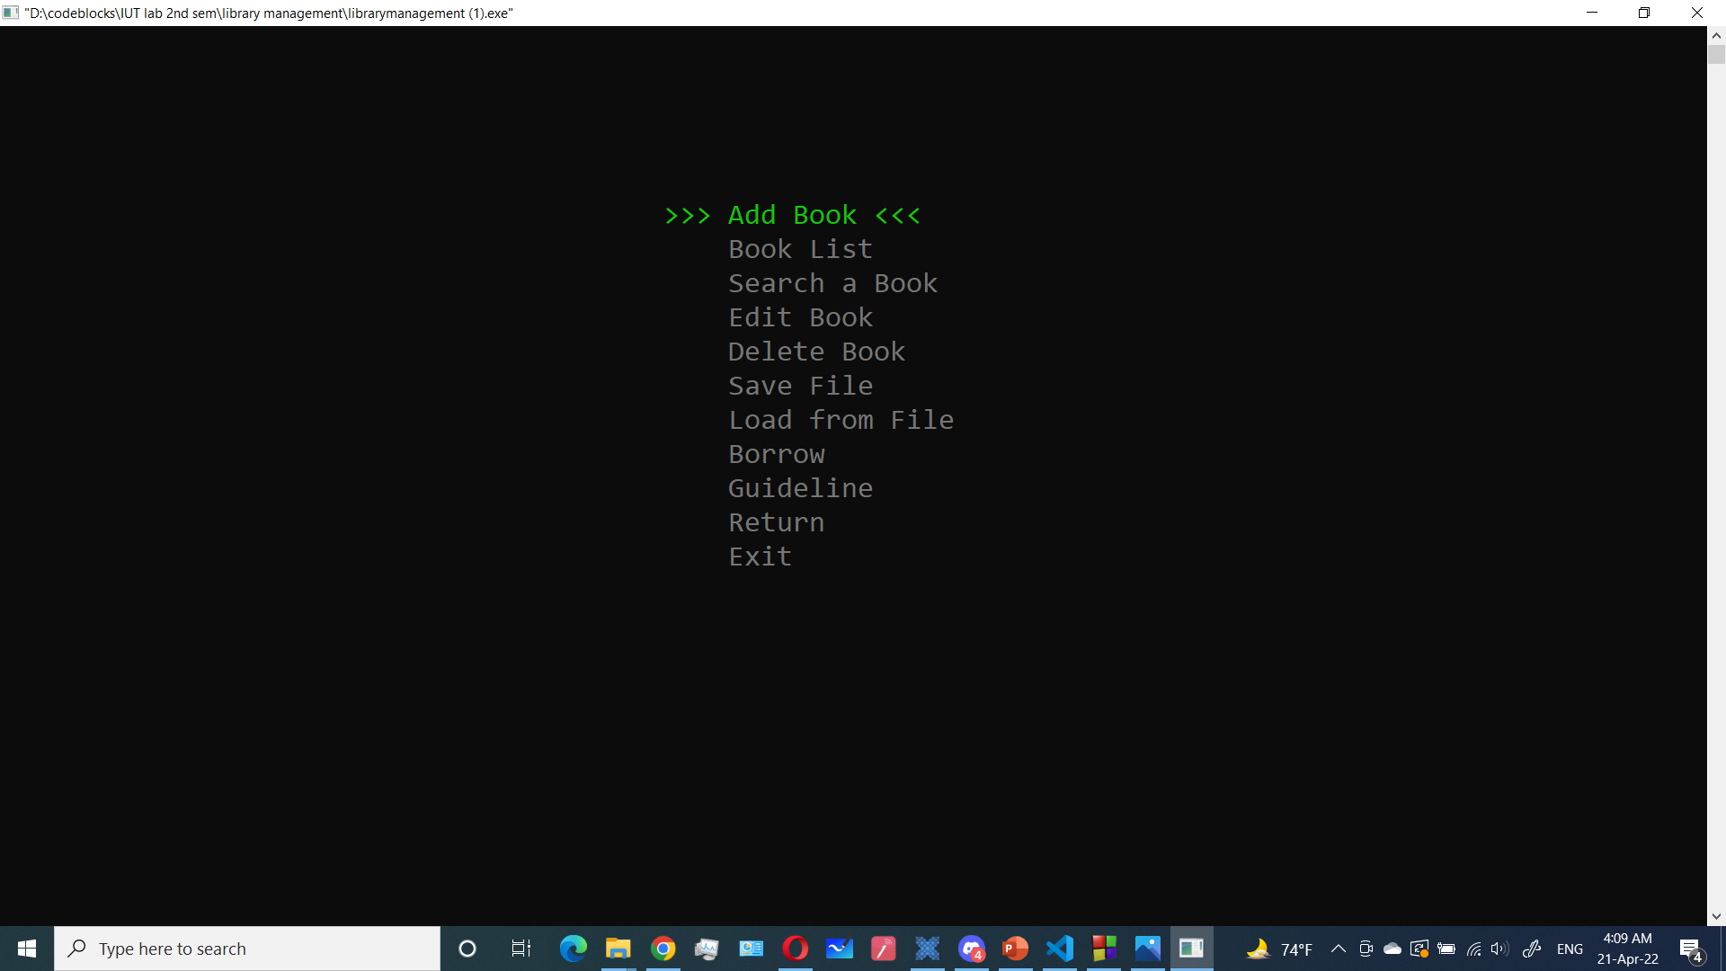
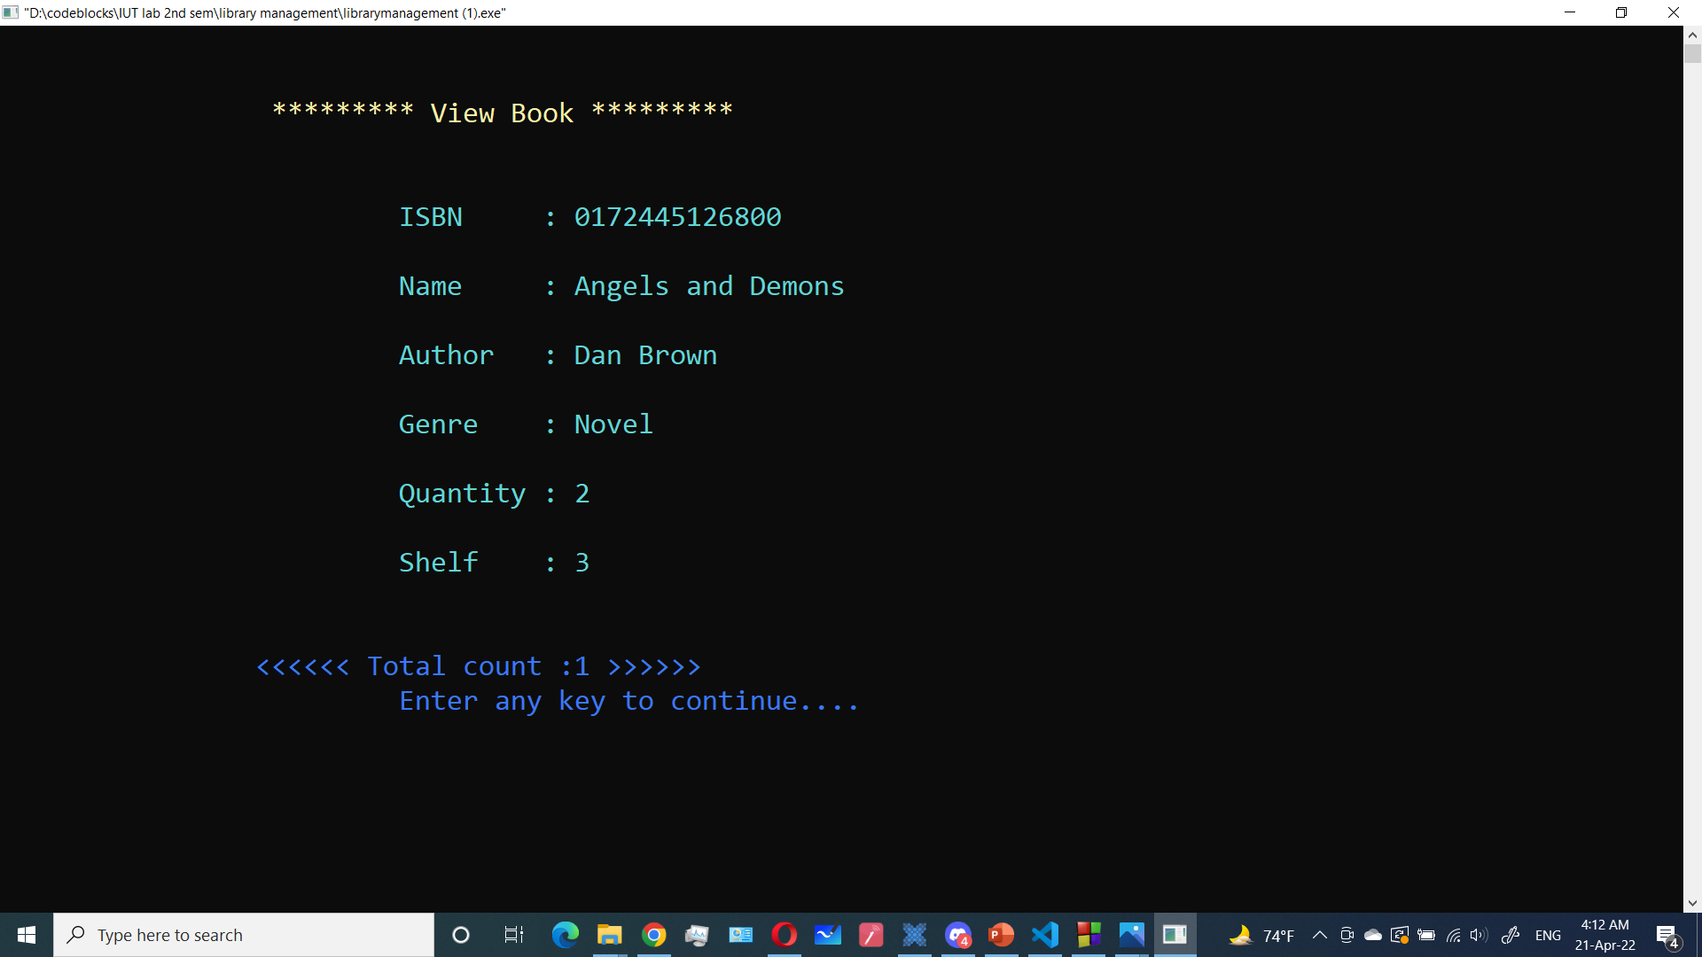
Page 08

Slide 9
Search Book’s profile
Different search options like by ISBN,book’s name
Filter out books profile by author and genre
Edit Book’s profile
Search by name or ISBN to edit any particular book’s profile
Page 09

Slide 10
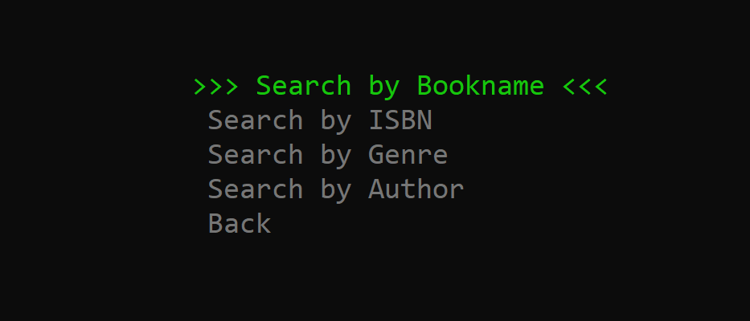
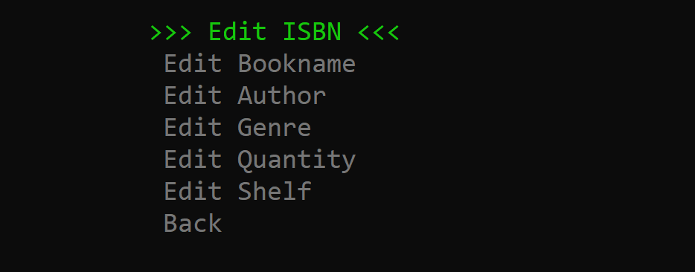
Page 10

Slide 11
Delete Book’s profile
Deletes the entire record of particular book by searching through different criteria
Return and Borrow Book
In case of borrow reduces the quantity of book
Shows out of stock if the book is currently unavailable
In case of return increases the quantity of book
Page 11

Slide 12

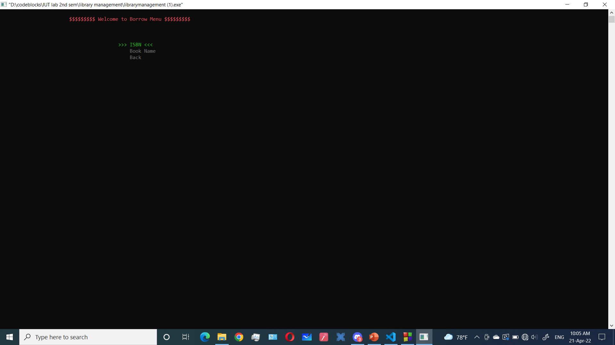
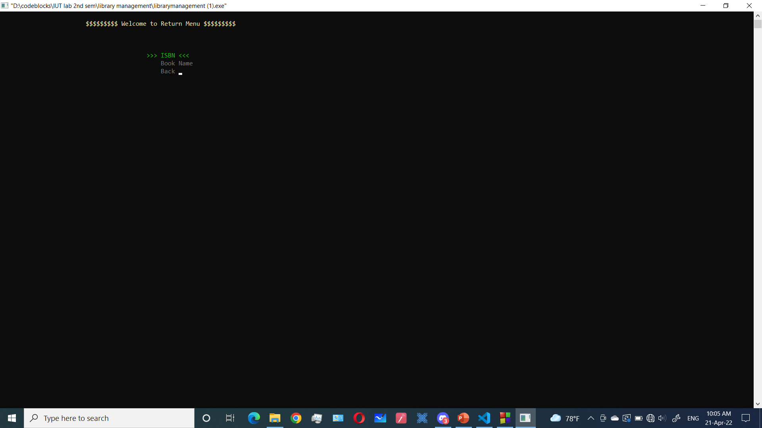
Delete Menu
Page 12

Slide 13
Let us see a demonstration
Page 13

Slide 14
Proposal vs Implementation
We have tried to implement all the features those were proposed
We tried to add some new features those were not proposed earlier like Password Verification and Change system are newly Introduced
We tried to implement XOR encryption but it didn’t load properly
We used an UI system to make it user friendly
Page 14

Slide 15
Challenges and Solutions
We have faced problem in writing strings.So we used %[^\n] and fgets
While setting cursor positions some printing texts were hectic.So in some places we used escape sequences like \n and \t
While putting asterisk(*) in place of password inputs we have faced difficulties in handling backspace.Then we just wrote some logics to place asterisk(*) with space character whenever getting backspace to removing any character
While encrypting book record we faced difficulties in proper format of display and the quantity of books.By looking through some documents we overcame this problem
While creating binary file for user record , writing to it and reading from it.Through studying characteristics of binary files we solved it
Page 15

Slide 16
Contributions of members
Features design : Zahid
Code skeleton : Fahim and Zahid
Login system : All
Password Management : Amit
Add book feature with ISBN concept : Zahid
Search ,Edit , Delete, Borrow , Return : Fahim
File System Handling : Fahim and Zahid
File security : Amit
User Interface : Zahid and Fahim
Documentation, Debugging and Testing : All
Page 16

