Slide 1
Capstone_Project_2 House Price Prediction
Amit Hiremath

Slide 2
Contents:
Problem Statement
Description of Dataset
Data Wrangling
Exploratory Data Analysis(EDA)
Modeling
Result Analysis
Recommendation for clients
Future Work

Slide 3
Problem Statement :
To predict the final price of each home according to the market prices taking into account different features ranging from the basic amenities to that of its proximity to public transport hub.
Buyers Sellers
Agents

Slide 4
Scope of solution space:
- Find the actual Price of the house
- Save the Money from Middle Man
Constraints within the solution space:
- Predictions are not always correct
Stakeholders:
- House owners
- Buyers
- Investors
- Agents

Slide 5
Description of Dataset:
- Dataset is from Ames, Iowa Housing dataset from Kaggle.com
https://www.kaggle.com/c/house-prices-advanced-regression-techniques/data
79 explanatory variables (features)
1460 observations
Target variable is SalePrice
Datatypes- int,float, object with some null values

Slide 6
Data Wrangling:
Feature columns with null values > 80% removed
Filling null values:
int/float features - averageg (mean) of the column
object/categorical features – frequently occurred category
Shape of dataset
1460 observations
76 columns => 3 columns removed

Slide 7
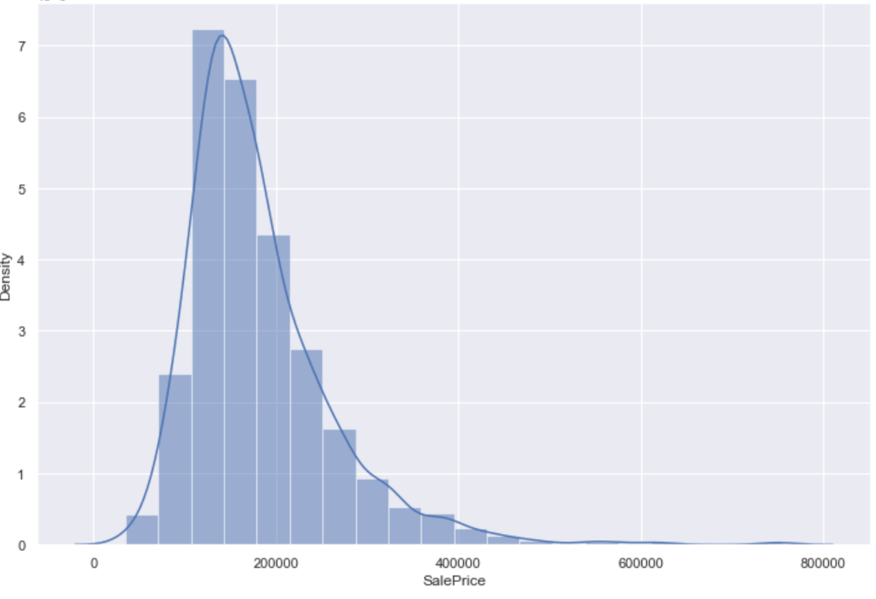
EDA: Histogram:

Slide 8
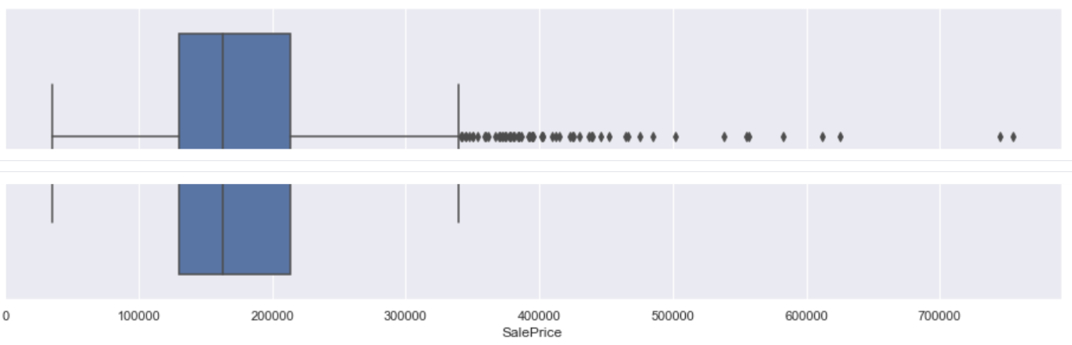
Boxplot:

Slide 9
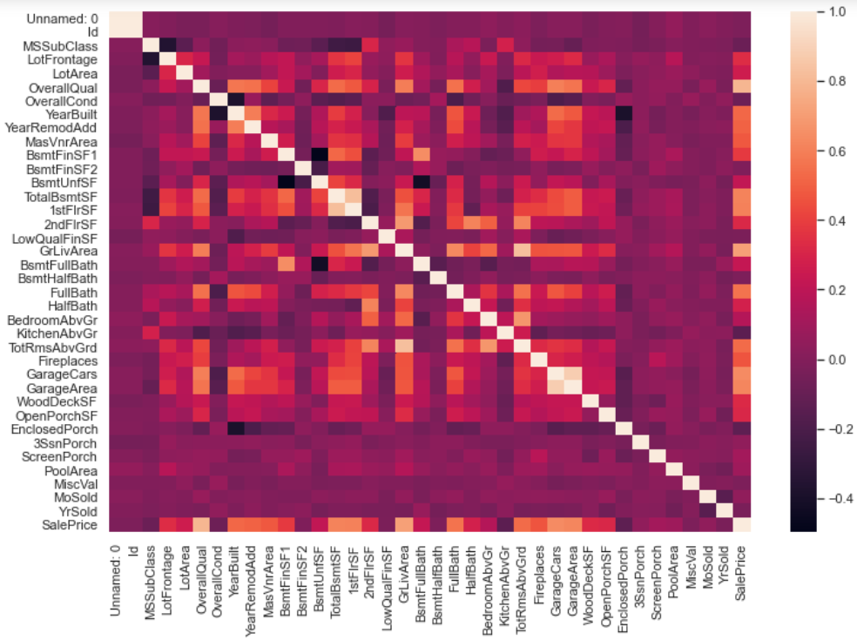
heatmap

Slide 10
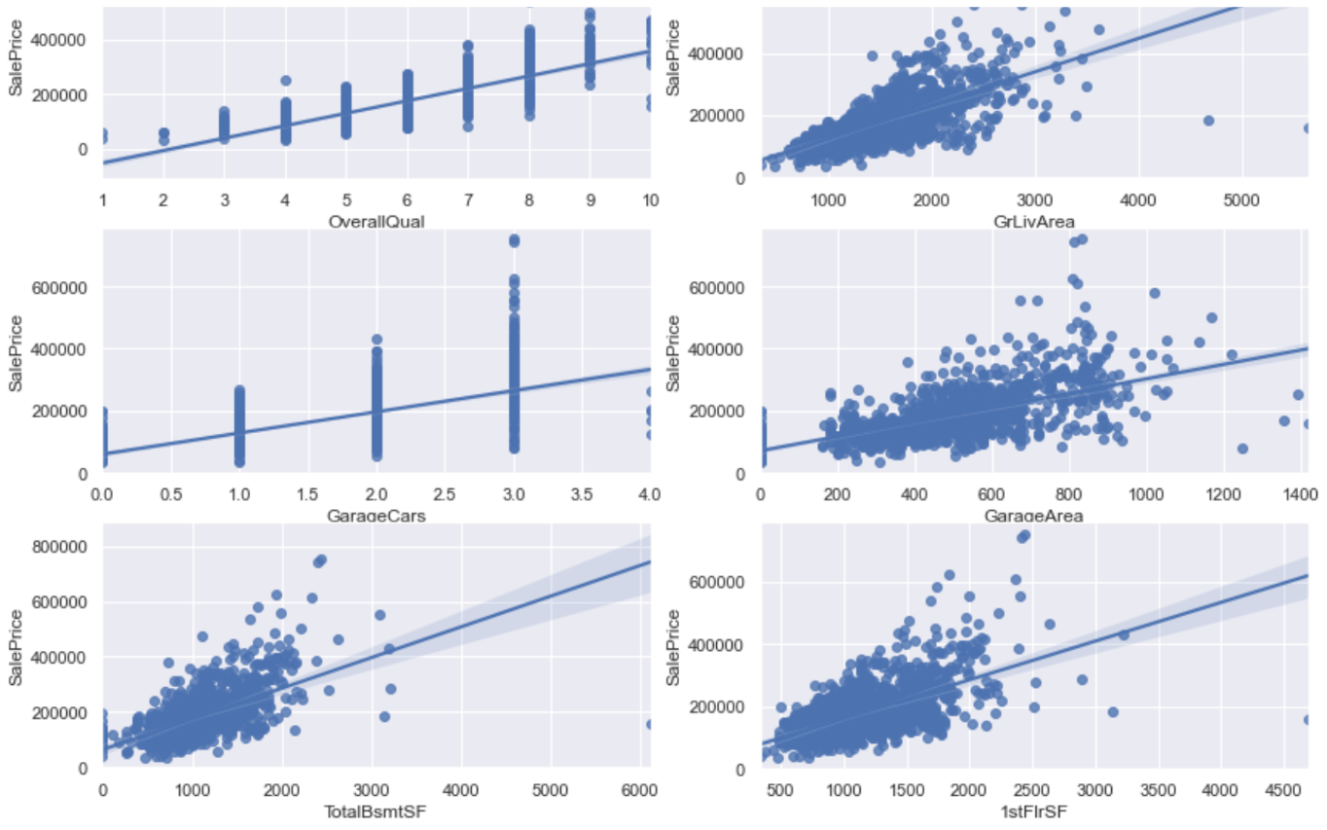
Scatter plot

Slide 11
Feature Engineering:
Filter features which have +ve or –ve impact on target variable.
Features impacting on target with same amount then we select one among them hence it reduces the feature size to 73.
categorical features into dummy features which leads to 275 columns.
Data Normalization.
transforming numeric columns to a common scale.
Splitting dataset into training and testing dataset.

Slide 12
Modeling:
Column1 | Column2 | Column3 | Column4 | Column5 | Column6
Sno | Model | RMSE | R^2 | parameters | Reviews
1 | Linear regression | 6.08E+18 | -3.57E+19 | NA | Very bad performance
2 | Ridge Regression | 0.01486523 | 0.9127787 | alpha =100 | very good performance
3 | Lasso GridSearchCV | 0.015560653 | 0.908698427 | alpha =0.01 | good performance

Slide 13
Conclusion and Future Scope:
Analyse the dataset
Filter the dataset and find correlated features
Feed these futures to three algorithms
Linear Regression, Ridge Regression, Lasso GridSearchCV
Ridge Regression model selected as final model based on its performance to train the data.
Future Scope:
- work on large data set
- Make use of more algorithms

