Slide 1
Capstone_Project_3 Identify Whether a Text Message is Spam or Ham
AMIT HIREMATH

Slide 2
Contents
Problem Statement
Description of Dataset
Data Wrangling
Exploratory Data Analysis(EDA)
Feature Engineering
Modeling and Result Analysis
Model Deployment
Future Scope

Slide 3
Problem Statement:
To predict the message as spam (junk) or ham (legitimate) by building a spam filter (model).
Spam Message – “Unsolicited Bulk Message”
Unsolicited message is normal email (examples: first contact enquiries, job enquiries, sales enquiries)
Bulk message is normal email (examples: subscriber newsletters, customer communications)

Slide 4
Scope of solution space:
Find out the message as spam or ham using the trained model
User will be free from fraud communications
Constraints within the solution space:
Predictions are not always correct
User will be in dilemma
Stakeholders:
Sender
Recipient

Slide 5
Description of Dataset:
SMS Spam Collection is a set of SMS collected from three different sources and made available in kaggle.com
The Grumbletext Web site
NUS SMS Corpus (NSC)
Caroline Tag's PhD Thesis
https://www.kaggle.com/uciml/sms-spam-collection-datase
two features – label and mesasge
5574 messages
Target variable – label (ham/spam)
No null and missing values

Slide 6
Data Wrangling:
Text content:
email address, website address, phone number, money symbol and digits
Ham messages - 86.59%
Spam Messages - 13.41%
- case of imbalanced data set
No much wrangling needed because dataset is clean

Slide 7
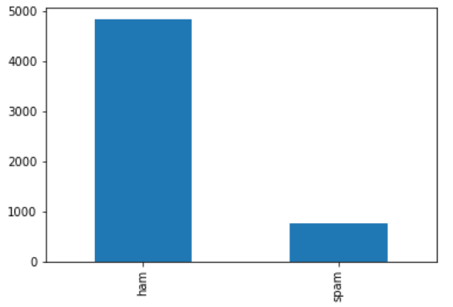
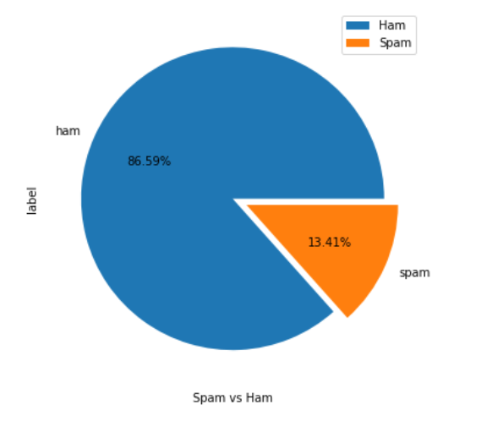
EDA: Bar plot and Pie plot:

Slide 8
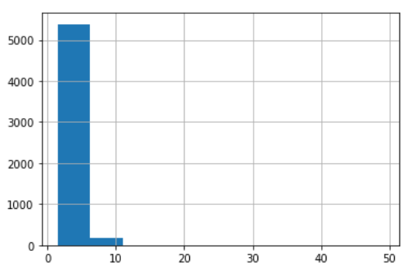
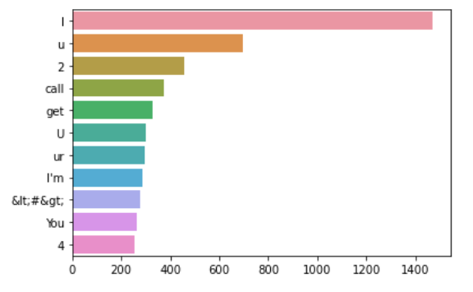
Bar plots for average word length and most frequently occurred words

Slide 9
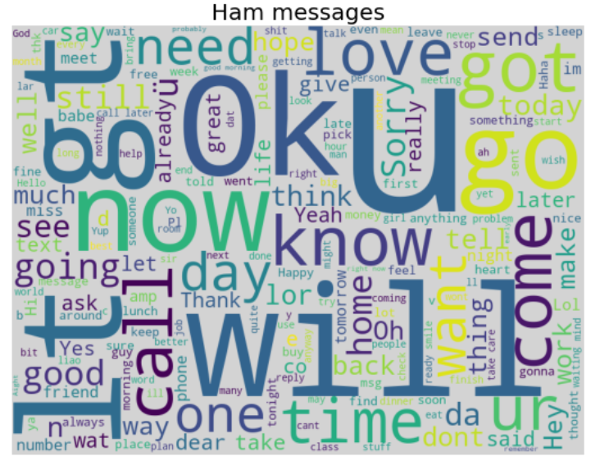
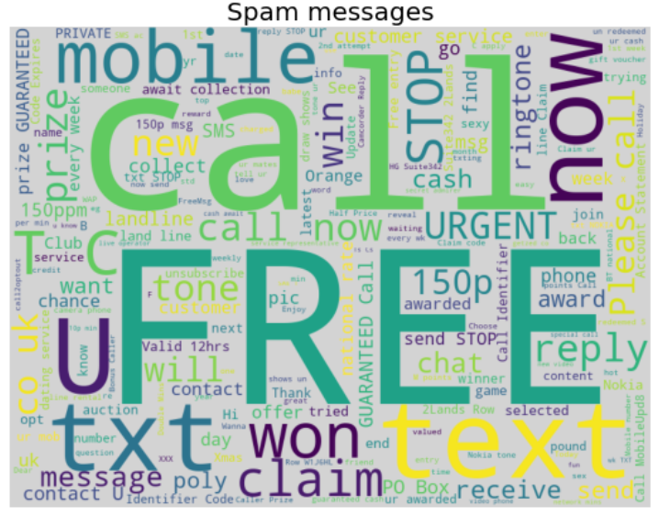
WordCloud for spam and ham words

Slide 10
Feature Engineering:
use regular expressions to replace email addresses, URLs, phone numbers, other numbers.
replace email addresses with 'email'
Replacing:
- URLs with 'webaddress‘
- money symbols (£, $) with ‘moneysymb’
- 10 digit phone numbers with 'phonenumber'
- Numbers(digits) with 'numbr’
- punctuation with white space
- whitespace between terms with a single space - removing leading and trailing whitespace
- last changing all words to lower case

Slide 11
stopwords:
Using stopword library to remove english stop words
Stemming:
The process of reducing a word to its word stem
CountVectorizer:
library in Python which is used to transform a given text into a vector on the basis of the frequency (count) of each word that occurs in the entire text

Slide 12
Modeling and Result Analysis:
Column1 | Column2 | Column3 | Column4
Sno | Model | Performance(Accuracy) | Review
1 | Logistic Regression | 98.30% | Best Performance
2 | Naive Bayes classifier | 98.48% | Excellent Performance
3 | K-nearest neighbors | 95.61% | Better Performance
4 | Support Vector Machine | 87.17% | Good Performance
5 | Decision Tree Classifier | 97.94% | Better Performance
6 | Random Forest Classifier | 98.39% | Best Performance
7 | Gradient Boosting Classifier | 98.12% | Better Performance
8 | AdaBoost Classifier | 98.30% | Best Performance

Slide 13
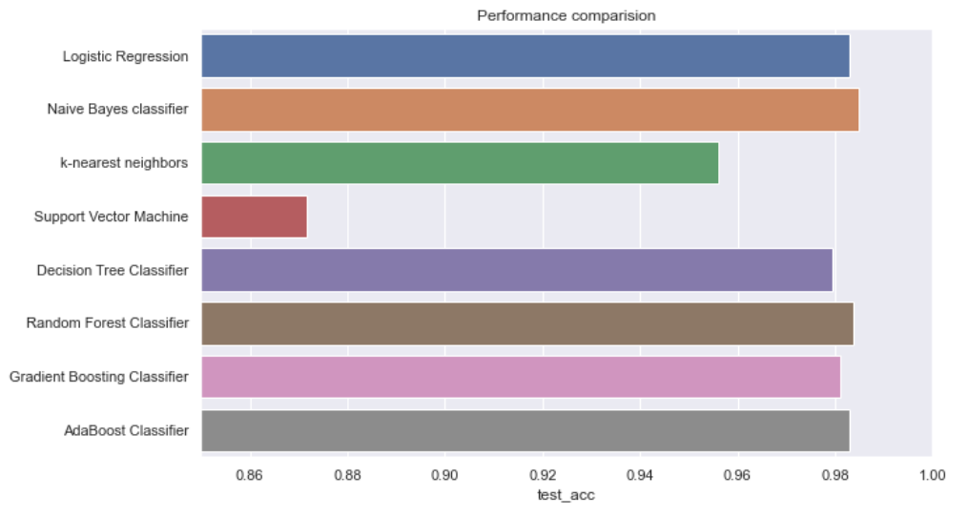
Performance comparisons of models:

Slide 14
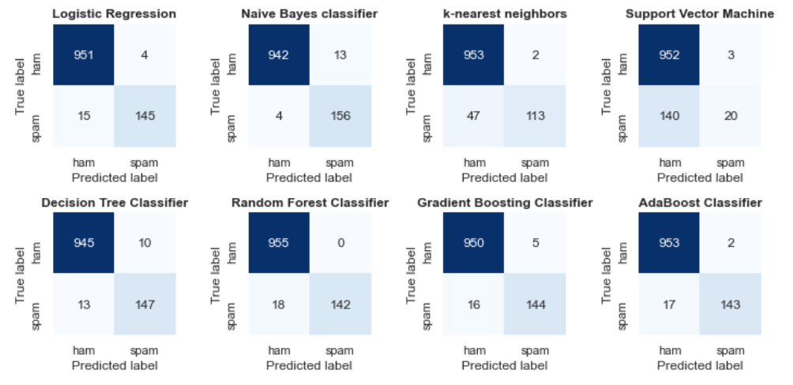
Confusion Matrix of Models:

Slide 15
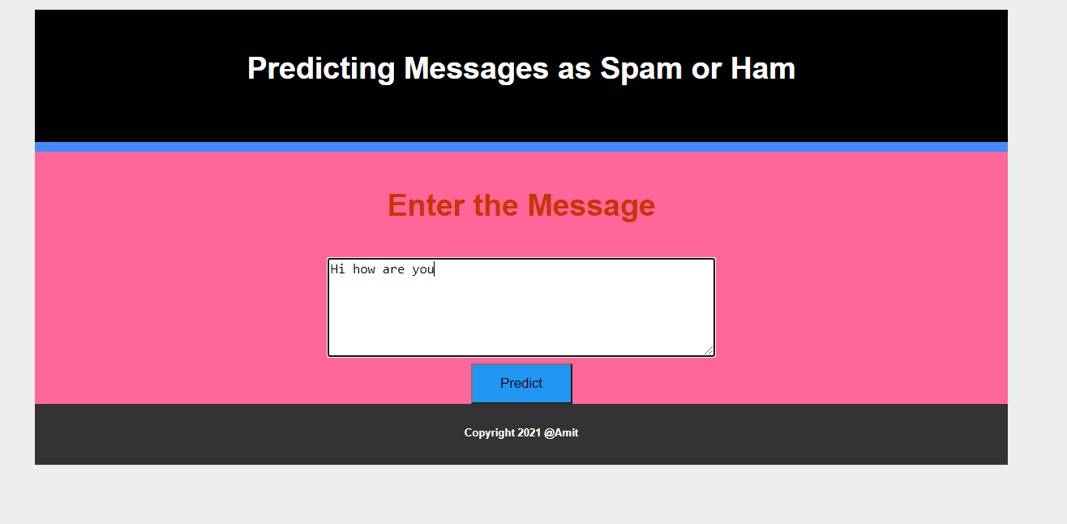
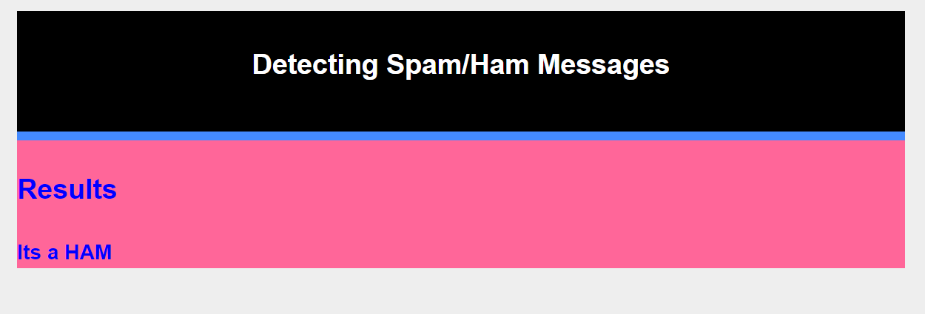
Model Deployment:

Slide 16
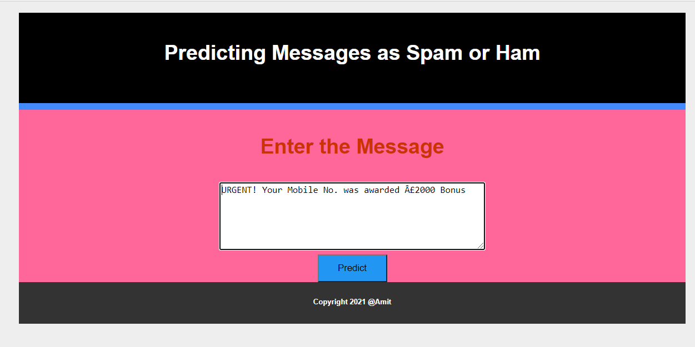
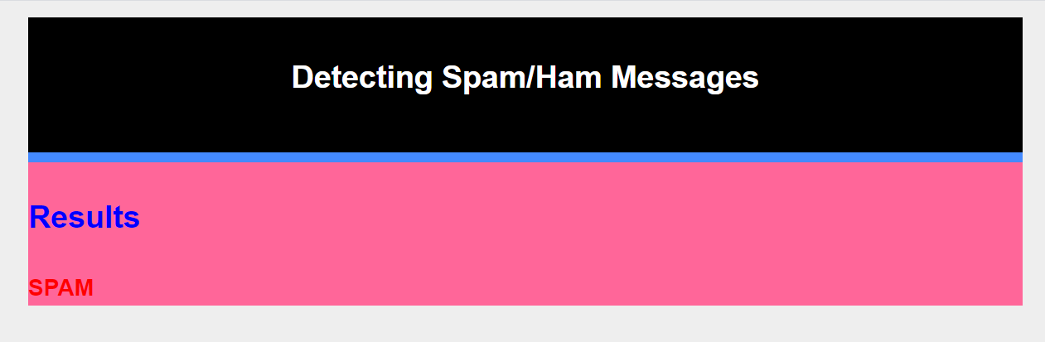

Slide 17
Conclusion and Future Scope:
Analyse the dataset
Filtering and transforming the dataset to vector by stopwords, stemming and CountVector module
algorithms used: Logistic regression, Naive Bayes Classifier, K-nearest neighbors, Support Vector Machine, Decision Tree Classifier, Random Forest Classifier, Gradient Boosting Classifier, AdaBoost
Naive Bayes Classifier selected as final model based on its performance to train the data.
Future Scope:
- work on large data set with more spam related content

