Slide 1
Top Down Parsing
TeachING Assistant: David Trabish

Slide 2
Examples
void f(int a) {
((((8))));
}

Slide 3
Examples
void f(int a) {
((((8))));
}
Valid

Slide 4
Examples
void f(int a) {
((((8);
}

Slide 5
Examples
void f(int a) {
((((8);
}
Invalid

Slide 6
Examples
void f(int a) {
5;;;;;
}

Slide 7
Examples
void f(int a) {
5;;;;;
}
Valid

Slide 8
Examples
void f() {
int a[];
}

Slide 9
Examples
void f() {
int a[];
}
Invalid

Slide 10
Examples
void f() {
int a[10.0];
}

Slide 11
Examples
void f() {
int a[10.0];
}
Invalid

Slide 12
Examples
void f(int a[]) {
}

Slide 13
Examples
void f(int a[]) {
}
Valid

Slide 14
Examples
void f() {
int i = 0;
i = 8;
int j = i;
}

Slide 15
Examples
void f() {
int i = 0;
i = 8;
int j = i;
}
Valid

Slide 16
Examples
void f() {
int i = 0;
i = 8;
int j = z;
}

Slide 17
Examples
void f() {
int i = 0;
i = 8;
int j = z;
}
Valid

Slide 18
Examples
void f() {
int i = 0;
i = 8;
int j = i
}

Slide 19
Examples
void f() {
int i = 0;
i = 8;
int j = i
}
Invalid

Slide 20
Examples
void f() {
g()++;
}

Slide 21
Examples
void f() {
g()++;
}
Valid

Slide 22
Language of Balanced Parentheses
Contains string of the form:
8, (1), (((03))), …
Not allowing:
((1), 8()

Slide 23
Language of Balanced Parentheses
Contains string of the form:
8, (1), (((03))), …
Not allowing:
((1), 8()
Is there a DFA/NFA that accepts the language?
Is there a regular expression the accepts the language?

Slide 24
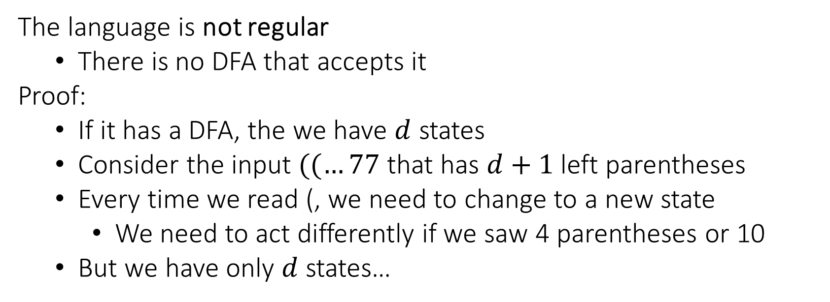
Language of Balanced Parentheses
The language is not regular
There is no DFA that accepts it
Proof:
If it has a DFA, the we have $d$ states
Consider the input $((…77$ that has $d+1$ left parentheses
Every time we read (, we need to change to a new state
We need to act differently if we saw 4 parentheses or 10
But we have only $d$ states…

Slide 25
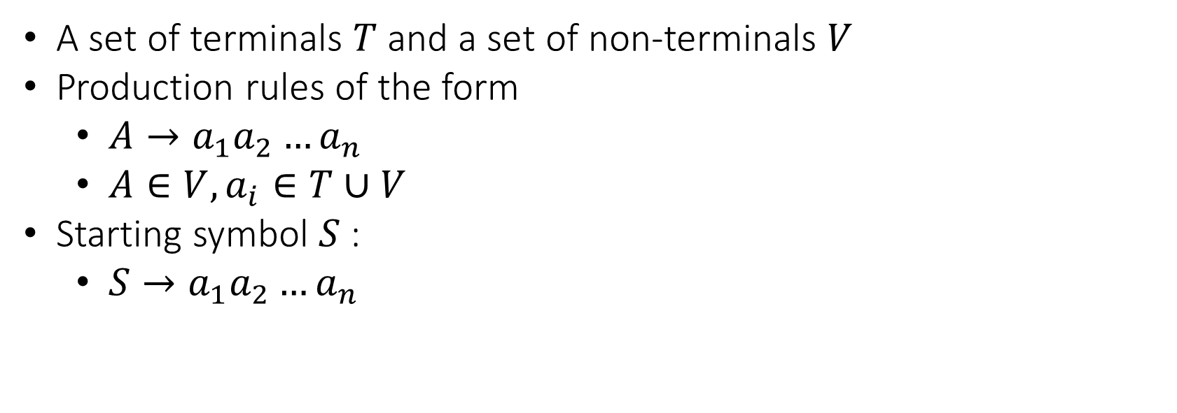
Context Free Grammar
A set of terminals $T$ and a set of non-terminals $V$
Production rules of the form
$A→a_{1}a_{2}…a_{n}$
${A∈V, a}_{i}∈T∪V$
Starting symbol $S$:
$S→a_{1}a_{2}…a_{n}$

Slide 26
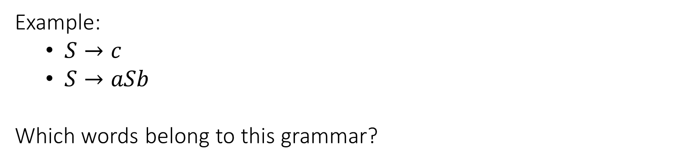
Context Free Grammar
Example:
$S→c$
$S→aSb$
Which words belong to this grammar?

Slide 27
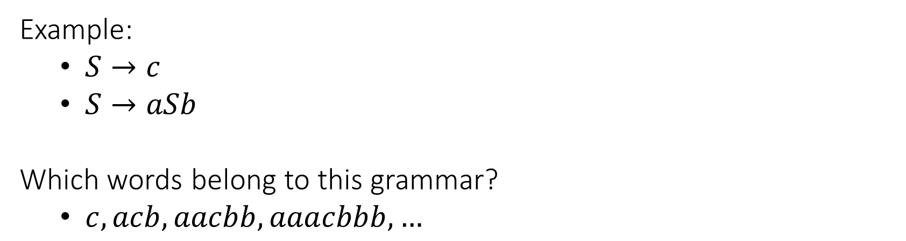
Context Free Grammar
Example:
$S→c$
$S→aSb$
Which words belong to this grammar?
$c, acb,aacbb, aaacbbb,…$

Slide 28
Context Free Grammar
Is the language of balanced parentheses has a CFG?

Slide 29
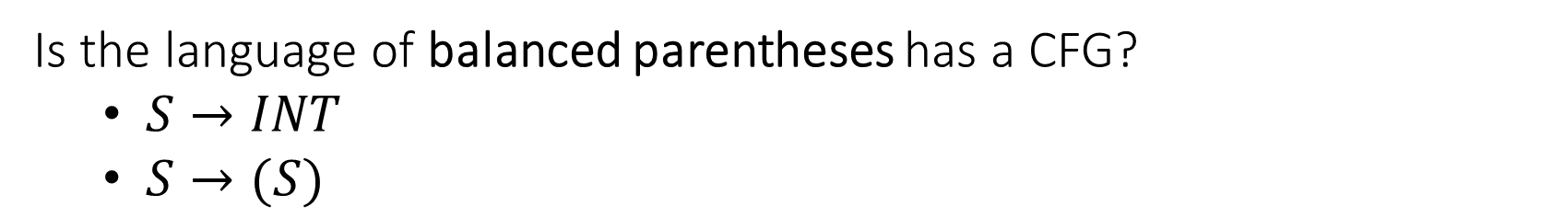
Context Free Grammar
Is the language of balanced parentheses has a CFG?
$S→INT$
$S→(S)$

Slide 30
Context Free Grammar: Questions
Are there languages which has no CFG? Yes
Is it possible to have multiple CFG describing the same? Yes

Slide 31
Predictive Parser: Definition
Some languages has a predictive parser:
We determine the production rule according to the current token
We begin we the start symbol
From the top…

Slide 32
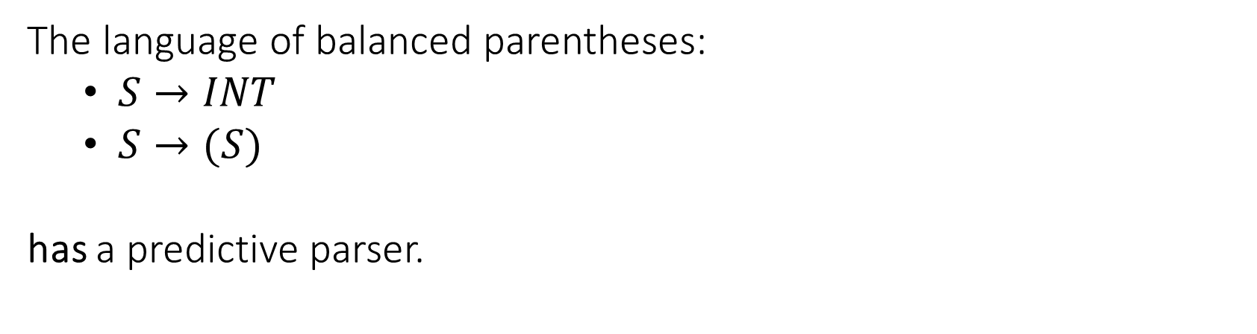
Predictive Parser: Example
The language of balanced parentheses:
$S→INT$
$S→(S)$
has a predictive parser.

Slide 33
Predictive Parser: Example
void parse_S() {
switch (token) {
case INT:
parse_token(INT);
break;
case L_PAREN:
parse_token(L_PAREN);
parse_S();
parse_token(R_PAREN);
break
default:
// error
}
}
void parse_token(int expected) {
if (token == expected) {
token = lexer.next_token();
} else {
// error
}
}

Slide 34
Predictive Parser: Example
What happens for the input (7)?
Call trace:
parse_S
parse_token // match with ‘(‘
parse_S
parse_token // match with ‘7‘
parse_token // match with ‘)‘

Slide 35
Predictive Parser: Example
What happens for the input ((7)?
Call trace:
parse_S
parse_token // match with ‘(‘
parse_S
parse_token // match with ‘(‘
parse_S
parse_token // match with ‘7’
parse_token // match with ‘)’
parse_token // error, expecting ‘)’

Slide 36
Language of Balanced Parentheses 2
Find a CFG for a language with the 3 kinds of parentheses:
(), [], {}
Contains string of the form:
(([][]{}))[]
[()]
Not allowing:
(({))

Slide 37
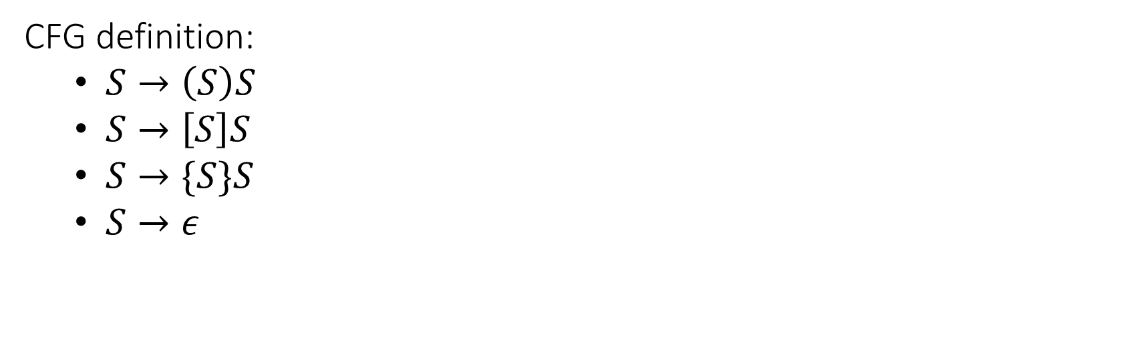
Language of Balanced Parentheses 2
CFG definition:
$S→\left(S\right)S$
$S→\left[S\right]S$
$S→\{S\}S$
$S→ε$

Slide 38
Language of Balanced Parentheses 2
void parse_S() {
switch (token) {
case L_PAREN:
parse_S1();
break;
case L_BRACKET:
parse_S2();
break;
case L_BRACE:
parse_S3();
break;
default:
// error
}
}
void parse_S1() {
parse_token(L_PAREN);
parse_S();
parse_token(R_PAREN);
parse_S();
}
void parse_S2() {
parse_token(L_BRACKET);
parse_S();
parse_token(R_BRACKET);
parse_S();
}
void parse_S3() {
parse_token(L_BRACE);
parse_S();
parse_token(R_BRACE);
parse_S();
}

Slide 39
Calculator Language
A language with binary operators (+,-,*,/) and numbers:
1
1+1
(1+1)*(7/2)
2+1-7

Slide 40

Calculator Language
A (possible) CFG for that language:
$S→N$
$S→S+S$
$S→S−S$
$S→S∗S$
$S→S / S$
$S→(S)$

Slide 41
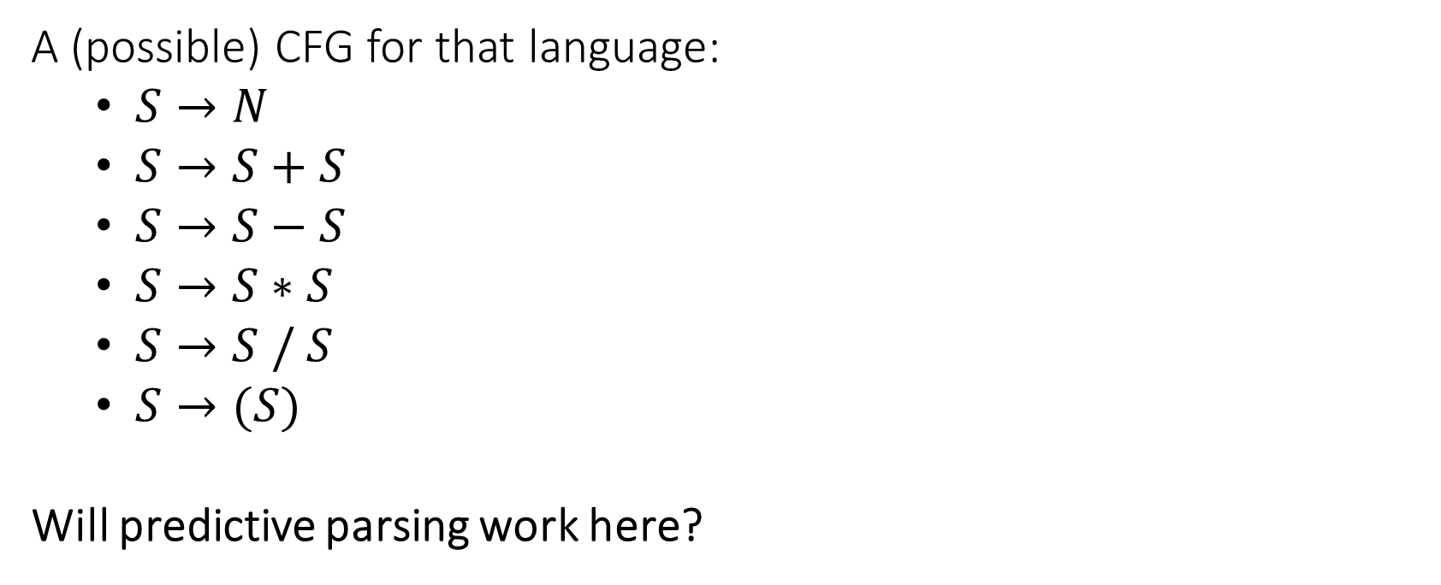
Calculator Language
A (possible) CFG for that language:
$S→N$
$S→S+S$
$S→S−S$
$S→S∗S$
$S→S / S$
$S→(S)$
Will predictive parsing work here?

Slide 42
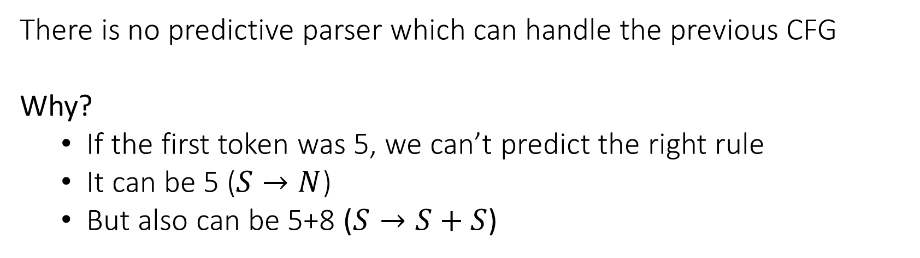
Left Recursion
There is no predictive parser which can handle the previous CFG
Why?
If the first token was 5, we can’t predict the right rule
It can be 5 ($S→N$)
But also can be 5+8 ($S→S+S$)

Slide 43
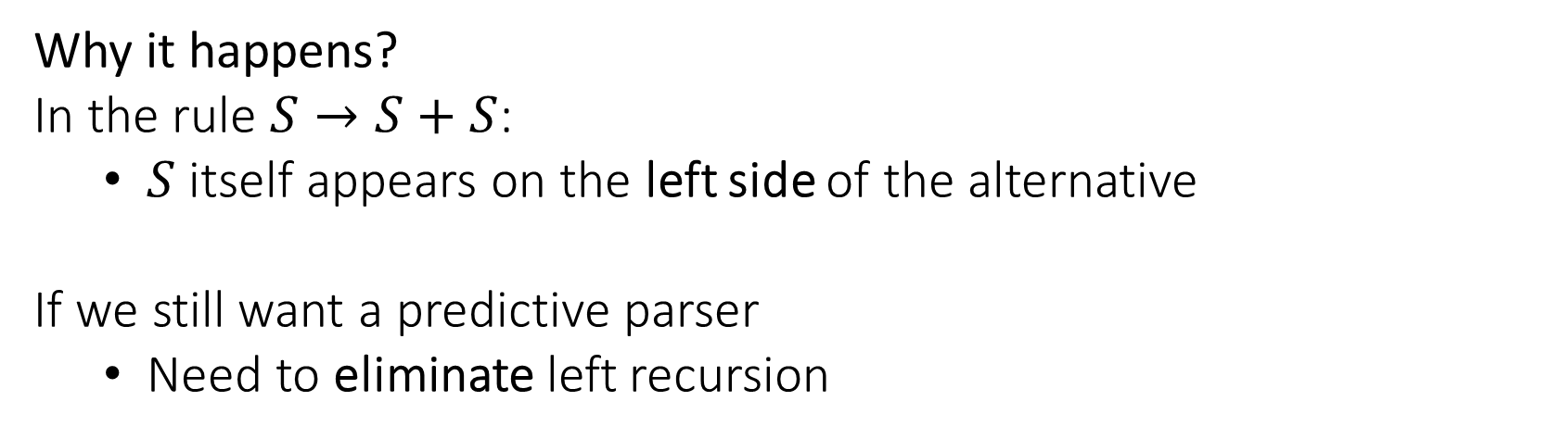
Left Recursion
Why it happens?
In the rule $S→S+S$:
$S$ itself appears on the left side of the alternative
If we still want a predictive parser
Need to eliminate left recursion

Slide 44

Left Recursion Elimination
If we have:
$X→a$
$X→Xb$
Then the language contains:
$a,ab,abb,abbb,…$
Define an alternative CFG:
$X→aY$
$Y→bY | ε$

Slide 45

Left Recursion Elimination
In general, if we have:
$X→a_{1} \left| a_{2} \right|…$
$X→Xb_{1} \left| Xb_{2} \right| …$
We will rewrite as follows:
$X→a_{1}Y\left|a_{2}Y\right|…$
$Y→b_{1}Y\left|b_{2}Y\right|…| ε$

Slide 46
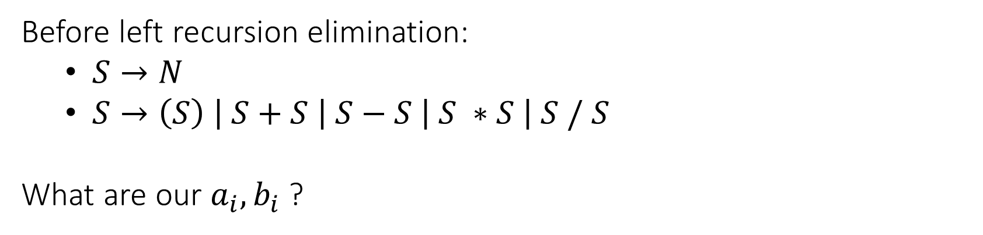
Calculator Language
Before left recursion elimination:
$S→N$
$S→\left(S\right) \left| S+S \left| S−S \right| S ∗S \right| S / S$
What are our $a_{i},b_{i}$ ?

Slide 47

Calculator Language
Before left recursion elimination:
$S→N$
$S→\left(S\right) \left| S+S \left| S−S \right| S∗S \right| S / S$
What are our $a_{i},b_{i}$ ?
$a_{1}=N, a_{2}=(S)$
$b_{1}=+S,b_{2}=−S,b_{3}= ∗S,b_{4}=/S$

Slide 48
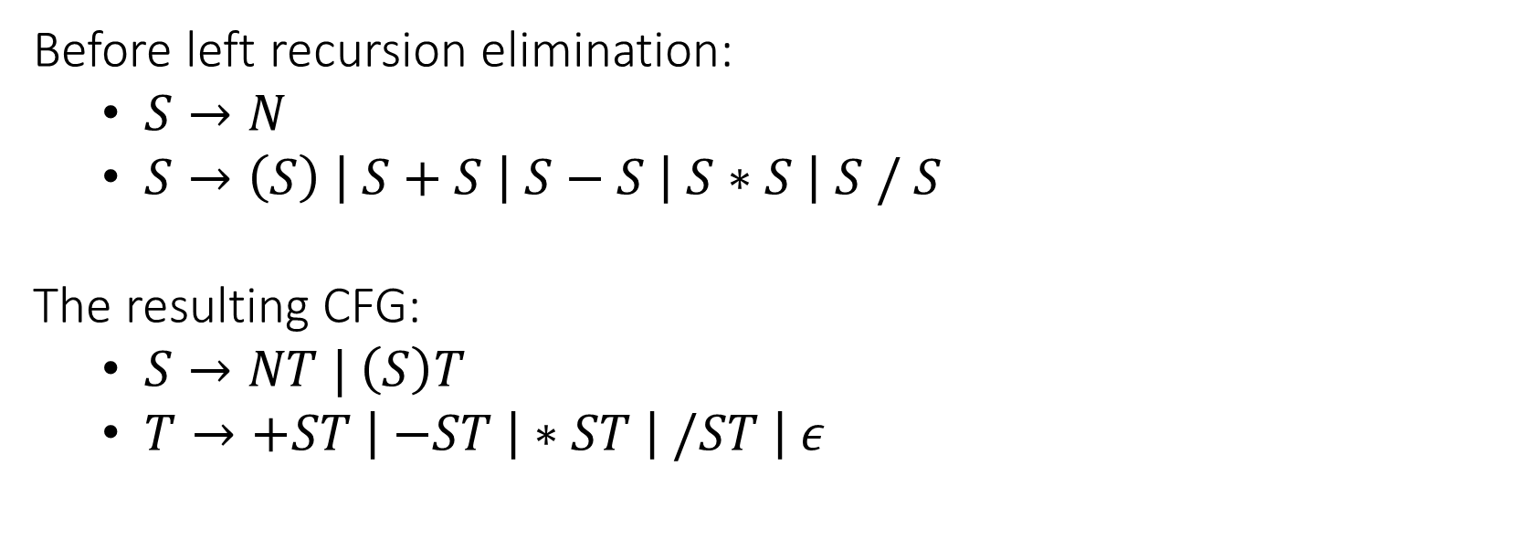
Calculator Language
Before left recursion elimination:
$S→N$
$S→\left(S\right) \left| S+S \left| S−S \right| S∗S \right| S / S$
The resulting CFG:
$S→NT | \left(S\right)T$
$T→+ST \left| −ST \right|∗ST \left| /ST \right| ε$

Slide 49
CFG vs Language
A language may hove more the one CFG
We might have a language which 2 CFG’s where:
One has a predictive parser
The other one doesn’t…

Slide 50
LL(1)
Definitions:
A grammar that has a predictive parser is called LL(1)
A language that has LL(1) grammar is called LL(1)

Slide 51

Derivation Tree
S
Which rules are applied for the expression 8 * 4 + 3?
$S→NT$
$S→\left(S\right)T$
$T→+ST$
$T→−ST$
$T→ ∗ST$
$T→ /ST$
$T→ε$
8
T
*
S
T
4
T
+
S
T
3
T

Slide 52

Derivation Tree
S
Which rules are applied for the expression 8 * 4 + 3?
$S→NT$
$S→\left(S\right)T$
$T→+ST$
$T→−ST$
$T→ ∗ST$
$T→ /ST$
$T→ε$
8
T
*
S
T
4
T
+
S
T
3
T

Slide 53

Derivation Tree
S
Which rules are applied for the expression 8 * 4 + 3?
$S→NT$
$S→\left(S\right)T$
$T→+ST$
$T→−ST$
$T→ ∗ST$
$T→ /ST$
$T→ε$
8
T
*
S
T
4
T
+
S
T
3
T

Slide 54

Derivation Tree
S
Which rules are applied for the expression 8 * 4 + 3?
$S→NT$
$S→\left(S\right)T$
$T→+ST$
$T→−ST$
$T→ ∗ST$
$T→ /ST$
$T→ε$
8
T
*
S
T
4
T
+
S
T
3
T

Slide 55
Derivation Tree
S
Which rules are applied for the expression 8 * 4 + 3?
$S→NT$
$S→\left(S\right)T$
$T→+ST$
$T→−ST$
$T→ ∗ST$
$T→ /ST$
$T→ε$
8
T
*
S
T
4
T
+
S
T
3
T

Slide 56

Derivation Tree
S
Which rules are applied for the expression 8 * 4 + 3?
$S→NT$
$S→\left(S\right)T$
$T→+ST$
$T→−ST$
$T→ ∗ST$
$T→ /ST$
$T→ε$
8
T
*
S
T
4
T
+
S
T
3
T

Slide 57
Derivation Tree
S
Which rules are applied for the expression 8 * 4 + 3?
$S→NT$
$S→\left(S\right)T$
$T→+ST$
$T→−ST$
$T→ ∗ST$
$T→ /ST$
$T→ε$
8
T
*
S
T
4
T
+
S
T
3
T

Slide 58
Derivation Tree
S
Which rules are applied for the expression 8 * 4 + 3?
$S→NT$
$S→\left(S\right)T$
$T→+ST$
$T→−ST$
$T→ ∗ST$
$T→ /ST$
$T→ε$
8
T
*
S
T
4
T
+
S
T
3
T

Slide 59
Derivation Tree
S
Which rules are applied for the expression 8 * 4 + 3?
$S→NT$
$S→\left(S\right)T$
$T→+ST$
$T→−ST$
$T→ ∗ST$
$T→ /ST$
$T→ε$
8
T
*
S
T
4
T
+
S
T
3
T

Slide 60
Operator Precedence
Our CFG does not contain information about operator precedence!
The expression 8 * 4 + 3 is interpreted as 8 * (4 + 3)
We need to find another grammar…

Slide 61
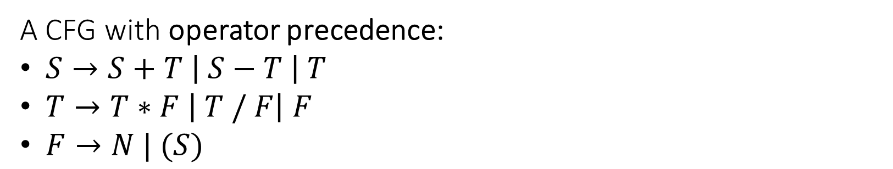
Operator Precedence
A CFG with operator precedence:
$S→S+T \left| S−T \right| T$
$T→T∗F \left| T / F\right| F$
$F→N | (S)$

Slide 62

Operator Precedence
A CFG with operator precedence:
$S→S+T \left| S−T \right| T$
$T→T∗F \left| T / F\right| F$
$F→N | (S)$
After eliminating left recursion:
$S→TS^{′}$
$S^{′}→+TS^{′}\left| −TS^{′}\right| ε$
$T→FT^{′}$
$T^{′}→ ∗FT^{′}\left| /FT′ \right| ε$
$F→N | (S)$

Slide 63
Derivation Tree
With the new CFG, the derivation tree for 8 * 4 + 3:
S
T
S’
F
T’
+
T
S’
8
*
F
T’
F
T’
4
3

Slide 64
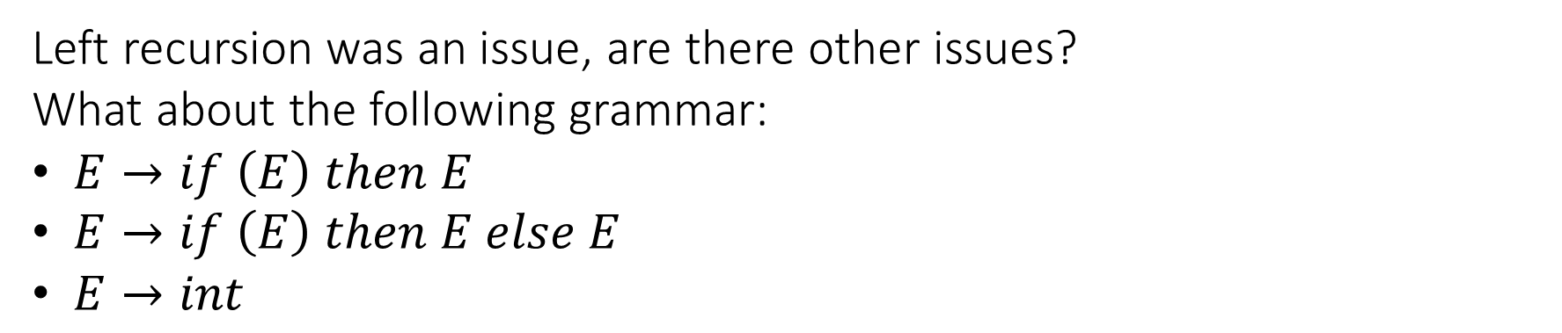
Left Factoring
Left recursion was an issue, are there other issues?
What about the following grammar:
$E→if \left(E\right) then E$
$E→if \left(E\right) then E else E$
$E→int$

Slide 65

Left Factoring
Rewrite the original CFG:
$E→if \left(E\right) then E$
$E→if \left(E\right) then E else E$
$E→int$
To the following:
$E→if \left(E\right) then EX$
$X→ε$
$X→else E$
$E→int$

Slide 66
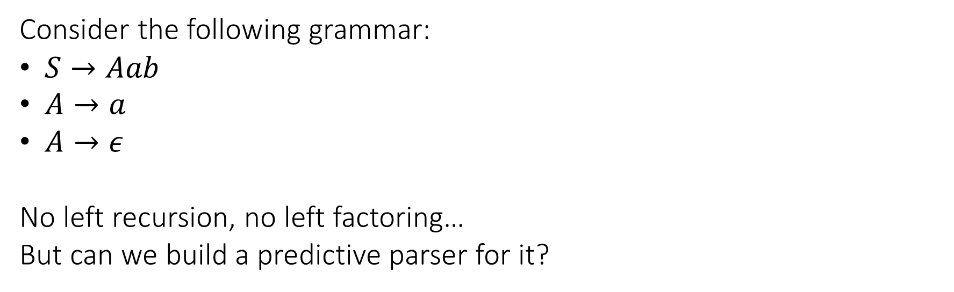
Nullable Rules
Consider the following grammar:
$S→Aab$
$A→a$
$A→ε$
No left recursion, no left factoring…
But can we build a predictive parser for it?

Slide 67
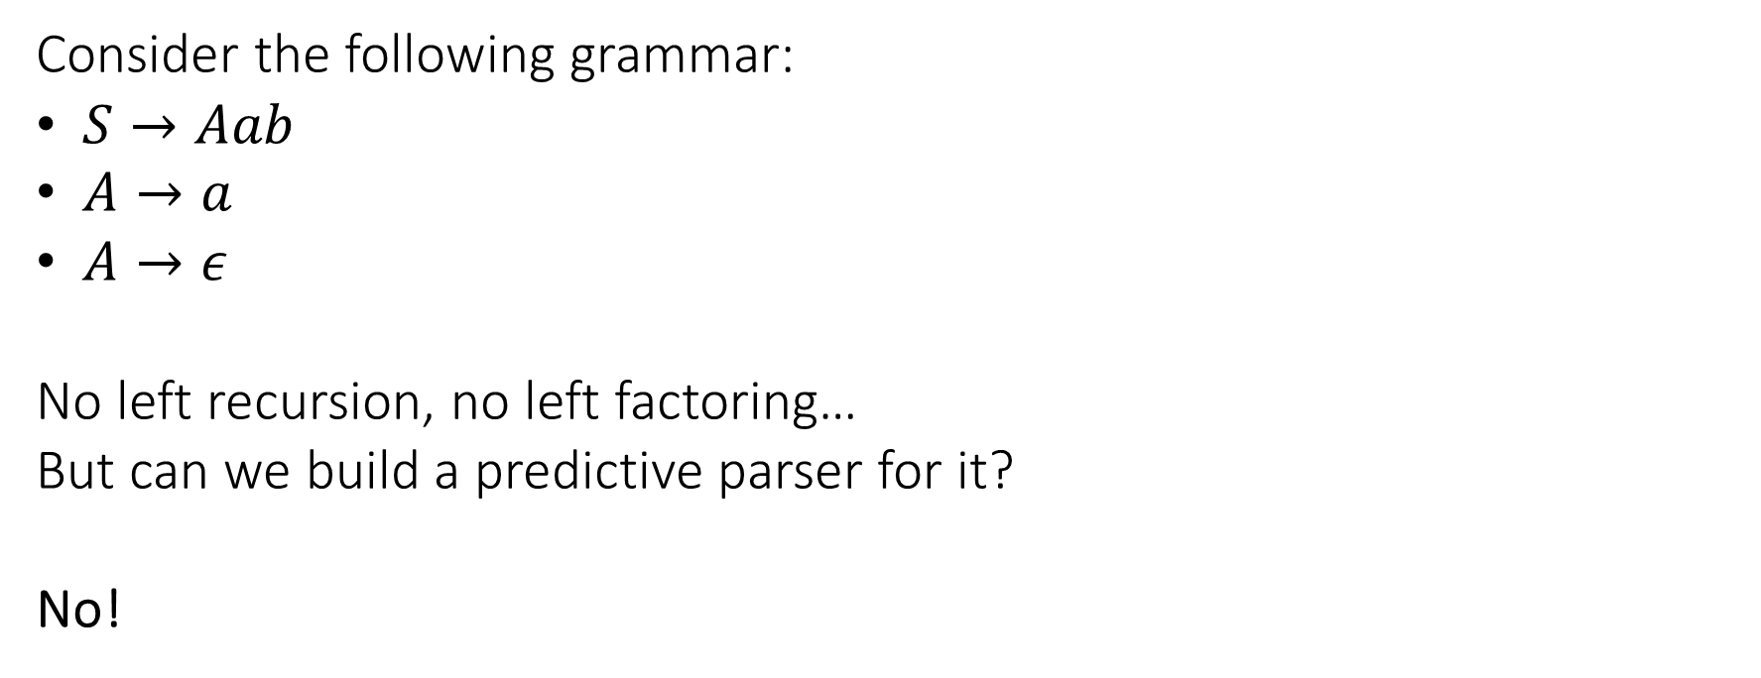
Nullable Rules
Consider the following grammar:
$S→Aab$
$A→a$
$A→ε$
No left recursion, no left factoring…
But can we build a predictive parser for it?
No!

Slide 68
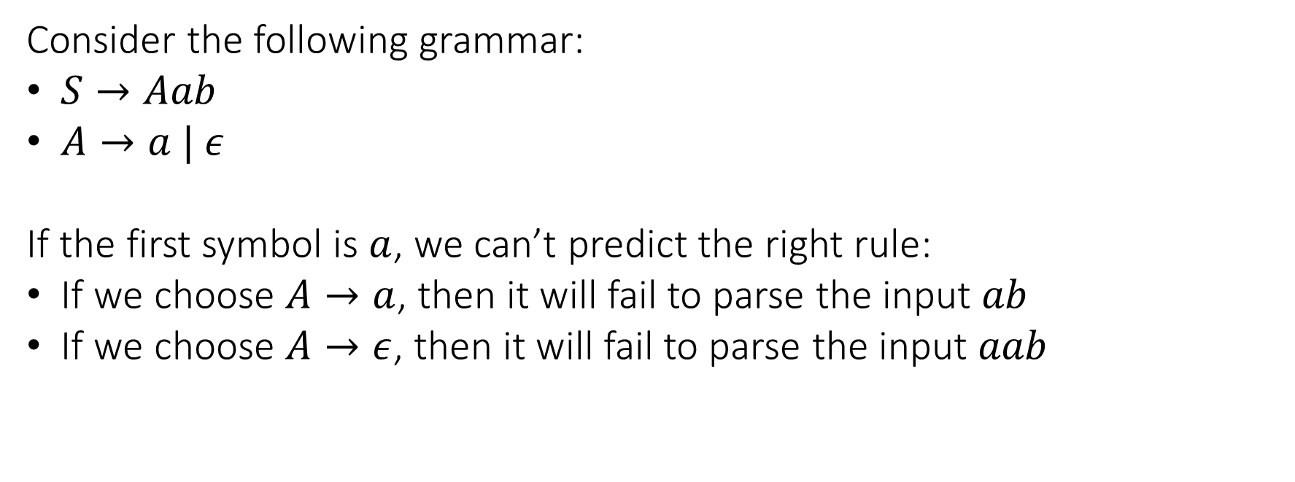
Nullable Rules
Consider the following grammar:
$S→Aab$
$A→a | ε$
If the first symbol is $a$, we can’t predict the right rule:
If we choose $A→a$, then it will fail to parse the input $ab$
If we choose $A→ε$, then it will fail to parse the input $aab$

Slide 69

Nullable Rules
We can substitute $A$ with it’s possible alternatives.
The original grammar:
$S→Aab$
$A→a | ε$
After substitution:
$S→ab$
$S→aab$
Are we done?

Slide 70
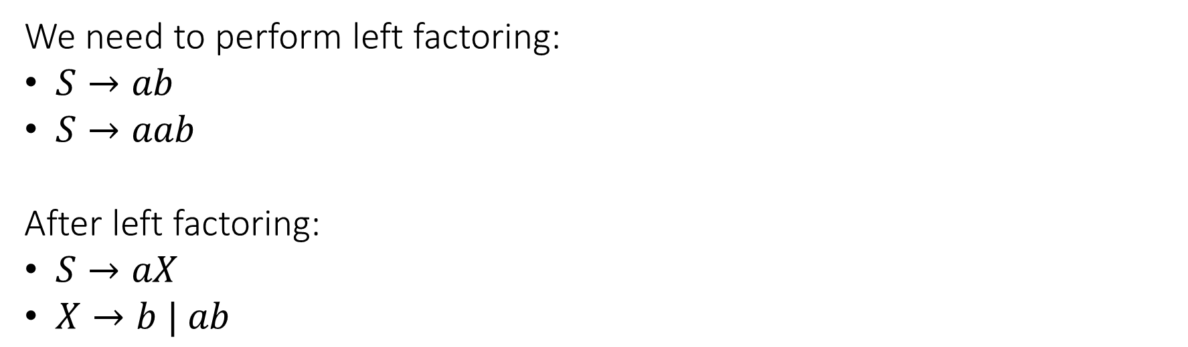
Nullable Rules
We need to perform left factoring:
$S→ab$
$S→aab$
After left factoring:
$S→aX$
$X→b | ab$

Slide 71
Building an LL(1) Parser
Some of the common issues:
Left recursion
Left factoring
Nullable rules

Slide 72
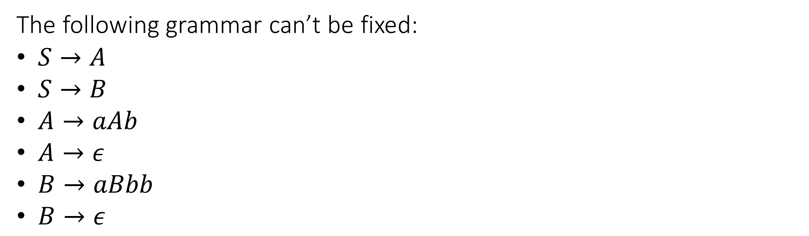
LL(1) Parsing is not always possible
The following grammar can’t be fixed:
$S→A$
$S→B$
$A→aAb$
$A→ε$
$B→aBbb$
$B→ε$

Slide 73
LL(1) Parsing: is it always desirable?
Grammars of real languages are overloaded with
Left recursion
Left factoring
Nullable rules
Even if we can fix it, the resulting grammar may be unreadable…

