Slide 1
Intermediate Representation
TeachING Assistant: David Trabish

Slide 2
Intermediate Representation
Allows language and machine independent optimizations
Translated from the AST
Translated to machine code

Slide 3
IR Language
Temporary variables (IR registers)
t1, t2, … (unlimited)
Instructions
Assignments
t1 = c (assign constant value)
t1 = x (read from memory x)
x = t1 (write to memory x)
add, sub, call, return, …
Labels
label_1:

Slide 4
IR Example
t1 = x
t2 = y
t3 = add t1, t2
z = t3
t4 = z
t5 = 1
t6 = add t4, t5
w = t6
t7 = w
return t7
int foo(int x, int y) {
int z = x + y;
int w = z + 1;
return w;
}

Slide 5
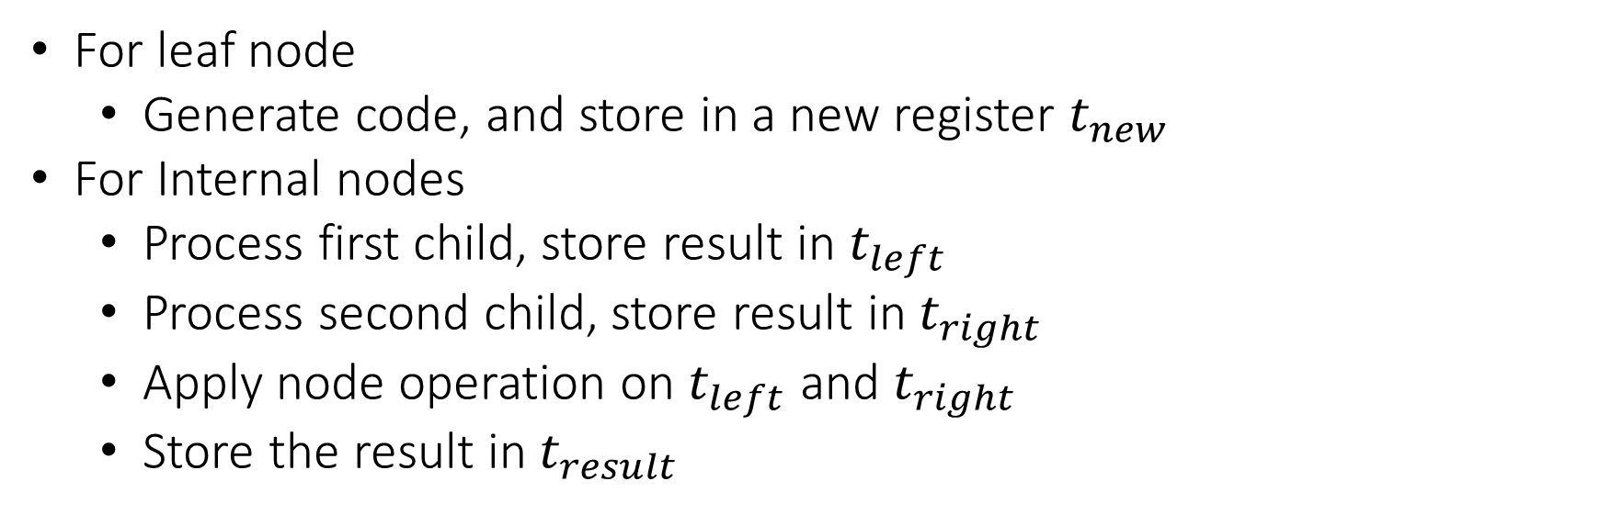
Translating Expressions
For leaf node
Generate code, and store in a new register $t_{new}$
For Internal nodes
Process first child, store result in $t_{left}$
Process second child, store result in $t_{right}$
Apply node operation on $t_{left}$ and $t_{right}$
Store the result in $t_{result}$

Slide 6
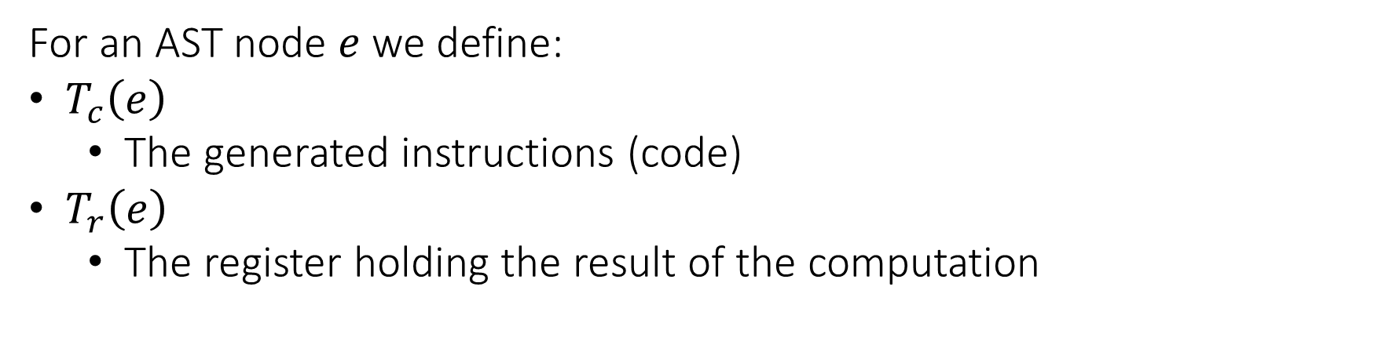
Translating Expressions
For an AST node $e$we define:
$T_{c}\left(e\right)$
The generated instructions (code)
$T_{r}\left(e\right)$
The register holding the result of the computation

Slide 7
Translating Expressions
For x + 42:
Binop
+
t1 = x
t3
Simple
Var
x
INT
42
t1
t2

Slide 8
Translating Expressions
For x + 42:
Binop
+
t1 = x
t2 = 42
t3
Simple
Var
x
INT
42
t1
t2

Slide 9
Translating Expressions
For x + 42:
Binop
+
t1 = x
t2 = 42
t3 = add t1, t2
t3
Simple
Var
x
INT
42
t1
t2

Slide 10
Translating Expressions
For x + y + z:
Binop
+
t1 = x
t5
Binop
+
Simple
Var
z
t3
t4
Simple
Var
x
Simple
Var
y
t1
t2

Slide 11
Translating Expressions
For x + y + z:
Binop
+
t1 = x
t2 = y
t5
Binop
+
Simple
Var
z
t3
t4
Simple
Var
x
Simple
Var
y
t1
t2

Slide 12
Translating Expressions
For x + y + z:
Binop
+
t1 = x
t2 = y
t3 = add t1, t2
t5
Binop
+
Simple
Var
z
t3
t4
Simple
Var
x
Simple
Var
y
t1
t2

Slide 13
Translating Expressions
For x + y + z:
Binop
+
t1 = x
t2 = y
t3 = add t1, t2
t4 = z
t5
Binop
+
Simple
Var
z
t3
t4
Simple
Var
x
Simple
Var
y
t1
t2

Slide 14
Translating Expressions
For x + y + z:
Binop
+
t1 = x
t2 = y
t3 = add t1, t2
t4 = z
t5 = add t3, t4
t5
Binop
+
Simple
Var
z
t3
t4
Simple
Var
x
Simple
Var
y
t1
t2

Slide 15




Translating Expressions
For $e_{1} or e_{2}$:
…
t1 = ...
t3 = 1
compare t1, t3
branch_eq end_label
…
t2 = ...
t3 = or t1, t2
end_label:
$$T_{c}(e_{1})$$
$$T_{r}(e_{1})$$
$$T_{c}(e_{2})$$
$$T_{r}(e_{2})$$

Slide 16
Translating Expressions
For $e_{1} and e_{2}$:
...
t1 = ...
t3 = 0
compare t1, t3
branch_eq end_label
...
t2 = ...
t3 = and t1, t2
end_label:
$$T_{c}(e_{1})$$
$$T_{r}(e_{1})$$
$$T_{c}(e_{2})$$
$$T_{r}(e_{2})$$

Slide 17

Translating Expressions
For $e_{1}== e_{2}$:
...
t1 = ...
...
t2 = ...
t3 = 1
compare t1, t2
branch_eq end_label
t3 = 0
end_label:
$$T_{c}(e_{1})$$
$$T_{c}(e_{2})$$

Slide 18
Translating Expressions
For a == b + 1:
t1 = a
t2 = b
t3 = 1
t4 = add t2, t3
t5 = 1
compare t1, t4
branch_eq end_label
t5 = 0
end_label:

Slide 19




Translating Expressions
For $e_{1}[e_{2}]$:
...
t1 = ...
...
t2 = ...
t3 = array_access t1, t2
$$T_{c}(e_{1})$$
$$T_{r}(e_{1})$$
$$T_{c}(e_{2})$$
$$T_{r}(e_{2})$$

Slide 20
Translating Expressions
For x[z+1]:
t1 = x
t2 = z
t3 = 1
t4 = add t2, t3
t5 = array_access t1, t4

Slide 21


Translating Expressions
For $e.f$:
...
t1 = ...
t2 = field_access t1, f
$$T_{c}(e)$$
$$T_{r}(e)$$

Slide 22
Translating Expressions
For x[3].foo:
t1 = x
t2 = 3
t3 = array_access t1, t2
t4 = field_access t3, foo

Slide 23
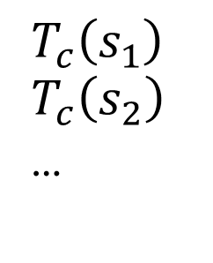
Translating Basic Block
For $s_{1};s_{2};…$:
$$T_{c}\left(s_{1}\right)$$
$$T_{c}\left(s_{2}\right)$$
…

Slide 24



Translating Statements
For $if \left(e\right) then \{s\}$:
...
t1 = ...
compare t1, 0
branch_eq end_label
...
...
end_label:
$$T_{c}(e)$$
$$T_{r}(e)$$
$$T_{c}(s)$$

Slide 25
Translating Statements
For if (x * y) then { z = 0; }:
t1 = x
t2 = y
t3 = mul t1, t2
compare t3, 0
branch_eq end_label
t4 = 0
z = t4
end_label:

Slide 26




Translating Statements
For $if \left(e\right) then \left\{s_{1}\right\} else \{s_{2}\}$:
...
t1 = ...
compare t1, 0
branch_eq false_label
...
...
branch end_label
false_label:
...
...
end_label:
$$T_{c}(e)$$
$$T_{r}(e_{1})$$
$$T_{c}(s_{1})$$
$$T_{c}(s_{2})$$

Slide 27
Translating Statements
For if (w) then { z = 0; } else { z = 100; }:
t1 = w
compare t1, 0
branch_eq false_label
t2 = 0
z = t2
branch end_label
false_label:
t3 = 100
z = t3
end_label:

Slide 28



Translating Statements
For $while \left(e\right) \left\{s\right\}$:
cond_label:
...
t1 = ...
compare t1, 0
branch_eq end_label
...
...
branch cond_label
end_label:
$$T_{c}(e)$$
$$T_{r}(e)$$
$$T_{c}(s)$$

Slide 29
Translating Statements
For while (z / x) { }:
cond_label:
t1 = z
t2 = x
t3 = div t1, t2
compare t3, 0
branch_eq end_label
branch cond_label
end_label:

Slide 30


Translating Statements
For $f\left(e_{1},e_{2},…\right)$:
...
t1 = ...
...
t2 = ...
...
t0 = call f(t1, t2, ...)
$$T_{c}(e_{1})$$
$$T_{c}(e_{2})$$

Slide 31
Translating Statements
For func(2, x + 1):
t1 = 2
t2 = x
t3 = 1
t4 = add t2, t3
t5 = call func(t1, t4)

Slide 32



Translating Statements
For $o.f\left(e_{1},e_{2},…\right)$:
...
t1
...
t2 = ...
...
t3 = ...
...
t0 = virtual_call t1.f(t2, t3, ...)
$$T_{c}(o)$$
$$T_{c}(e_{1})$$
$$T_{c}(e_{2})$$

Slide 33
Translating Statements
For obj.bar(2, x + 1):
t1 = obj
t2 = 2
t3 = x
t4 = 1
t5 = add t3, t4
t6 = virtual_call t1.func(t2, t5)

Slide 34

Translating Statements
For $return e$:
...
t1 = ...
return t1
$$T_{c}(e)$$

Slide 35
Translating Statements
For return w * 3:
t1 = w
t2 = 3
t3 = mul t1, t2
return t3

Slide 36

Example
x = 42;
while (x > 0) {
x = x - 1;
}
$$T_{c}($$
x = 42;
while (x > 0) {
x = x – 1;
}
$$)$$

Slide 37
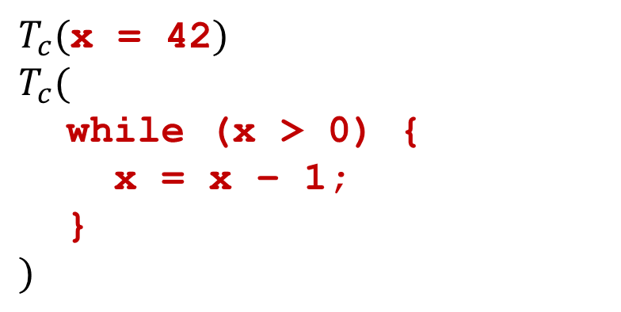
Example
x = 42;
while (x > 0) {
x = x - 1;
}
$T_{c}($x = 42$)$
$$T_{c}($$
while (x > 0) {
x = x – 1;
}
$$)$$

Slide 38

Example
x = 42;
while (x > 0) {
x = x - 1;
}
t1 = 42
x = t1
$$T_{c}($$
while (x > 0) {
x = x – 1;
}
$$)$$

Slide 39
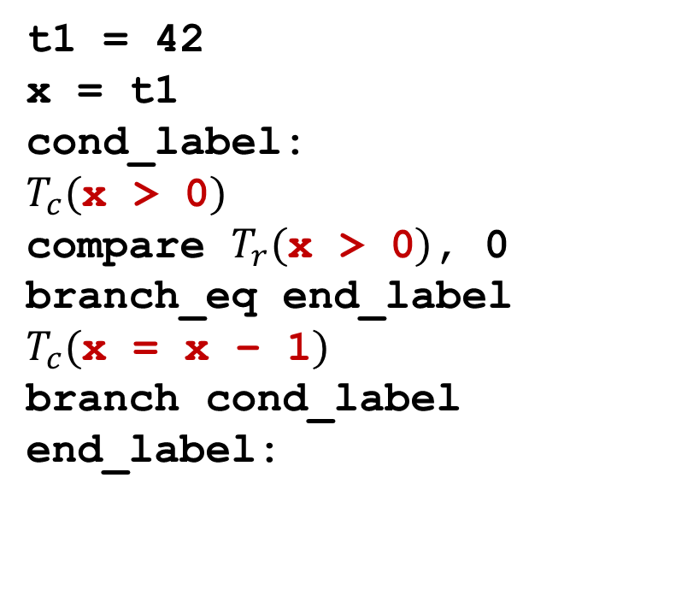
Example
x = 42;
while (x > 0) {
x = x - 1;
}
t1 = 42
x = t1
cond_label:
$T_{c}($x > 0$)$
compare $T_{r}($x > 0$)$, 0
branch_eq end_label
$T_{c}($x = x – 1$)$
branch cond_label
end_label:

Slide 40
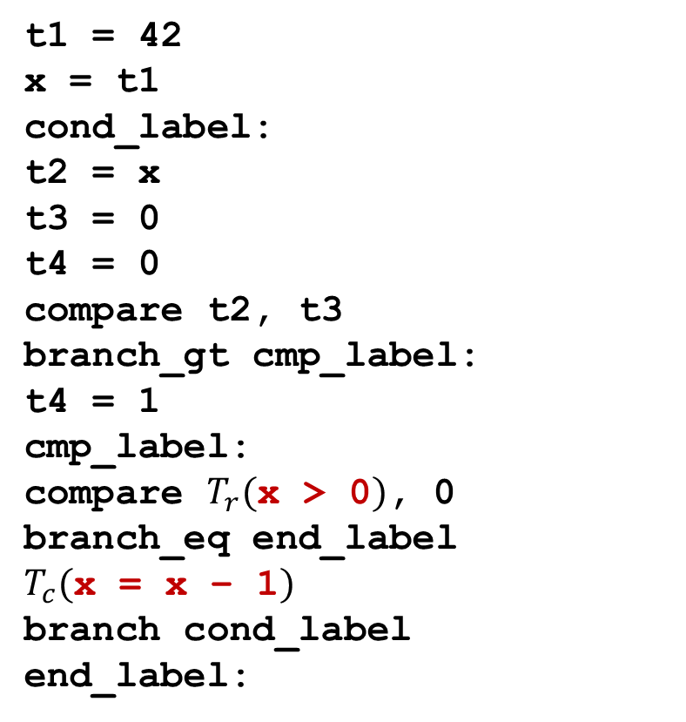
Example
t1 = 42
x = t1
cond_label:
t2 = x
t3 = 0
t4 = 0
compare t2, t3
branch_gt cmp_label:
t4 = 1
cmp_label:
compare $T_{r}($x > 0$)$, 0
branch_eq end_label
$T_{c}($x = x – 1$)$
branch cond_label
end_label:
x = 42;
while (x > 0) {
x = x - 1;
}

Slide 41
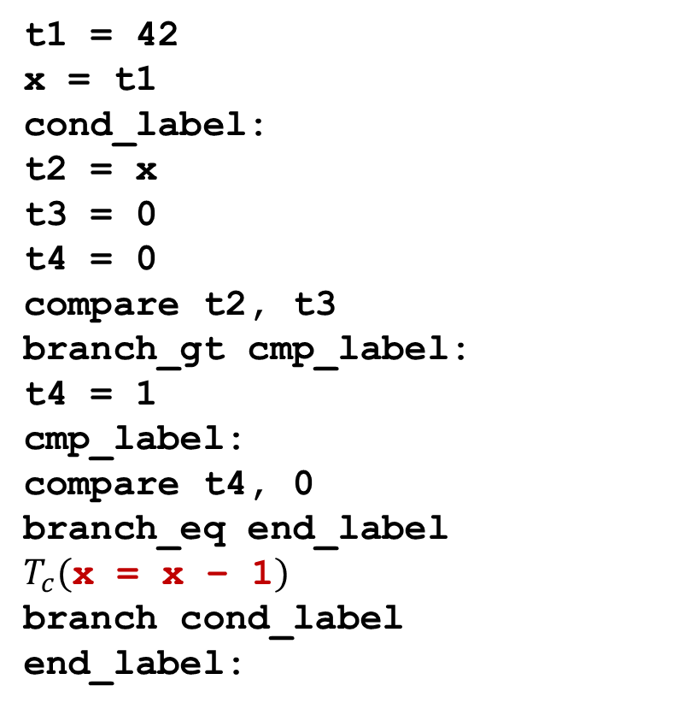
Example
t1 = 42
x = t1
cond_label:
t2 = x
t3 = 0
t4 = 0
compare t2, t3
branch_gt cmp_label:
t4 = 1
cmp_label:
compare t4, 0
branch_eq end_label
$T_{c}($x = x – 1$)$
branch cond_label
end_label:
x = 42;
while (x > 0) {
x = x - 1;
}

Slide 42
t1 = 42
x = t1
cond_label:
t2 = x
t3 = 0
t4 = 0
compare t2, t3
branch_gt cmp_label:
t4 = 1
cmp_label:
compare t4, 0
branch_eq end_label
t5 = x
t6 = 1
t7 = sub t5, t6
x = t7
branch cond_label
end_label:
Example
x = 42;
while (x > 0) {
x = x - 1;
}

Slide 43
Implementation
Classes for IR Instructions
AST Visitor
Define visitor for each node type
Should return
List of generated instructions
Result register (for expressions)

Slide 44
Alternative Representation
For z = x + 42 the generated code is:
t1 = x
t2 = 42
t3 = add t1, t2
z = t3
Notes:
Remove?

Slide 45
Alternative Representation
We can take a more low level approach:
(assuming that x is first parameter and z first local variable)
t1 = add fp, 8
t2 = load t1
t3 = 42
t4 = add t2, t3
t5 = sub fp, 4
store t5, t3
Notes:
Remove?

