Slide 1
Intermediate Representation
TeachING Assistant: David Trabish

Slide 2
Intermediate Representation
Allows language and machine independent optimizations
Translated from the AST
Translated to machine code

Slide 3
IR Language
Temporary variables (IR registers)
t1, t2, … (unlimited)
Instructions
Assignments
t1 = c (assign constant value)
t1 = x (read from memory x)
x = t1 (write to memory x)
add, sub, call, return, …
Labels
label_1:

Slide 4
IR Example
t1 = x
t2 = y
t3 = add t1, t2
z = t3
t4 = z
t5 = 1
t6 = add t4, t5
w = t6
t7 = w
return t7
int foo(int x, int y) {
int z = x + y;
int w = z + 1;
return w;
}

Slide 5
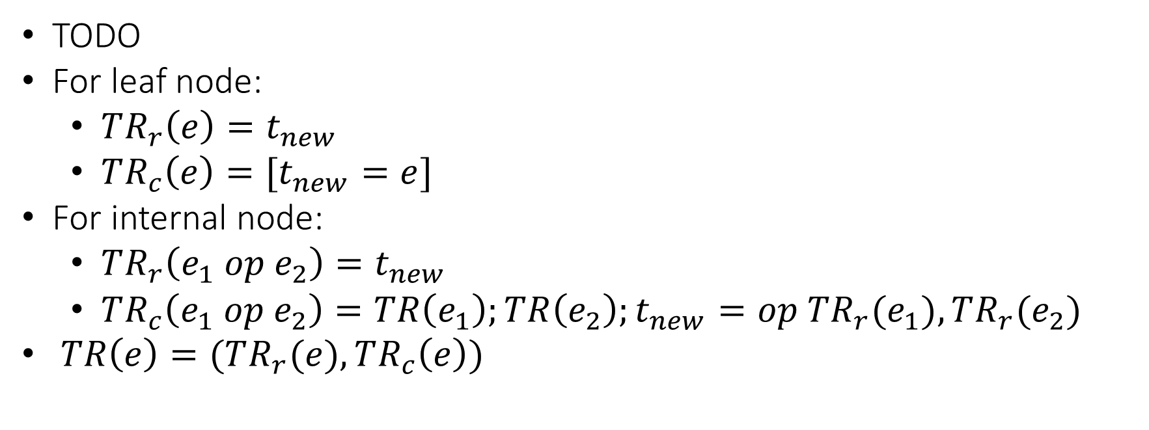
Translating Expressions
TODO
For leaf node:
$TR_{r}\left(e\right)=t_{new}$
$TR_{c}\left(e\right)=[t_{new}=e]$
For internal node:
$TR_{r}\left(e_{1} op e_{2}\right)=t_{new}$
$TR_{c}\left(e_{1} op e_{2}\right)=TR\left(e_{1}\right);TR\left(e_{2}\right);t_{new}=op TR_{r}(e_{1}), TR_{r}(e_{2})$
$TR\left(e\right)=(TR_{r}(e), TR_{c}\left(e\right))$

Slide 6
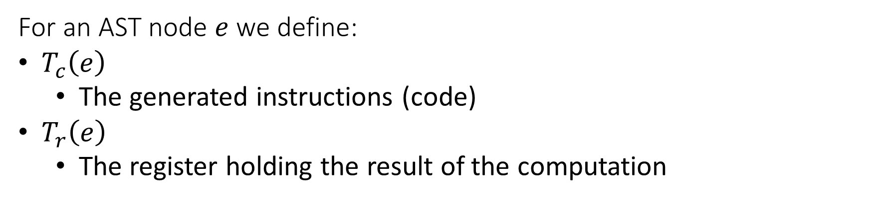
Translating Expressions
For an AST node $e$we define:
$T_{c}\left(e\right)$
The generated instructions (code)
$T_{r}\left(e\right)$
The register holding the result of the computation

Slide 7
Translating Expressions
For x + 42:
Binop
+
t1 = x
t2 = 42
t3 = add t1, t2
t3
Simple
Var
x
INT
42
t1
t2

Slide 8
Translating Expressions
For x + y + z:
Binop
+
t1 = x
t2 = y
t3 = add t1, t2
t4 = z
t5 = add t3, t4
t5
Binop
+
Simple
Var
z
t3
t4
Simple
Var
x
Simple
Var
y
t1
t2

Slide 9


Translating Expressions
For $op e$:
…
t1 = ...
t2 = op t1
$$T_{c}(e)$$
$$T_{r}(e)$$

Slide 10




Translating Expressions
For $e_{1} or e_{2}$:
…
t1 = ...
t3 = 1
compare t1, t3
branch_eq end_label
…
t2 = ...
t3 = or t1, t2
end_label:
$$T_{c}(e_{1})$$
$$T_{r}(e_{1})$$
$$T_{c}(e_{2})$$
$$T_{r}(e_{2})$$

Slide 11
Translating Expressions
For $e_{1} and e_{2}$:
...
t1 = ...
t3 = 0
compare t1, t3
branch_eq end_label
...
t2 = ...
t3 = and t1, t2
end_label:
$$T_{c}(e_{1})$$
$$T_{r}(e_{1})$$
$$T_{c}(e_{2})$$
$$T_{r}(e_{2})$$

Slide 12




Translating Expressions
For $e_{1}[e_{2}]$:
...
t1 = ...
...
t2 = ...
t3 = array_access t1, t2
$$T_{c}(e_{1})$$
$$T_{r}(e_{1})$$
$$T_{c}(e_{2})$$
$$T_{r}(e_{2})$$

Slide 13


Translating Expressions
For $e.f$:
...
t1 = ...
t2 = field_access t1, f
$$T_{c}(e)$$
$$T_{r}(e)$$

Slide 14
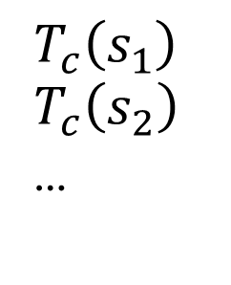
Translating Basic Block
For $s_{1};s_{2};…$:
$$T_{c}\left(s_{1}\right)$$
$$T_{c}\left(s_{2}\right)$$
…

Slide 15



Translating Statements
For $if \left(e\right) then \{s\}$:
...
t1 = ...
compare t1, 0
branch_eq end_label
...
...
end_label:
$$T_{c}(e)$$
$$T_{r}(e)$$
$$T_{c}(s)$$

Slide 16




Translating Statements
For $if \left(e\right) then \left\{s_{1}\right\} else \{s_{2}\}$:
...
t1 = ...
compare t1, 0
branch_eq end_label
...
...
branch end_label
false_label:
...
...
end_label:
$$T_{c}(e)$$
$$T_{r}(e_{1})$$
$$T_{c}(s_{1})$$
$$T_{c}(s_{2})$$

Slide 17



Translating Statements
For $while \left(e\right) \left\{s\right\}$:
cond_label:
...
t1 = ...
compare t1, 0
branch_eq end_label
...
...
branch cond_label
end_label:
$$T_{c}(e)$$
$$T_{r}(e)$$
$$T_{c}(s)$$

Slide 18


Translating Statements
For $f\left(e_{1},e_{2},…\right)$:
...
t1 = ...
...
t2 = ...
...
t0 = call f(t1, t2, ...)
$$T_{c}(e_{1})$$
$$T_{c}(e_{2})$$

Slide 19



Translating Statements
For $o.f\left(e_{1},e_{2},…\right)$:
...
t1
...
t2 = ...
...
t3 = ...
...
t0 = virtual_call t1.f(t2, t3, ...)
$$T_{c}(o)$$
$$T_{c}(e_{1})$$
$$T_{c}(e_{2})$$

Slide 20

Translating Statements
For $return e$:
...
t1 = ...
return t1
$$T_{c}(e)$$

Slide 21

Example
x = 42;
while (x > 0) {
x = x - 1;
}
$$T_{c}($$
x = 42;
while (x > 0) {
x = x – 1;
}
$$)$$

Slide 22
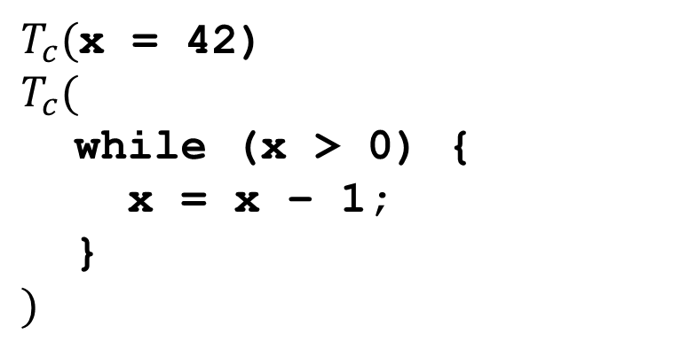
Example
x = 42;
while (x > 0) {
x = x - 1;
}
$T_{c}($x = 42)
$$T_{c}($$
while (x > 0) {
x = x – 1;
}
$$)$$

Slide 23

Example
x = 42;
while (x > 0) {
x = x - 1;
}
t1 = 42
x = t1
$$T_{c}($$
while (x > 0) {
x = x – 1;
}
$$)$$

Slide 24
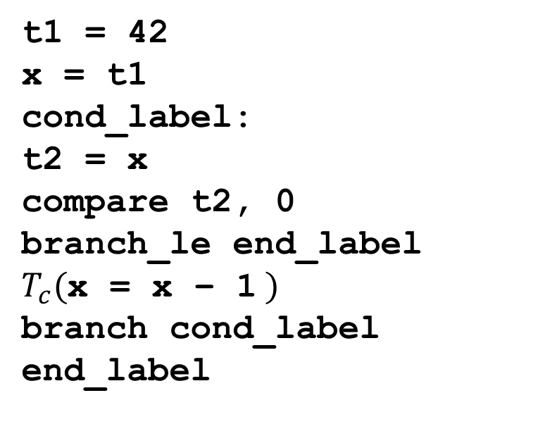
Example
x = 42;
while (x > 0) {
x = x - 1;
}
t1 = 42
x = t1
cond_label:
t2 = x
compare t2, 0
branch_le end_label
$T_{c}($x = x – 1 $)$
branch cond_label
end_label

Slide 25
Example
x = 42;
while (x > 0) {
x = x - 1;
}
t1 = 42
x = t1
cond_label:
t2 = x
compare t2, 0
branch_le end_label
t4 = x
t5 = 1
t6 = sub t4, t5
x = t6
branch cond_label
end_label

Slide 26
Alternative Representation
For z = x + 42 the generated code is:
t1 = x
t2 = 42
t3 = add t1, t2z
z = t3

Slide 27
Alternative Representation
We can take a more low level approach:
(assuming that x is first parameter and z first local variable)
t1 = load (bp + 8)
t2 = 42
t3 = add t1, t2
store (bp – 4), t3

