Slide 1

Basic Details of the Team and Problem Statement
Ministry/Organization Name/Student Innovation: Ministry of AYUSH
PS Code: SIH1503
Problem Statement Title: Automatic Drug Dispenser
Team Name: Team-Atulya
Team Leader Name: Saurabh Yogeshkumar Panchal
Institute Code (AISHE): C-382
Institute Name: Vishwakarma Government Engineering College, Gujarat
Theme Name: MedTech / BioTech / HealthTech

Slide 2





Idea/Approach Details
Project Idea:
Payment Activation: Hardware activates upon user payment.
Medicine Filling: Ayurvedic medicines such as Bilvadi Leha, Brahama Rasayana, Chitraka Haritak, and Chyavanprash Avaleha are loaded into designated compartments or boxes.
Medicine Dispensing: The dispensing process causes medicines to slide down from each box into individual funnel-like containers.
Consolidation: Medicines from each funnel are collected into a common funnel, ensuring all prescribed medications are in one place.
Dosage Segregation: The system segregates medicines according to the prescribed dosages for different times of the day
Packaging and Labeling: The system packages medicines according to the day-wise dosage and simultaneously prints essential information, including the patient's name and details of the enclosed medicines, on each sachet for clear identification.
Technology stack:

Slide 3
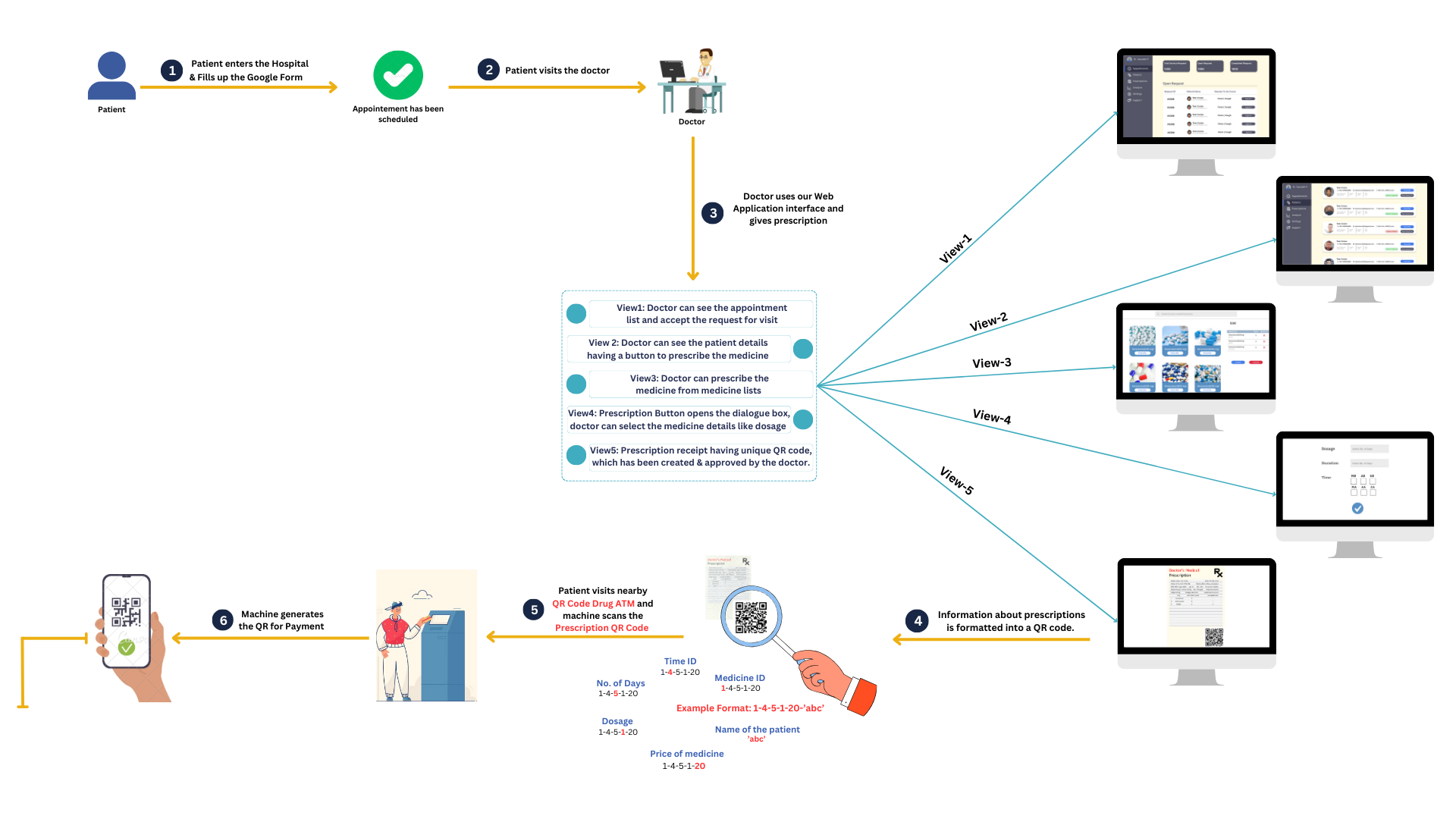
SOFTWARE FLOW

Slide 4
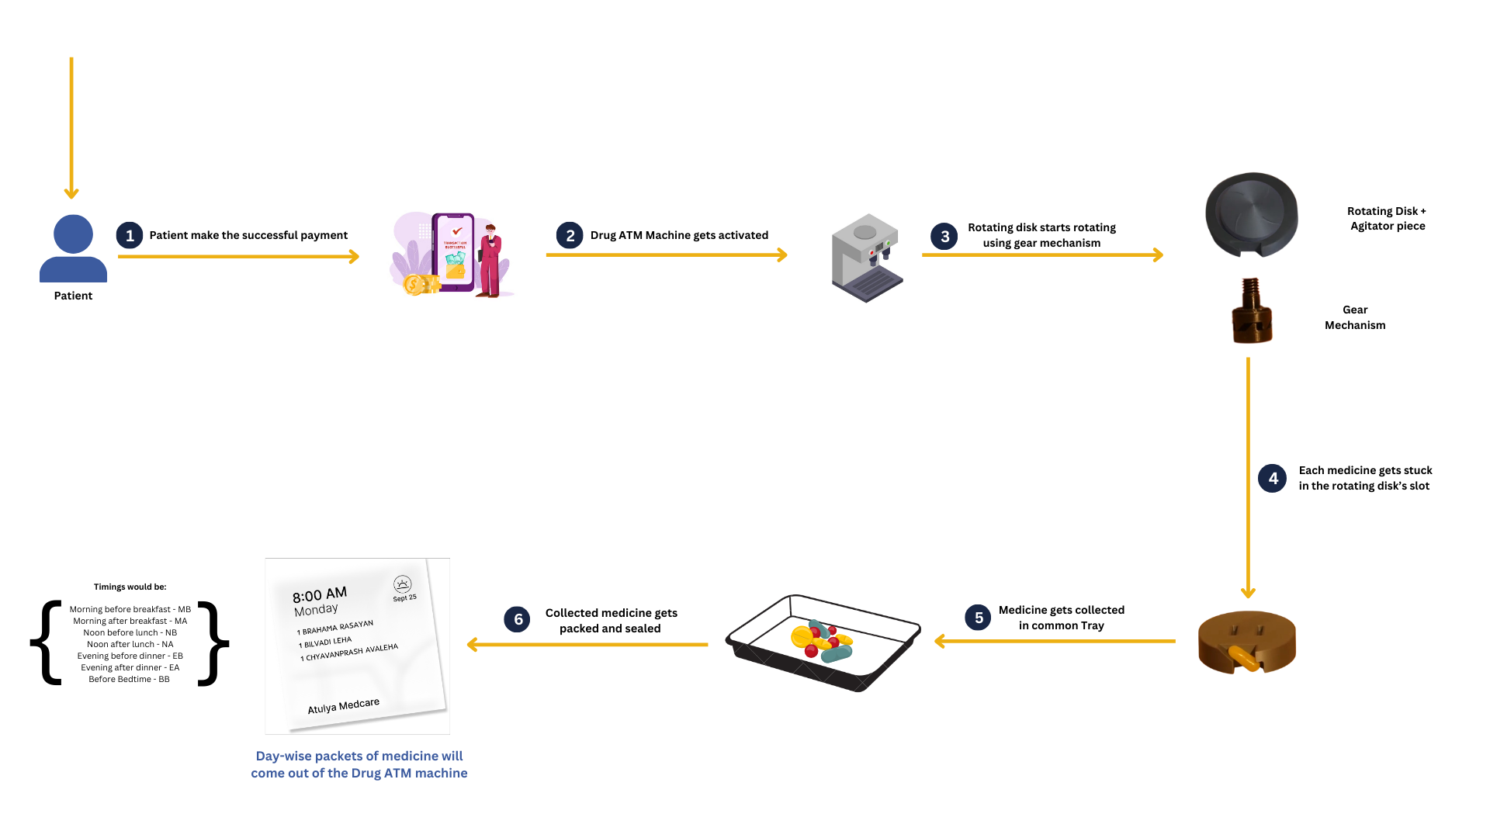
HARDWARE FLOW

Slide 5
Idea/Approach Details
Use Cases
Dependencies / Show stopper
The system aims to enable senior citizens to access and manage their medication independently, eliminating the need for constant assistance.
Patients with chronic illnesses or conditions can benefit from our automatic drug dispenser, ensuring they take their prescribed medications on time.
Hospitals can utilize our automatic drug dispenser to streamline medication distribution to patients.
Ayurvedic Dispensaries can automate the prescription-filling process using our system, improving efficiency and minimizing human errors.
The availability of high-quality, compliant packaging material is essential for our automatic drug dispenser.
Collaborating with the Ayush Medicine Store to distribute medication effectively and efficiently to the patients

Slide 6
Team Member Details
Team Leader Name: Saurabh Panchal
Branch: Btech Stream: CE Year: VII
Team Member 1 Name: Tridip Chavda
Branch: Btech Stream: CE Year: VII
Team Member 2 Name: Amit Gohel
Branch: Btech Stream: CE Year: VII
Team Member 3 Name: Hetanshi Acharya
Branch: Btech Stream: CE Year: VII
Team Member 4 Name: Pranchal Goyal
Branch: Btech Stream: EE Year: VII
Team Member 5 Name: Prasad Mistry
Branch: Btech Stream: EE Year: V
Team Mentor 1 Name: Dr. Vinodray Thumar
Category (Academic/Industry): Academic Expertise: Blockchain/IoT Domain Experience (in years): 7
Team Mentor 2 Name: Prof. Avani Dave
Category (Academic/Industry): Academic Expertise: System Design/ML Domain Experience (in years): 7

