Slide 1



FRAUD Detection Analysis Report for RCMP using POWER BI
Report by: Amit Kumar

Slide 2
Analysis OBJECTIVE
Objective
The objective of this analysis is to assess the FRAUD Crime Rates and patterns in Ontario, Manitoba, and British Columbia over the past 10 years with a specific focus on fraud-related crimes. The analysis aims to provide actionable insights to the RCMP (The Royal Canadian Mounted Police) in these provinces for better strategic planning, resource allocation, and crime prevention strategies.
Dear Mr. Ricard, i extend a warm welcome to this presentation, aimed at advancing our collective understanding of FRAUD Dynamics in Ontario, Manitoba, and British Columbia, with a specific focus on fraud-related incidents.
Analysis Contents:
Comparing Crime Rates (Last 10 Years): Evaluate and compare crime rates in Ontario, Manitoba, and British Columbia over the past decade to unveil long-term trends.
Top 3 High Crime Cities: Analyze the top three cities in each province with the highest crime rates in the past 10 years, spotlighting local issues of significance.
Correlation Analysis: Probe into the connection between youth and adult crime rates within high-crime cities, empowering targeted interventions based on age-related crime dynamics.
Crime Rate Forecast (Next Year -2023): Predict forthcoming crime rates in Ontario, Quebec, and British Columbia, enabling law enforcement agencies to proactively plan.
By exploring these facets, I strive to equip the RCMP and our provincial law enforcement partners with actionable intelligence, fostering safer communities and optimizing resource allocation.

Slide 3
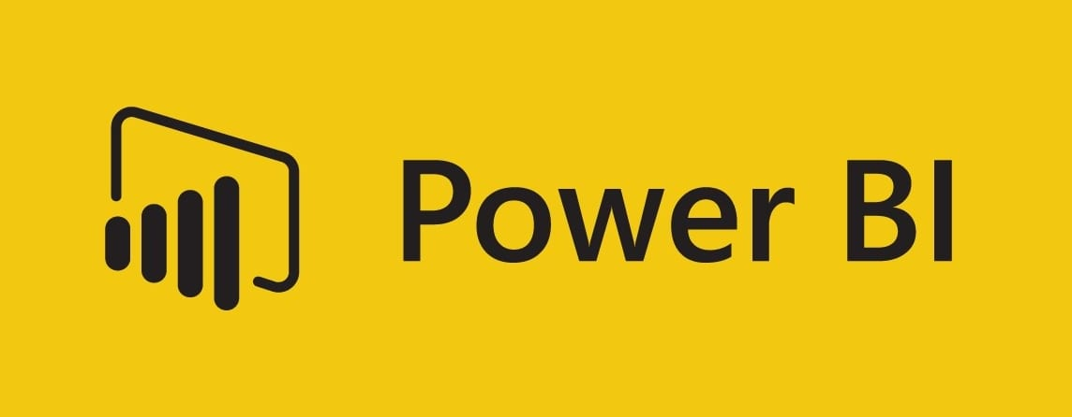
Why POWER BI?
Power BI's adaptability and data visualization will empower this study and understanding, including Officer Ricard. Its user-friendly interface aids resource allocation, crime prevention, and response strategy development. Interactive dashboards, predictive analytics, and collaboration features enhance decision-making and stakeholder engagement.
Advantages of Power BI for RCMP Data Analysis:
Data Visualization: Power BI offers interactive and visually compelling dashboards for easier data interpretation.
Analytical Insights: Enables in-depth analysis of crime data, aiding resource allocation and strategy development.
Predictive Analytics: Provides forecasting capabilities to prepare for future challenges.
Collaborative: Facilitates seamless information sharing and collaboration among stakeholders.
User-Friendly: Intuitive interface for ease of use by law enforcement professionals.
Efficiency: Streamlines data processing and reporting for quicker decision-making.
Scalability: Handles large datasets and adapts to evolving data needs.

Slide 4
Data Analysis and Visualization Strategy
In our pursuit of enhancing fraud detection, we undertake a methodical approach within Ontario, Manitoba, and British Columbia. This comprehensive strategy involves:
Data Preparation: Initial steps include collecting and cleansing historical fraud data across the three provinces, ensuring accuracy and reliability.
Comparative Analysis: We construct compelling visualizations to compare fraud rates over the last decade, providing immediate insights into long-term trends and variations between the provinces.
Top 3 Cities Analysis: Our focus then shifts to localized concerns, identifying and scrutinizing the top 3 high-fraud cities in each province. This in-depth analysis unveils unique insights requiring targeted attention.
Correlation Assessment: Using scatter plots, we investigate the connection between youth and adult fraud rates in high-fraud cities, illuminating age-related dynamics in fraudulent activities.
Fraud Rate Forecast: Leveraging predictive analytics, we project fraud rates for the upcoming year, arming law enforcement agencies with proactive insights.
Interactive Dashboards: We unify these visualizations into interactive dashboards, providing stakeholders, including Officer Ricard and local law enforcement, with a dynamic space for collaborative exploration. This approach enhances fraud prevention and response strategies, contributing to the safety and security of our communities.

Slide 5
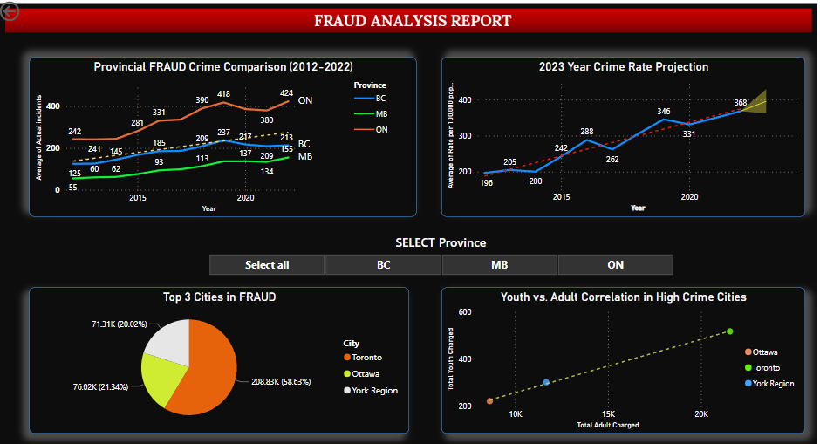
FRAUD Analysis DASHBOARD

Slide 6
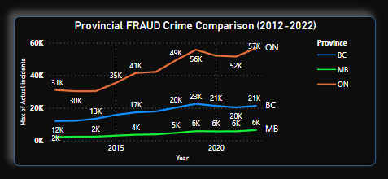
Comparing Provincial FRAUD (2012-2022)
Ontario: Recorded 57,000 fraud cases in the last decade.
British Columbia: Reported 21,000 fraud cases during the same period.
Manitoba: Documented 6,000 fraud cases over the past ten years.

Slide 7
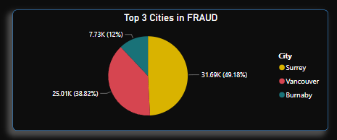
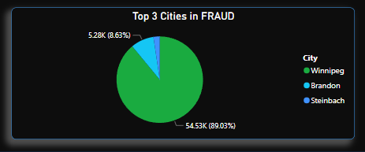
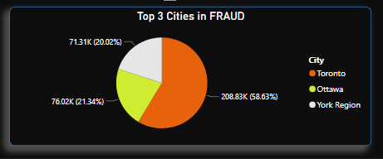
"Top 3 Cities with Highest Fraud Cases (2012-2022)“ Province Wise
British Columbia
Manitoba
Ontario
Surrey accounts for most fraud cases in British Columbia, representing 49.18% of the total.
Vancouver follows closely with 38.82% of reported fraud cases.
Burnaby, while lower in percentage, still contributes significantly with 12% of the fraud cases in the province.
Winnipeg dominates the fraud cases in Manitoba, accounting for a significant 89.03% of the total.
Brandon, while smaller in percentage, contributes notably with 8.63% of reported fraud cases.
The remaining areas, primarily Steinbach, collectively make up the rest of the cases.
Toronto stands out with a majority share of 58.63% of fraud cases in Ontario.
Ottawa follows with a significant 21.34% of the reported fraud cases.
York Region contributes notably with 20.02% of the fraud cases.

Slide 8
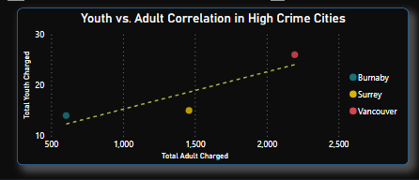
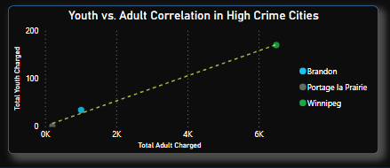
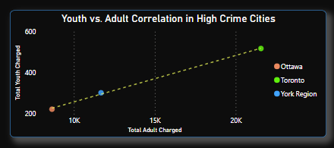
Correlation Analysis: Youth vs. Adult Crime in High Crime Rate Cities
British Columbia
Across the top three cities in each province, a consistent trend emerges in the correlation between youth and adult charges in fraud cases. The parallel patterns suggest that, regardless of the city, youth and adult charges in fraud exhibit a similar relationship. This finding highlights the need for a uniform approach in addressing both youth and adult involvement in fraud-related activities within these high-crime areas. A unified strategy focused on prevention, education, and enforcement could be effective in these regions to mitigate fraud-related issues.
Manitoba
Ontario

Slide 9
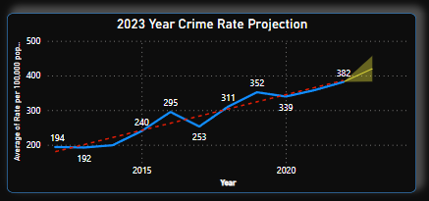
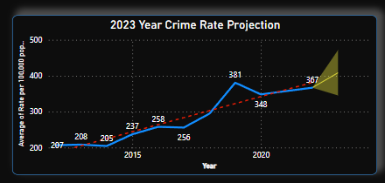
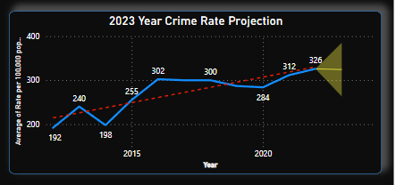
Forecasting Crime Rates for Ontario, Manitoba, and British Columbia in the 2023 Year
1.Ontario
Forecast Insights:
The forthcoming year's fraud case projections offer essential insights into anticipated trends in Ontario, Manitoba, and British Columbia. In Ontario, an average of 419 fraud cases foreseen in 2023 suggests a level of stability in reported incidents, with authorities able to plan resources accordingly. Meanwhile, Manitoba is expected to experience approximately 324 fraud cases, indicating a relatively lower incidence rate compared to its larger counterparts. In contrast, British Columbia, with its larger population and diverse urban areas, is predicted to record around 408 fraud cases in 2023. These forecasts serve as valuable references for law enforcement agencies, enabling them to allocate resources strategically and develop targeted prevention and response strategies for the year ahead. Understanding these projections empowers authorities to better prepare for potential challenges in fraud prevention and management, ultimately contributing to the safety and security of their respective communities.
2.British Columbia
3.Manitoba

Slide 10
Conclusion
In our comprehensive analysis of fraud cases across Ontario, Manitoba, and British Columbia, we have unveiled valuable insights. These insights extend from understanding the concentration of fraud cases in specific cities to recognizing consistent trends in the relationship between youth and adult charges. Furthermore, our forecasted crime rates for the upcoming year provide proactive guidance for resource allocation and strategy development.
By harnessing the power of data analysis and visualization, we equip law enforcement agencies, including Officer Ricard and the RCMP, with the knowledge and tools to enhance fraud detection, prevention, and response strategies. Our collective efforts aim to foster safer communities, optimize resource allocation, and contribute to the security and well-being of our provinces.

Slide 11
References
https://www.classcentral.com/report/best-microsoft-power-bi-courses/
https://mindmajix.com/power-bi-visualization-types
https://analyticstraininghub.com/different-types-of-charts-in-power-bi-and-their-uses/
https://www.theknowledgeacademy.com/blog/top-power-bi-charts-for-data-visualization-/

Slide 12
Thank You

