Slide 1

Optimus Call Center Services Data Analysis using Power BI
Project Presentation
By: Amit Kumar

Slide 2

Team Composition
Team Members and Their Roles:
1. Project Manager: Amit Kumar
2. Data Analyst: Team Member 1
3. Database Manager: Team Member 2
4. Data Scientist: Team Member 3
5. Communication Specialist: Team Member 4
6. Project Coordinator: Team Member 5
7. Data Analyst: Team Member 6

Slide 3

Organization and Problem Background
Optimus Call Services (OCS) is a fictional international call center provider. Our goal is to address the business problem and opportunity they face.

Slide 4

Business Problem/Opportunity
Stakeholders: OCS management, customer service teams, and clients seeking improved call center services.
Challenge/Opportunity: Enhancing call center performance, customer-agent interactions, customer retention, and diversity and inclusion programs.
Humanity Considerations: Providing insightful information and practical solutions.

Slide 5
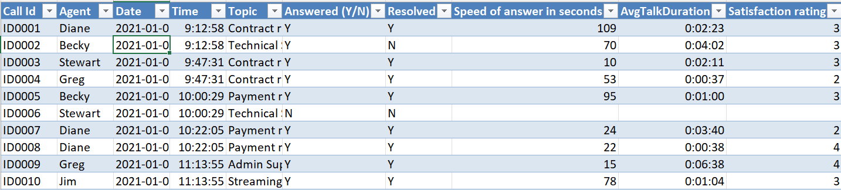
Call Center Dataset

Slide 6

Data Mining Problem & Data Description
Data Mining Problem: Utilizing data analytics to improve OCS's operational effectiveness and customer service efficiency.
Data Description: Historical call center data with call IDs, agent names, date, time, topics, call outcomes, and more.

Slide 7
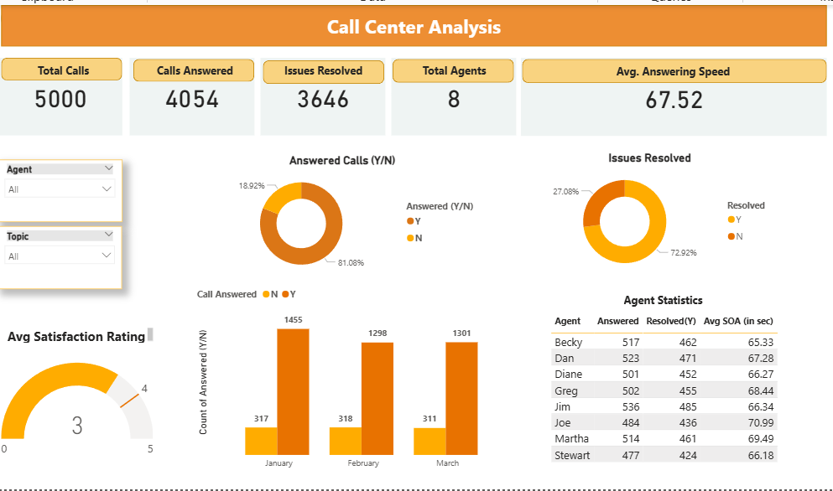
Dashboard

Slide 8
Implications
Implications: Findings will guide OCS to make data-driven decisions, enhance customer experiences, and optimize costs.
Actions: OCS can use the insights to improve call center performance, agent effectiveness, and cost-saving measures.

Slide 9
Preliminary Recommendations
Recommendations: Address data quality issues, adapt to changing business environments, and ensure effective team collaboration.
Client Awareness: Ensure the client is aware of the challenges encountered and the importance of future data collection and analysis.

Slide 10
Thank You

