Slide 1

Green Destination Project Data Analysis

Slide 2
Introduction
Green Destinations is a well-known travel agency. The HR Director has recently noticed and increase in employees leaving (attrition).
She would like to figure out any trends or patterns. She has surveyed the staff of Green Destinations and provided you with the data. She would like to know what the attrition rate is (% of people who left). She would also like to know if factors like age, years at the company and income play a part in determining if people will leave or not.
As being a Data Analyst, I was asked to analyze the employee attrition data & produce meaningful insights.

Slide 3
Approach
I have followed 6 step data analysis approach for this employee attrition data analytics project
(PREPARE – PROCESS – ANALYSE – REPORT – DASHBOARD )
Prepare - I received the dataset from unified mentor management team
Process - renaming columns, checked null values, we found out rest of the dataset was well organized

Slide 4
Approach
Analyse -
Sorting & filtering data
Calculated average salary, age, attrition rate & years employee work in a company
Segregated Male & Female within the dataset
Calculated attrition by job role
Calculated attrition by age
Calculated attrition by salary
Calculated attrition by education

Slide 5
Approach
Share -
- No. of employee's: 1470
- No. of attrition: 237
- Attrition rate: 16.1 %
- Average age: 37, Average salary: $ 6503, Average years: 7.0
- Male: 882, Female: 588
- Attrition by Gender: Male: 150, Female: 87
- No. of job roles: 9

Slide 6
Approach
Share -
- Attrition by Job Role:
1. Sales Executive: 57
2. Research Scientist: 47
3. Laboratory Technician: 62
4. Manufacturing Director: 10
5. Healthcare Representative: 9
6. Manager: 5
7. Sales Representative: 33
8. Research Director: 2
9. Human Resources: 12

Slide 7
Approach
Share -
Attrition by Education:
1. Life Sciences: 89
2. Others: 11
3. Medical: 63
4. Marketing: 35
5. Technical Degree: 32
6. Human Resources: 7

Slide 8
Approach
Conclusion (Act) -
Based on these insights,
It appears that factors such as age, gender, salary, job role, and education field significantly influence attrition rates within the organization.
Further analysis could delve into reasons behind these trends and formulate strategies to mitigate attrition, such as targeted retention programs, career development initiatives, and salary adjustments.

Slide 9
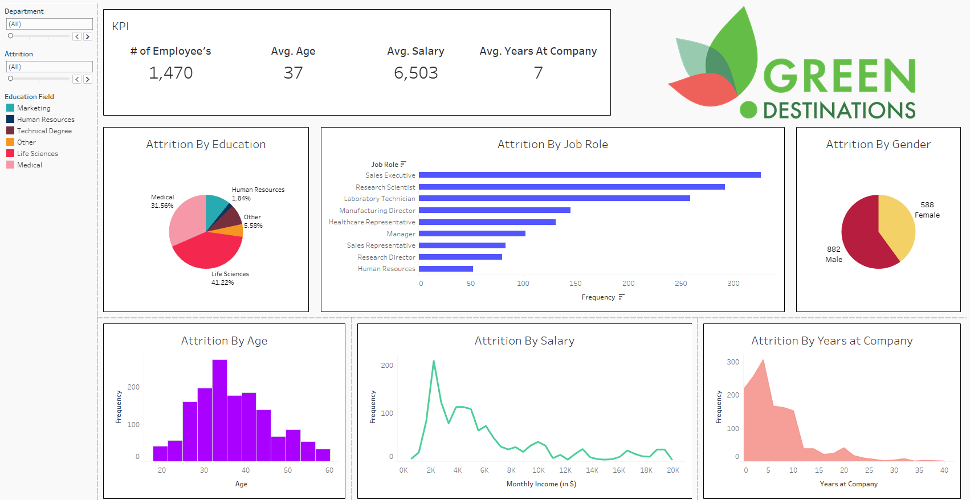
Dashboard

Slide 10



Thank You

