Slide 1

Novel AI and feature engineering techniques for DDoS attack detection in IoT.
Focus on adaptive cumulative entropy thresholding
Amit Kumar Jaiswal
PhD researcher
Moscow Institute of Physics and Technology, Moscow, Russia
Department of Radio Engineering and Cybernetics
E-mail: dzhaisval.a@phystech.edu

Slide 2
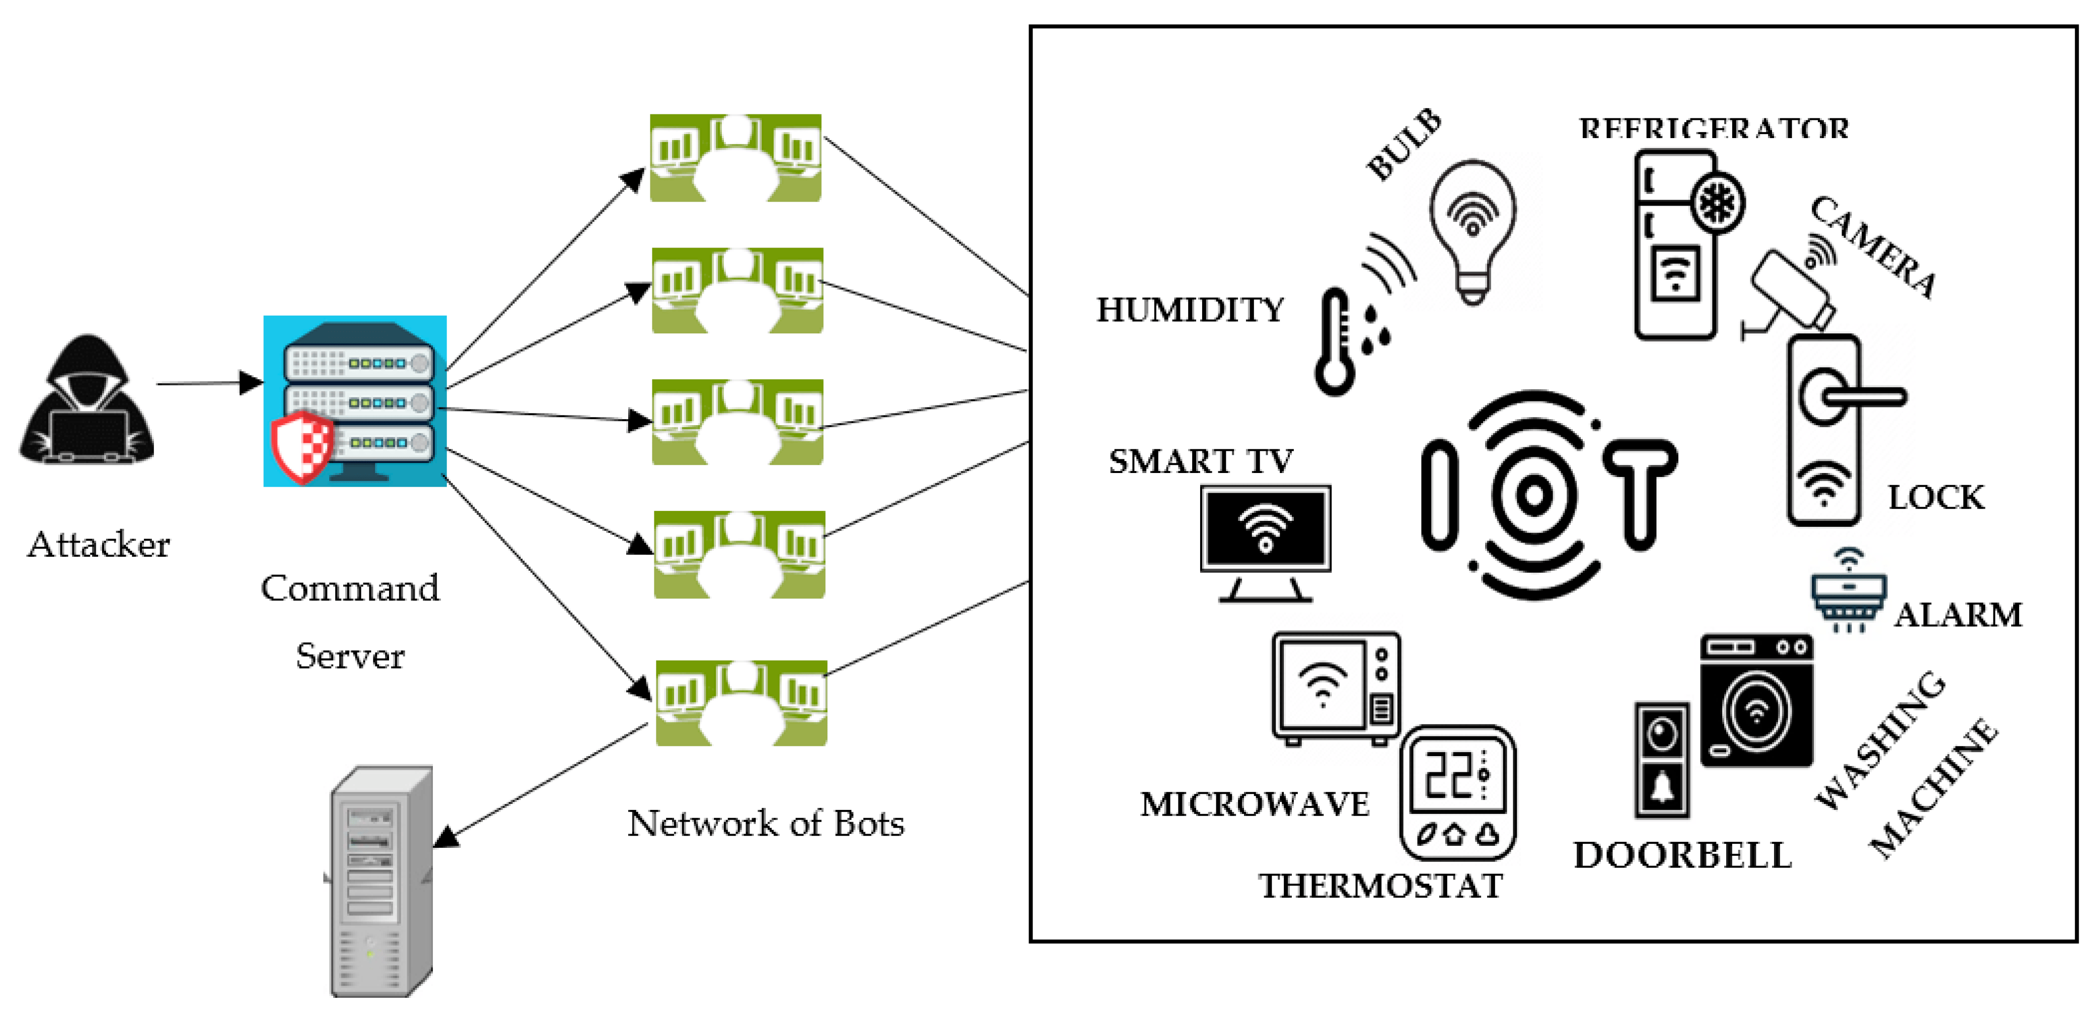
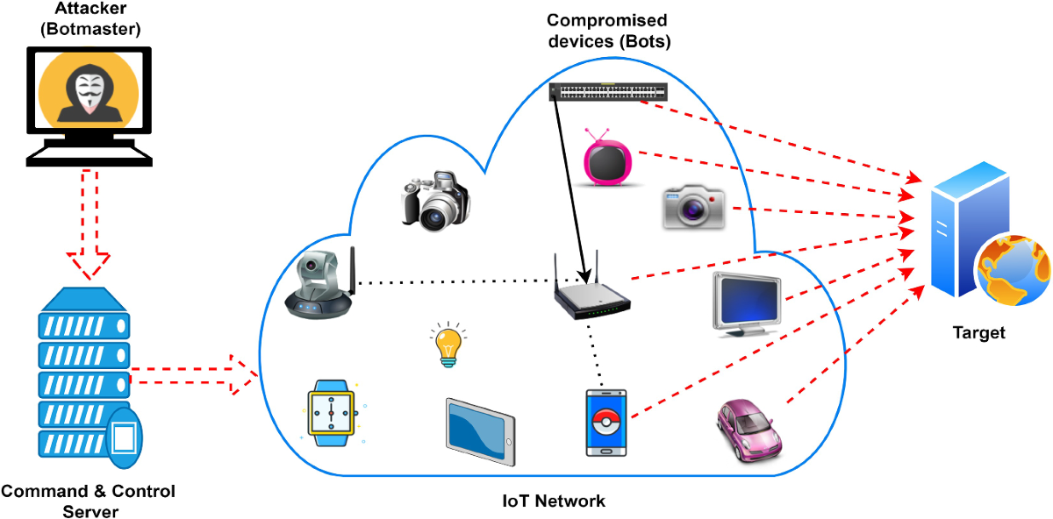
Growing security concerns
1 situation
2 situation

Slide 3
Which problem are we solving?
We are trying to solve problems with DDos attack on IoT detection
using cumulative entropy method with thresholding
– NOTE –
Previous authors have utilized several thresholding techniques on different field and datasets for different purpose research.
However, our novel approach, that is
network traffic detection with time series analysis
using cumulative entropy method with thresholding
has not been used by any authors to detect such attacks most likely in DDos
on smart home systems and on IOT devices specifically,
which ultimately will help future research scope growth.

Slide 4
What are we trying to achive?
How to detect anomaly in the IoT devices
Achieve highest detection thresholding accuracy
Finding what features are best suitable for detection
Discovering and creating new features for better detection

Slide 5
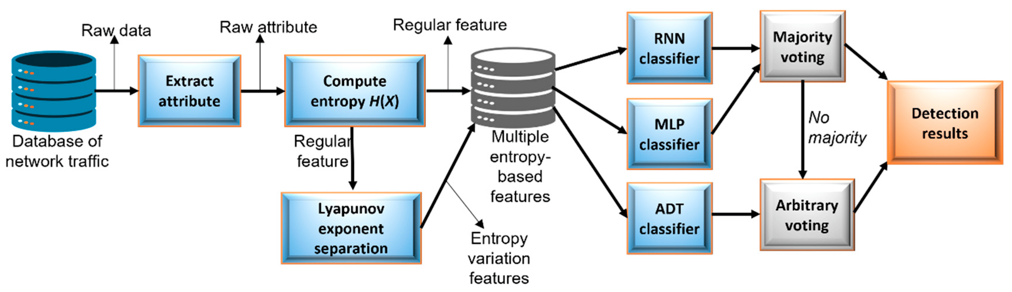
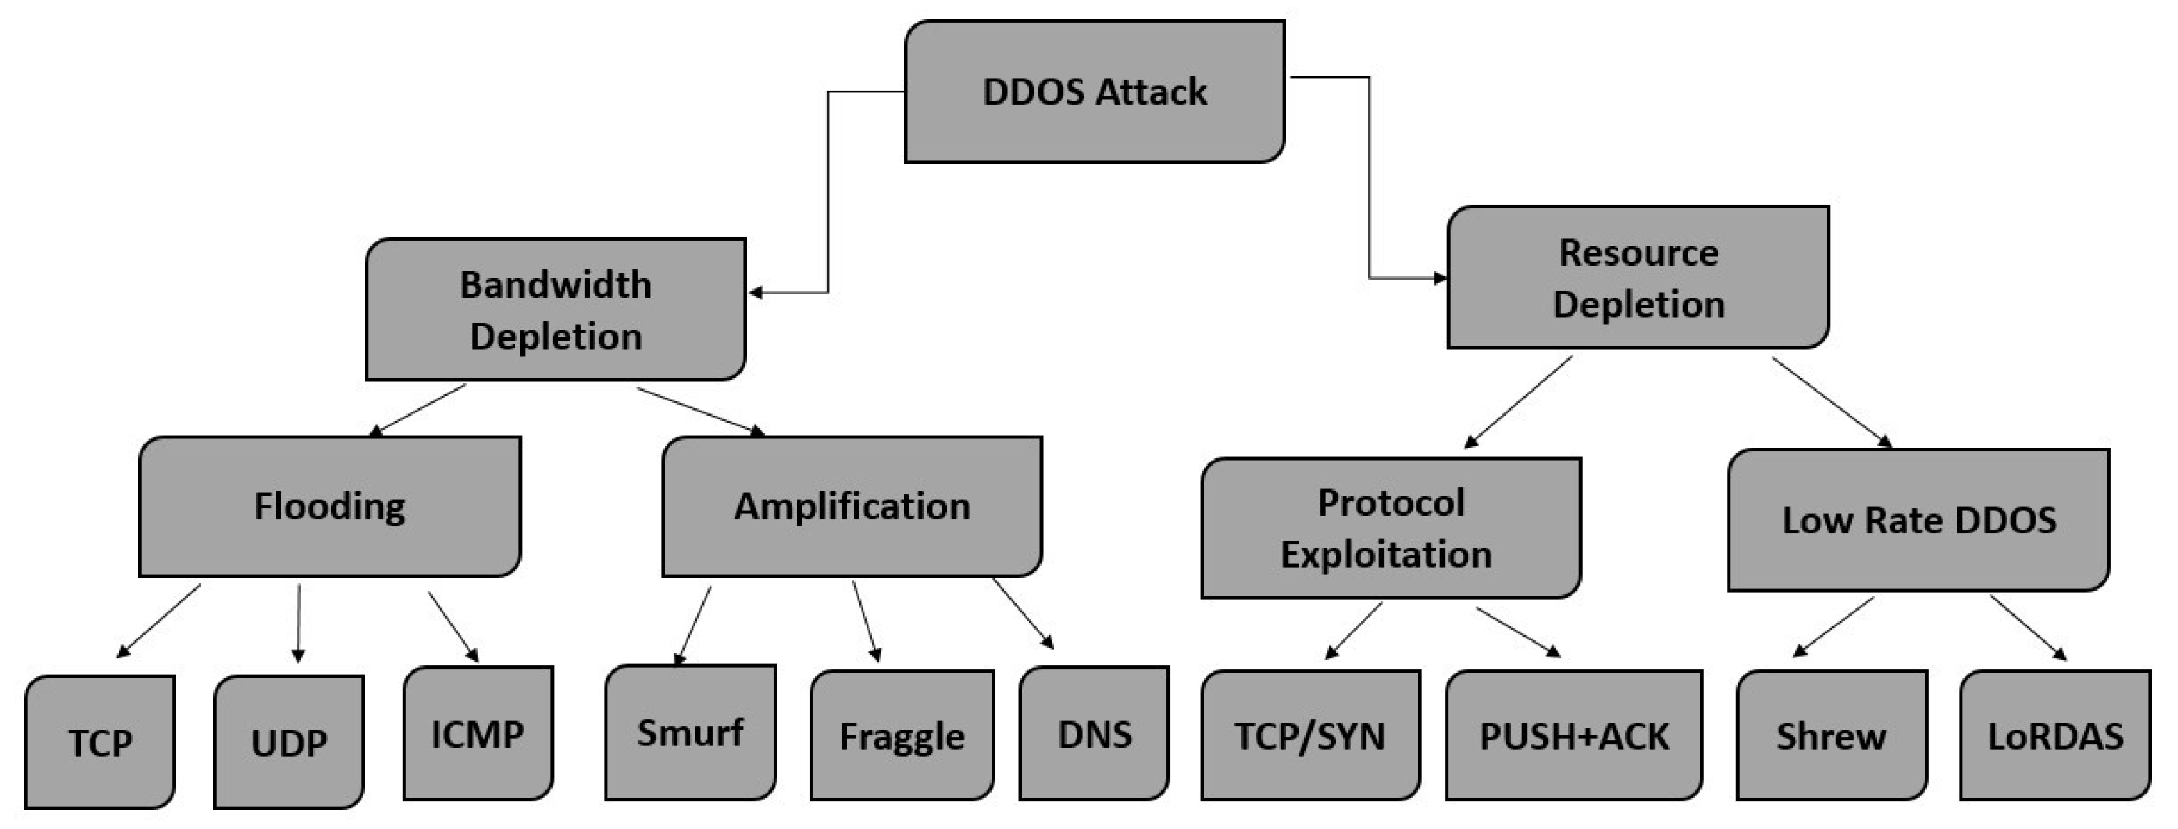
Used methodology
Trusted Source
UCL IoT Dataset
EDA and FE
Exploratory data analysis

Slide 6
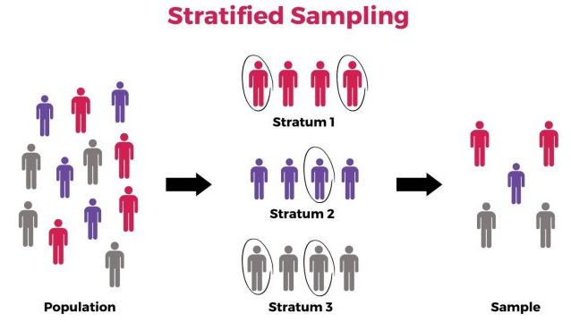

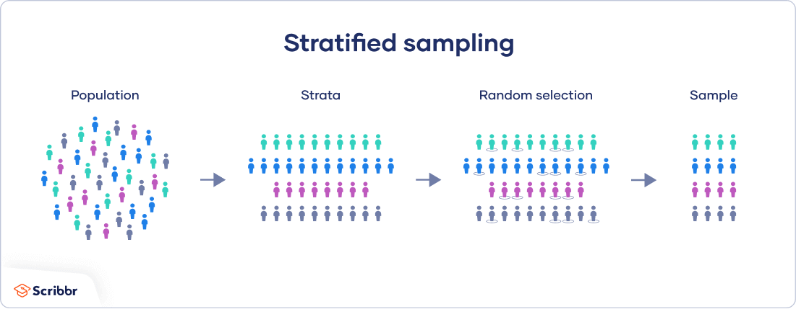
Stratified sampling

Slide 7
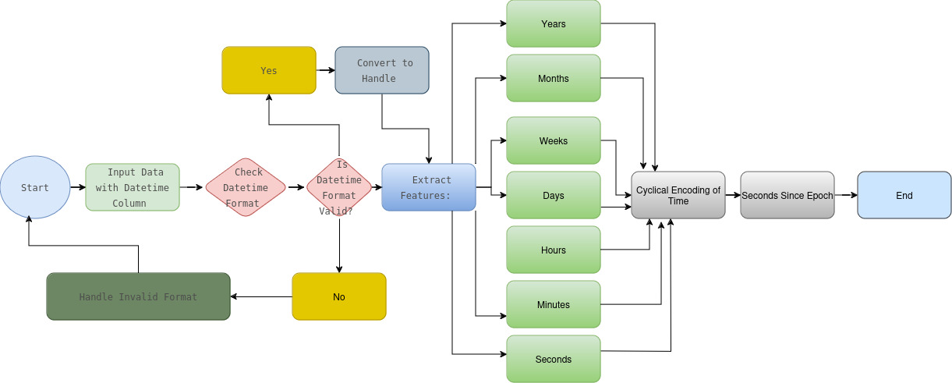
Feature engineering techniques

Slide 8
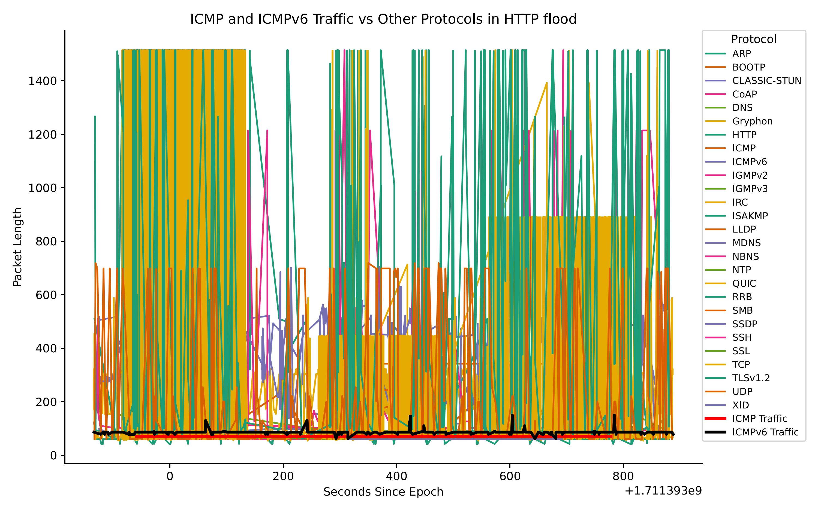
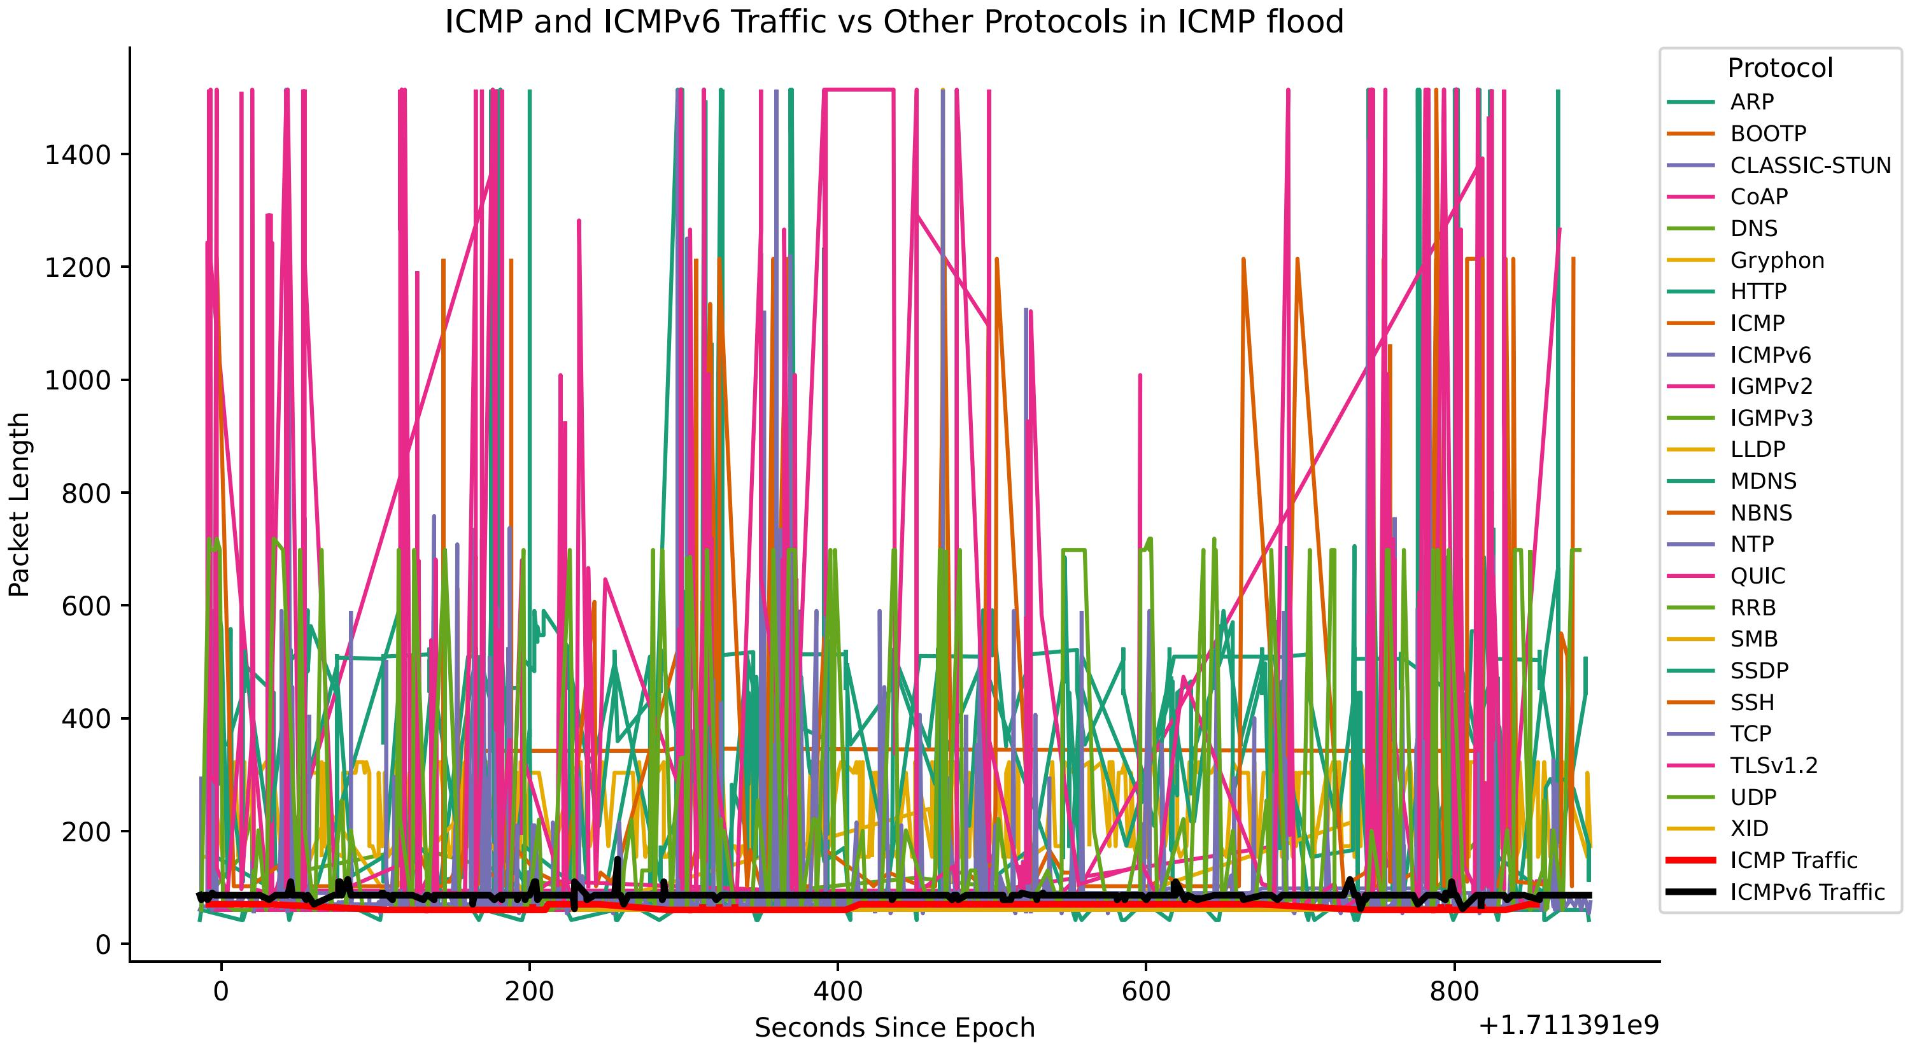
Results and evaluation
Time series analysis research findings on dataset comparing HTTP flood attacks and ICMP flood attacks.
Anomaly Detection using Cumulative Entropy and Thresholding on dataset
comparing HTTP flood attacks and ICMP flood attacks.
Time series analysis

Slide 9
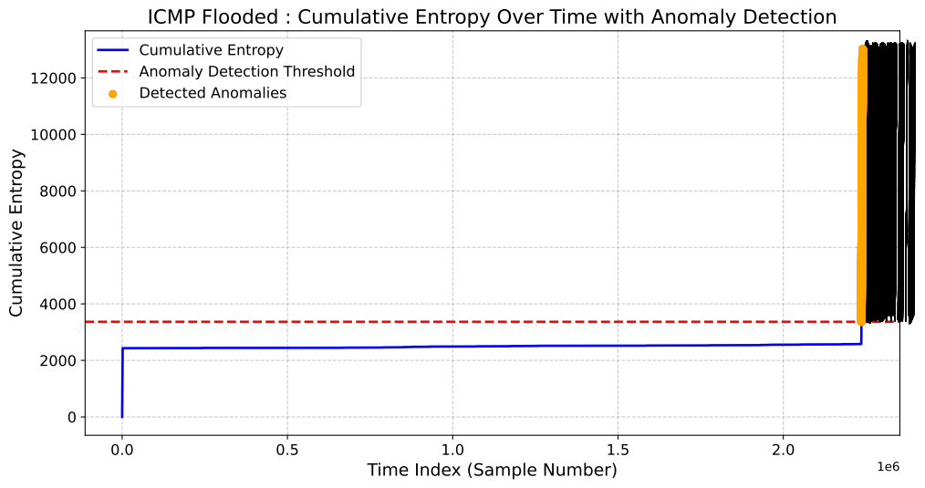
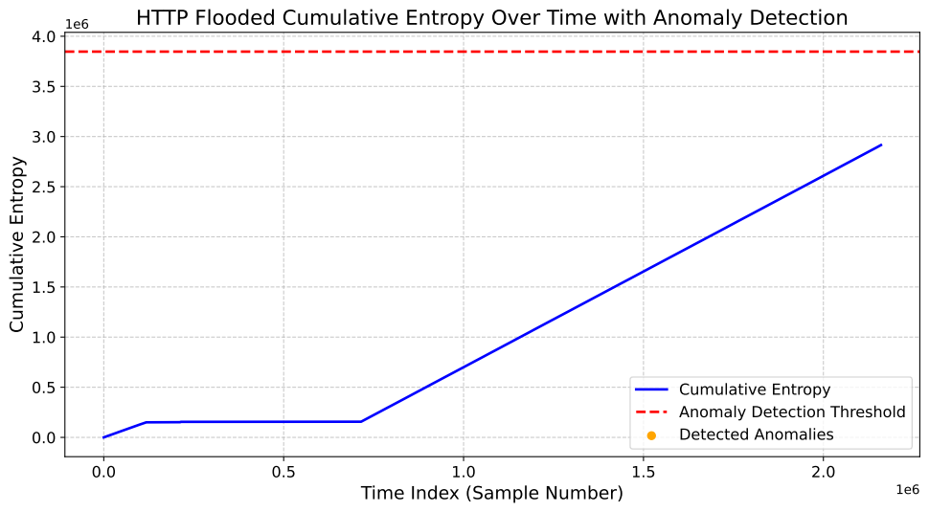
Anomaly detection using Cumulative Entropy and Thresholding
Anomaly detected
No anomaly detectedfff

Slide 10
Discussion
As IoT devices proliferate, robust detection mechanisms are critical for safeguarding networks against DDoS threats.
The proposed technique can be integrated into existing security frameworks to enhance resilience against attacks. The adaptive thresholding approach dynamically adjusts based on real-time traffic patterns, enhancing detection accuracy.
By leveraging cumulative entropy measures, the method effectively distinguishes between normal and attack traffic, reducing false positives.
Conclusion gg
Our results indicated that ICMP traffic level was significantly higher than HTTP in ICMP flood dataset with the highest risk among other threats as reflected by our dataset.
By investigating cumulative entropy graphs, we noted the presence of peak sections or varying windows, where anomalies occur along time signatures which function as reliable indicators to identify a potential malicious behavior and provide required knowledge on during; how long and how network can be exposed to DDoS attacks harm.
We discovered that simultaneous surges in both ICMP and HTTP traffic might indicate a multi-vector assault approach.

Slide 11
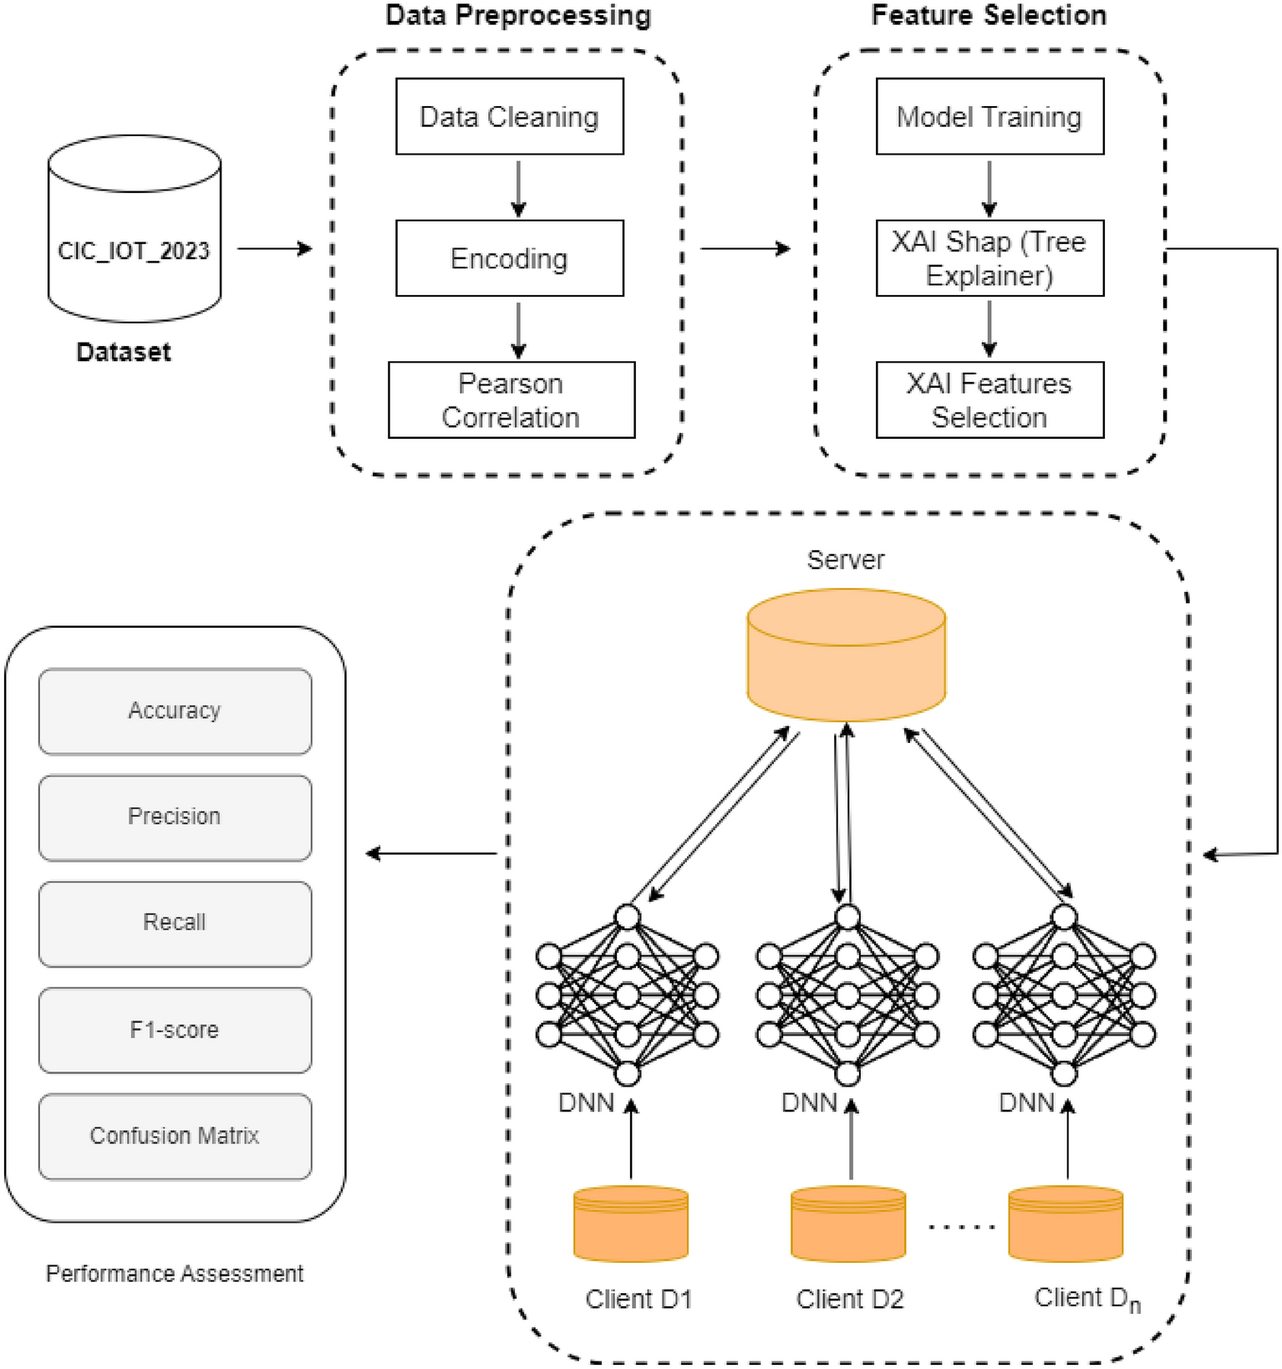
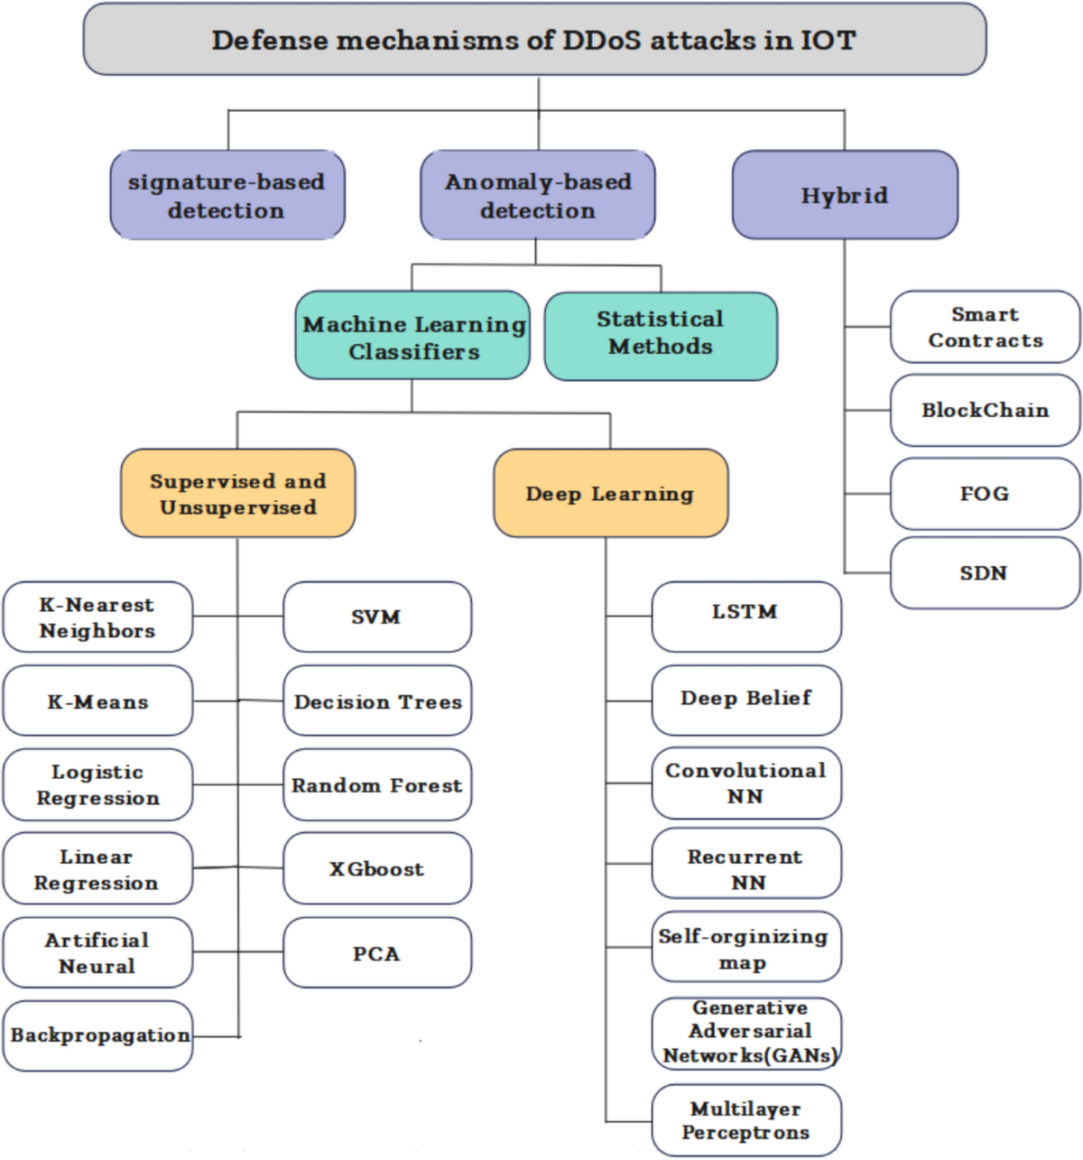
Future work
Explore the integration of machine learning algorithms to further improve detection capabilities and adapt to new attack vectors
Investigate
the application of this method in diverse IoT environments
and across different types of network architectures.

Slide 12
Thank You
for Your Attention!
Amit Kumar Jaiswal
PhD researcher
Moscow Institute of Physics and Technology, Moscow, Russia
Department of Radio Engineering and Cybernetics
E-mail: dzhaisval.a@phystech.edu

