Slide 1
Authentication & Authorization Project

Slide 2
Introduction
This project demonstrates the use of Authentication and Authorization Concept as shown in the screenshot in upcoming slides.

Slide 3
Team Members
Suraj Tamang
Dinesh Saud
Amit Magar
Biplove Jaisi

Slide 4
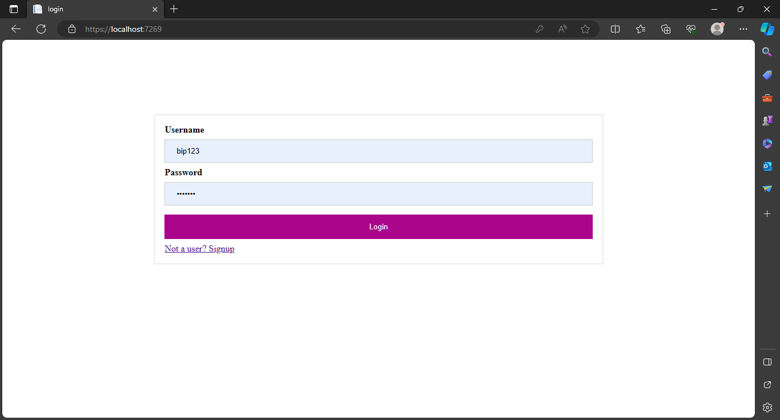

Slide 5
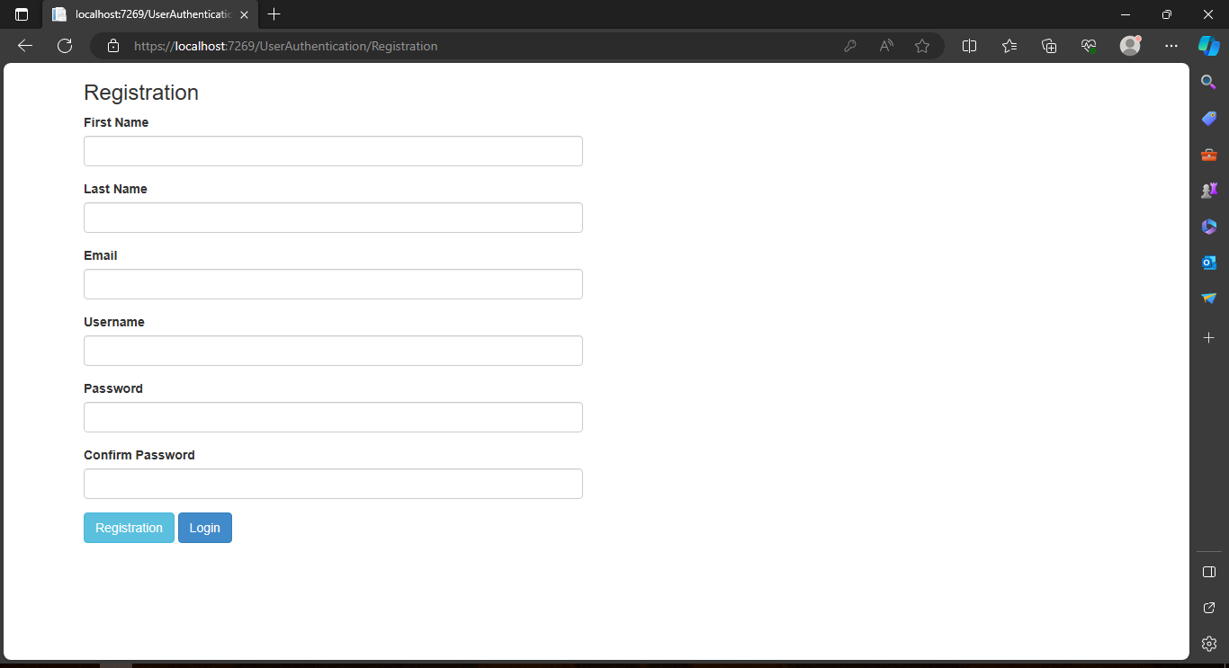

Slide 6
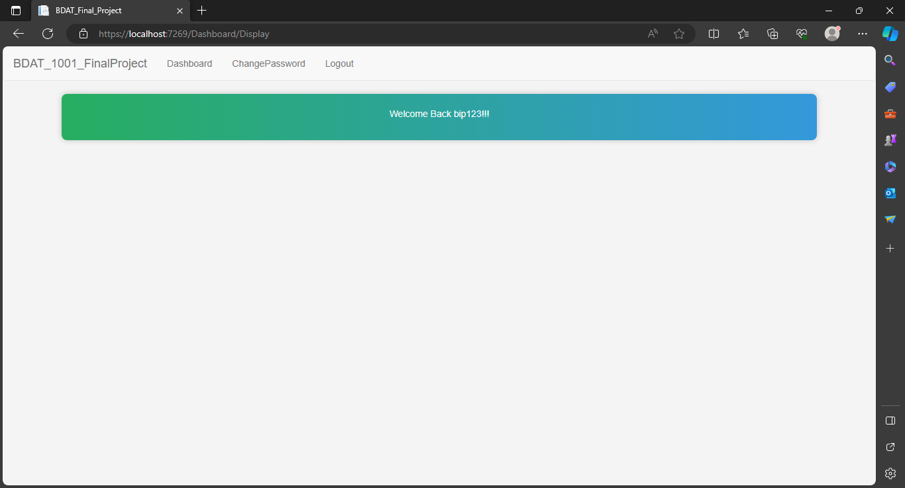

Slide 7
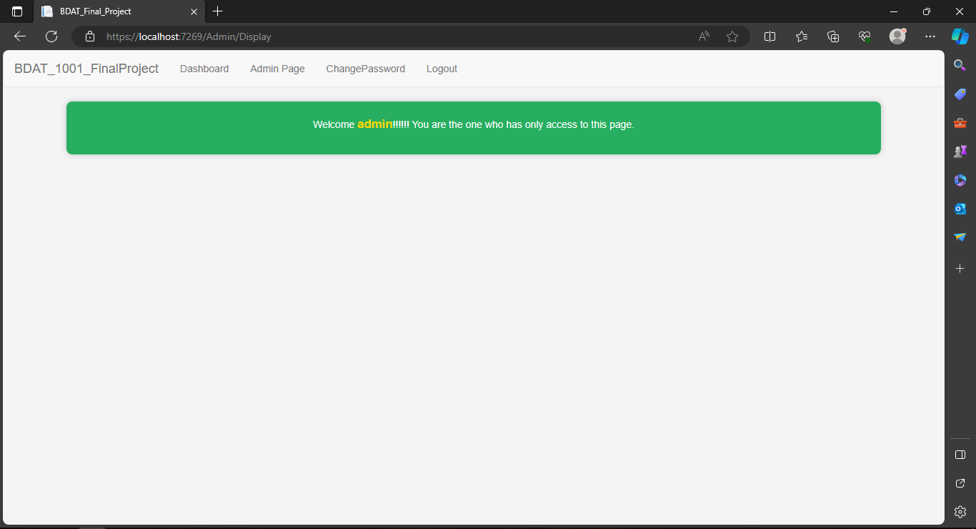

Slide 8
Thank you
.

